Slide 1
WELCOME!
Today we will be talking about how to increase your energy at work, how to sleep better, how to lose weight and how to improve your health!
We Will Have A Brief Presentation and Then Answer Questions

Slide 2
Obesity Trends* Among U.S. Adults BRFSS, 1985
(*BMI ≥30, or ~ 30 lbs. overweight for 5’ 4” person)
No Data <10% 10%–14%

Slide 3
Obesity Trends* Among U.S. Adults BRFSS, 1986
(*BMI ≥30, or ~ 30 lbs. overweight for 5’ 4” person)
No Data <10% 10%–14%

Slide 4
Obesity Trends* Among U.S. Adults BRFSS, 1987
(*BMI ≥30, or ~ 30 lbs. overweight for 5’ 4” person)
No Data <10% 10%–14%

Slide 5
Obesity Trends* Among U.S. Adults BRFSS, 1988
(*BMI ≥30, or ~ 30 lbs. overweight for 5’ 4” person)
No Data <10% 10%–14%

Slide 6
Obesity Trends* Among U.S. Adults BRFSS, 1989
(*BMI ≥30, or ~ 30 lbs. overweight for 5’ 4” person)
No Data <10% 10%–14%

Slide 7
Obesity Trends* Among U.S. Adults BRFSS, 1990
(*BMI ≥30, or ~ 30 lbs. overweight for 5’ 4” person)
No Data <10% 10%–14%

Slide 8
Obesity Trends* Among U.S. Adults BRFSS, 1991
(*BMI ≥30, or ~ 30 lbs. overweight for 5’ 4” person)
No Data <10% 10%–14% 15%–19%

Slide 9
Obesity Trends* Among U.S. Adults BRFSS, 1992
(*BMI ≥30, or ~ 30 lbs. overweight for 5’ 4” person)
No Data <10% 10%–14% 15%–19%

Slide 10
Obesity Trends* Among U.S. Adults BRFSS, 1993
(*BMI ≥30, or ~ 30 lbs. overweight for 5’ 4” person)
No Data <10% 10%–14% 15%–19%

Slide 11
Obesity Trends* Among U.S. Adults BRFSS, 1994
(*BMI ≥30, or ~ 30 lbs. overweight for 5’ 4” person)
No Data <10% 10%–14% 15%–19%

Slide 12
Obesity Trends* Among U.S. Adults BRFSS, 1995
(*BMI ≥30, or ~ 30 lbs. overweight for 5’ 4” person)
No Data <10% 10%–14% 15%–19%

Slide 13
Obesity Trends* Among U.S. Adults BRFSS, 1996
(*BMI ≥30, or ~ 30 lbs. overweight for 5’ 4” person)
No Data <10% 10%–14% 15%–19%

Slide 14
Obesity Trends* Among U.S. Adults BRFSS, 1997
(*BMI ≥30, or ~ 30 lbs. overweight for 5’ 4” person)
No Data <10% 10%–14% 15%–19% ≥20%

Slide 15
Obesity Trends* Among U.S. Adults BRFSS, 1998
(*BMI ≥30, or ~ 30 lbs. overweight for 5’ 4” person)
No Data <10% 10%–14% 15%–19% ≥20%

Slide 16
Obesity Trends* Among U.S. Adults BRFSS, 1999
(*BMI ≥30, or ~ 30 lbs. overweight for 5’ 4” person)
No Data <10% 10%–14% 15%–19% ≥20%

Slide 17
Obesity Trends* Among U.S. Adults BRFSS, 2000
(*BMI ≥30, or ~ 30 lbs. overweight for 5’ 4” person)
No Data <10% 10%–14% 15%–19% ≥20%

Slide 18
Obesity Trends* Among U.S. Adults BRFSS, 2001
(*BMI ≥30, or ~ 30 lbs. overweight for 5’ 4” person)
No Data <10% 10%–14% 15%–19% 20%–24% ≥25%

Slide 19
Obesity Trends* Among U.S. Adults BRFSS, 2002
(*BMI ≥30, or ~ 30 lbs. overweight for 5’ 4” person)
No Data <10% 10%–14% 15%–19% 20%–24% ≥25%

Slide 20
Obesity Trends* Among U.S. Adults BRFSS, 2003
(*BMI ≥30, or ~ 30 lbs. overweight for 5’ 4” person)
No Data <10% 10%–14% 15%–19% 20%–24% ≥25%

Slide 21
Obesity Trends* Among U.S. Adults BRFSS, 2004
(*BMI ≥30, or ~ 30 lbs. overweight for 5’ 4” person)
No Data <10% 10%–14% 15%–19% 20%–24% ≥25%
Notes:
21
We have never had an epidemic like this that we have been able to track so thoroughly and see. As I told you, this is conservative.
About 60 million adults, or 30 percent of the adult population, are now obese, which represents a doubling of the rate since 1980.

Slide 22
Obesity Trends* Among U.S. Adults BRFSS, 2005
(*BMI ≥30, or ~ 30 lbs. overweight for 5’ 4” person)
No Data <10% 10%–14% 15%–19% 20%–24% 25%–29% ≥30%
Notes:
22
We have never had an epidemic like this that we have been able to track so thoroughly and see. As I told you, this is conservative.
About 60 million adults, or 30 percent of the adult population, are now obese, which represents a doubling of the rate since 1980.

Slide 23
Obesity Trends* Among U.S. Adults BRFSS, 2006
(*BMI ≥30, or ~ 30 lbs. overweight for 5’ 4” person)
No Data <10% 10%–14% 15%–19% 20%–24% 25%–29% ≥30%
Notes:
23
We have never had an epidemic like this that we have been able to track so thoroughly and see. As I told you, this is conservative.
About 60 million adults, or 30 percent of the adult population, are now obese, which represents a doubling of the rate since 1980.

Slide 24
Obesity Trends* Among U.S. Adults BRFSS, 2007
(*BMI ≥30, or ~ 30 lbs. overweight for 5’ 4” person)
No Data <10% 10%–14% 15%–19% 20%–24% 25%–29% ≥30%
Notes:
24
We have never had an epidemic like this that we have been able to track so thoroughly and see. As I told you, this is conservative.
About 60 million adults, or 30 percent of the adult population, are now obese, which represents a doubling of the rate since 1980.

Slide 25
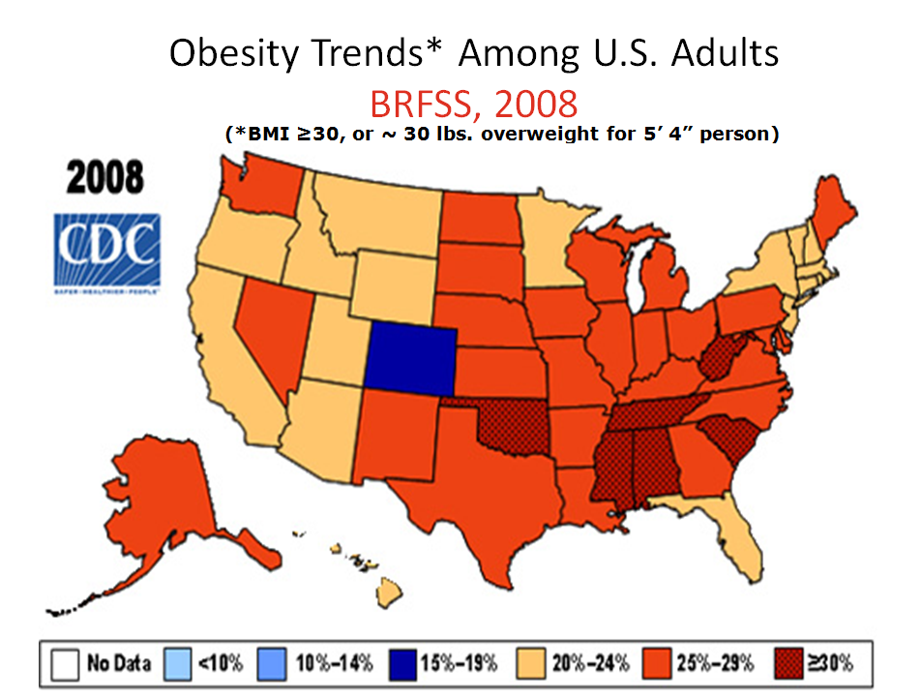

Slide 26
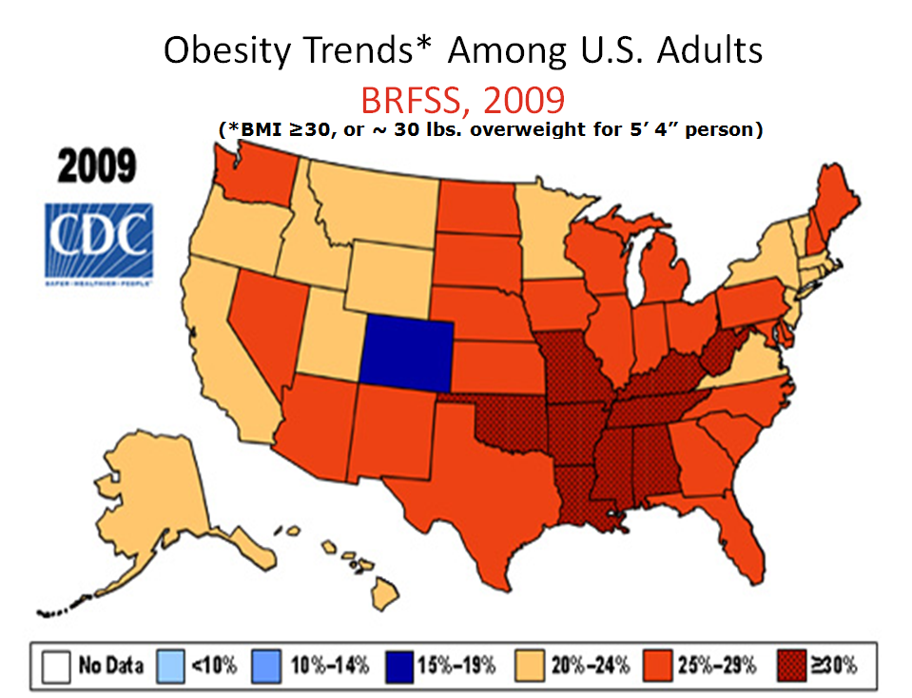

Slide 27
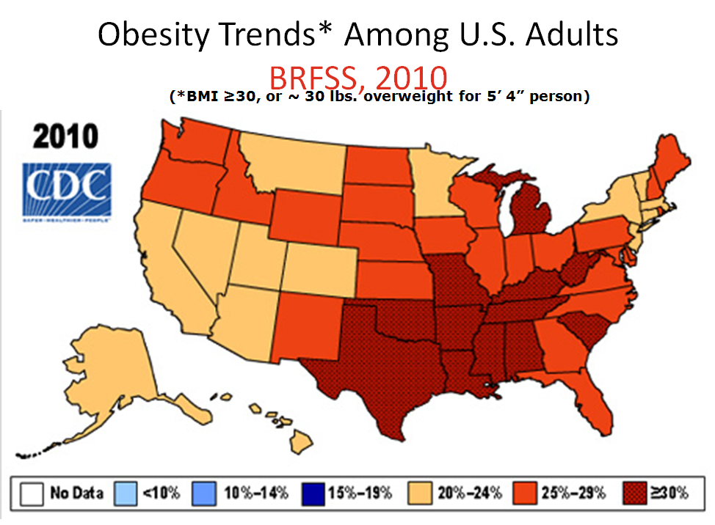

Slide 28
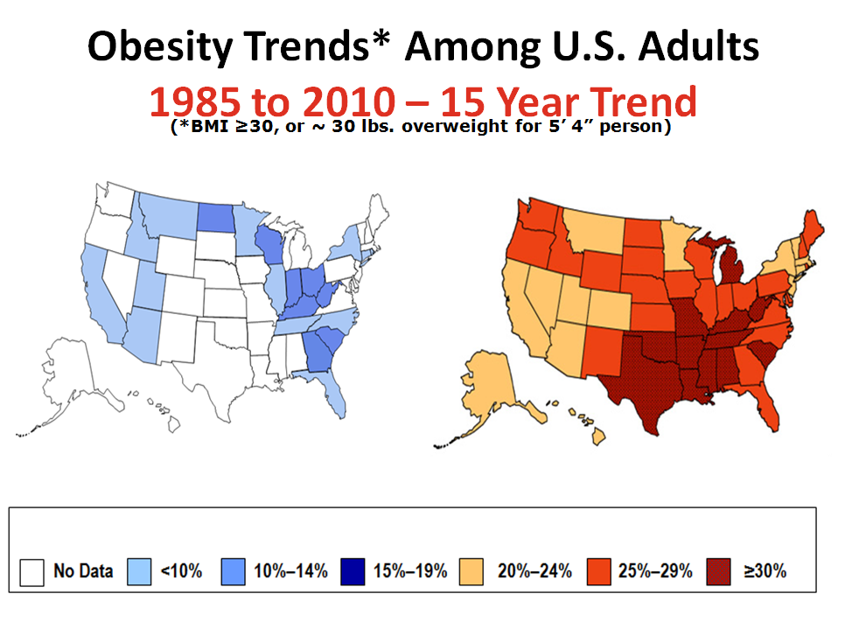

Slide 29
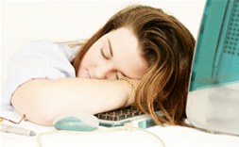
Do You Have Less Energy Than You Should, and Do You Struggle with Losing Weight? You Need to Detoxify and Cleanse Your Body!

Slide 30

10 Reasons You May Not Have Energy at Work and How You Can Be Triggering Your Fat Burning Hormones.

Slide 31
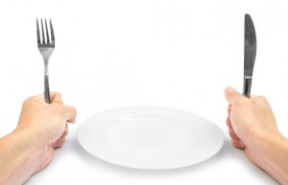
10 Reasons You May Not Be Triggering Your Fat Burning Hormones:
Reason #1
Skipping Meals Reducing Calories Letting Yourself Get Hungry

Slide 32
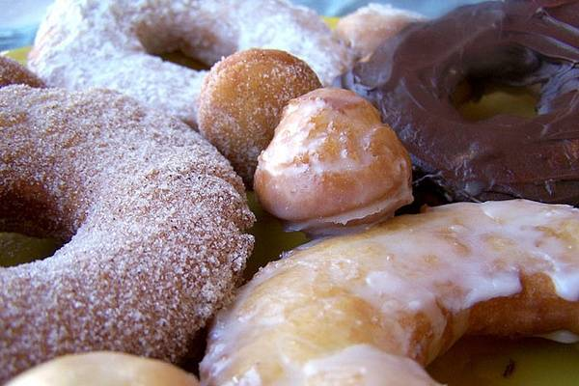
10 Reasons You May Not Be Triggering Your Fat Burning Hormones:
Reason #2
Eating Refined Sugars and Refined Grains

Slide 33
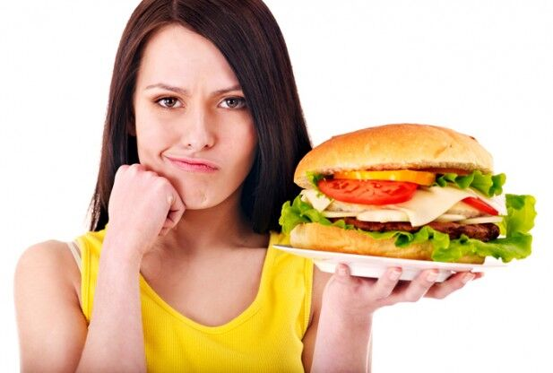
10 Reasons You May Not Be Triggering Your Fat Burning Hormones:
Reason #3
Excess Sugar Mixed with Excess Protein

Slide 34
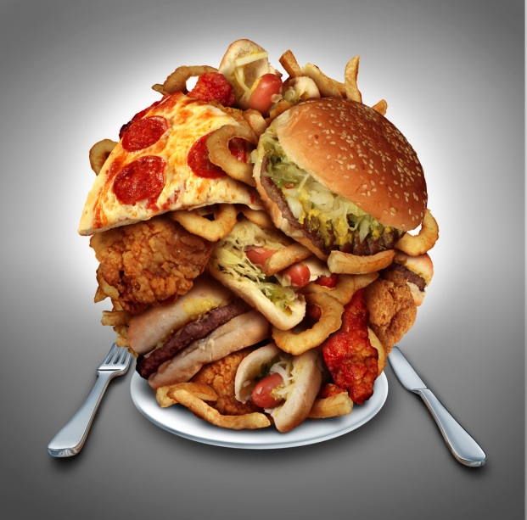
10 Reasons You May Not Be Triggering Your Fat Burning Hormones:
Reason #4
Overeating

Slide 35
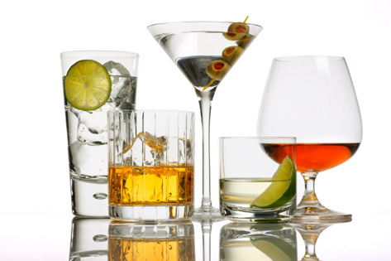
10 Reasons You May Not Be Triggering Your Fat Burning Hormones:
Reason #5
Consuming Alcohol
(Alcohol triggers insulin, thus causing weight gain)

Slide 36
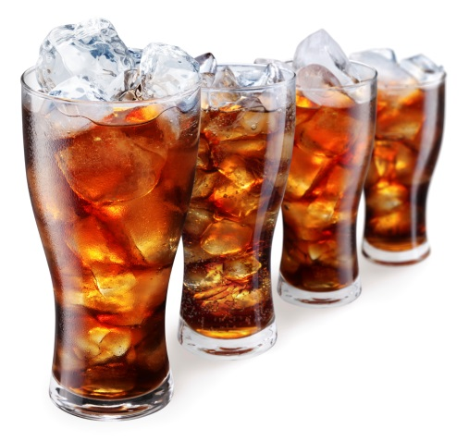

10 Reasons You May Not Be Triggering Your Fat Burning Hormones:
Reason #6
Consuming Caffeinated Drinks Such as Coffee
or Colas

Slide 37
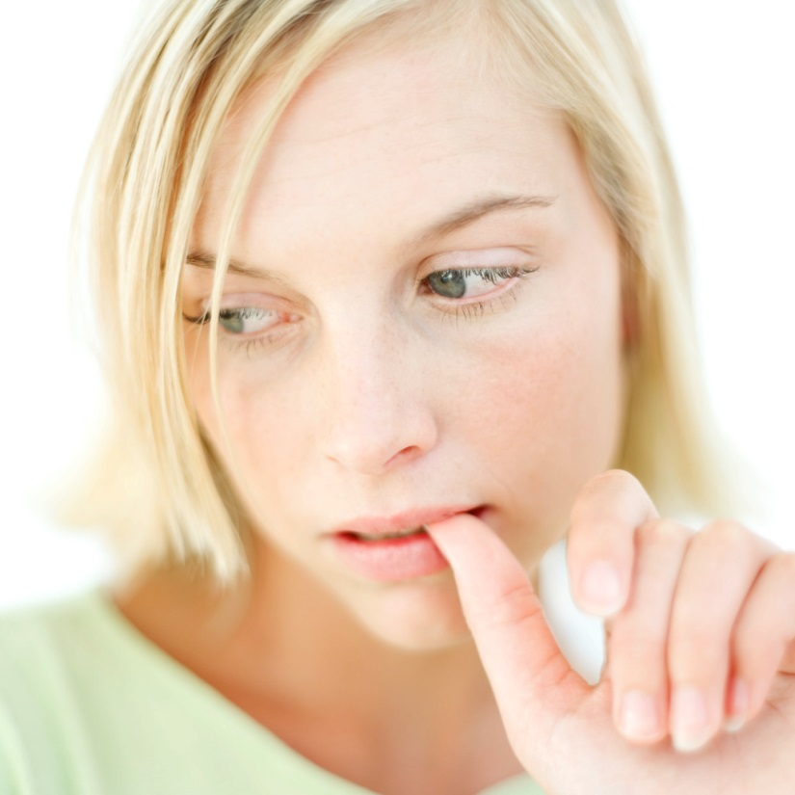
Wait…Are you thinking…
“I don’t have willpower to
eat less,
quit eating sugar or stop drinking colas.”

Slide 38
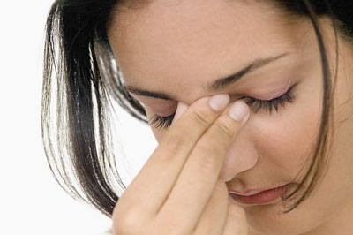
Are you thinking, “I want to lose weight, but I don’t think I can change my habits!”

Slide 39

Don’t Worry! There is hope and we can help!

Slide 40

Why else would I NOT be triggering my fat burning hormones?

Slide 41
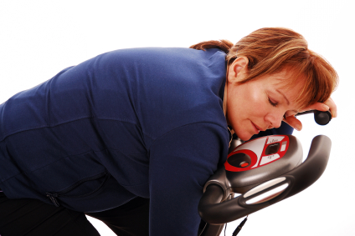
10 Reasons You May Not Be Triggering Your Fat Burning Hormones:
Reason #7
No Exercise or WRONG EXERCISE

Slide 42

10 Reasons You May Not Be Triggering Your Fat Burning Hormones:
Reason #8
Too Much Stress

Slide 43
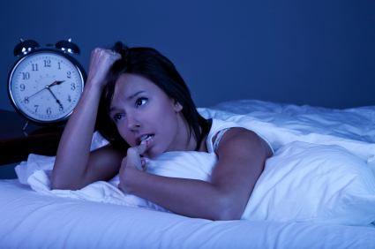
10 Reasons You May Not Be Triggering Your Fat Burning Hormones:
Reason #9
Poor Sleeping Habits

Slide 44
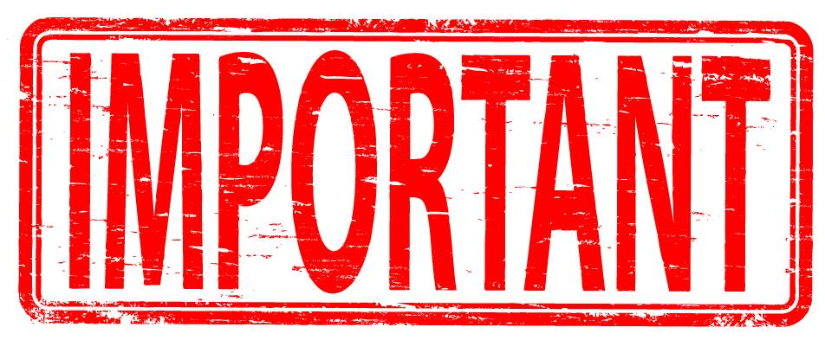
THE MOST IMPORTANT REASON YET……

Slide 45
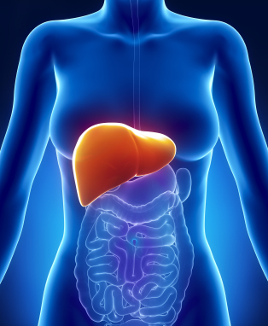
10 Reasons You May Not Be Triggering Your Fat Burning Hormones:
Reason #10
Poor Liver Function

Slide 46

How do you cleanse your liver so it can aid in weight loss and increase energy?

Slide 47
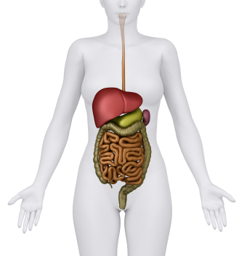
Detoxification…
Is the process of addressing the natural toxins in the body.
The LIVER along with the digestive tract, kidneys, bladder, lymphatic system, lungs, and skin are the major systems/organs that are involved in the neutralization and elimination of toxins.

Slide 48
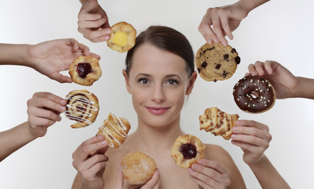
The reason you’ve had low willpower in the past is because an imbalanced body experiences cravings!

Slide 49

When your liver is cleansed, cravings disappear. Your energy and health improve and pounds melt away!

Slide 50
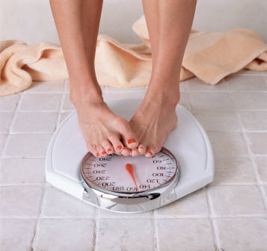
If you decide NOT to do the detoxification, your body will still be imbalanced. You might be able to lose SOME weight on another program, but you will gain it back because you’re fat burning hormones are not working properly.

Slide 51

If you are interested in cleansing your body to:
increase your energy levels
experience higher quality of sleep
get your fat burning hormones working for you instead of against you…
Today’s Your Lucky Day!

Slide 52
By coming to this seminar today, you will receive a COUPON good for a FREE assessment of your health, to see why you haven’t been able to lose your weight. Without this coupon, the assessment is normally $125.00!

Slide 53

By coming to this presentation today, you will receive a coupon good for a Personalized One-on-One Weight Loss ASSESSMENT. Without this coupon, the assessment is normally $125.00. Here’s what you’ll receive…..

Slide 54
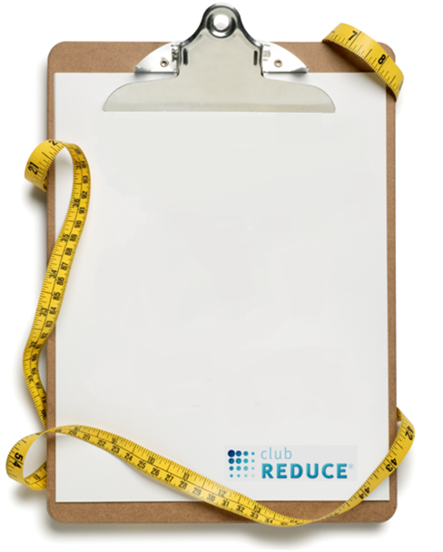
√ Weight Loss Assessment √ Low-Energy/Thyroid/Pre- diabetes Assessment √ Computerized Nutritional Evaluation √ Computerized Hormone Analysis Determining Underlying Cause of Weight Gain and Health Issues √ Consultation with Doctor √ Report of Exam Findings

Slide 55

This Coupon is Valid One Week Only! After that, the cost of the Evaluation is $125.00.
Those of you that would like to redeem this coupon
and schedule for your
Free One-on-One Weight Loss ASSESSMENT
please see one of our staff members now!
Thank you for attending!

