Slide 1

Internal Marketing: Monthly Promotions

Slide 2
Having a Monthly Promotion on a product or a service keeps patients interested on deals and saving money in your office!

Slide 3



January: New Year’s Resolutions Drawing
Have patients write down their new year’s resolution and put them all in a box. At the end of the month have a drawing for a free product or service!
February: Lovers special –
a 2-for-1 Body Wrap or Massage
March: Lucky Green!
Encourage your patients to eat more greens and have them keep track in their food journal. At the end of the month, whoever ate greens every day gets a free product or service.

Slide 4



April: April Showers bring Detox Kits!
Have the detox kit on sale all month!
May: Fun in the Sun!
Have Vitamin D on sale.
June: Fathers Day
Invite the fathers of all your patients to come in for a free product or service.

Slide 5



July: Pledge to your Health
Have the detox kit on sale all month!
September: Back to School
For every person that a patient refers to your learn and lose class, they get a free product or service.
October: Masks!
Sell the Herbalogica Masks at a discounted price.

Slide 6


November: Have your Turkey and Detox Too!
Have the detox kit on sale all month!
December: Secret Santa
For every patient that gives a name and address to refer to our office, they get a free product or service.

Slide 7
Club Reduce
Each month we will have monthly promotions you can use in your office!
Here are some ideas for the Christmas Season

Slide 8
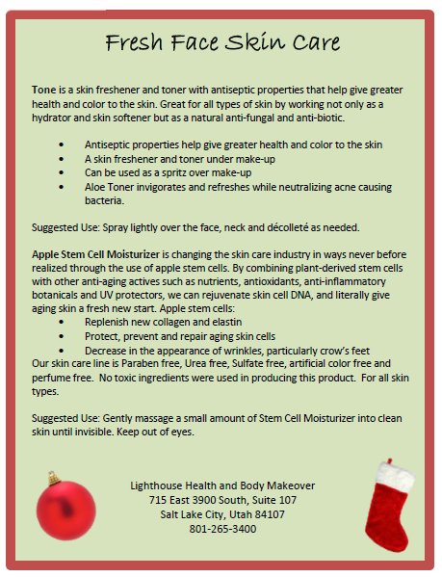

Fresh Face Skin Care Bundle Gifts for Mom
Tone
Apple Stem Cell Moisturizer
Tone | $10.00
Apple Stem Cell | $28.00
Total | $38.00
20% OFF | $29.00

Slide 9
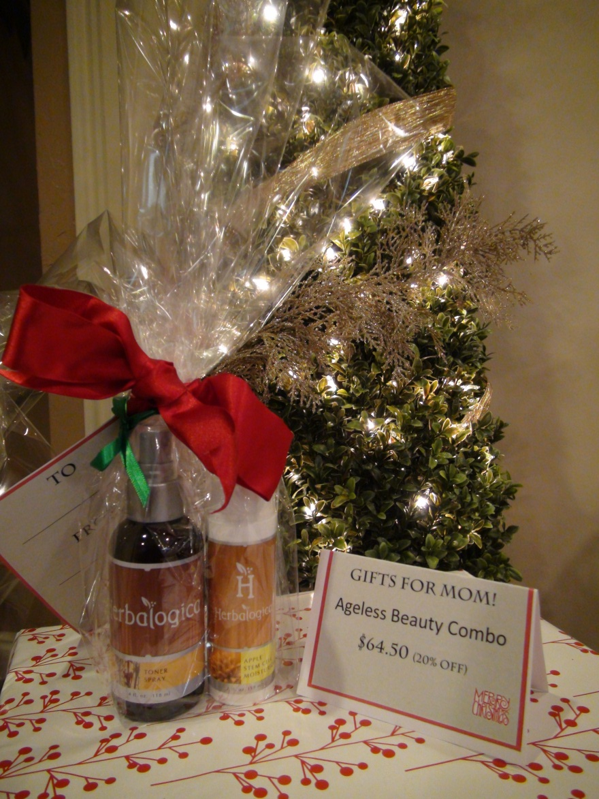

Slide 10
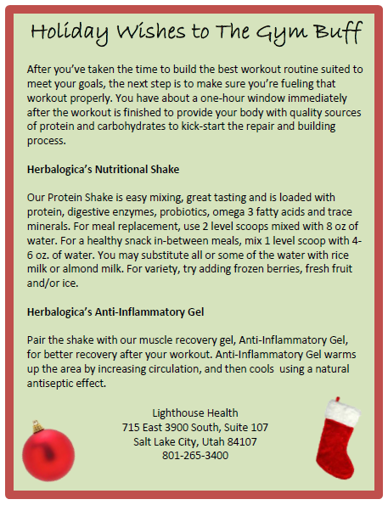
Gym Buff Bundle Gifts for Men
Nutritional Shake
Anti-Inflammatory Gel or Exercise Gel
Shake | $50.00
Anti-Inflam Gel | $17.00
Total | $67.00
20% OFF | $59.60

Slide 11
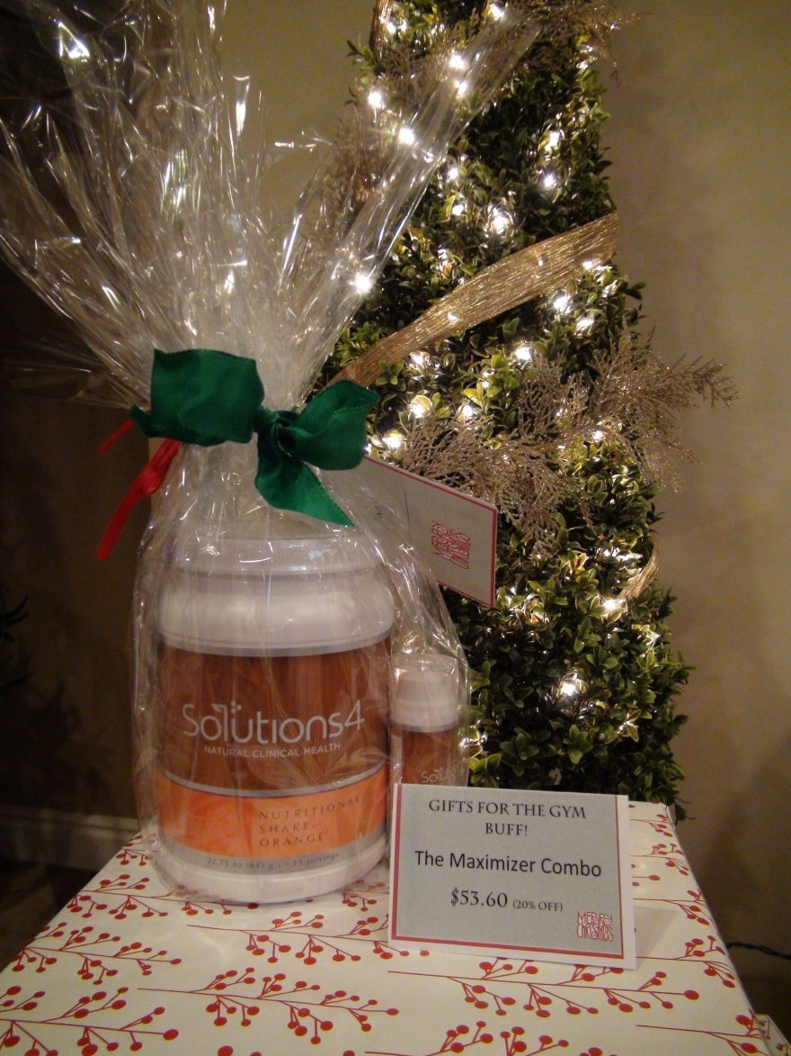

Slide 12
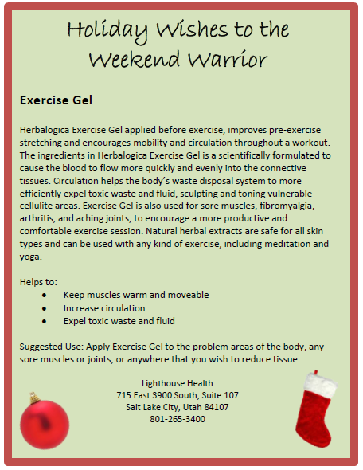
Natural Daily Skin Care Gifts for Men
Exercise Gel
Exfoliator | $29.00
Total | $29.00
20% OFF | $23.20

Slide 13
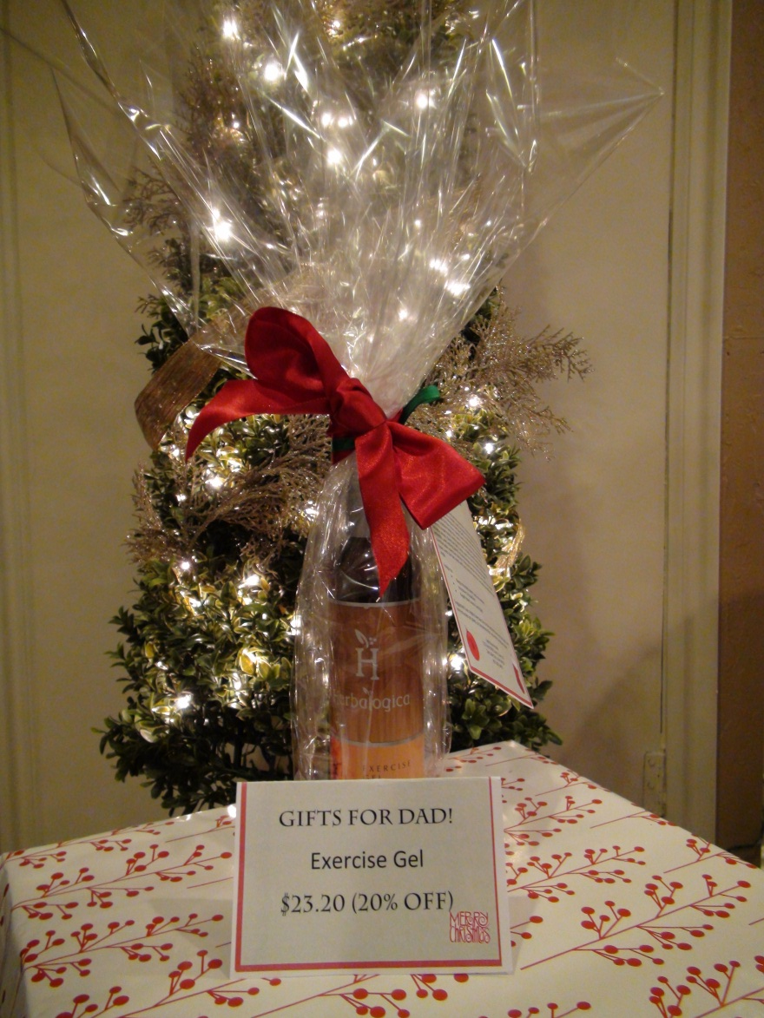

Slide 14
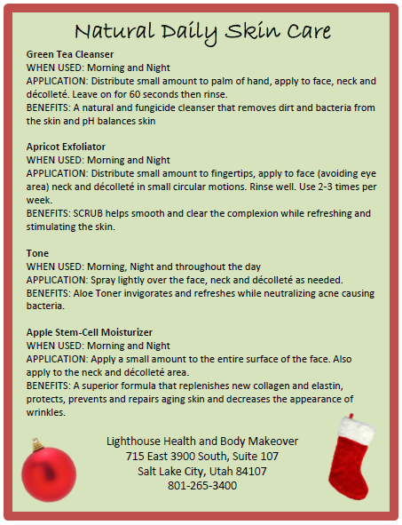
Natural Daily Skin Care Gifts for Women
Green Tea Cleanser
Apricot Exfoliator
Tone
Apple Stem-Cell Moisturizer
Green Tea Cleanser | $25.00
Apricot Exfoliator | $29.00
Tone Spray | $10.00
Apple Stem Cell | $28.00
Total | $92.00
20% OFF | $73.60

Slide 15
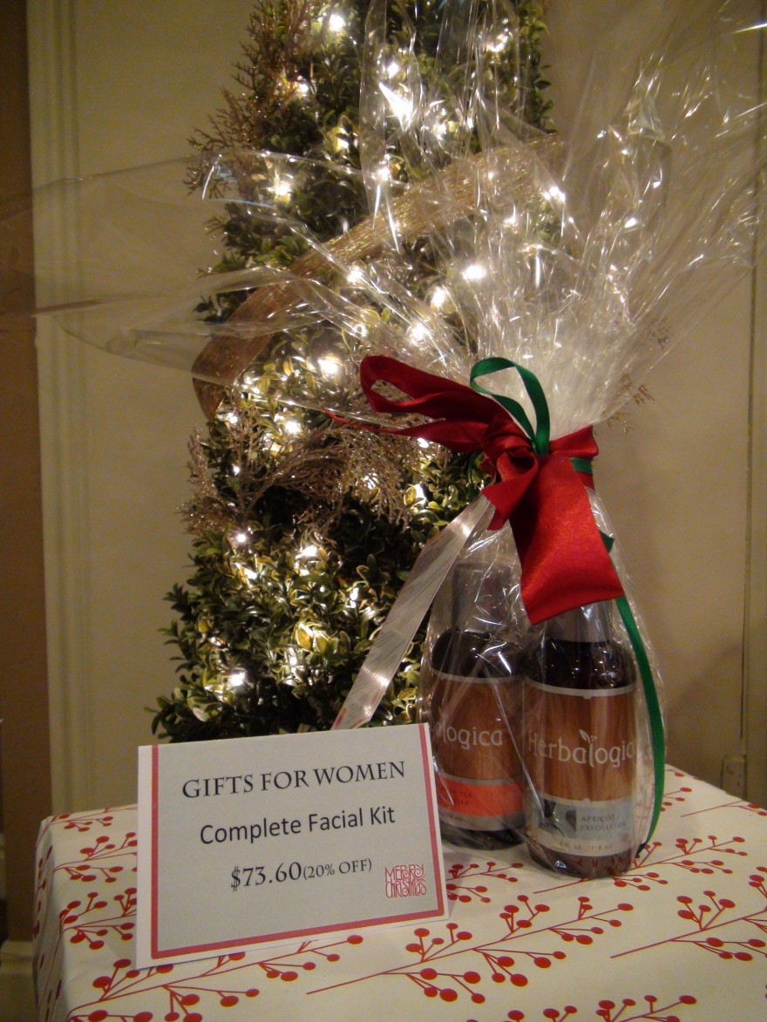

Slide 16
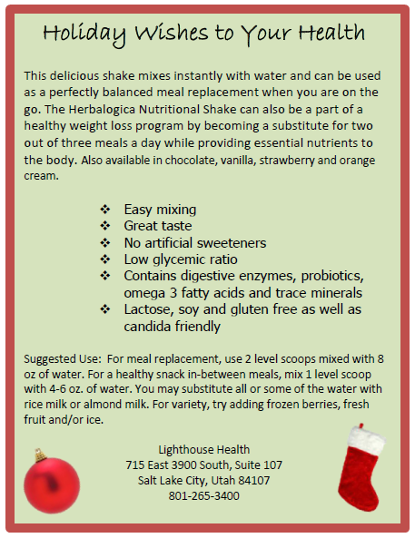
Solutions4 Shakes Gifts for Everyone!
Nutritional Shake
Shake | $50.00
Total | $50.00
20% OFF | $40.00

Slide 17
