Slide 1

Lesson 15: How Your Skin Relates
to Balanced Health!

Slide 2
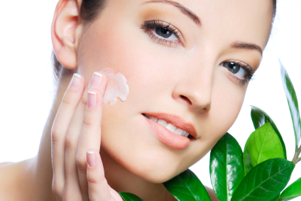
You can enjoy beautiful, glowing skin
the natural way!
Before we tell you how, here’s some interesting information about your skin:

Slide 3
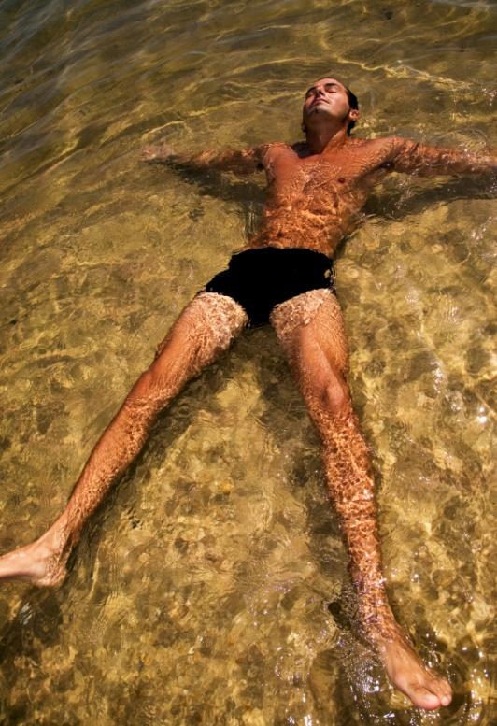
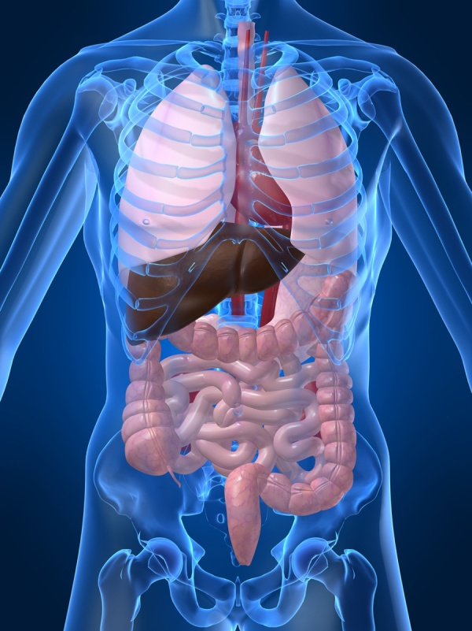
Your skin is the largest organ of your body.

Slide 4
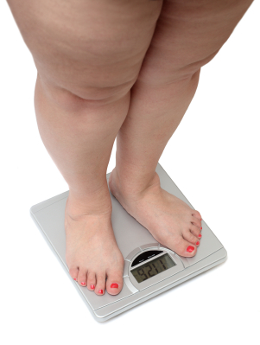
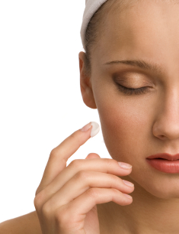
The skin of an average adult covers approximately 7 square feet of space.
16% of
It makes up 16% of a person’s total body weight.

Slide 5
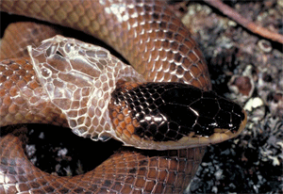
Every 24 hours, the skin sheds a layer of dead cells and totally renews itself every 3-4 weeks – just like a snake!!

Slide 6

90% of what we think is household dust is really dead skin cells!

Slide 7

A person discards about 88 pounds of dead skin cells during a lifetime!

Slide 8

Sometimes, we don’t realize that the condition of our skin is a key factor in determining our overall health.

Slide 9
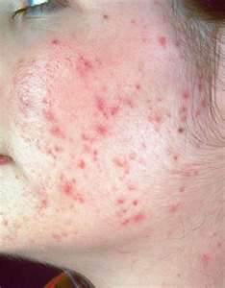

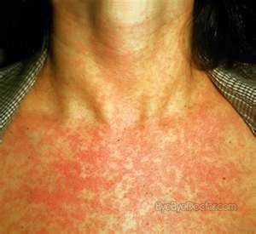
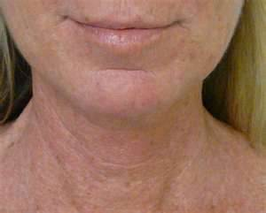
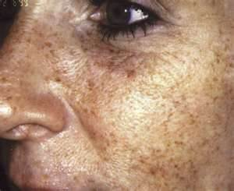
The way our skin looks can give us good insight into the state of our health!

Slide 10

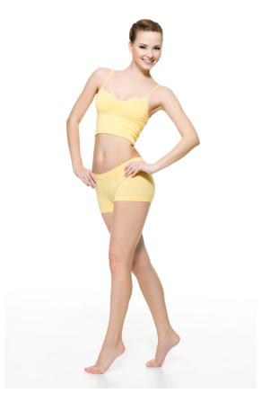
The skin plays some important roles for us. It gives shape to the body. It also acts as a barrier, protecting us from invading bacteria, viruses, etc.

Slide 11
Our skin works as a thermostat and helps regulate body temperature.
It also senses environmental hazards, such as excess heat or cold.

Slide 12
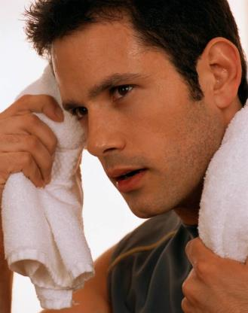
The skin is the largest eliminative organ of the body. It uses sweat to help
get rid of waste fluid and to purify the body. As the body detoxifies, the skin responds with acne, eczema, psoriasis, boils, etc.

Slide 13
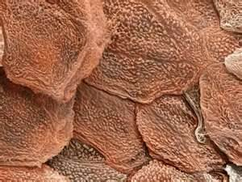
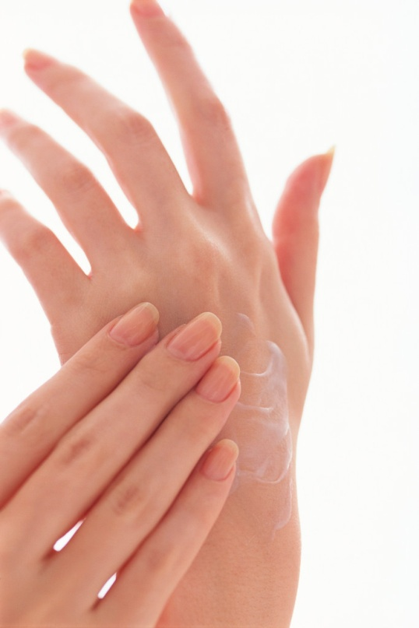

The skin has three layers. The top layer is called the epidermis. This layer consists of flat, gray cells.

Slide 14
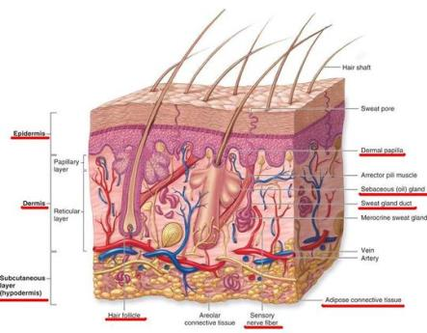
The second layer is the dermis. This layer contains hair follicles, oil, sweat glands, nerve endings, and blood vessels. It also contains collagen and elastin. Deterioration of this layer causes aging, sagging, and wrinkling.

Slide 15
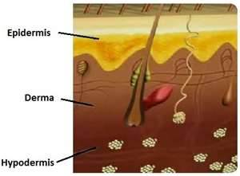
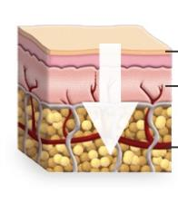
The third layer of skin is the hypodermis, or subcutaneous layer. It contains fat cells, veins, and muscles. It acts as both a shock absorber and a thermal insulator. Cellular renewal occurs in this layer.

Slide 16
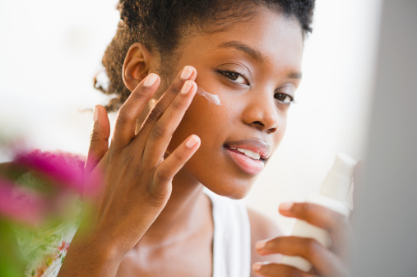
To keep your skin moisturized, you must use transdermal products in order to penetrate all of the layers of skin and to stimulate the production of natural collagen and elastin.

Slide 17

Now that you know a little more about skin, let’s talk about when our skin is unhealthy.

Slide 18
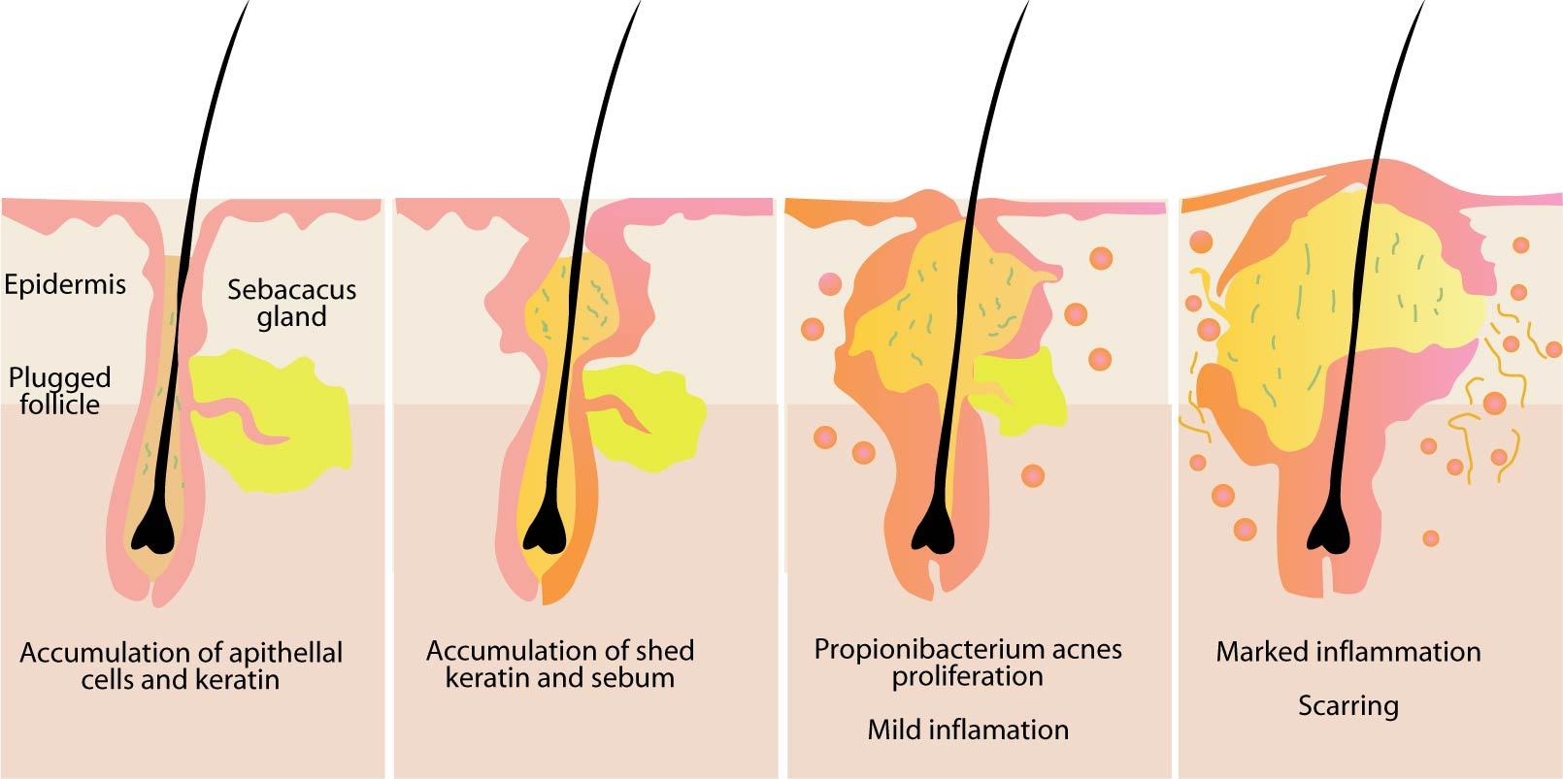
Acne is a skin inflammation that affects about 80% of all those between the ages of 12 and 24. A sebacacus gland, located in each hair follicle or tiny pit of the skin, produces oil that lubricates the skin.

Slide 19
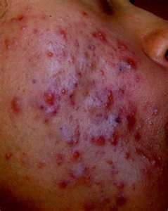
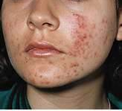
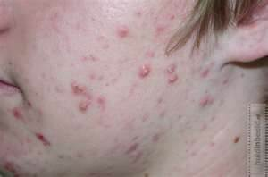
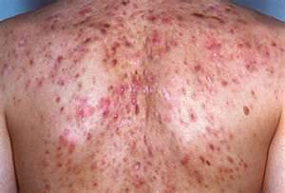
If some of the oil becomes trapped, bacteria multiplies in the pit and the skin becomes inflamed. Most adolescents have acne, because these glands are stimulated by hormones at puberty.

Slide 20
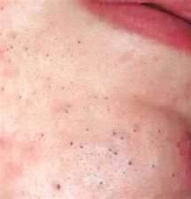
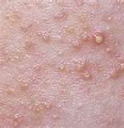
Blackheads form when sebum combines with skin pigments and plugs the pores. If scales below the surface of the skin become filled with sebum, whiteheads appear.

Slide 21
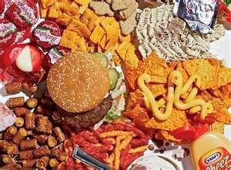



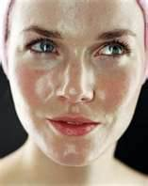
Factors that contribute to acne are: oily skin, androgens (male hormones produced in increased amounts when a boy or girl reaches puberty), oral contraceptives, allergies, stress, and junk food.

Slide 22

Acne, from a mild case of scattered pimples to deep cysts over the face and back, is likely caused by sensitivity to sugar and other refined, processed foods. It can also be caused by a lack of zinc or the right type of essential fatty acids.

Slide 23
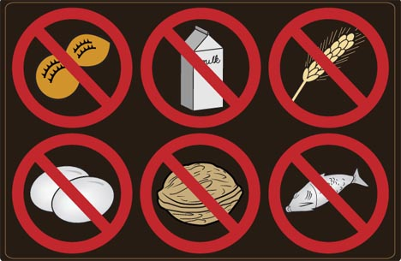
In really bad cases, an allergy could be involved. An adult past 25 years of age with acne almost always has food allergies.

Slide 24

Conventional medicine often insists that diet has little to do with acne or other skin problems. Their usual go-to solution is to subject a patient to strong antibiotics, irradiation treatment, or steroid-type medications.

Slide 25

These pills and creams may work temporarily, but only cause further damage to the skin in the end, because they are not targeting the source of the problem!

Slide 26
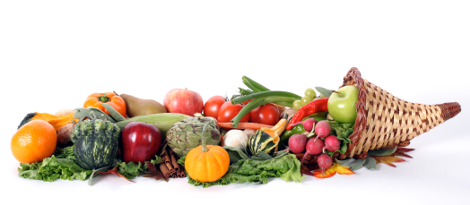
Holistic wellness, on the other hand, approaches skin disorders more comprehensively. They reach further than what is “skin deep.”

Slide 27

They believe that dietary abnormalities (excesses and deficiencies) play a significant role in causing skin disorders. Nutritional approaches also offer the best results in clearing up skin issues.

Slide 28


The good news about holistic methods of treating skin problems is that they treat the underlying causes of skin disorders, from internal to external.

Slide 29

There are a few simple tips you can incorporate into your life to keep your skin looking clear, healthy, and vibrant.
First, a liquid cleanse is always beneficial to detoxifying the inside of your body.

Slide 30
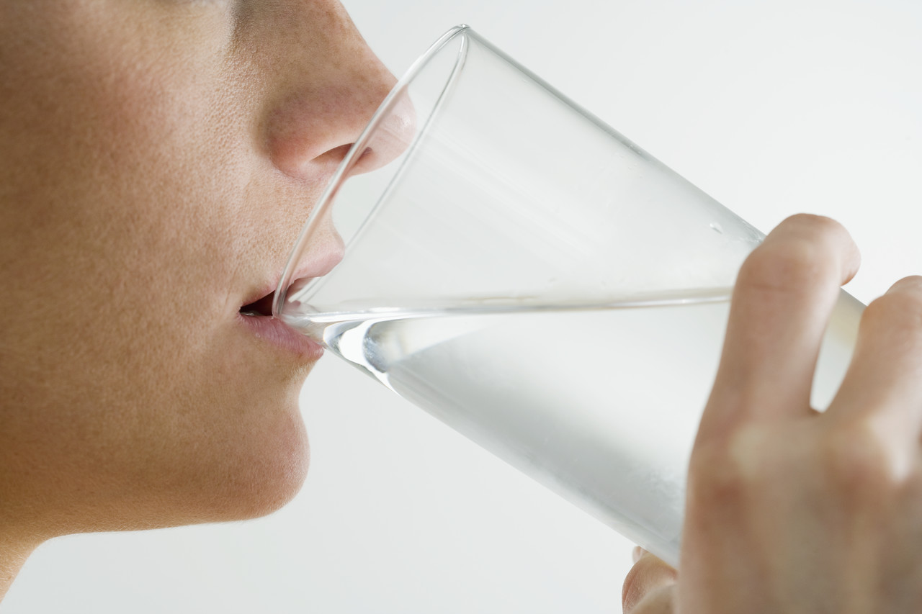
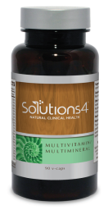
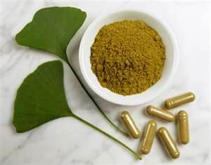
You’ll also want to drink at least eight glasses of water each day for body and skin flushing.
Take a daily multivitamin to maximize your nutrition.

Slide 31

Improving your diet is also very key. Nutritional deficiencies directly contribute to skin problems. You’ll need to increase your intake of raw fruits, vegetables, and fresh juices.

Slide 32





To keep clear skin, avoid sugar in every form. Caffeine, alcohol, excessive salt, nutrition-less and processed foods, oily and fatty foods, and animal fat are all bad for your skin. Stay away from nicotine and over-the-counter drugs, too.

Slide 33
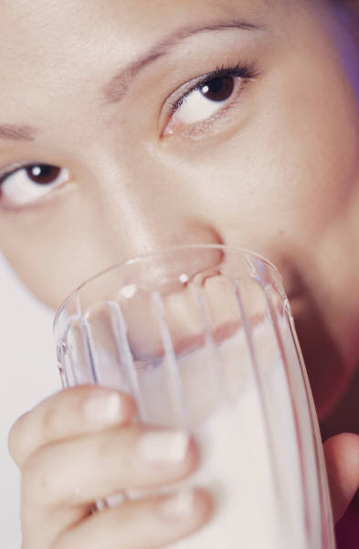
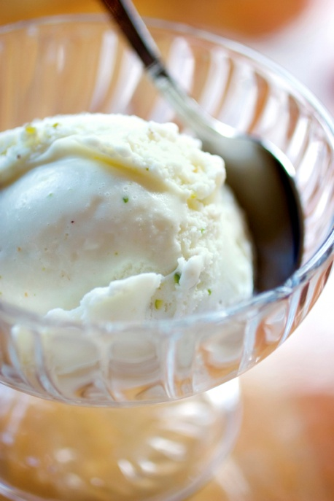
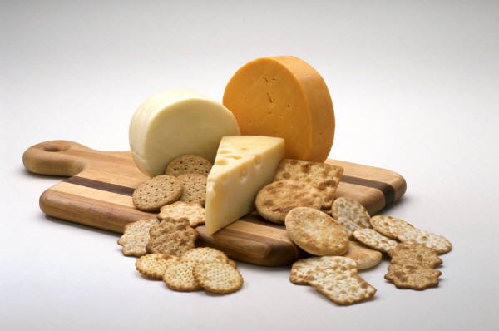
If acne persists, try eliminating dairy products for an entire 30-day cycle. Acne often develops due to an allergic reaction or an unknown intolerance to lactose. The fat content in dairy products can worsen the condition, as well.

Slide 34
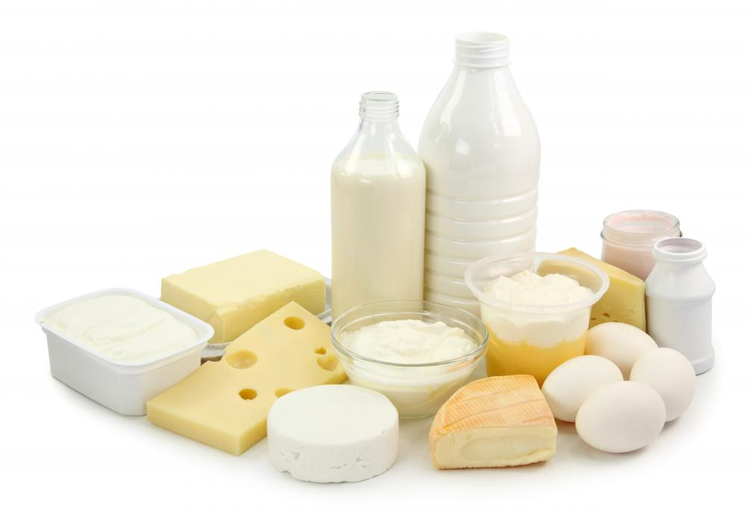
At the end of the 30-day cycle, add one dairy product back at a time. If acne reoccurs, eliminate dairy completely from your diet.

Slide 35
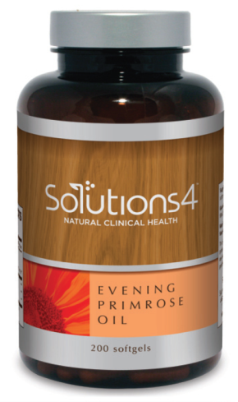
Adding Evening Primrose Oil is a good healer for dermatitis, acne, and other skin disorders. It contains linoleic acid, which is needed by the skin. It’s more powerful when it’s combined with zinc.

Slide 36

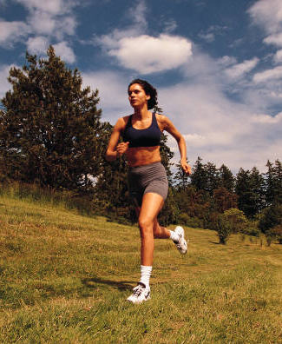

Exercise! Lack of exercise contributes to internal sluggishness and poor elimination, which, in turn, contributes
to skin problems.

Slide 37
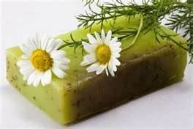
Following a daily skin care routine using balanced, all-natural products that help keep your skin clean and remove impurities will help you to create a beautiful, glowing complexion.

Slide 38
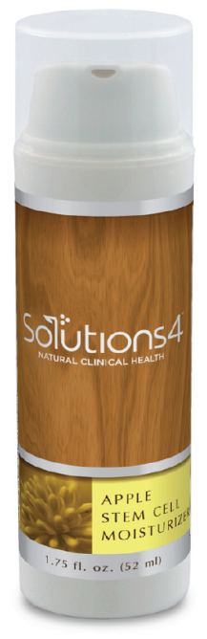
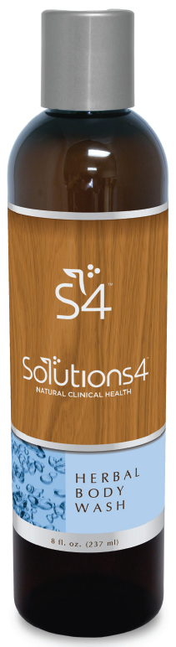
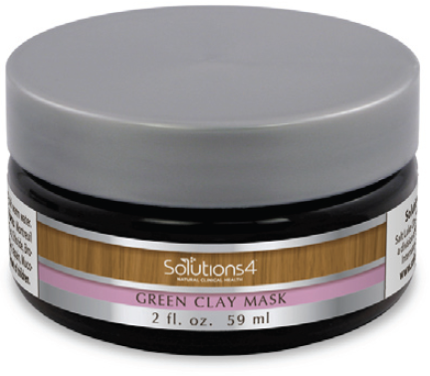
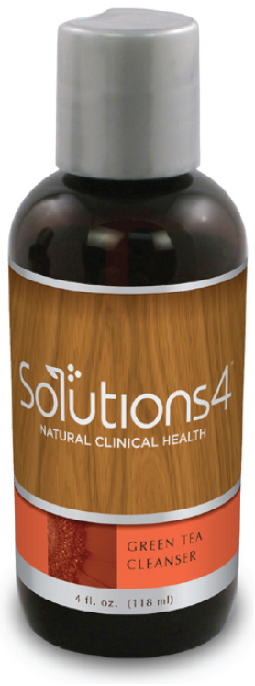
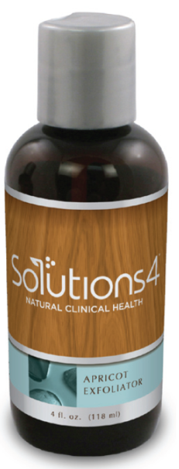
Solutions4 has an all-natural, balanced skin care line that’s great for all skin types!

Slide 39

Most skin care products are available from your Club Reduce doctor. Call them for recommendations and pricing!

Slide 40

Before you go, there are supplements you can take, with the recommendation of your Club Reduce Doctor, to help with your skin care.

Slide 41




Introducing
Solutions4…
Green Tea Cleanser
Apricot Exfoliator
Apple Stem Cell Moisturizer
Body Exfoliator

Slide 42
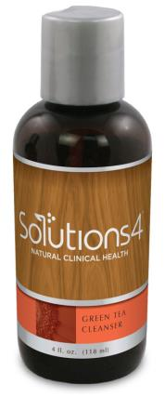
Green Tea Cleanser!
The Green Tea Cleanser will leave your skin clean, soothed, and moisturized. Green tea is effective in the prevention and treatment of abnormal skin conditions, such as acne, psoriasis, and eczema. Green tea’s antioxidant powers protect the skin from environmental factors and free-radicals that lead to premature aging, too.

Slide 43
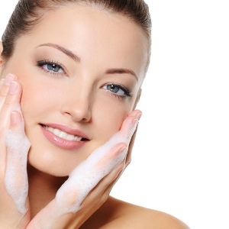
Combined in this superior wash are gentle emollients, vitamins, antibacterial properties, hydrators, and anti-inflammatory and UV protectors.

Slide 44
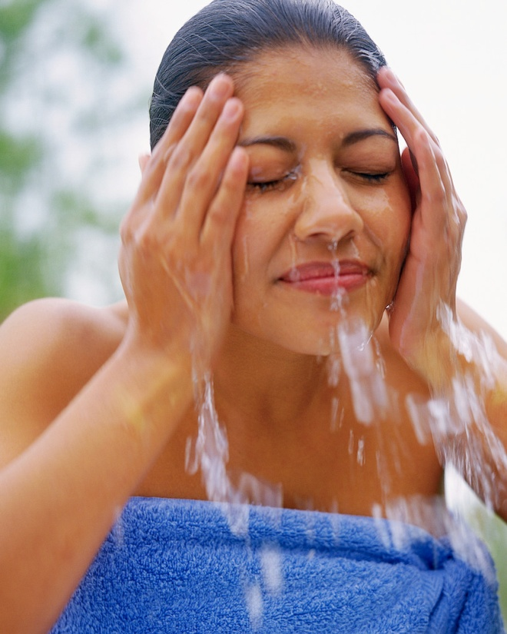
Benefits of using the
Green Tea Cleanser include:
Makeup and environmental buildup
removal!
Assisting in the prevention of skin
cancer!
Treating acne, psoriasis, and eczema!
It’s free from parabens, urea,
sulfates, artificial colorants, toxic
ingredients, and perfumes!

Slide 45
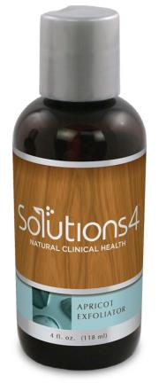
Apricot Exfoliator!
The Apricot Exfoliator is a grape seed oil-based scrub that combines a perfect blend of vitamins,
anti-oxidants, UV protectors, hydrators, moisturizers, collagen, and elastin builders to provide powerful protection and gentle exfoliation.

Slide 46
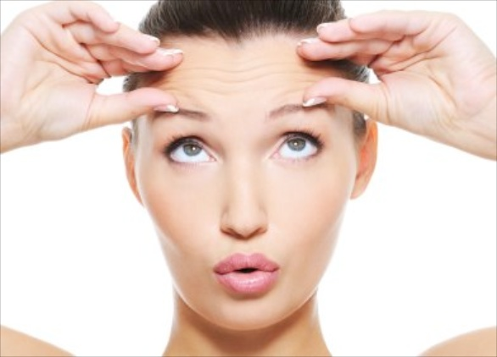
This apricot scrub contains natural alpha-hydroxy acid, which gently exfoliates the skin to prevent the appearance of wrinkles and fine lines. It also contains antioxidants that help diminish the sun’s damaging effects and lessen free radical damage.

Slide 47
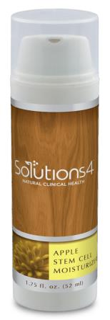
Apple Stem Cell Moisturizer!
Apple Stem Cell Moisturizer is changing the skin care industry in ways never before realized through the use of apple stem cells that protect the longevity of skin stem cells! This incredible product slows the aging process as it hydrates, heals, and soothes your skin. It also replenishes new collagen and elastin!

Slide 48

Apple stem cells have the tremendous ability to stimulate, protect, and rejuvenate skin cell DNA, literally giving your aging skin a spring-fresh start.

Slide 49

This superior moisturizer for the face and neck combines anti-aging actives, nutrients, antioxidants, anti-inflammatory botanicals, and UV protectors in order to both prevent and repair aging skin cells, by replacing lost and damaged cells with healthy new ones.

Slide 50

You’ll be amazed at its ability to reduce fine lines, wrinkles, and especially crow’s feet. It will also protect your skin against sun and environmental damage, restore lost moisture, and maintain skin elasticity!

Slide 51



Use gentle upward strokes to apply to your face and neck, morning and night, after washing with Solutions4 Green Tea Cleanser and Apricot Scrub. You’ll soon enjoy smooth and youthful skin!

Slide 52

Body Exfoliator!
The Body Exfoliator uses papaya enzymes to dissolve dead skin and round pumice crystals to exfoliate. This formula is unique and, unlike sea salt, will not cut or damage the skin’s surface. It softens the skin and delays the appearance of fine lines and wrinkles.

Slide 53


ORDER ONLINE!
Don’t Forget! You can have Solutions4 products delivered right to your door! On top of that, if you order online, you may receive a special discount.

Slide 54

Finally, here’s a quick review of the basic healthy living guidelines that promote long-term weight loss and maintenance
(available for download at the end of this lesson).

Slide 55

Top 10 Healthy Living Guidelines
1. Replace 1-2 Meals Daily with Solutions4 Nutritional Shake.
2. Anchor Your Diet with Fresh Vegetables and Fruit (at least half of everything
you eat should be a vegetable or fruit).
3. Avoid Processed Foods and Refined Sugars.
4. Use Healthy Oils for Cooking and Salad Dressing (a.k.a. cold pressed olive oil,
flaxseed oil, coconut oil, etc.)
5. Stay Hydrated. Drink half your body weight in ounces of water every day.
6. Go to Bed Early and Get at Least 8 Hours of Sleep.
7. Keep an Food and Exercise Log. People who track lose twice as much weight.
8. Track Your Calories. For weight loss, women should eat around 1,000 calories
and men should eat around 1,200 calories.
9. Take All Recommended Supplements (prescribed by your Club Reduce Doctor).
10. Limit Emotional Eating by listening to Self-Mastery Technology (SMT)!
(Available for download the end of this lesson.)

Slide 56


That’s all for
today’s lesson.
Now it’s time to LIVE IT!
You have to implement what you’ve learned. You need to live what you’ve learned.

Slide 57

Do Your Homework!
Every Learn and Lose lesson will include homework. Each week’s homework is designed to help
you take simple, clear steps to LIVE what you’ve LEARNED.
Download and read through it NOW. If you want to lose weight and regain health, the sooner you start, the better.

Slide 58
In this lesson, we talked about:
1. How the conditions of our skin give us a clue about our overall health.
2. The structure of skin, its role for the body, and fascinating facts about it.
3. What factors contribute to bad skin conditions.
4. What steps you can take to revitalize and restore a healthy, glowing complexion.

Slide 59


Don’t forget! You can watch this again throughout the week. We’ll see you back here
in 7 days for the next class.
Keep this up and you’re sure to Lose It!

Slide 60

Now go…

