Slide 1

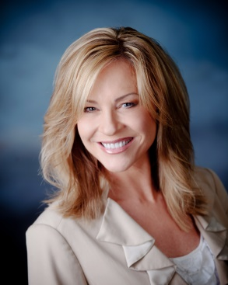
Build Your Business During the Holidays
Take advantage of the Holiday Season to get people into that LITTLE BLACK DRESS for New Years!
Shar Lewis Club Reduce Consultant Vice President of Marketing

Slide 2

Objective
Get into that little black dress for the holidays!
Don’t give up over the holidays and gain another 10 pounds!
Studies show that many Americans gain 5-10 pounds over the holidays.
Lose 10-20 pounds and 4-14 inches in just 3-5 weeks with one of our unique breakthrough weight loss programs.
Shed your weight by the end of December and save your New Year’s Resolution for something better like learning a new language, taking a longer vacation, or spending more time with your loved ones.
Take control and start today!

Slide 3

Strategies
The Successful Six:
  Holiday Scripting (Marketing)
  Holiday Tradeshows and Community Events (Marketing)
  Holiday Direct Mail Campaign & Email Blast (Marketing/Sales)
  Holiday Weight Loss Program Add-On (Doctor or Health Specialist/Sales)
  Holiday Promotion Referrals (Front Desk, Spa Technicians, WL Coach)
  Holiday Package Product Gift Sales (Front Desk, Spa Technicians, WL Coach)

Slide 4
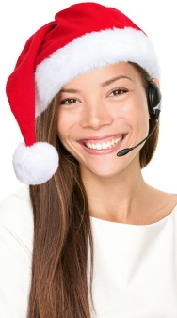
Holiday Scripting
It is important to change your scripting when calling leads over the holidays.
Everyone gives the excuse they are too busy over the holidays.
Everyone says they want to wait until the New Year to get started.
Your job is to convince them otherwise!
Don’t give up over the holidays and gain another 10 pounds!
Take control and start today with one of our unique breakthrough weight loss programs.
Lose 10-20 pounds and 4-14 inches in just 3-5 weeks and fit into that little black dress for the Holidays!

Slide 5

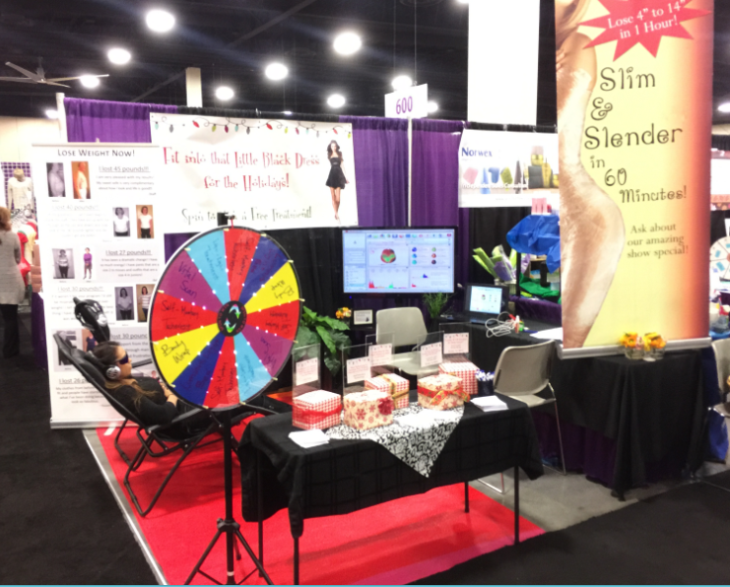
Holiday Tradeshows and Community Events
Booth Strategy
Get into that little black dress in time for the holidays!
Entice people to come to your booth with a SPIN WHEEL that lets them SPIN TO WIN a FREE WEIGHT LOSS TREATMENT.

Slide 6
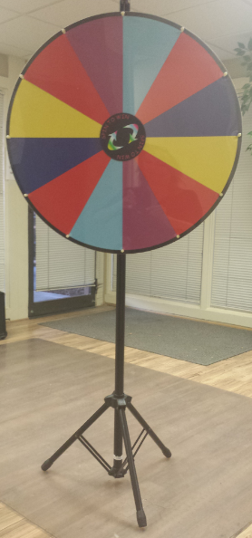
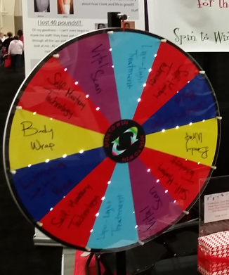
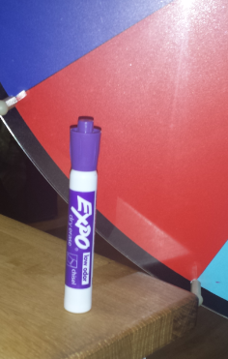
Holiday Tradeshows and Community Events
The Spin Wheel
  Purchase a Spin Wheel online
  Range in price from $100 - $500 (ours pictured here was $300)
  Write on and Wipe off Treatment Offers
  Include Services you have in your office:
    Body Wrap
    Lipo-Light
    Vital Scan
    Luminis Light Therapy Bed
    Self-Mastery Technology

Slide 7

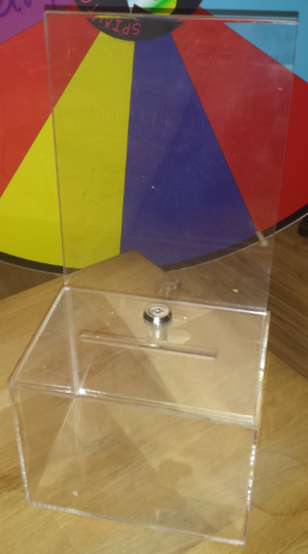
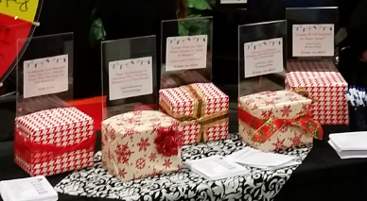
Holiday Tradeshows and Community Events
The Weight Loss Treatment Entry Boxes
    Purchase acrylic entry boxes with sign holders attached
    These boxes may be purchased for $15-$20
    Have one box for each treatment on the spin wheel
    Wrap the boxes like gifts
    Print treatment signs to go in sign holders attached to entry box

Slide 8
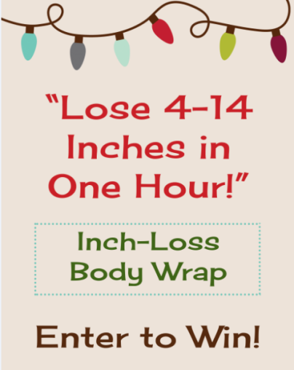



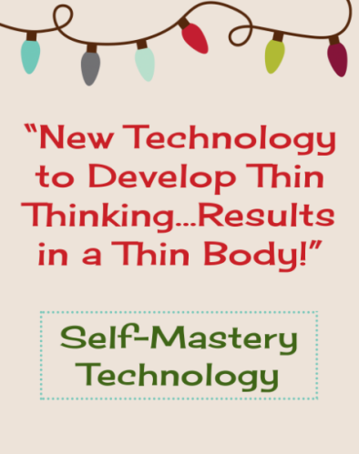
Holiday Tradeshows and Community Events
The Treatment Entry Box Signs

Slide 9

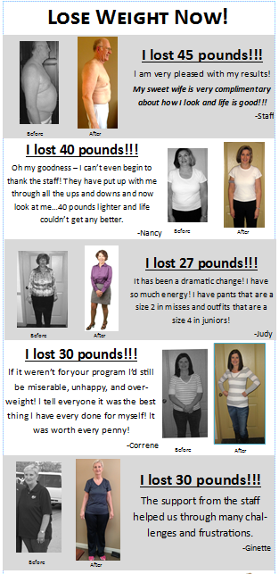

Holiday Tradeshows and Community Events
Banners

Slide 10
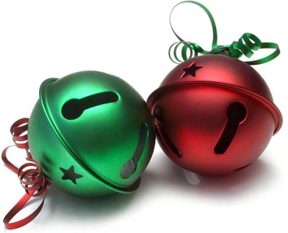
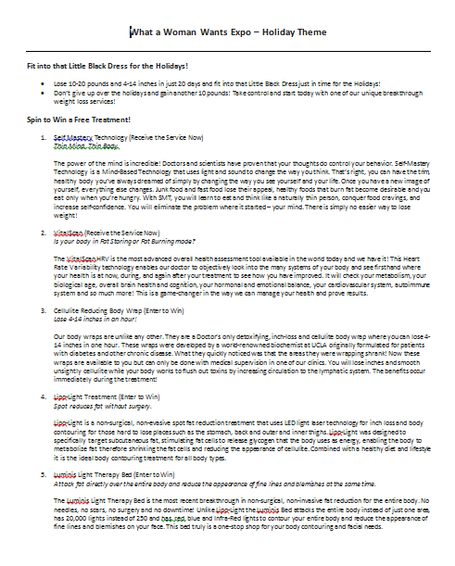
Holiday Tradeshows and Community Events
Holiday Expo Booth Script
    Spin to Win a Free Treatment
    Conversational style verbiage and
explanation on Treatments
    Include all Treatments/Services you offer
    Write up includes:
      Cellulite Reducing Body Wrap – Lose 4-14 inches in an hour
      Lipo-Light Treatment – Spot Reduce Fat without Surgery
      VitalScan – Is your body in Fat Storing or Fat Burning Mode
      Luminis Light Therapy Bed – Attack fat directly over the entire body and reduce the appearance of fine lines at the same time.
      Self Mastery Technology – Thin Mind. Thin Body.

Slide 11

Holiday Tradeshows and Community Events
Follow the Rest of the Regular Tradeshow Guidelines
Strategy is still ENTER TO WIN and BUY IT FOR CHEAP.
Remember we never give anything away for free or cheap unless it requires them to attend the seminar and the one-on-one health evaluation with the Doctor or Health Specialist prior to redeeming.
Everyone is a winner!
Remember, if they PURCHASE a service or package AND they ENTERED to win you take their name out of the winners list. They don’t get both!
Make all follow up calls immediately after the event. All winners and those that purchased certificates should be called within a week (2 days is preferable).

Slide 12

Holiday Direct Mail Postcard Campaign & Email Blast
THREE Targets for Mailing:
  Current and Past Chiropractic Patients
  Club Reduce Leads that have attended seminar but have not purchased program
  All past Club Reduce patients
  *This is similar to your holiday marketing calls only should be done by the Doctor or Health Specialist who is responsible for Sales and managing the Sales Tickler System.
  *As these leads have already attended a Seminar they are booked directly into a one-on-one.
  *Past patient list should be called by coach.

Slide 13

Holiday Direct Mail Postcard Campaign & Email Blast
Create a TARGETED Mailing List and Email List:
  Determine who you are going to target for this mailing
  Create a mailing list for that target audience
  Create an email list to accompany your mailing list
  *Only do this campaign if you have someone identified to follow up with phone calls and manage in Tickler System. Please review previous webinar titled “Leads for the Leadless – Direct Mail and Telemarketing” for research and statistics on mailings and calling. Follow up is critical!
  *If you have done the “Marketing to Current Chiropractic Patients for Weight Loss” campaign these leads will already be in your Tickler System. If you are not familiar with this campaign please review the webinar with the same title.

Slide 14
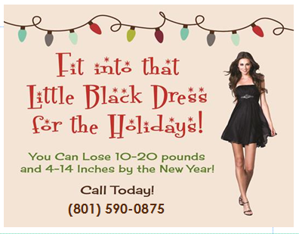
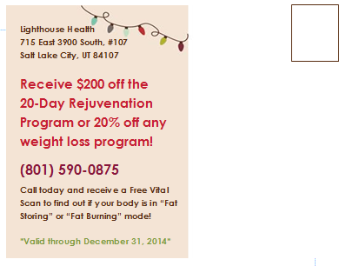
Holiday Direct Mail Postcard Campaign & Email Blast
Holiday Postcard with Offer

Slide 15

Holiday Direct Mail Postcard Campaign & Email Blast
Post Office Criteria for Size, Postage, and Mailing Label
NORMAL FIRST CLASS PIECE
Regular stamp that anyone can buy at the post office.
REQUIREMENTS
  Address can go anywhere on the piece
  There must be a return address. The return address has to be positioned to the upper left of the delivery address.
  There must be a place for a stamp. The stamp must be to the upper right of the delivery address.
  Different fonts can be used including handwritten fonts for the delivery address.

Slide 16

Holiday Direct Mail Postcard Campaign & Email Blast
Post Office Criteria for Size, Postage, and Mailing Label
PRESORT MAILINGS
There are two different classes (First Class and Standard Mail) and three different sizes (postcard, letter, flat) hat are commonly used. All presort mailings need a return address and a spot for the presort stamp.
  Return address positioned to the upper left of the delivery address
  Presort stamp positioned to the upper right of delivery address
  4” x 2” tall white space for the delivery address and barcode
  On a postcard or letter size piece this white space needs to be on the bottom right of the mail piece
  On a flat size piece, it can be at the top
PRESORT FIRST CLASS MAIL
  Estimated to arrive in 2-4 days
  Quantity 500 or more
PRESORT STANDARD MAIL (cheaper than first class but takes longer)
  Estimated to arrive in 5-10 days
  Quantity of 200

Slide 17

Holiday Direct Mail Postcard Campaign & Email Blast
Post Office Criteria for Size, Postage, and Mailing Label
POSTCARD SIZE
  Minimum 5’ x 3.5”, Maximum 6” x 4.25”
  Common sizes are 6” wide x 4” tall and 5.5” wide x 4.25” tall
LETTER SIZE
  Maximum 11.5” x 6.125”
  Common sizes are 9” wide x 6” tall and 8.5” wide x5.5” tall
FLAT SIZE
  Maximum 15” x 12”
  Common sizes are 11” wide x 8.5” tall and 12” wide x 9” tall
*Contact Richard Selby from the Club Reduce Resource Page for additional information and/or to print, post and mail your campaign.

Slide 18
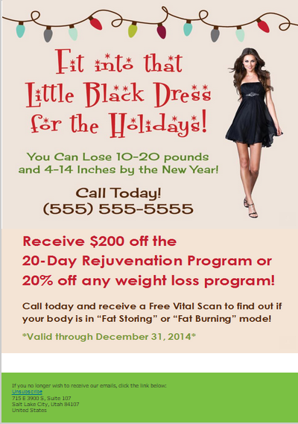
Holiday Direct Mail Postcard Campaign & Email Blast
Holiday Email Template and Blast
  Club Reduce will send this for you.
  Provide phone number you want on the email and we will personalize your email for you (This should be the same phone number as on postcard)
  Please provide email list in Excel .csv format and email to Damon@ClubReduce.com. (Directions on how to create is on Club Reduce)
  Provide the date you want the email to go out. This should be the same week the postcard is mailed.

Slide 19
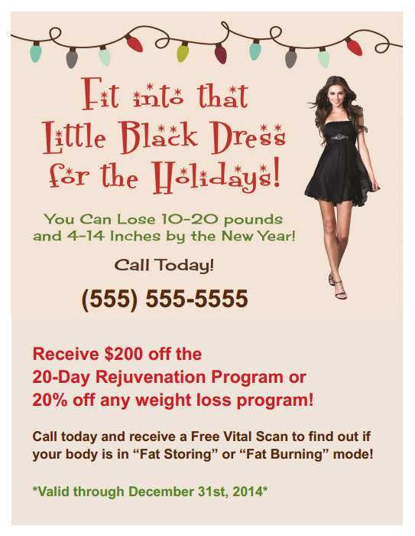
Holiday Direct Mail Postcard Campaign & Email Blast
Flyers and Signs at Front Desk
      Place this flyer in an acrylic sign holder and have at the front desk
      Have flyers printed up and hand out to all patients in office and ask them to give to their friends, family and business associates

Slide 20

Holiday Weight Loss Program Add-On
Add a Week or Two onto their Program
  When selling weight loss programs in November and December tell your potential patients that you will add an extra week or two onto their program including all services (not supplements) to help them make up for and get back on track due to Thanksgiving and Christmas.
  Also be sure to let them know that you have a proven technique to get rid of the extra pound or two they may have put on while endulging in their holiday feasts with the Lemon Detox to eliminate all the toxins, cleanse their body and accelerate them back into fat burning weight loss mode.

Slide 21

Holiday Promotion Push for Referrals
Every staff member should be asking for referrals during the holidays and offering the holiday special.
  Remind the patient of your referral program. In our office we offer a free shake ($50 value) or $25 towards any product when they refer someone that purchases a program.
  Remind all staff that if someone comes in off of them as a referral they will get the bonus/incentive. In our office this is $10 per person that shows for seminar or comes back and books evaluation with Doctor or Health Specialist off of Holiday promotion. Have them write their name on the Holiday Flyer or attach their business card.
  You may want to set a goal for each staff member and have a prize for whoever gets the most.

Slide 22
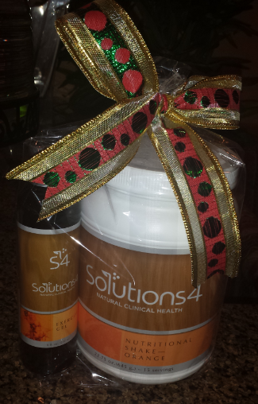
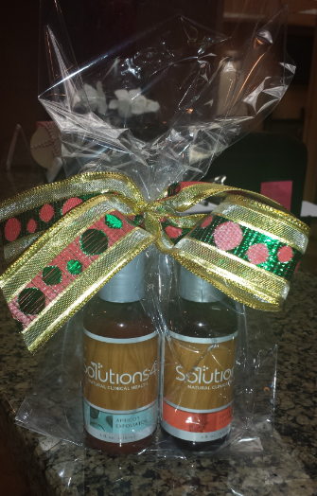
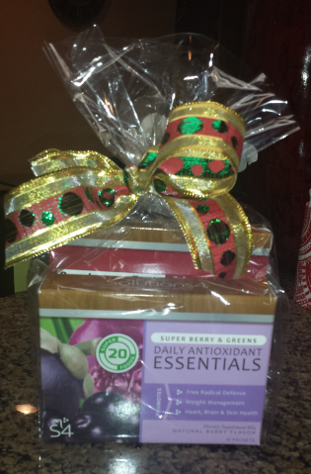
Holiday Packaged Product Gift Sales
Bundle your Products and Sell for 10% - 15% Off
    Ageless Beauty Combo
      Vitamin C Lotion, Toner Spray
    Deluxe Fresh Face Skin Care
      Green Tea Cleanser, Apricot Exfoliator, Toner Spray, Apple Stem-Cell Moisturizer
    Exercise Enthusiasts – Weekend Warriors
      Exercise Gel, Cardio Health Drink Mix, B12
    Body Beautifying Kit
      Body Exfoliator, Anti-Cellulite Lotion
    Holiday Wishes - Gifts for Everyone
      Nutritional Shake or 4 Sample Nutritional Shakes
    The Gift of Energy
      Berry Greens Drink Mix, Cardio Health Drink Mix, B12

Slide 23


Make December your Highest Producing Month this Year
We can do it and you can too!

Slide 24

The 2014 Summit was Amazing!
Three Success Strategies to Grow your Practice:
NEW SUCCESS CHECKLIST
NEW MARKETING QUICKSTART GUIDE
HIRE ME to come to your clinic to provide personal, one-on-one COACHING and CONSULTING

Slide 25


SUCCESS STRATEGY ONE: Success Checklist
To Streamline Set-Up and Ensure Success
“You have always had, you have at this moment, you will always have in the future the power to achieve, to accomplish, to have anything and everything you want.”

Slide 26
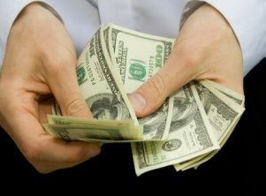


SUCCESS STRATEGY TWO:
Marketing Quick Start Guide
Your Top Money Making Campaigns
  “If you are failing to plan, you are planning to fail.” – Tariq Siddique
  Detailed guide including:
      How To Checklists
      Helpful Hints
      Interesting Facts
      ROI
      Strategy
      Implementation
      Set Up

Slide 27

SUCCESS STRATEGY THREE: On-Site Personal Consulting
  Are you making $25,000, $50,000, $100,000 or more each month with Club Reduce?
  Do you want to be?
  I can personally help you DOUBLE, TRIPLE or even QUADRUPLE your Club Reduce business in just a few short months.

Slide 28


Personal One-on-One Coaching and Consulting at your Clinic!
Ask yourself these questions:
  Do you want help TRAINING your staff and IMPLEMENTING all these NEW systems, products, and programs in your clinic?
  Do you want to get your clinic running like a WELL-OILED MACHINE?
  Do you want to take your business to the NEXT LEVEL and make more money now?
  Do you want to increase the PRODUCTIVITY of your staff so you can STEP AWAY
  Do you want to maximize your marketing strategies to INCREASE SALES?
  Do you want to improve your closing rates so you convert MORE LEADS TO PATIENTS?
  Do you want to train your staff to educate patients so they become PATIENTS FOR LIFE?
  Do you want to increase employee productivity and MORALE?
  Do you want to increase your profits and MAKE MORE MONEY?

Slide 29



I Can Help You!
Personal
training and coaching
at your clinic
for you and your staff
specific to your needs
and goals

Slide 30

Sign Up Today!
Train your staff NOW to be ready for the
NEW YEAR weight loss frenzy!
www.ClubReduceConsulting.com
801.917.0900

Slide 31

Thank You!

