Slide 1
How Nutrition Can Make Adjustments More Effective
With Dr. Todd Singleton

Slide 2
An intro slide about what you will be talking about…

Slide 3


Role of microbiome in arthritic disease may be the next frontier in medicine orthopedics today!
Attention to this topic peaked when the White House announced the $121 million National Microbiome Initiative.

Slide 4

Microbiomes and Arthritis
Despite the variability of organisms throughout the human body, some stability at the level of the microbial community suggests the microbiome plays a role in preserving function. The host microbiome relationship is complex in that microbes can confer symbiotic benefits to the host in multiple aspects of life that are important for maintaining health.

Slide 5
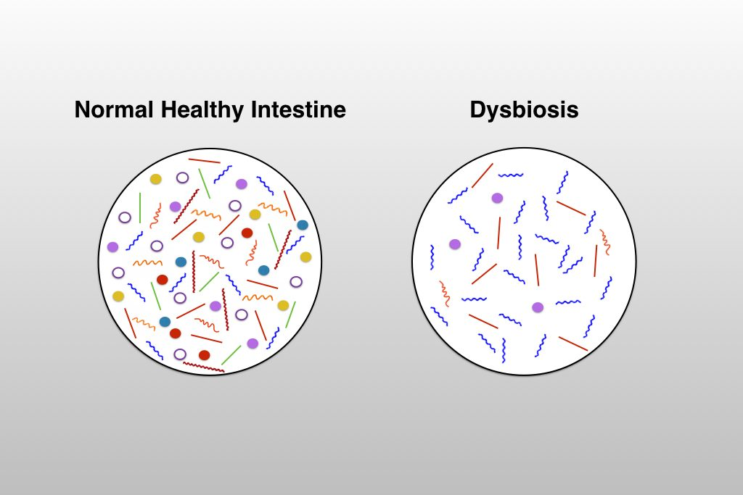
Microbiomes and Arthritis
However deficiencies in this complex interaction may also disturb this symbiotic relationship and cause pathology.
Lately gut microbiome has been the focus of much research because imbalances in the microbiome known as dysbiosis have been linked to numerous pathologies including arthritis.

Slide 6
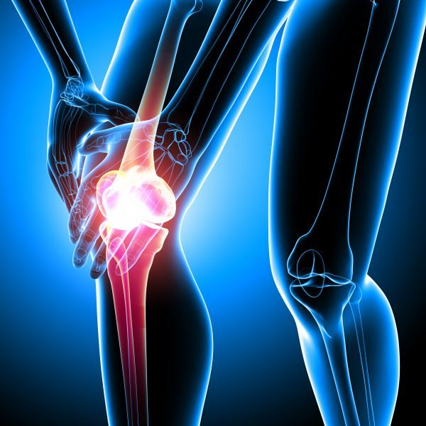
Microbiomes and Arthritis
Ongoing studies aim to find similar correlations between gut microbiome and osteoarthritis (OA).
The association between disruption in the microbial host balance and several ailments has raised the question of how the association between microbial host balance and certain ailments can be influenced to treat (OA).

Slide 7
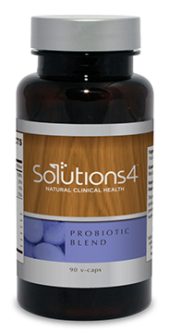
Microbiomes and Arthritis OA Etiology
Probiotic supplementation has been suggested as a method to relieve inflammation and other symptoms in arthritic patients because of its effect on the human microbiome.
The effect of glucosamine on the microbiome and OA has been studied and changes to the microbiome were noted
Given the ease with which peptic ulcer disease is treated with a handful of medications, the prospect of OA being of infectious etiology is certainly enticing
*Coulson S, et al. Inflamopharmacology.2013;doi:10.1007/x10787-012-0146-4
*Heiken TJ, etal. Sci Rep.2016:10.1038/Srep30751

Slide 8
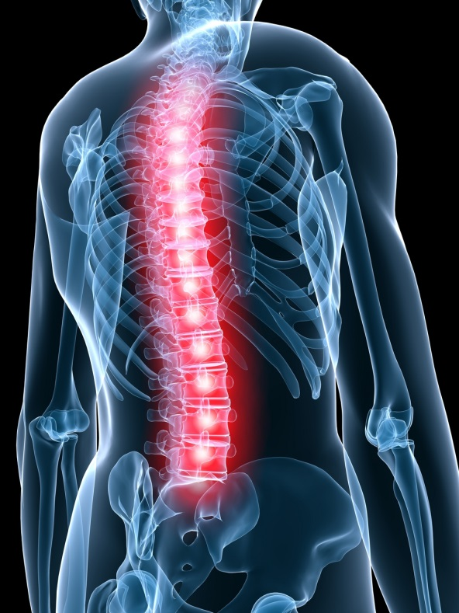
Gut Inflammation and Microbiome in Spondyloarthritis
Spondyloarthritis (SpA) is a chronic inflammatory disease involving joints and the spine. Bowel inflammation is common is (SpA), which may be classified as acute or chronic.
Chronic gut inflammation is most common in SpA patients with axial involvement as compared to those presenting with peripheral involvement alone.

Slide 9
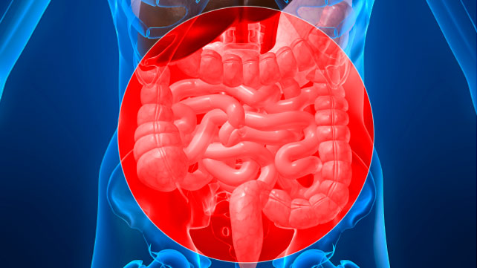
Gut Inflammation and Microbiome in Spondyloarthritis
The pathogenesis of gut inflammation in SpA could be explained by two factors-over-activation of immunological cells and altered gut microbiome.
In SpA, the gut microbiome could emerge as diagnostic and prognostic marker of disease
Modulation of gut microbiome is slated to have therapeutic potential as well
*ncbi.nlm.nih.gov/pubmed/26719306(KabeerdossI)

Slide 10
In Conclusion…..
This helps with adjustments because…

Slide 11
Thank you!
Call or Text me at 801-903-7141

