Slide 1
Welcome
-Neuropathy Seminar-

Slide 2
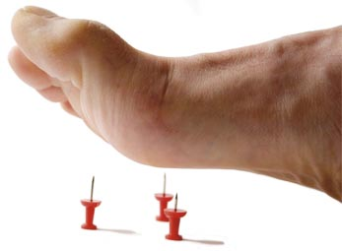
What is Neuropathy?
Neuropathy may be diffuse; affecting many parts of the body. Or it can be focal; affecting a single, specific nerve and part of the body.

Slide 3
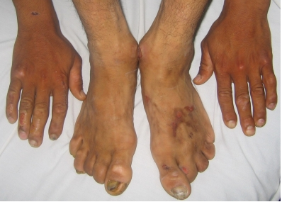
What is Neuropathy?
Diffuse Neuropathy:
The two categories of Diffuse Neuropathy are Peripheral Neuropathy, affecting the hands and feet and Autonomic Neuropathy, affecting the internal organs.

Slide 4
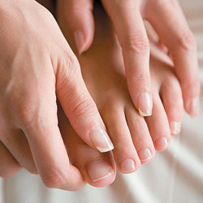
What is Neuropathy?
Peripheral Neuropathy:
This is the most common type; damaging the nerves of the limbs, especially the feet and affecting both sides of the body.

Slide 5
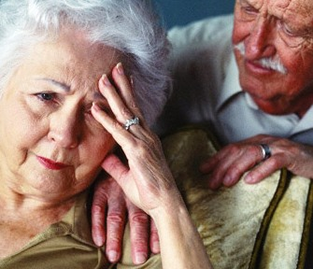
What is Neuropathy?
- Common symptoms of Peripheral Neuropathy are:
Numbness or insensitivity to pain or temperature
Tingling, burning or prickling sensations
Sharp pains or cramps (or like walking on sponges)
Extreme sensitivity to touch, even light touch
Loss of balance and coordination
- These symptoms are often worse at night.

Slide 6
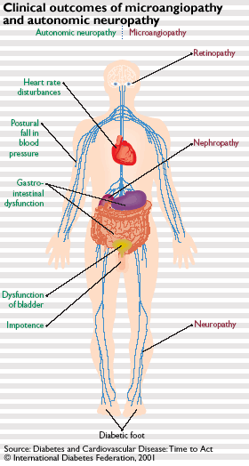
What is Neuropathy?
Autonomic Neuropathy (also called Visceral Neuropathy):
This is another form of diffuse neuropathy. It affects the nerves that serve the heart and internal organs.

Slide 7
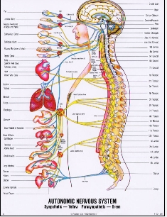
Neuropathy And Its Effects:
Neuropathy affecting the organs via nerve damage can lead to:
Urinary incontinence
- Lack of sexual function
- Digestion issues (stomach emptying slowly, bloating, persistent nausea and vomiting)
- Lower bowel problems (constipation, diarrhea)

Slide 8
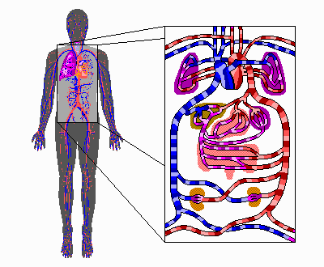
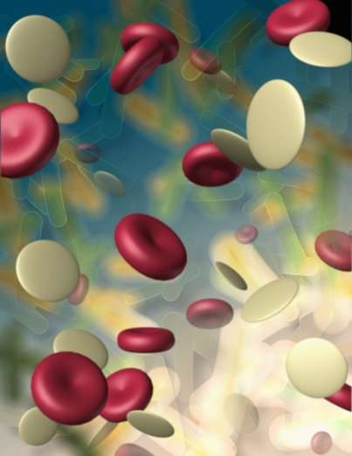
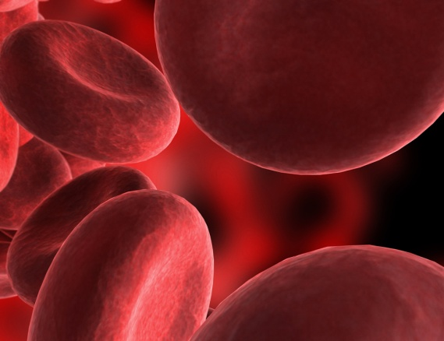
It can also effect:
- The cardiovascular system (which controls the circulation throughout the body)
Damage to this system effects the signal for the blood in regulating blood pressure and heart rate. One can feel dizzy upon standing as a result (orthostatic hypotension).

Slide 9
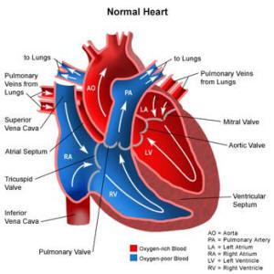
Neuropathy affects this system in the perception of pain from heart disease. People may not experience angina as a warning sign of heart disease and suffer painless heart attacks.
Note: raising the risk of a heart attack during general anesthesia can occur.

Slide 10
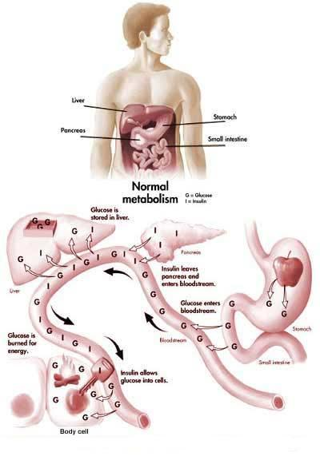
It can also lead to:
- Hypoglycemia or low blood sugar.
This condition makes it difficult to recognize and treat an insulin reaction.

Slide 11
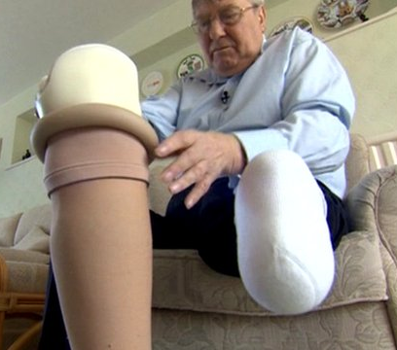
Amputations Caused by Pre-Diabetes to
Full-Blown Diabetes
Uncontrolled diabetes (even on medication) results from a poor diet, lack of exercise and unstable sugar levels. These can lead to conditions such as Neuropathy, which affects the whole body potentially leading to amputations.

Slide 12
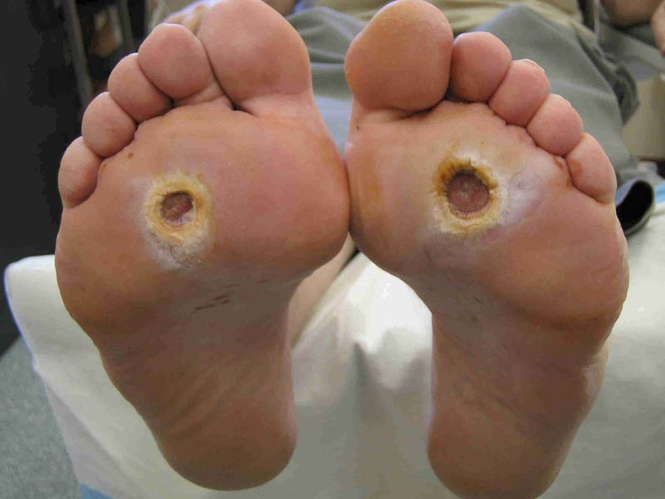
Glucose levels (high blood sugar due to diet) harms nerves and blood vessels. This effects circulation, especially the peripheral area of the body, such as limbs and extremities.
This will then lead to Diabetic Neuropathy, which damages nerve fibers, causing numbness that leads to injuries and/or infections due to decreased sensations.

Slide 13
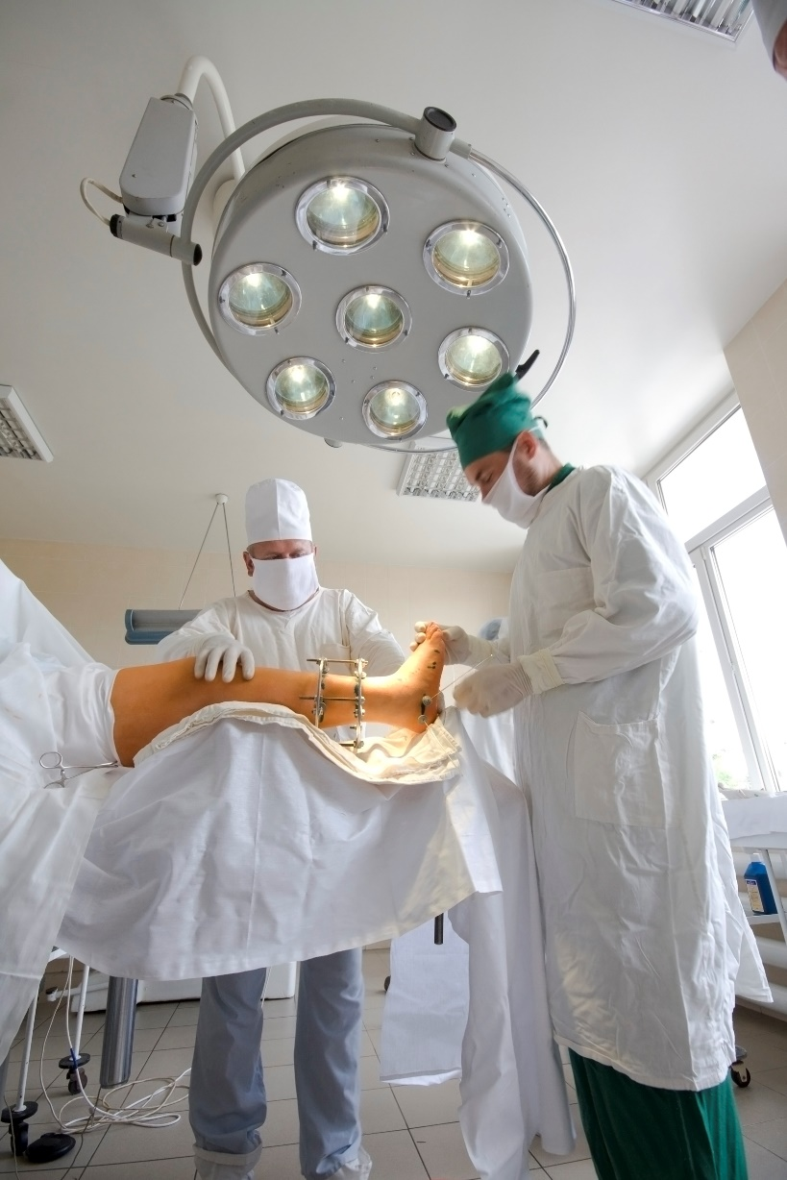
Amputations Caused by Pre-Diabetes to
Full-Blown Diabetes
Blood circulation is then compromised, leading to infections, injuries, foot ulcers, which can then lead to foot and leg amputations. This is because the blood cannot circulate fast enough to heal wounded areas.

Slide 14
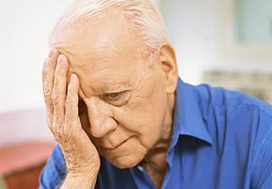
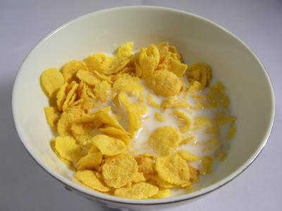
The Cause: Malnutrition Neuropathy
Malnutrition Neuropathy is caused by eating yourself sick; eating foods out of a box, bag or can. These foods are all dead foods – no live enzymes are present.

Slide 15
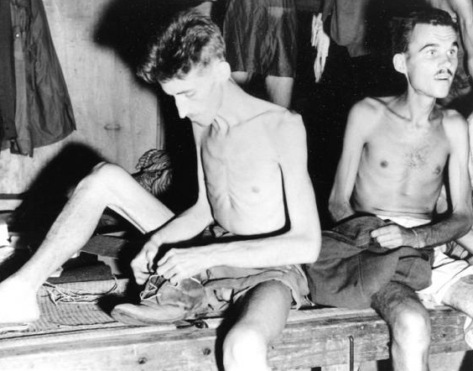
The Cause: Malnutrition Neuropathy
This condition of Neuropathy was brought to attention during WWII. This provided an unprecedented opportunity for observation of the effects of nutritional deficiencies. Men of many races were subjected to years of defective nutrition as prisoners of war.

Slide 16
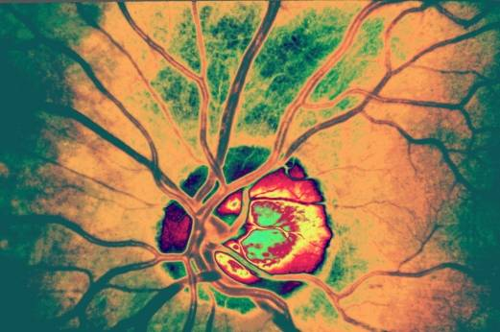
The Cause: Malnutrition Neuropathy
This malnutrition effected the most highly differentiated cells of the organism that would suffer the most. In fact, they found that the nervous system shows the severest and most common lesions.

Slide 17


The Cause: Malnutrition Neuropathy
These findings were not due to the region of the world these men were in – as the findings were the same no matter where someone was on the planet. Malnutrition was the only common denominator in all the physical ailments these men experienced.

Slide 18
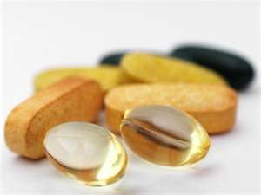
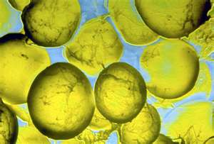
This is essentially a degenerative or catabolic nature arising under conditions of deprivation. The imbalance of the altered diet being given to the POWs effected their gastro-intestinal tract, leading to defective absorption and defective biosynthesis.
Due to the altered balance of the deficient diet, reduction of good quality proteins, fats and vitamins, the body was starving for good balanced food.

Slide 19

This level of deficient nutrition is now prevalent in all the foods we consume today.
It is completely lacking in live enzymes, vitamins and minerals, which are essential to healing the body and allowing it to function properly. This malnutrition affects the central and peripheral nervous system as a result.

Slide 20


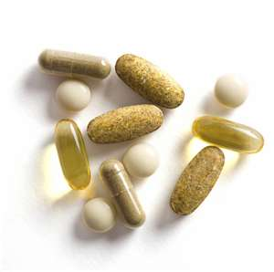
The Solution!
The Club Reduce Neuropathy Program is amazing because it addresses any nutritional deficiencies a person may have. It gets the body to start digesting and assimilating food better. It also allows the body to start healing from the inside and decreases the degenerative process of the nervous system.

Slide 21

By combining supplements and a good eating program with hands-on treatment, we are accelerating healing and reversing the degeneration process that had already set in. We are essentially giving our patients their life, well-being, health, and happiness back!

Slide 22

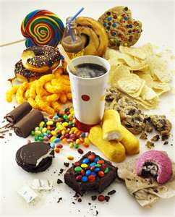
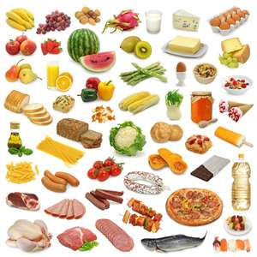
A Change of Diet…
Changing diet and using effective supplements are a VITAL part of the healing process. We recommend a more restrictive diet for the first 30 days (much like the 20-Day Rejuvenation), followed by several weeks of healthy eating (like a Candida Program).

Slide 23
When these vitamins are depleted….this is
what causes neuropathy, diabetes, etc.
We’re trying to get your body to 100% nutrition.
=

Slide 24
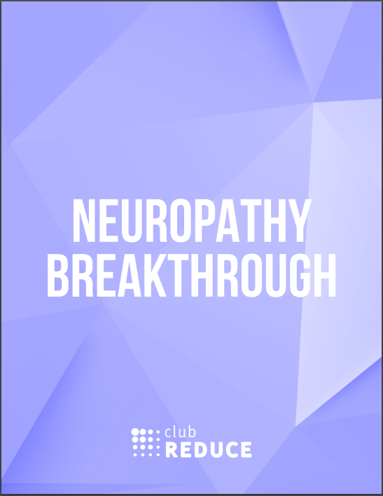
Receive Help With The Neuropathy Breakthrough Program!

Slide 25
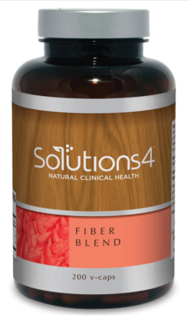
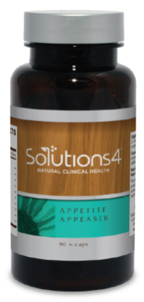
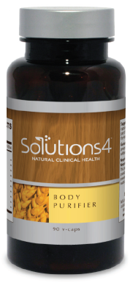
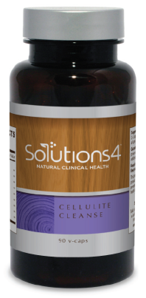
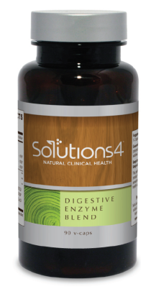
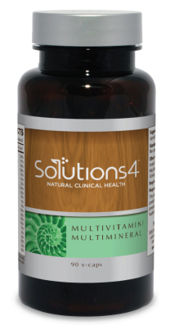
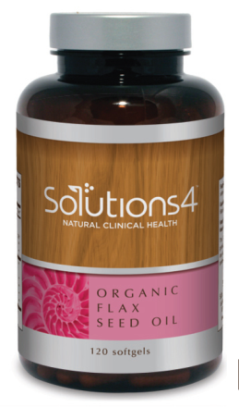
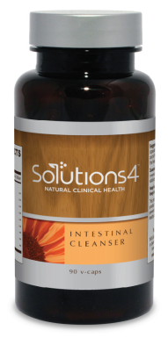
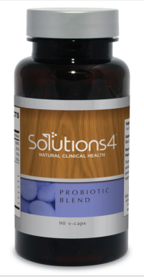
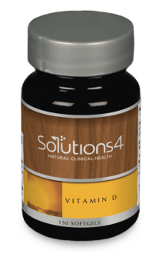
Supplements in the Neuropathy Program
Appetite Appeaser Body Purifier Cellulite Cleanse Digestive Enzymes Fiber Blend
Intestinal Cleanser Multivitamin Vitamin D Probiotic Blend Flax Seed Oil

Slide 26
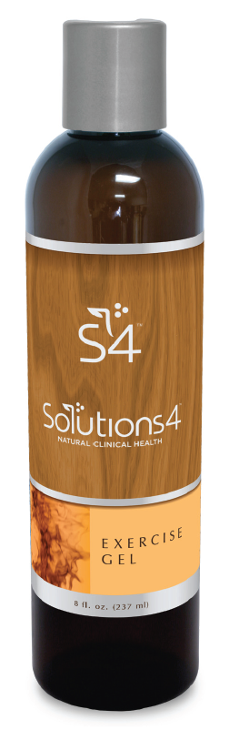
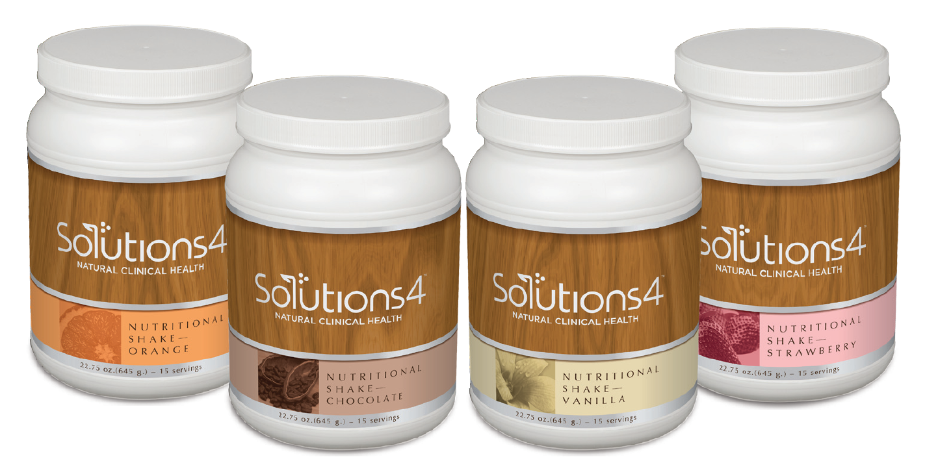
Supplements in the Neuropathy Program

Slide 27


This Program Works!
Continue with the supplementation for 12 weeks
Have one or two shakes a day
Use the Exercise Gel at home
Add SMT
Leg wraps developed at UCLA for neuropathy patients
TESLA MAX TM-4 unit for neuropathy
Anodyne LED therapy
8 Hz back ground music for healing

Slide 28
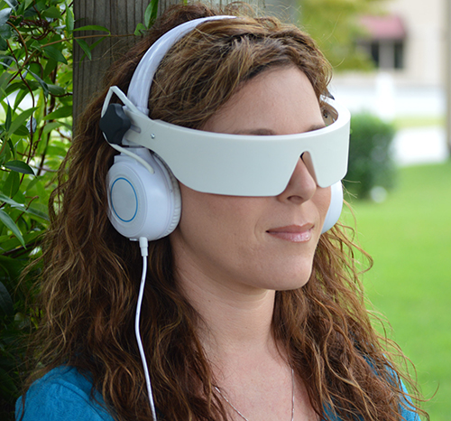
Self-Mastery Technology for Neuropathy
Decreases cortisol
Decreases stress on the body, which increases circulation
When the body is in a more relaxed state healing can occur
10 SMT sessions for Neuropathy

Slide 29

Sign Up Today for a FREE Evaluation to See if We Can Help You!

