Slide 1
Welcome to
Club Reduce!

Slide 2
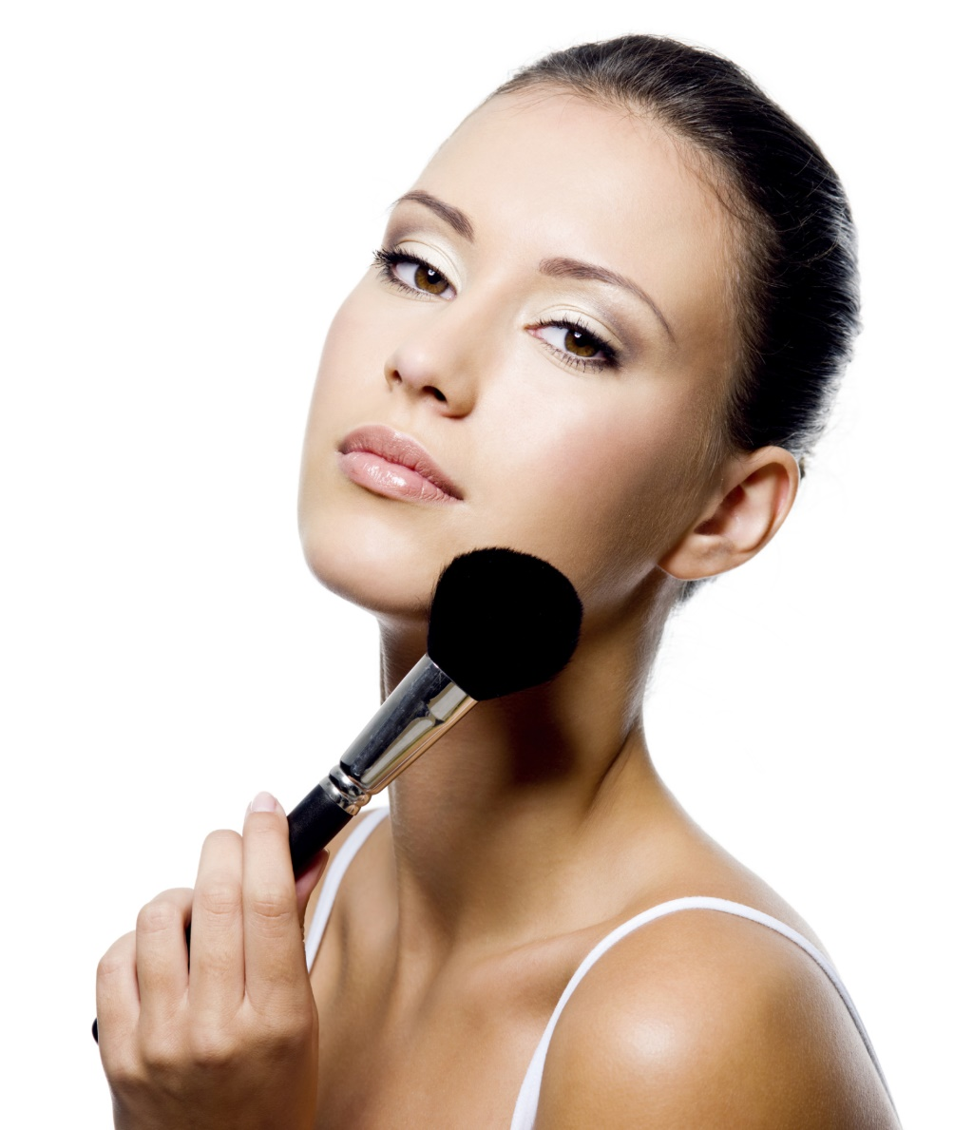
Today, we’re going to talk about hidden dangers
lurking in your makeup bag.

Slide 3

All of the classes in this series build upon one another.
By attending regularly, you’ll learn the habits of a naturally thin person!

Slide 4
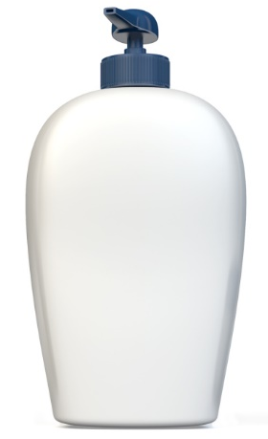
Pervasive Toxins in Skincare
Skincare products are some of the least regulated products on the market. Most skincare products are never tested for safety before they are widely distributed!

Slide 5
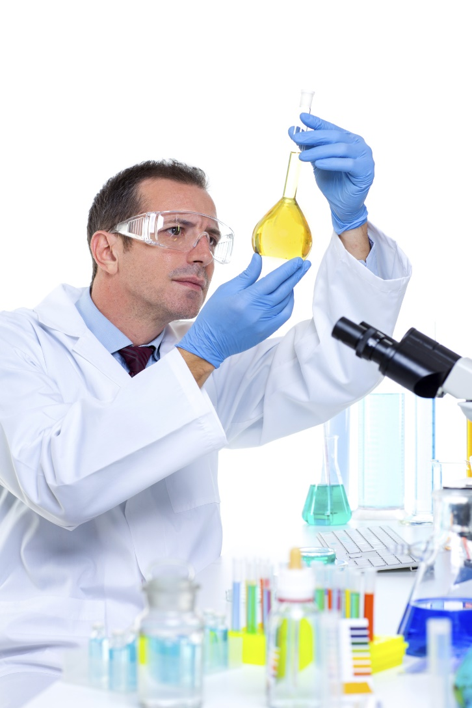
Pervasive Toxins in Skincare
Of the 13,000 chemicals used in cosmetics in the United States, only about 10% have been evaluated for safety.

Slide 6
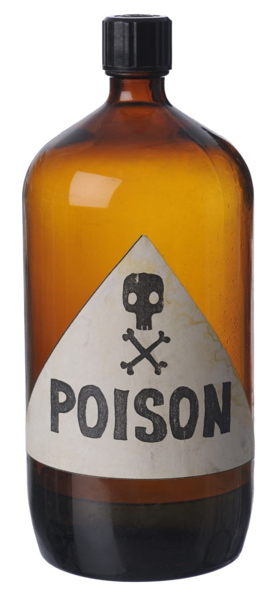
Pervasive Toxins in Skincare
Of the 10% of chemicals that have been tested, the National Institute of Occupational Safety and Health found that 884 of those chemicals are actually toxic to human health!

Slide 7

Pervasive Toxins in Skincare
Women use an average of 12 personal care products & cosmetics each day. Through these products, women end up putting an average of 168 chemicals on their skin every single day!

Slide 8

Pervasive Toxins in Skincare
If you’re putting 168 different chemicals on your skin every single day, imagine how they add up over the course of your entire life!

Slide 9

Absorption of Toxins
The skin is the largest organ in the human body, and also the most permeable. When you use lotions or skincare products, the ingredients are absorbed, and many make it into your bloodstream.

Slide 10
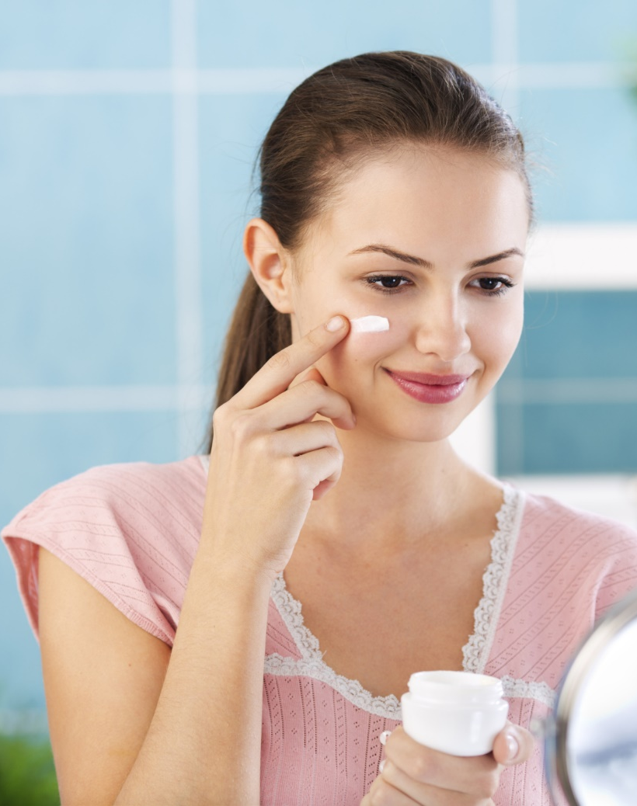
Absorption of Toxins
Here in our clinic, we believe that you shouldn’t put on your skin what you wouldn’t put in your mouth. Toxic ingredients can hinder attempts at weight loss and contribute to poor health.

Slide 11

Toxins and Complexion
Toxins in skincare products and cosmetics also contribute to skin
problems ranging from
acne to premature aging
— the very problems
that skincare products
are supposed to treat!

Slide 12
Top 20 Toxins to Watch Out For:
Polyethylene glycol (PEG)
Benzoyl Peroxide
Propylene Glycol
Butylene Glycol
DEA (Diethanolamine)
MEA (Monoethanolamine)
TEA (Triethanolamine)
Parabens
Sodium Lauryl/Laureth Sulfate
Dioxins
Avobenzone
Benzphenone
Ethoxycinnamate
DMDM Hydatoin & Urea
Phthalates
Triclosan
BHA and BHT
Coal tar dyes
Siloxanes
PABA

Slide 13
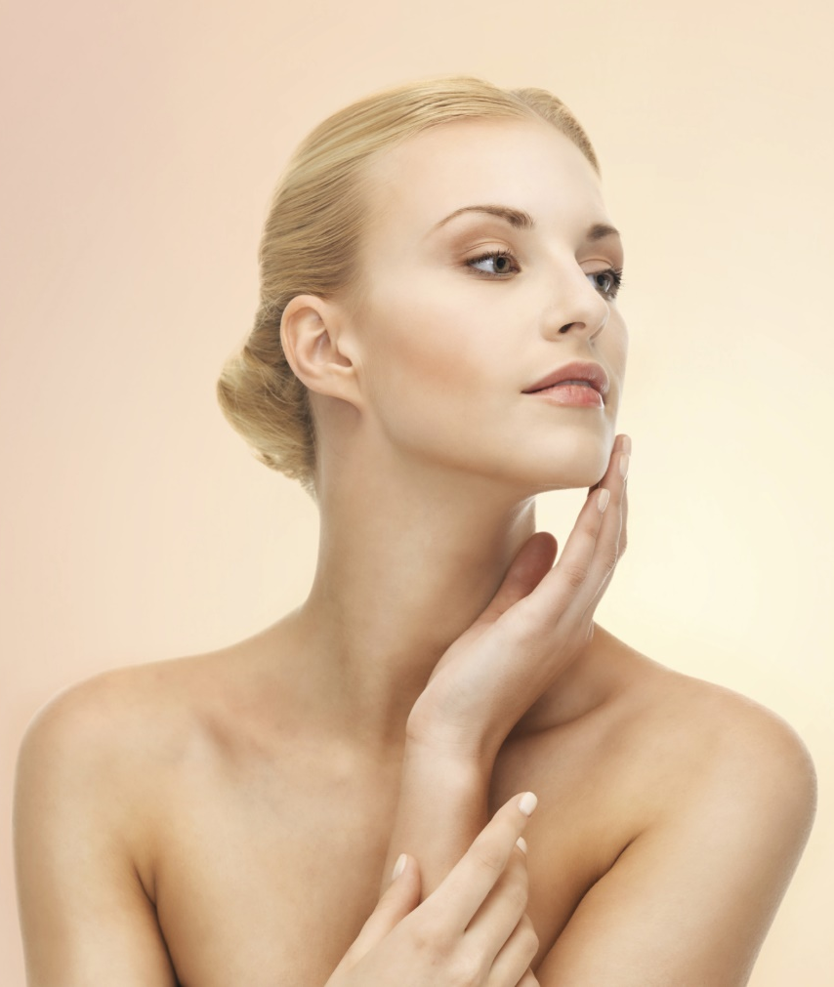
Toxins and Complexion
If you want a smooth, glowing, healthy complexion, it’s time to think more seriously about what you’re absorbing through the largest organ of your body.

Slide 14

A Non-Toxic Alternative
Switching out your old, toxic products for all-natural skincare can
make all the
difference!

Slide 15

A Non-Toxic Alternative
Our office offers a unique line of non-toxic, 100% natural skincare that’s different from anything else. These skincare products don’t just wash away impurities – they actually have healing properties.

Slide 16

A Non-Toxic Alternative
When you switch to our all-natural line, your friends and family will see the difference and want to try it too!

Slide 17
Summary:
Most skincare products on the market contain toxic chemicals that are absorbed by the skin.
These toxins cause problems ranging from acne to weight gain.
By switching to all-natural skincare products, you can help heal your skin and avoid the health effects of harmful toxins.

Slide 18

On Sale This Week:
We’re offering our three most popular Solutions4 skincare products at a discount for this week only! These products include:
1. Green Tea Cleanser
2. Apple Stem Cell Moisturizer
3. Apricot Exfoliator

Slide 19
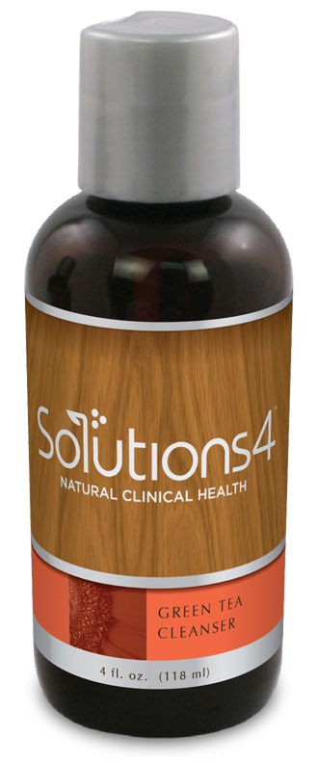
Green Tea Cleanser
The Green Tea Cleanser is a super-potent cleanser that heals and softens your skin. It includes antioxidants like green tea leaves, CoQ10, and vitamin C to fight off the free radicals that cause premature aging.

Slide 20
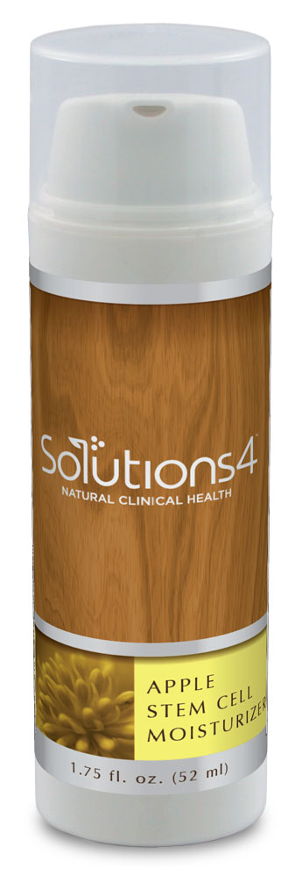
Apple Stem Cell Moisturizer
The Apple Stem Cell Moisturizer uses stem cells derived from a rare Swiss apple (the Uttwiler Spätlauber) to restore skin to a state of youthful vibrancy. We are able to literally give aging skin a fresh new start.

Slide 21
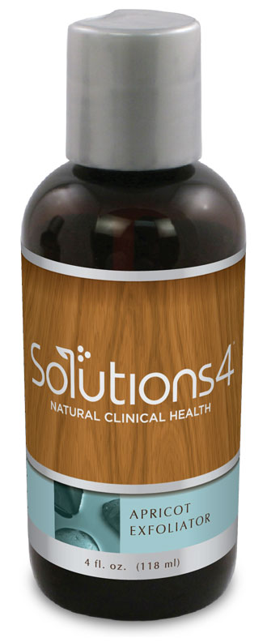
Apricot Exfoliator
The Apricot Exfoliator is a grapseed-oil based scrub that uses apricot seeds to provide gentle exfoliation. It also contains collagen and elastin builders to prevent against fine lines and wrinkles.

Slide 22
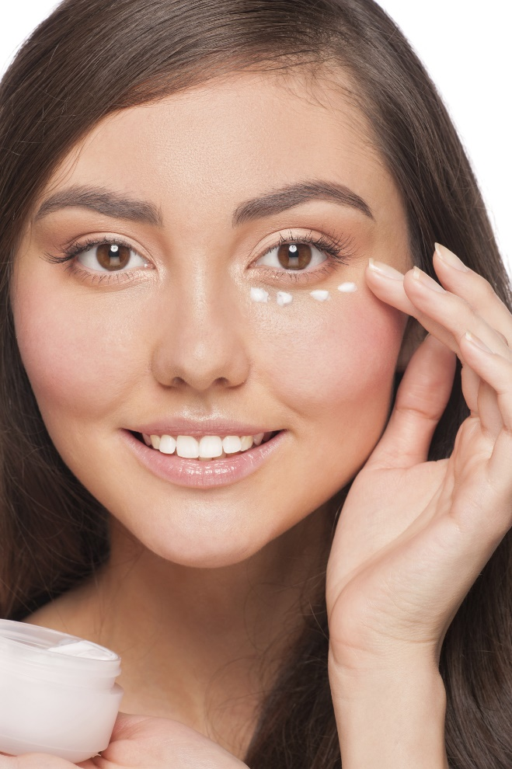
Also Recommended:
Eye Serum
If you suffer from a dark circles or under-eye puffiness, you know how hard it can be to find an effective solution. When you try the Solutions4
Eye Serum, you’ll fall in love on the spot!

Slide 23
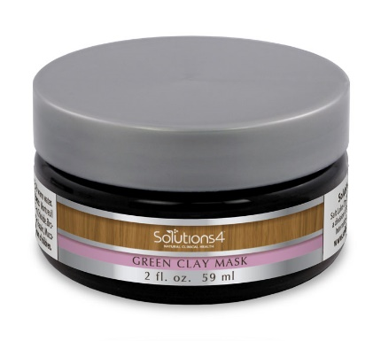
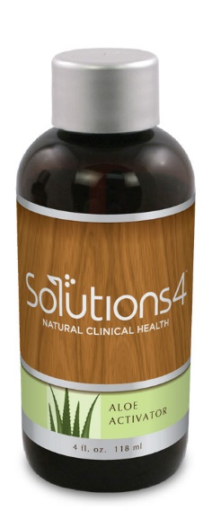
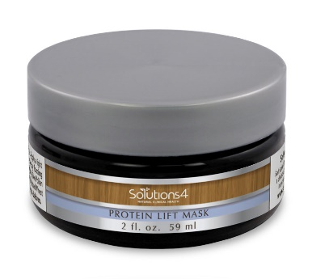
Also Recommended:
Detoxifying Facial Masks
The Green Clay Mask absorbs excess oils and draws impurities out of the skin!
The Protein Lift Mask and Aloe Activator work together to provide a natural alternative to face-lift surgery! These incredible products tone and tighten the skin to produce impressive results.

Slide 24
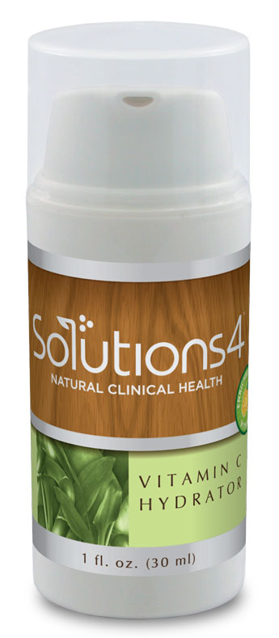
Also Recommended:
Vitamin C Hydrator
The Vitamin C Hydrator contains hyaluronic acid, a naturally occurring part of the human skin that has the ability to absorb 1,000 times its weight in water. This helps to maintain the skin’s natural elasticity and give you a glowing complexion!

Slide 25
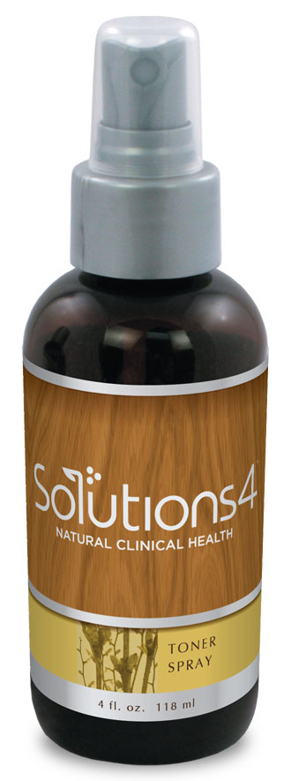
Also Recommended:
Toner Spray
The Toner Spray contains botanical extracts and aloe vera that brighten the skin and give it a silky smooth texture. You can use it before applying makeup or anytime throughout the day to freshen up!

Slide 26

Integrate what you’ve learned today by listening to:
LHL002 — Healthy
Habits for Radiant
Skin

