Slide 1
Welcome to
Club Reduce!

Slide 2

Today, we’re going to talk about sugar. Is it really as bad as people claim? Let’s find out…
Notes:
There are many ways to lose weight without first creating health and harmony, but these methods will lead you to gain the weight back and return to your original weight (or worse). Time has proven that health and harmony are foundational for long-term weight loss. A healthy body will not be able to hold onto excess weight! This is the key that needs to be stressed in our seminars. This seminar is an introduction to removing toxins and excess fluid from the body in order to create the right environment for weight loss and health.

Slide 3

All of the classes in this series build upon one another.
By attending regularly, you’ll learn the habits of a naturally thin person!

Slide 4
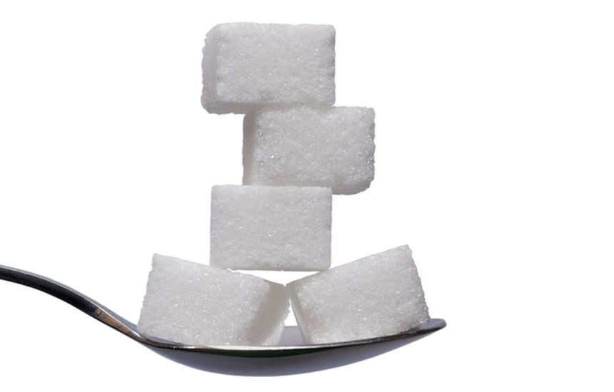
What Makes Sugar So Bad?
Sugar contains no nutrients, no protein, no healthy fats, and no enzymes. It provides a source of empty calories that actually pull minerals from the body during digestion. Eating too much can create hormonal imbalances and cause other harmful health effects.

Slide 5

What Makes Sugar So Bad?
Unfortunately, more than 70% of the American diet is composed of refined carbohydrates like white sugar and flour!
Notes:
There are many ways to lose weight without first creating health and harmony, but these methods will lead you to gain the weight back and return to your original weight (or worse). Time has proven that health and harmony are foundational for long-term weight loss. A healthy body will not be able to hold onto excess weight! This is the key that needs to be stressed in our seminars. This seminar is an introduction to removing toxins and excess fluid from the body in order to create the right environment for weight loss and health.

Slide 6
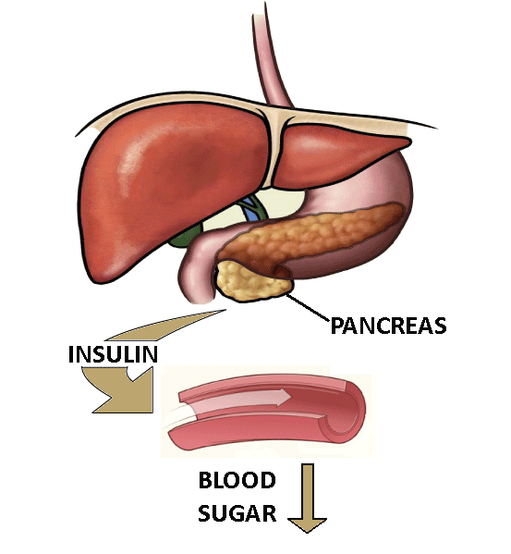
The Vicious Sugar Cycle
A couple of hours after eating too much sugar, your blood sugar levels will plummet, and you’ll want to reach for something sweet. This new sugary snack will stimulate insulin production, causing your blood sugar to drop even more. You’ll experience low energy, hunger, and cravings — causing the vicious cycle to continue.
Notes:
There are many ways to lose weight without first creating health and harmony, but these methods will lead you to gain the weight back and return to your original weight (or worse). Time has proven that health and harmony are foundational for long-term weight loss. A healthy body will not be able to hold onto excess weight! This is the key that needs to be stressed in our seminars. This seminar is an introduction to removing toxins and excess fluid from the body in order to create the right environment for weight loss and health.

Slide 7
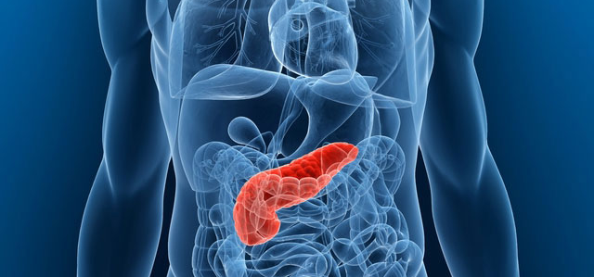
The Vicious Sugar Cycle
Eventually, if this cycle continues, the pancreas will slow or stop producing insulin altogether. Without insulin, your body’s blood sugar levels can go haywire!
Notes:
There are many ways to lose weight without first creating health and harmony, but these methods will lead you to gain the weight back and return to your original weight (or worse). Time has proven that health and harmony are foundational for long-term weight loss. A healthy body will not be able to hold onto excess weight! This is the key that needs to be stressed in our seminars. This seminar is an introduction to removing toxins and excess fluid from the body in order to create the right environment for weight loss and health.

Slide 8

The Vicious Sugar Cycle
However, you can put an end to this madness by eating high-quality proteins (fish or chicken), fiber-rich foods (fruits and vegetables), and healthy fats (coconut oil, olive oil, etc.) that satiate your appetite and actually leave you feeling full.
Notes:
There are many ways to lose weight without first creating health and harmony, but these methods will lead you to gain the weight back and return to your original weight (or worse). Time has proven that health and harmony are foundational for long-term weight loss. A healthy body will not be able to hold onto excess weight! This is the key that needs to be stressed in our seminars. This seminar is an introduction to removing toxins and excess fluid from the body in order to create the right environment for weight loss and health.

Slide 9

Metabolic Syndrome
Unfortunately, excess sugar in the diet doesn’t just make you fat. It can also lead to metabolic syndrome — a cluster of unhealthy conditions (high blood pressure, high blood sugar, a large waist circumference, and abnormal cholesterol levels) that lead to diabetes and heart disease.
Notes:
There are many ways to lose weight without first creating health and harmony, but these methods will lead you to gain the weight back and return to your original weight (or worse). Time has proven that health and harmony are foundational for long-term weight loss. A healthy body will not be able to hold onto excess weight! This is the key that needs to be stressed in our seminars. This seminar is an introduction to removing toxins and excess fluid from the body in order to create the right environment for weight loss and health.

Slide 10

The Prevalence of Sugar
This is especially frightening considering that Americans are consuming record-high amounts of sugar, with consumption increasing each year. Today, 16% of all calories come from added sugar, and the average American consumes 54 gallons of soda per year.
Notes:
There are many ways to lose weight without first creating health and harmony, but these methods will lead you to gain the weight back and return to your original weight (or worse). Time has proven that health and harmony are foundational for long-term weight loss. A healthy body will not be able to hold onto excess weight! This is the key that needs to be stressed in our seminars. This seminar is an introduction to removing toxins and excess fluid from the body in order to create the right environment for weight loss and health.

Slide 11

Hidden Sources of Sugar
But it’s not just soda that’s to blame for our sugar crisis. Hidden sugars are everywhere, even in foods that you wouldn’t expect. Refined sugar is added to pasta sauce, yogurt, granola bars, breakfast cereals, and other foods that you might consider “healthy.”
Notes:
There are many ways to lose weight without first creating health and harmony, but these methods will lead you to gain the weight back and return to your original weight (or worse). Time has proven that health and harmony are foundational for long-term weight loss. A healthy body will not be able to hold onto excess weight! This is the key that needs to be stressed in our seminars. This seminar is an introduction to removing toxins and excess fluid from the body in order to create the right environment for weight loss and health.

Slide 12
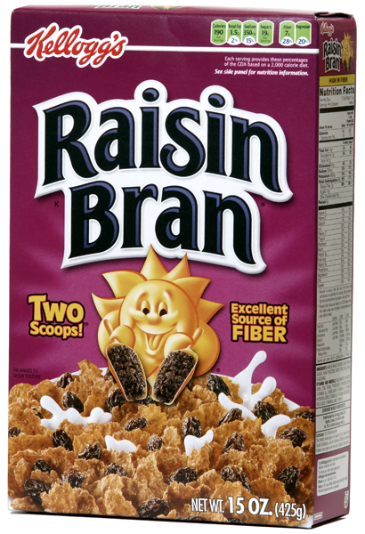
Hidden Sources of Sugar
This means that it’s not enough to stop drinking soda, even though that’s an important first step! You also need to become aware of the sneaky ways that sugar infiltrates your diet throughout the day.
Notes:
There are many ways to lose weight without first creating health and harmony, but these methods will lead you to gain the weight back and return to your original weight (or worse). Time has proven that health and harmony are foundational for long-term weight loss. A healthy body will not be able to hold onto excess weight! This is the key that needs to be stressed in our seminars. This seminar is an introduction to removing toxins and excess fluid from the body in order to create the right environment for weight loss and health.

Slide 13
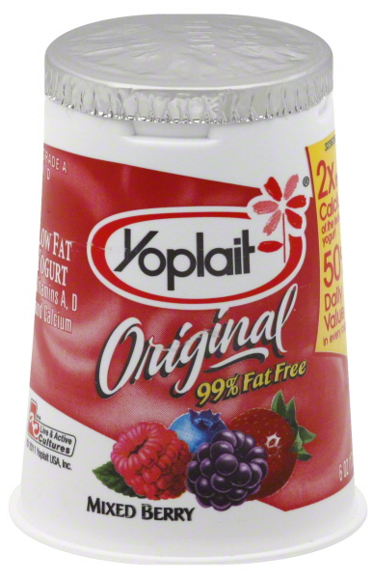
Sugar and Weight Loss
If you’re trying to lose weight, sugar is enemy #1. Recent studies are beginning to reveal that the overconsumption of sugar (not fat) is to blame for the obesity epidemic. In fact, “low fat” foods can actually be worse than their full-fat counterparts because they often replace fat with sugar.
Notes:
There are many ways to lose weight without first creating health and harmony, but these methods will lead you to gain the weight back and return to your original weight (or worse). Time has proven that health and harmony are foundational for long-term weight loss. A healthy body will not be able to hold onto excess weight! This is the key that needs to be stressed in our seminars. This seminar is an introduction to removing toxins and excess fluid from the body in order to create the right environment for weight loss and health.

Slide 14
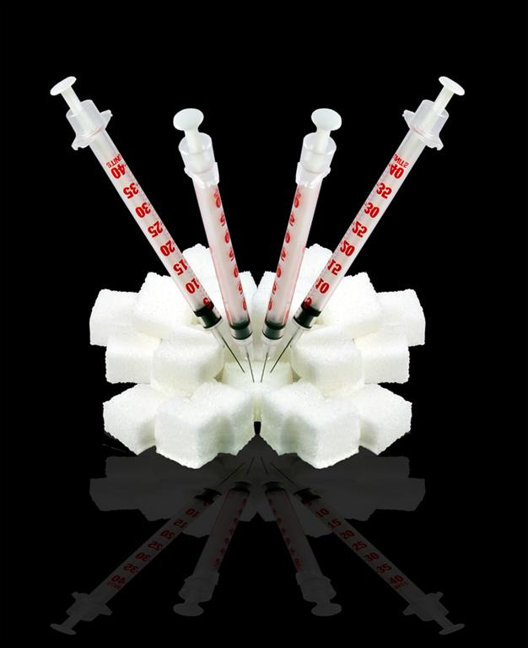
Sugar Is a Hard Drug to Quit
Though you probably know you need to cut down on sugar, it’s easier said than done! Studies have shown that sugar is more addictive than drugs like cocaine and heroin. So how can you escape the vicious cycle and make a change?
Notes:
There are many ways to lose weight without first creating health and harmony, but these methods will lead you to gain the weight back and return to your original weight (or worse). Time has proven that health and harmony are foundational for long-term weight loss. A healthy body will not be able to hold onto excess weight! This is the key that needs to be stressed in our seminars. This seminar is an introduction to removing toxins and excess fluid from the body in order to create the right environment for weight loss and health.

Slide 15
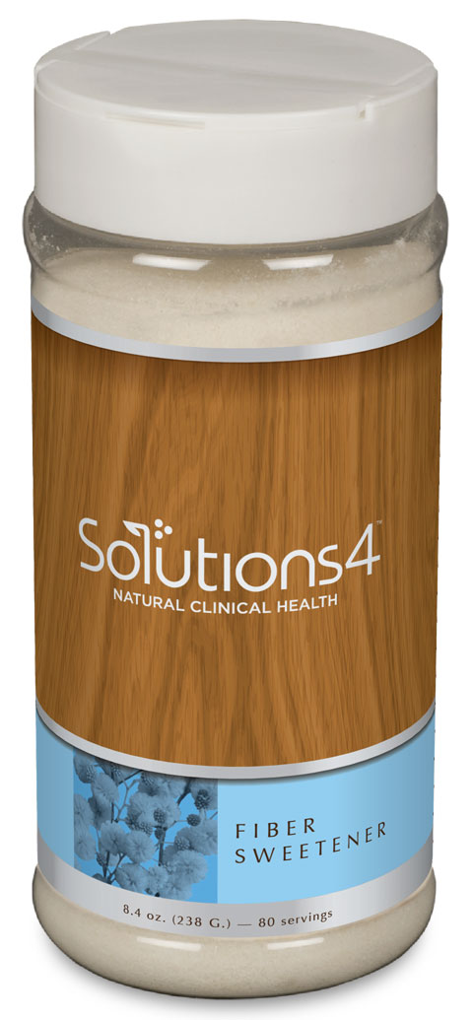
Introducing the Fiber Sweetener!
If you find it hard to cut sugar out of your diet, you’re not alone. That’s why we designed the Fiber Sweetener — a sugar-free, chemical-free, low-calorie, low-glycemic soluble fiber supplement and sweetener!
Notes:
There are many ways to lose weight without first creating health and harmony, but these methods will lead you to gain the weight back and return to your original weight (or worse). Time has proven that health and harmony are foundational for long-term weight loss. A healthy body will not be able to hold onto excess weight! This is the key that needs to be stressed in our seminars. This seminar is an introduction to removing toxins and excess fluid from the body in order to create the right environment for weight loss and health.

Slide 16
Introducing the Fiber Sweetener!
The Fiber Sweetener contains the following all-natural ingredients:
Lo Han Extract: Natural sweetener
Chicory Root: Natural sweetener and digestive aid
Acacia Fiber: Soluble fiber supplement
Xylitol: Natural sweetener
Citrus Bioflavonoids: Strengthens blood vessels and provides antioxidant protection
Silica: Strengthens bones and cartilage
Notes:
There are many ways to lose weight without first creating health and harmony, but these methods will lead you to gain the weight back and return to your original weight (or worse). Time has proven that health and harmony are foundational for long-term weight loss. A healthy body will not be able to hold onto excess weight! This is the key that needs to be stressed in our seminars. This seminar is an introduction to removing toxins and excess fluid from the body in order to create the right environment for weight loss and health.

Slide 17
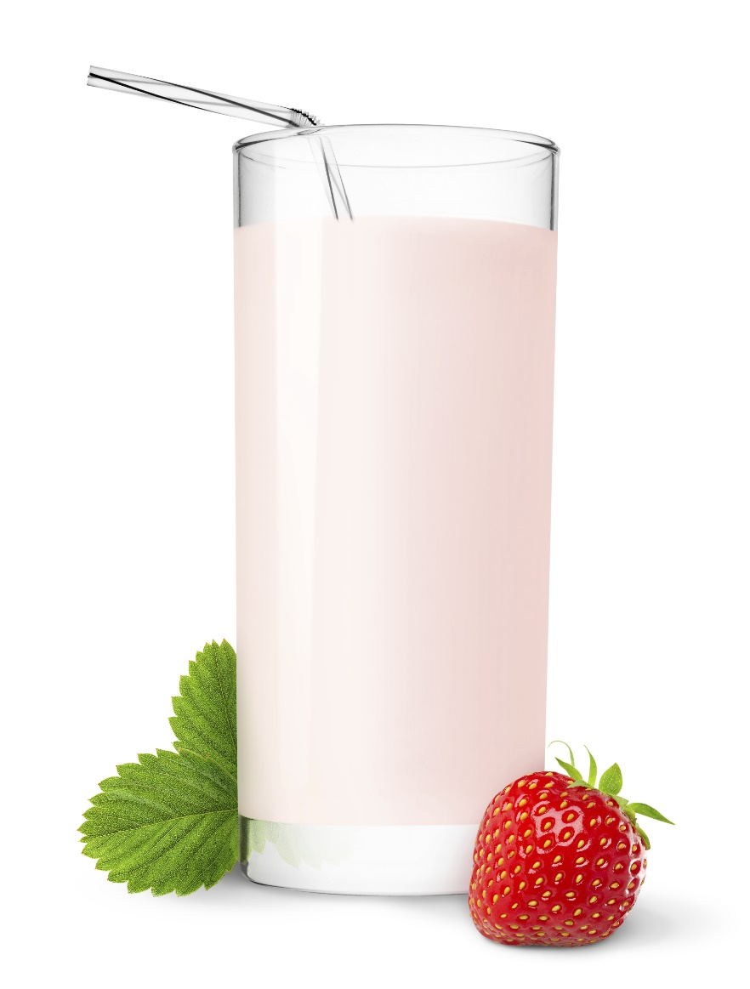
Introducing the Fiber Sweetener!
Though you can use this product to sweeten just about anything (homemade smoothies, sorbet, or even a healthy apple pie) it also contains a healthy dose of fiber! Fiber helps to speed up digestion, normalize bowel movements, lower cholesterol levels, and help you lose weight naturally.
Notes:
There are many ways to lose weight without first creating health and harmony, but these methods will lead you to gain the weight back and return to your original weight (or worse). Time has proven that health and harmony are foundational for long-term weight loss. A healthy body will not be able to hold onto excess weight! This is the key that needs to be stressed in our seminars. This seminar is an introduction to removing toxins and excess fluid from the body in order to create the right environment for weight loss and health.

Slide 18

Introducing the Fiber Sweetener!
Unlike other natural sweeteners, the Fiber Sweetener also contains two special forms of fiber — chicory root and acacia — that help stabilize blood sugar levels. This helps to reduce inflammation and prevents your energy levels from plummeting after a big meal!
Notes:
There are many ways to lose weight without first creating health and harmony, but these methods will lead you to gain the weight back and return to your original weight (or worse). Time has proven that health and harmony are foundational for long-term weight loss. A healthy body will not be able to hold onto excess weight! This is the key that needs to be stressed in our seminars. This seminar is an introduction to removing toxins and excess fluid from the body in order to create the right environment for weight loss and health.

Slide 19

Introducing the Fiber Sweetener!
With all of your newfound energy, you might feel like going for a walk, getting outside, or doing something else you love!

Slide 20

Introducing the Fiber Sweetener!
When you add the Fiber Sweetener to food or water, the fiber instantly dissolves. You’re left with a delicious natural sweetener with no artificial aftertaste! This makes the Fiber Sweetener perfect for just about everything.

Slide 21
Summary:
Eating sugar creates a vicious cycle that always ends with more sugar. Over time, this can lead to metabolic syndrome and other harmful health effects.
Sugar is becoming increasingly prevalent in the American diet. It’s even hidden in many foods that you wouldn’t expect!
Sugar makes weight loss extremely difficult.
The Fiber Sweetener provides a natural way for you to satisfy your sweet tooth without harming your health. Each serving contains a dose of health-boosting fiber!

Slide 22

On Sale This Week:
The Fiber Sweetener!

Slide 23

Integrate what you’ve learned today by listening to:
LHL010 — The
Harmful Health
Effects of Sugar

