Slide 1
Welcome to
Club Reduce!

Slide 2

Today, we’re going to talk about essential fatty acids and why they’re so important.
Notes:
There are many ways to lose weight without first creating health and harmony, but these methods will lead you to gain the weight back and return to your original weight (or worse). Time has proven that health and harmony are foundational for long-term weight loss. A healthy body will not be able to hold onto excess weight! This is the key that needs to be stressed in our seminars. This seminar is an introduction to removing toxins and excess fluid from the body in order to create the right environment for weight loss and health.

Slide 3

All of the classes in this series build upon one another.
By attending regularly, you’ll learn the habits of a naturally thin person!

Slide 4
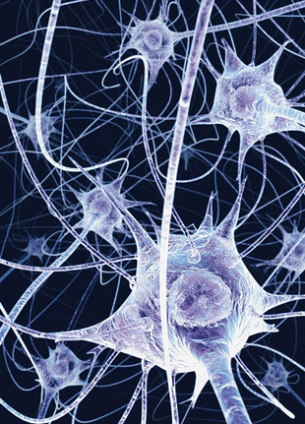
The Importance of Fat in the Body
The human brain is 60% fat. Fat maintains the integrity of neuron connections, allowing communication within the brain.
Many fats are necessary for normal reproduction and growth.
Fats are needed for absorption of vitamin A, D, E, and K.

Slide 5
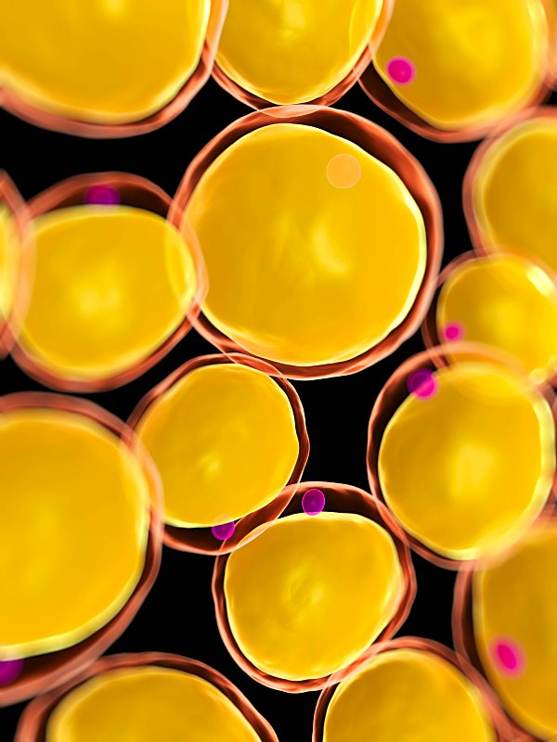
The Importance of Fat in the Body
Certain fats (especially omega-3) play a major role in reducing inflammation.
Fats slow the release of sugar in the bloodstream.
Fats play a role in the production of serotonin (a hormone necessary for a positive, balanced mood).

Slide 6
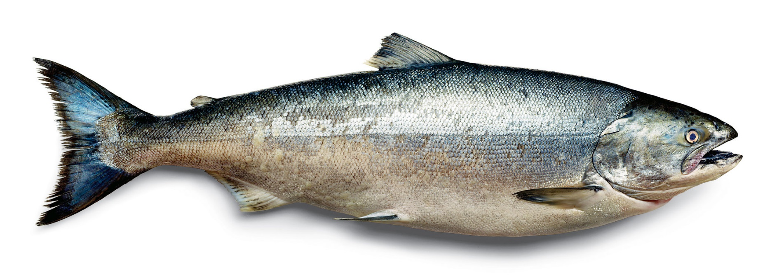
Essential Fatty Acids
There are two Essential Fatty Acids (EFAs) that cannot be manufactured by your own body: Omega-3 and Omega-6. They have to be obtained through diet.

Slide 7
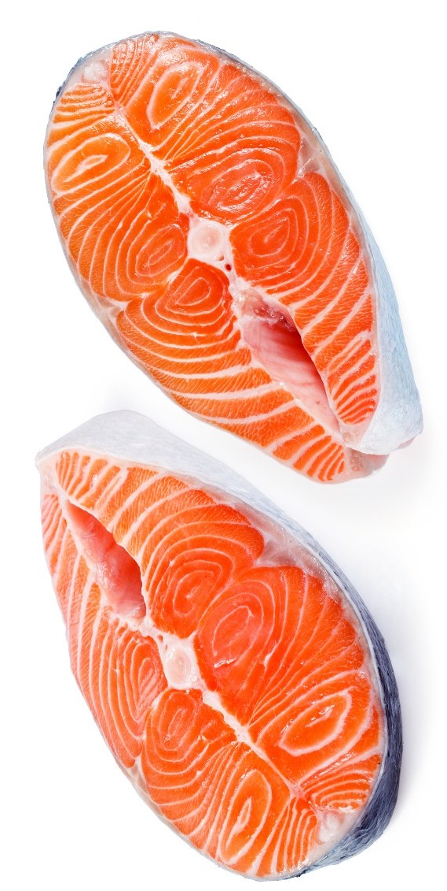
Essential Fatty Acids
Historically, our ancestors ate diets that were abundant in seafood and other sources of omega-3 fatty acids. Omega-6 fatty acids (primarily from nuts and seeds) were consumed as well, but in much lower quantities than most Americans eat today. The ratio of omega-3 to omega-6 was approximately 1:1. Today, the ratio is closer to 1:20, with far too little omega-3 in the diet.

Slide 8
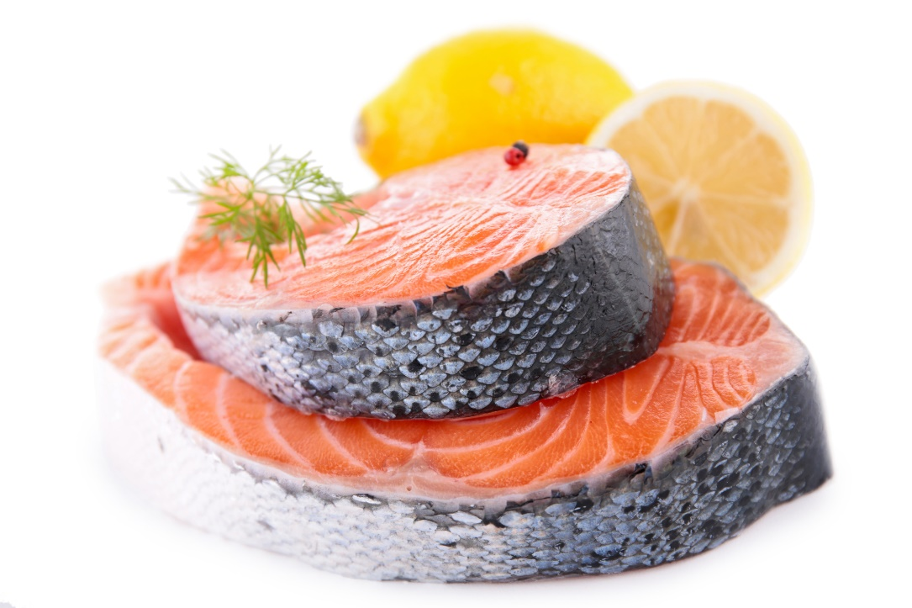
Omega-3 Fatty Acids
Omega-3 fatty acids are a powerful anti-inflammatory that provide incredible healing benefits
to the body. They’re also highly metabolically
active, meaning that they
play an important role in
healthy weight loss (by helping
your cells respond more
effectively to fat burning
hormones).

Slide 9
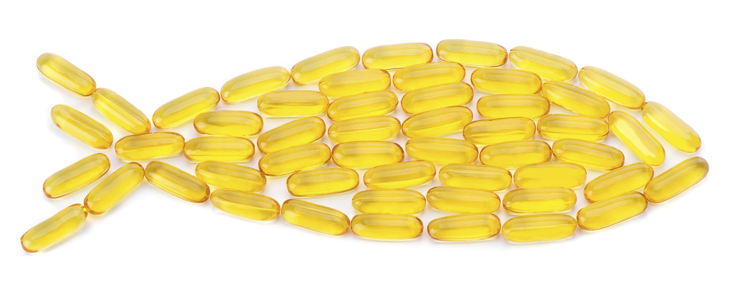
Omega-3 Fatty Acids
Those who fail to get enough omega-3 in the diet will find that they regain their weight easily (and find it harder to lose weight the next time).

Slide 10
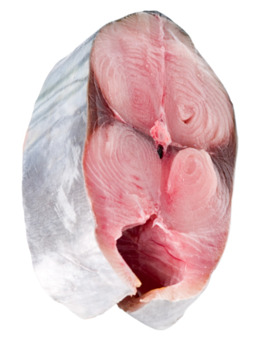
Omega-3 Fatty Acids
EPA (Eicosapentaenoic acid) and DHA (Docosahexaenoic acid) are the two most important forms of omega-3. These fats are found in oily fish (like tuna and salmon). They provide incredible health benefits including better mental health, reduced incidence of disease, and accelerated weight loss.

Slide 11
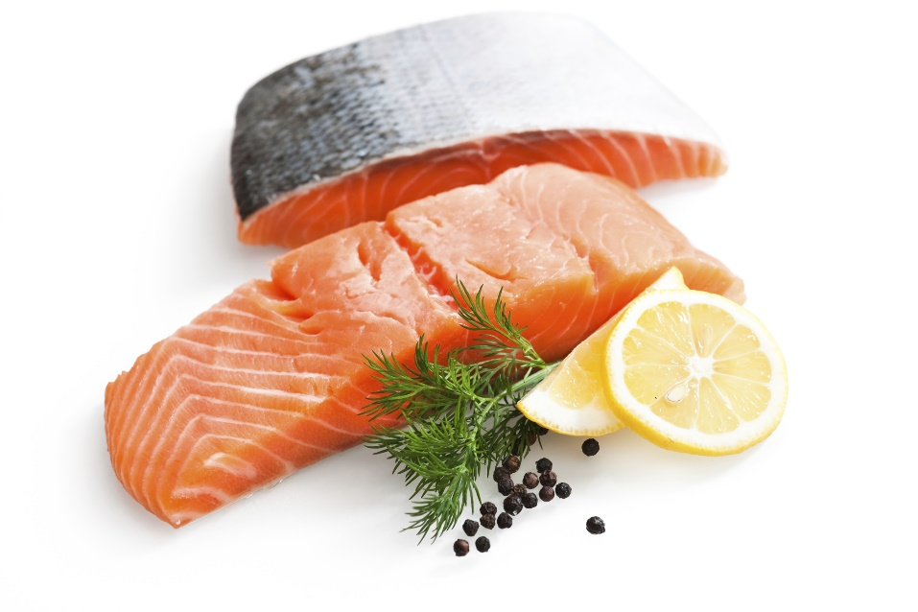
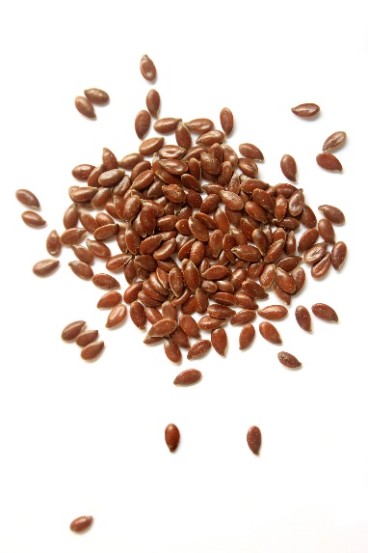
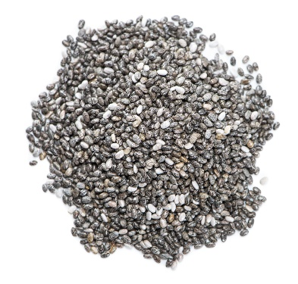
Omega-3 Fatty Acids
Omega-3 is found primarily in oily fish (salmon, tuna, sardines, anchovies, etc.), but also found in some plant-based foods (like flaxseeds, chia seeds, and algae).

Slide 12

Omega-6 Fatty Acids
Omega-6 fatty acids are also necessary for human health, but they’re generally overeaten in the standard American diet. Refined vegetable oils pack in record high levels of omega-6, which when eaten in excess, can have inflammatory effects in the body. Unfortunately, these oils are just about everywhere we turn.

Slide 13

Omega-6 Fatty Acids
Studies show that excessive amounts of omega-6 can promote a range of serious health effects including cardiovascular disease, cancer, and autoimmune disease.

Slide 14

Where You’ll Find Omega-6
Refined vegetable oils (canola, soy, sunflower, safflower, peanut, etc.) are the number one source of omega-6 fatty acids in the American diet, but other foods contain this type of fat as well. Red meat, poultry, margarine, and mayonnaise are all high in omega-6.

Slide 15
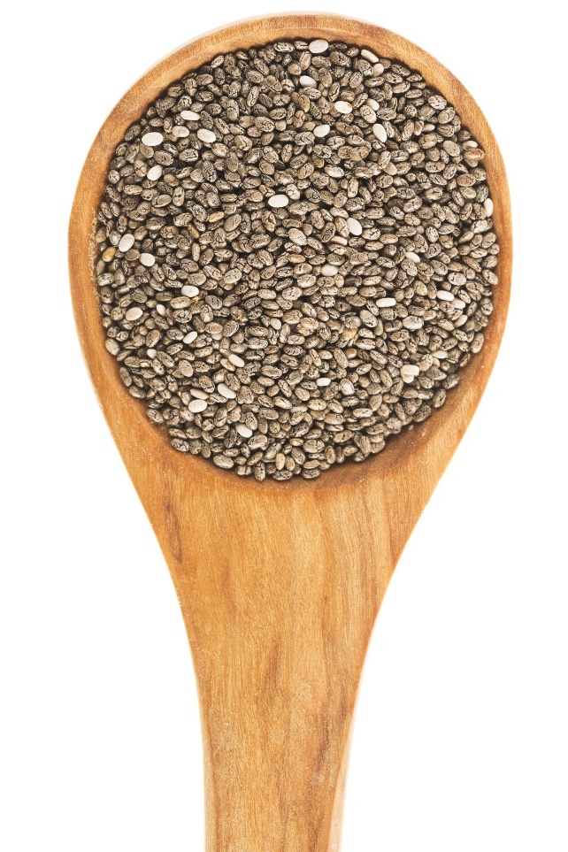
How to Balance Your
Omega Ratios for Better Health
Eat more oily fish (salmon, tuna, anchovies, sardines, etc.).
Eat chia seeds and flaxseeds.
Eat fewer refined vegetable oils (and processed foods made with refined vegetable oils).
Supplement with salmon oil for optimal results.

Slide 16
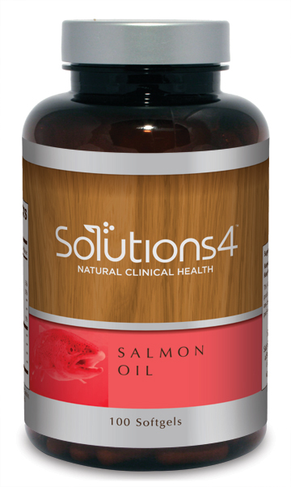
Solutions4 Salmon Oil
If you don’t get enough omega-3 fatty acids through your diet, you can always take a high quality supplement! Your body needs Omega-3 fatty acids to grow healthy, radiant hair, skin, and nails. But they won’t just make you look good – numerous studies show that omega-3 fatty acids keep your body healthy too.

Slide 17
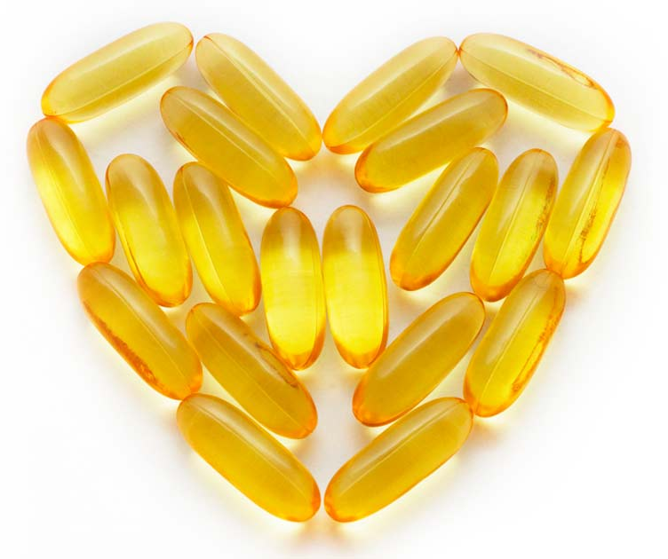
Solutions4 Salmon Oil
Omega-3 can also increase your production of fat burning hormones, making it easier to lose weight. Each capsule is enteric-coated to ensure maximum absorption and no fishy aftertaste.

Slide 18
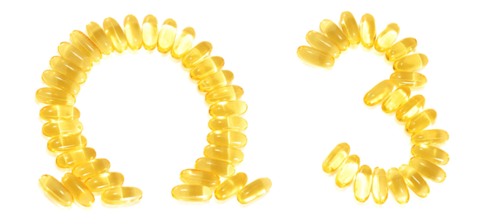
Solutions4 Salmon Oil
Each serving of Salmon Oil contains 180 mg of EPA and 200 mg of DHA, two of the most beneficial types of omega-3 fatty acids.

Slide 19

Solutions4 Salmon Oil
The salmon’s cold water habitat and relatively short lifespan dramatically reduce the exposure to common environmental toxins, resulting in a higher purity oil. Salmon’s dietary intake of protective carotenoids make their oil more resistant to spoilage and rancidity than other fish oils.

Slide 20
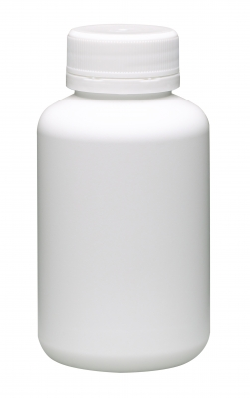

Solutions4 Salmon Oil
Other types of fish oil contain a blend of oils from several different types of fish. These oils have a much less consistent level of healthy omega-3 fatty acids. They can also contain unwanted additives and fillers that reduce the potency of the final product.

Slide 21
Summary:
The body needs essential fatty acids to function at peak performance. Most people don’t eat enough omega-3 and overeat omega-6.
To balance your omega ratios, it’s important to eat plenty of oily fish (salmon, tuna, etc.). Other sources of omega-3 (flaxseeds and chia) can be helpful as well.
When you can’t manage to eat fish several times each week, take the Solutions4 Salmon Oil supplement. The quality and purity of this incredible product can’t be beat!

Slide 22

On Sale This Week:
Solutions4 Salmon Oil

Slide 23

Integrate what you’ve learned today by listening to:
LHL011 —
Balancing Omega
Ratios for Better
Health

