Slide 1
Welcome to
Club Reduce!

Slide 2

Today, we’re going to talk about protein and why it’s so important.
Notes:
There are many ways to lose weight without first creating health and harmony, but these methods will lead you to gain the weight back and return to your original weight (or worse). Time has proven that health and harmony are foundational for long-term weight loss. A healthy body will not be able to hold onto excess weight! This is the key that needs to be stressed in our seminars. This seminar is an introduction to removing toxins and excess fluid from the body in order to create the right environment for weight loss and health.

Slide 3

All of the classes in this series build upon one another.
By attending regularly, you’ll learn the habits of a naturally thin person!

Slide 4

The Importance of Protein
Protein helps to regulate fat burning hormones, rebuilds damaged tissue when it breaks down, boosts your metabolism, and balances your energy levels. It also satisfies your appetite and makes it easier to eat a healthy diet!

Slide 5
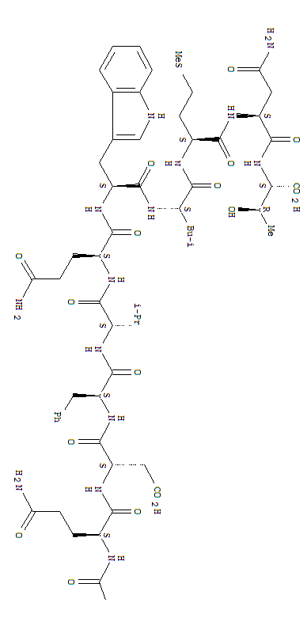
The Importance of Protein
When you eat protein, you stimulate your body’s production of glucagon. Glucagon helps to stabilize your blood sugar levels by mobilizing stored fat for energy. This is why protein can be so helpful when you’re trying to lose weight!

Slide 6

The Importance of Protein
If a meal doesn’t contain enough protein, your body will produce insulin without producing glucagon, making it harder for your body to let go of stored fat.

Slide 7

The Importance of Protein
Women between the ages of 19 and 70 need approximately 46-53 grams of protein per day.
Men in this same age range
need about 56-63 grams of
protein per day.

Slide 8
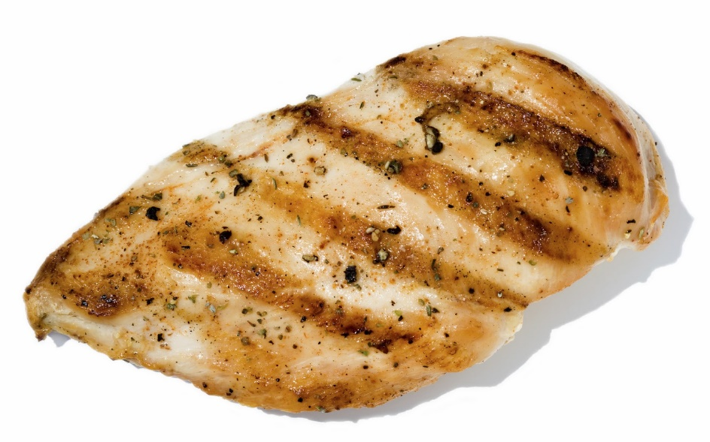

The Importance of Protein
To understand what this means, visualize a 3 oz. piece of meat (a portion that’s about the size of a deck of cards). This contains about 21 grams of protein.

Slide 9
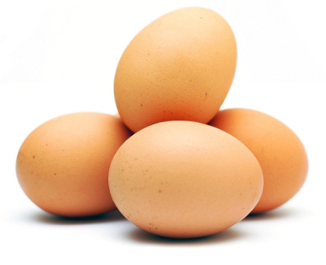
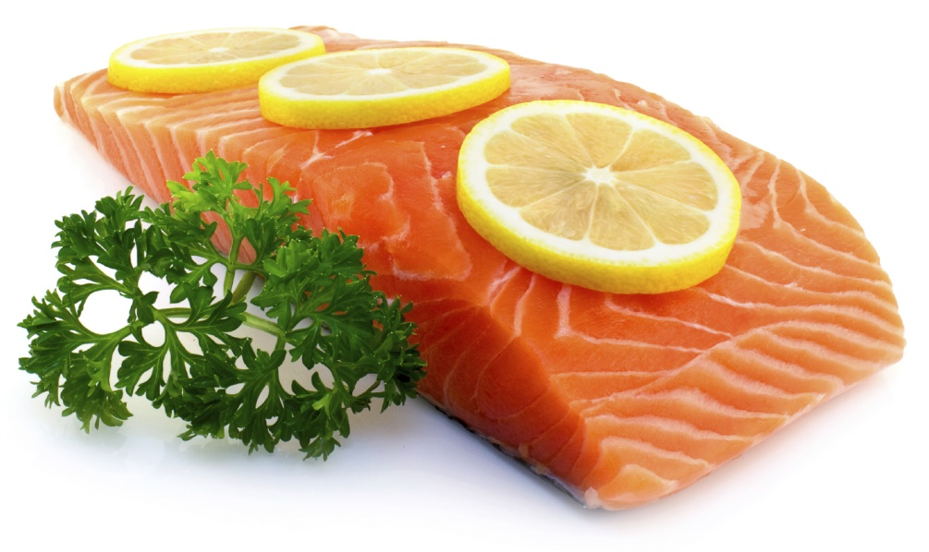
The Importance of Protein
Though protein matters, it’s not enough to just eat any type of protein. Quality matters as well.

Slide 10
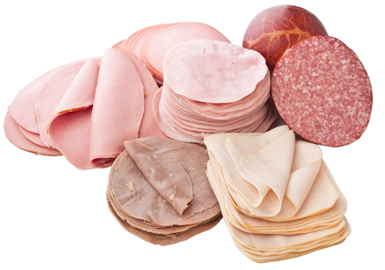
Unhealthy Sources of Protein
Processed meat
Lunch meat
(or sliced deli
meat)
Conventional
red meat

Slide 11

Good Sources of Protein
Conventional chicken
Farm-raised fish
Pasture-raised pork
Grass-fed beef
Conventional nuts
and seeds

Slide 12
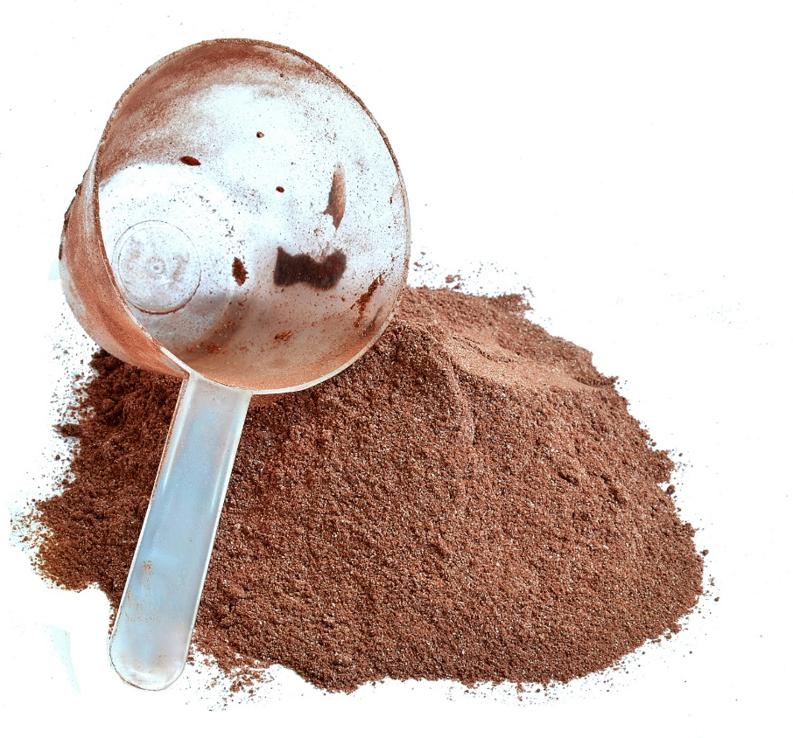
Better Sources of Protein
Organic, grass-fed whey protein
Organic, free-range chicken
Wild-caught fish
Other types of wild-caught
seafood
Organic, farm-fresh
eggs
Raw, organic nuts and
seeds

Slide 13
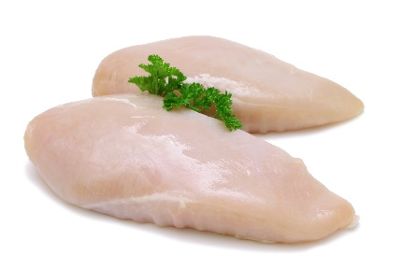
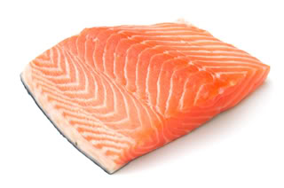
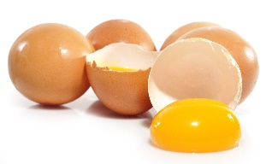
Where Do You Go From Here?
Make sure that you get adequate protein for breakfast, lunch, and dinner. Spreading out your intake is better than eating a large serving with one meal. If you don’t have time to prepare protein several times each day, you can use the Solutions4 Nutritional Shake instead!
+
+

Slide 14
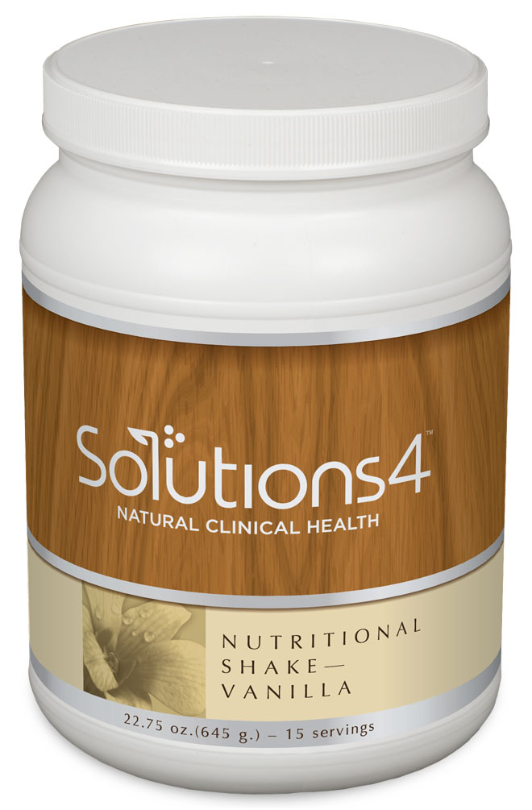
The Nutritional Shake
Each serving of this incredible shake provides 20 grams of protein! The New Zealand whey protein (from grass-fed cows) is different from anything else on the market. This protein has been shown to support fat-burning, improve insulin sensitivity, help regulate the appetite, and so much more!

Slide 15

The Nutritional Shake
The whey protein in the shake is made by pushing the liquid portion of grass-fed, organic cow’s milk through a filter. The material left behind is dried and forms whey protein concentrate. Further cold processing creates whey isolate. As whey concentrate is purified into whey isolate, some components can lose their biologic activity if harsh chemicals or heat are used.

Slide 16
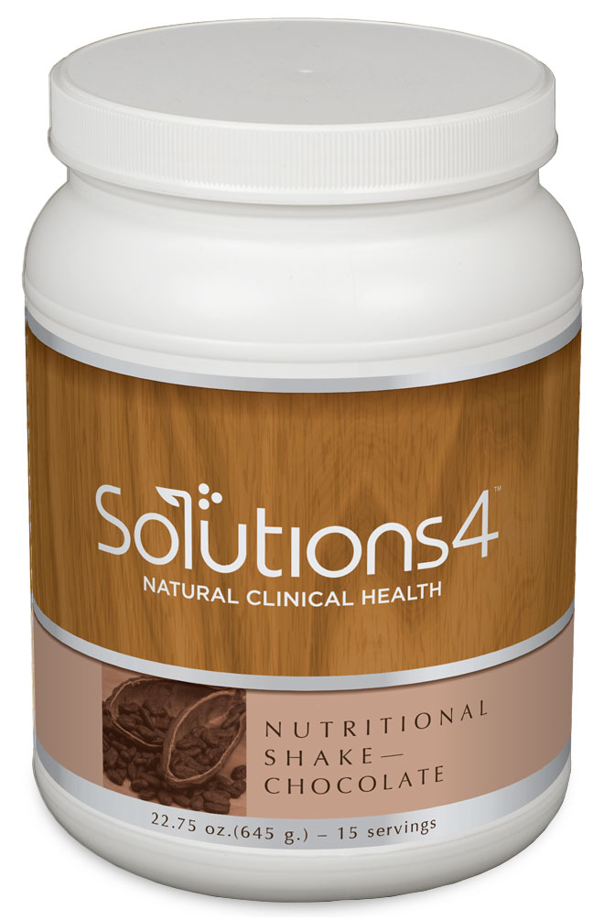
The Nutritional Shake
We avoid these processing methods and instead use a micro-filtration technique that, while more expensive, yields a whey isolate with more bioactive peptides. This preserves the integrity of the whey and ensures bioavailability.

Slide 17
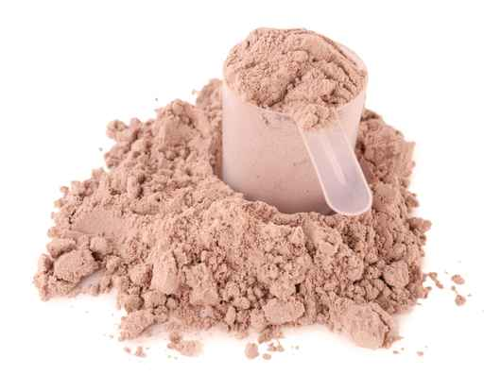
The Nutritional Shake
The Solutions4 Nutritional Shake contains a blend of both whey isolate and whey concentrate. Whey concentrate retains the
highest portion of biologically
active peptides (which are
released more slowly in
the digestive system),
while isolate provides a
more potent source of
amino acids (which enter
the blood stream rapidly).

Slide 18
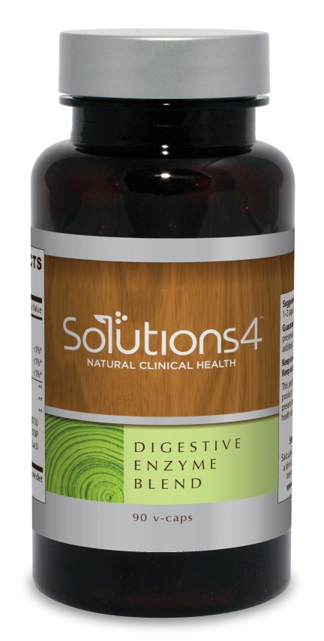
Digestive Enzyme Blend
Though it’s best to choose lighter proteins like chicken and fish, you’ll probably occasionally decide to eat something heavy (like a steak). When you do, you can take the Digestive Enzyme Blend to facilitate digestion so that you don’t experience uncomfortable digestive symptoms.

Slide 19
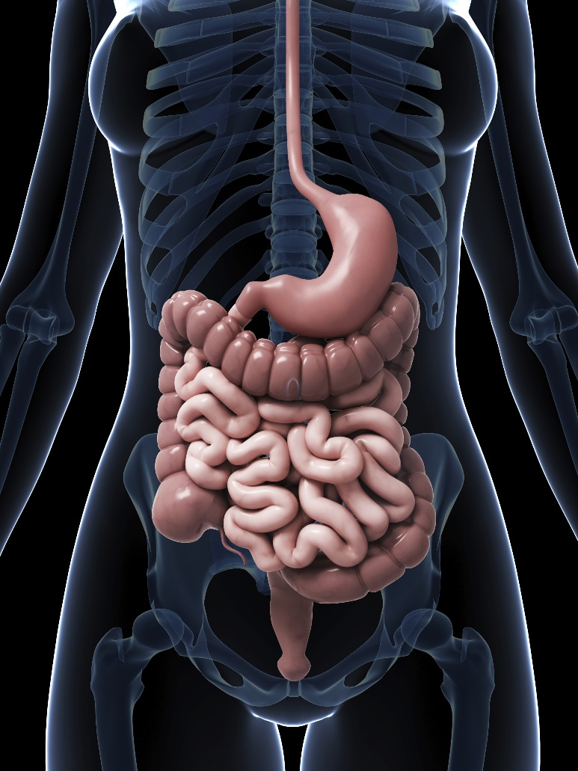
Digestive Enzyme Blend
This incredible blend of digestive enzymes contains protease — an enzyme that helps your body break down protein so that you can absorb 100% of the nutrients in your food. The next time you eat a steak, you’ll be able to absorb lots of healthy amino acids instead of feeling uncomfortable for the rest of the day.

Slide 20

Appetite Appeaser
If you’re used to eating a diet that’s heavy in carbs, you might feel a little different when you start replacing your morning bagel with a protein-rich Meal Replacement Shake. Though your body will quickly adjust to your healthier choices, Appetite Appeaser can help you make the transition more smoothly.

Slide 21
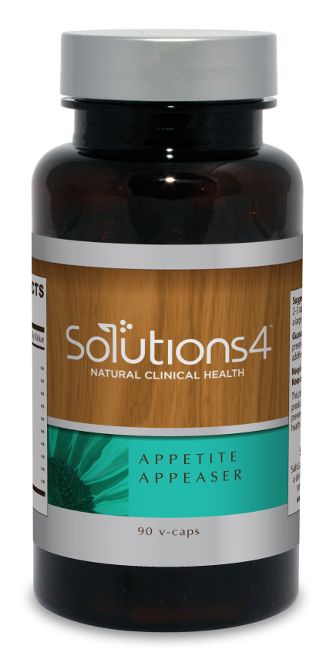
Appetite Appeaser
This supplement helps to satiate the appetite and help you feel full, even when you’re giving up the “comfort foods” that normally satisfy your appetite. This can make it easier than ever to switch over to a healthier and more balanced diet!

Slide 22
Summary:
Protein is essential for optimal health and weight loss. Each day, women need 46-53 grams and men need 56-63 grams.
The quality of your protein matters. Some of the best sources include grass-fed whey protein, wild-caught fish, and organic, free-range chicken.
If you don’t have time to grill a chicken breast, use the Nutritional Shake! The whey protein in this shake can help to activate your fat burning hormones and keep you feeling full throughout the day.
You can also use the Digestive Enzymes and Appetite Appeaser as you start to incorporate healthy sources of protein into your diet!

Slide 23
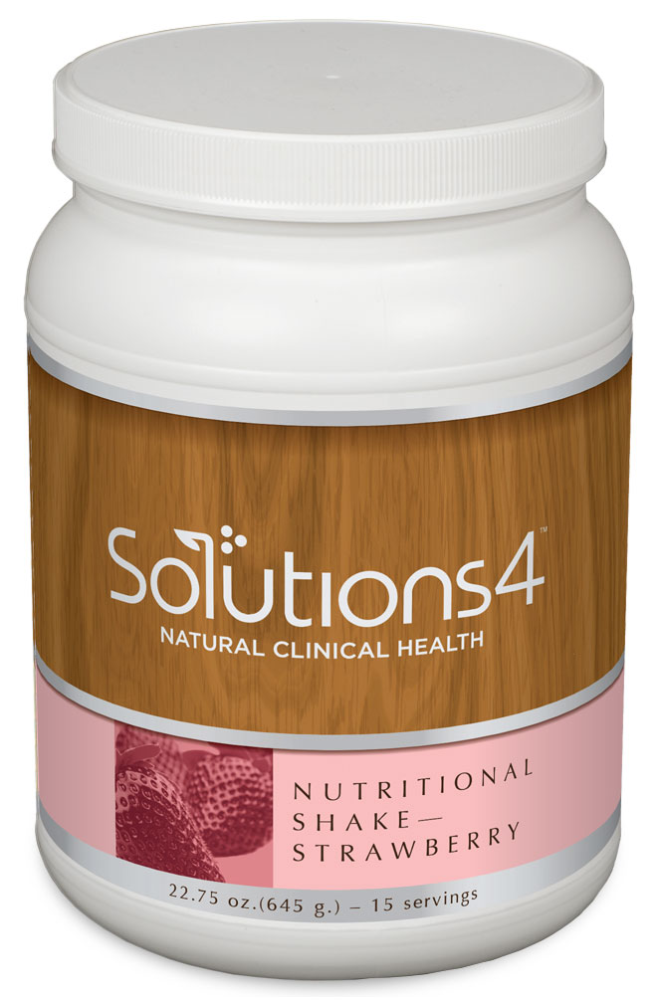

On Sale This Week:
The Nutritional Shake

Slide 24

Integrate what you’ve learned today by listening to:
LHL012 —
Protein: Balancing
Your Intake

