Slide 1
Welcome to
Club Reduce!

Slide 2

Today, we’re going to talk about why sleep is so important for optimal health and weight loss.
Notes:
There are many ways to lose weight without first creating health and harmony, but these methods will lead you to gain the weight back and return to your original weight (or worse). Time has proven that health and harmony are foundational for long-term weight loss. A healthy body will not be able to hold onto excess weight! This is the key that needs to be stressed in our seminars. This seminar is an introduction to removing toxins and excess fluid from the body in order to create the right environment for weight loss and health.

Slide 3

All of the classes in this series build upon one another.
By attending regularly, you’ll learn the habits of a naturally thin person!

Slide 4

The Importance of Sleep
Insufficient sleep is a public health epidemic. Before the invention of the light bulb, people slept an average of 10 hours each night. Today, most Americans average a mere 6.9 hours each night!

Slide 5

The Importance of Sleep
Getting enough sleep is essential for good health and for weight loss. Most people need at least 7-9 hours each night, beginning by at least 10 pm.

Slide 6

The Importance of Sleep
If you get in bed by 10 pm, your body will be able to get into REM
sleep – the deep sleep that
your body needs – from 12
to 2 am. During this time,
your body increases its
production of fat-burning
hormones, which helps with
weight loss. You’ll want to
always be asleep at this time
of night.

Slide 7

The Importance of Sleep
Unfortunately, missing out on quality sleep doesn’t just suppress your production of fat-burning hormones. It also causes your body to ramp up its production of the hunger-stimulating hormone ghrelin and reduce its production of leptin (a hormone involved in satiety).

Slide 8
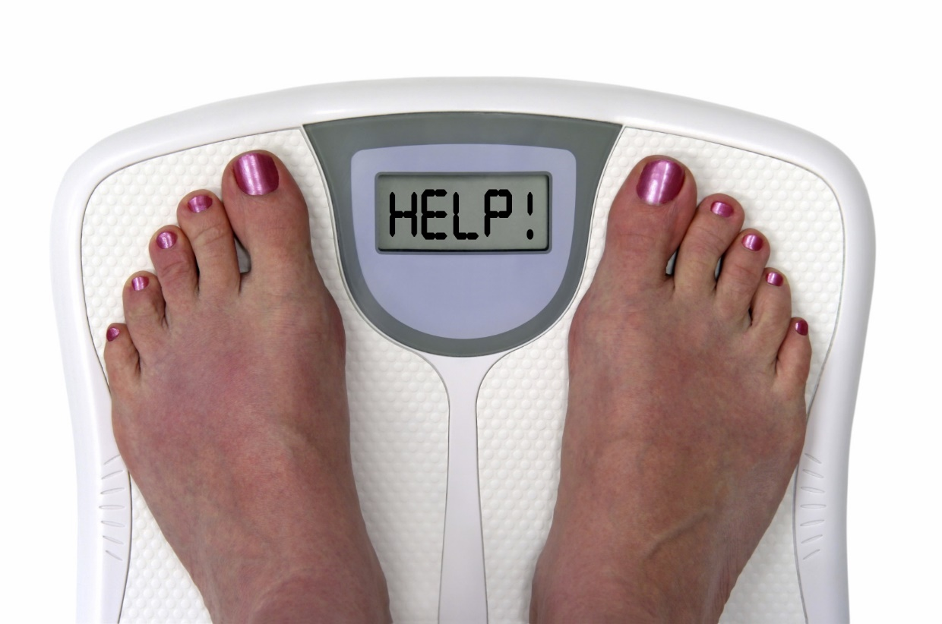
The Importance of Sleep
For these reasons, sleep deprivation makes it very difficult to lose weight.

Slide 9

Ways to Get Better Sleep
Avoid large meals before bedtime.

Slide 10

Ways to Get Better Sleep
Go to bed at the same time each night.

Slide 11

Ways to Get Better Sleep
Get enough daytime light exposure.

Slide 12

Ways to Get Better Sleep
Establish a bedtime routine that helps you wind down.

Slide 13

Ways to Get Better Sleep
Exercise earlier in the day to reduce restlessness.

Slide 14

Ways to Get Better Sleep
Avoid overuse of electronic devices after dark.

Slide 15

Ways to Get Better Sleep
Dim the lights an hour before bed.

Slide 16

Ways to Get Better Sleep
Avoid caffeine, nicotine, and other chemicals that can interfere with sleep.

Slide 17

Ways to Get Better Sleep
Keep your bedroom temperature comfortably cool.

Slide 18

Ways to Get Better Sleep
Use the Luxana Light Bed! Major health organizations recommend exposing yourself to bright light during the day in order to boost your ability to sleep at night. This, in turn, can help you lose weight!

Slide 19

Ways to Get Better Sleep
Use Self-Mastery Technology (SMT)! If you’re struggling to get to bed on time (or to stay asleep throughout the night), SMT can help you train your brain to sleep better. Many sessions are designed specifically to help with insomnia.

Slide 20

Ways to Get Better Sleep
Try the Solutions4 Liquid Calcium! Three capsules per day provide 100% of the US recommended daily allowance (RDA) of calcium, offering the balance that your body needs to lose weight while maintaining strong bone structure. When taken before bed, calcium can also help to ensure deep and restful sleep.

Slide 21
Summary:
Sleep deprivation makes it very difficult to lose weight.
Most people need 7-9 hours of sleep each night, beginning by at least 10 pm. If you’re in bed by 10, your body will increase its production of fat-burning hormones between 12 and 2 am.
Sleep deprivation can also make you hungrier.
You can use lifestyle strategies to improve the quality of your sleep (avoiding large meals before bedtime, etc.).
You can also use Club Reduce treatments and supplements to sleep better!

Slide 22

On Sale This Week:
Solutions4 Liquid Calcium

Slide 23

Integrate what you’ve learned today by listening to:
LHL013 —
Sleep More to Lose
More Weight

