Slide 1
Welcome to
Club Reduce!

Slide 2

Today, we’re going to talk about why vitamin D is so important for your health.
Notes:
There are many ways to lose weight without first creating health and harmony, but these methods will lead you to gain the weight back and return to your original weight (or worse). Time has proven that health and harmony are foundational for long-term weight loss. A healthy body will not be able to hold onto excess weight! This is the key that needs to be stressed in our seminars. This seminar is an introduction to removing toxins and excess fluid from the body in order to create the right environment for weight loss and health.

Slide 3

All of the classes in this series build upon one another.
By attending regularly, you’ll learn the habits of a naturally thin person!

Slide 4

The Importance of Vitamin D
Your body is pretty incredible. It has the power to synthesize vitamin D using nothing but your body’s own natural resources and sunlight! Unfortunately, most people don’t spend enough time outdoors to take advantage of the benefits that the body can naturally offer.

Slide 5


The Importance of Vitamin D
Vitamin D is also present in certain foods like tuna, salmon, sardines, egg yolks, mushrooms, and liver. Your body needs a combination of sunlight exposure and optimal nutrition to achieve a healthy balance of vitamin D in the body.

Slide 6
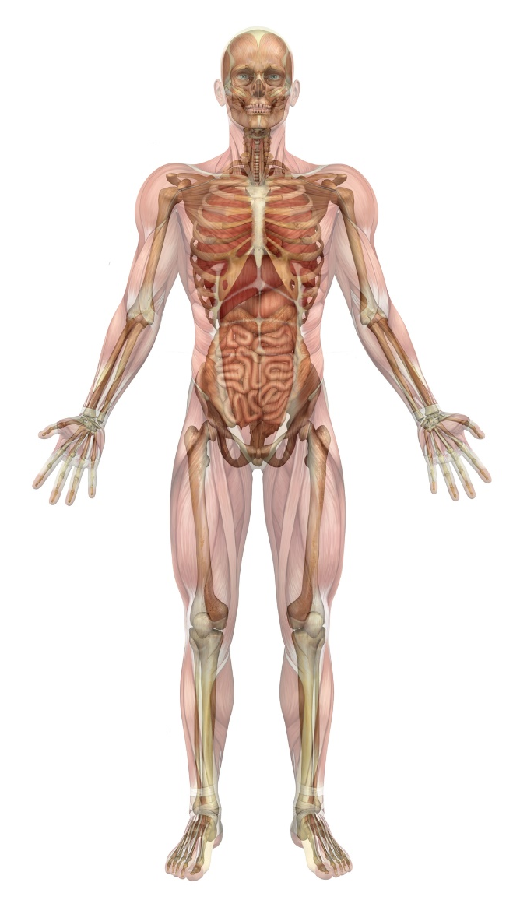
The Importance of Vitamin D
Vitamin D is necessary for calcium absorption in the gut, for bone growth, and for healthy immune function. It plays an integral role in thousands of intricate bodily processes. Nearly every tissue and cell in the body has receptors for vitamin D.

Slide 7

The Importance of Vitamin D
Unless your body maintains optimal vitamin D levels, you’ll be susceptible to a wide range of disorders including cardiovascular disease and diabetes. For example, a vitamin D deficiency makes you 91% more likely to develop
insulin resistance (pre-diabetes)
and more than doubles your
risk for full-blown
diabetes.

Slide 8

The Importance of Vitamin D
Vitamin D deficiencies can also make you age prematurely and make it easier to gain weight!

Slide 9

The Importance of Vitamin D
Unfortunately, vitamin D deficiencies are widespread around the world. Global studies estimate that up to one billion people are deficient in this important nutrient. In the United States, a full 64% of the population is deficient!

Slide 10

The Importance of Vitamin D
Most people with a vitamin D deficiency aren’t even aware of their condition. Many people mistakenly believe that their health problems and weight gain are just an inevitable part of the aging process.

Slide 11

The Importance of Vitamin D
Many people believe that they aren’t at risk for a vitamin D deficiency because they eat or drink foods fortified with vitamin D (like milk). However, these people fail to realize that fortified foods contain very little of the nutrient in question. You can get far more vitamin D from sunlight than a glass of milk!

Slide 12

The Importance of Vitamin D
Fortunately, rectifying the situation is as easy and inexpensive as supplementing with vitamin D
or exposing yourself to sunlight
more often throughout the day. Though you don’t want to
expose yourself to the point
of sunburn, you do want to
spend some time outdoors
every day.

Slide 13

The Importance of Vitamin D
In the summer, spending
about 15 minutes outdoors
in the middle of the day
is enough for your body to
produce the vitamin D it
needs. Of course, this
varies based on several
factors: the pigmentation
of your skin, the altitude,
the weather, etc.

Slide 14

The Importance of Vitamin D
In the winter, getting enough vitamin D is a little trickier because you can’t get it from sunlight alone. If you live north of Los Angeles, you really
won’t be able to get much
vitamin D from sunlight
between November and March. During these months, most
people rely upon vitamin D
derived from food and
supplements.

Slide 15

Vitamin D Supplementation
We have an extremely high quality vitamin D supplement available here in our clinic. When you use this incredible supplement, you’ll have no trouble maintaining optimal vitamin D levels year-round!

Slide 16
Summary:
Your body produces vitamin D when exposed to sunlight. It can also derive vitamin D from certain foods and supplements.
Vitamin D helps to protect your body from chronic disease, weight gain, and premature aging.
In the United States, 64% of the population is deficient in this important nutrient.
It’s easier to get enough vitamin D in the summer. In the winter, the sun’s rays aren’t as powerful.
To boost your vitamin D levels, consider taking the Solutions4 supplement available through our office!

Slide 17

On Sale This Week: Vitamin D

Slide 18

Integrate what you’ve learned today by listening to:
LHL014 —
The Importance of
Vitamin D

