Slide 1
Welcome to
Club Reduce!

Slide 2

Today, we’re going to talk about the lymphatic system.
Notes:
There are many ways to lose weight without first creating health and harmony, but these methods will lead you to gain the weight back and return to your original weight (or worse). Time has proven that health and harmony are foundational for long-term weight loss. A healthy body will not be able to hold onto excess weight! This is the key that needs to be stressed in our seminars. This seminar is an introduction to removing toxins and excess fluid from the body in order to create the right environment for weight loss and health.

Slide 3

All of the classes in this series build upon one another.
By attending regularly, you’ll learn the habits of a naturally thin person!

Slide 4
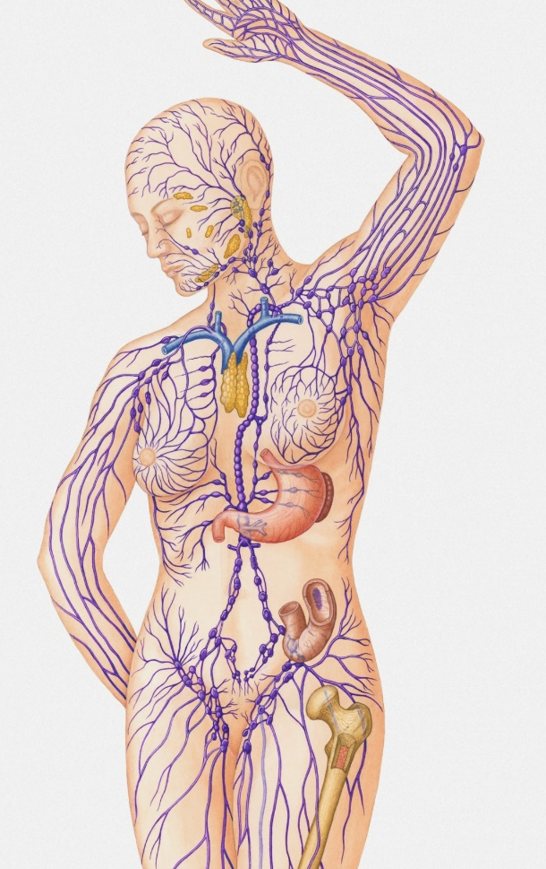
The Lymphatic System
Unlike the circulatory system, the lymphatic system doesn’t have a heart to pump lymph fluid through the lymphatic vessels. The lymphatic system depends upon the movement of the body to function the way it should.

Slide 5

The Lymphatic System
Unfortunately, many people don’t move enough – or move in the right ways – to stimulate healthy lymphatic flow. In this lesson, we’ll teach you all
about your lymphatic
system and what
you can do to
keep it
functioning at
peak
performance!

Slide 6
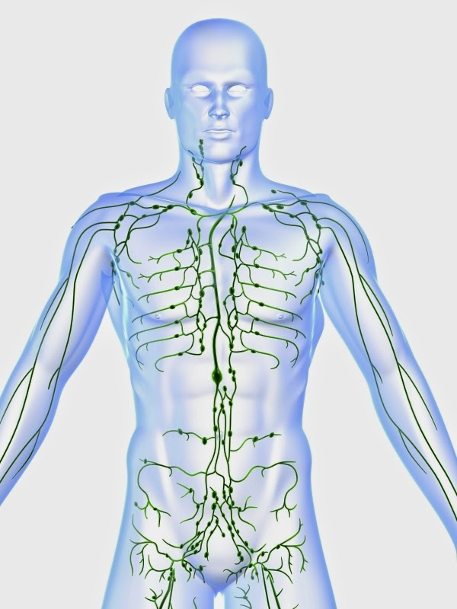
The Lymphatic System
The lymphatic system is made up of a series of branching, tree-like tubes that run throughout your body. The lymphatic system is designed
to circulate lymph – a colorless fluid containing white blood cells and lymphocytes – and thus rid the body of toxins, waste products, and other unwanted materials.

Slide 7
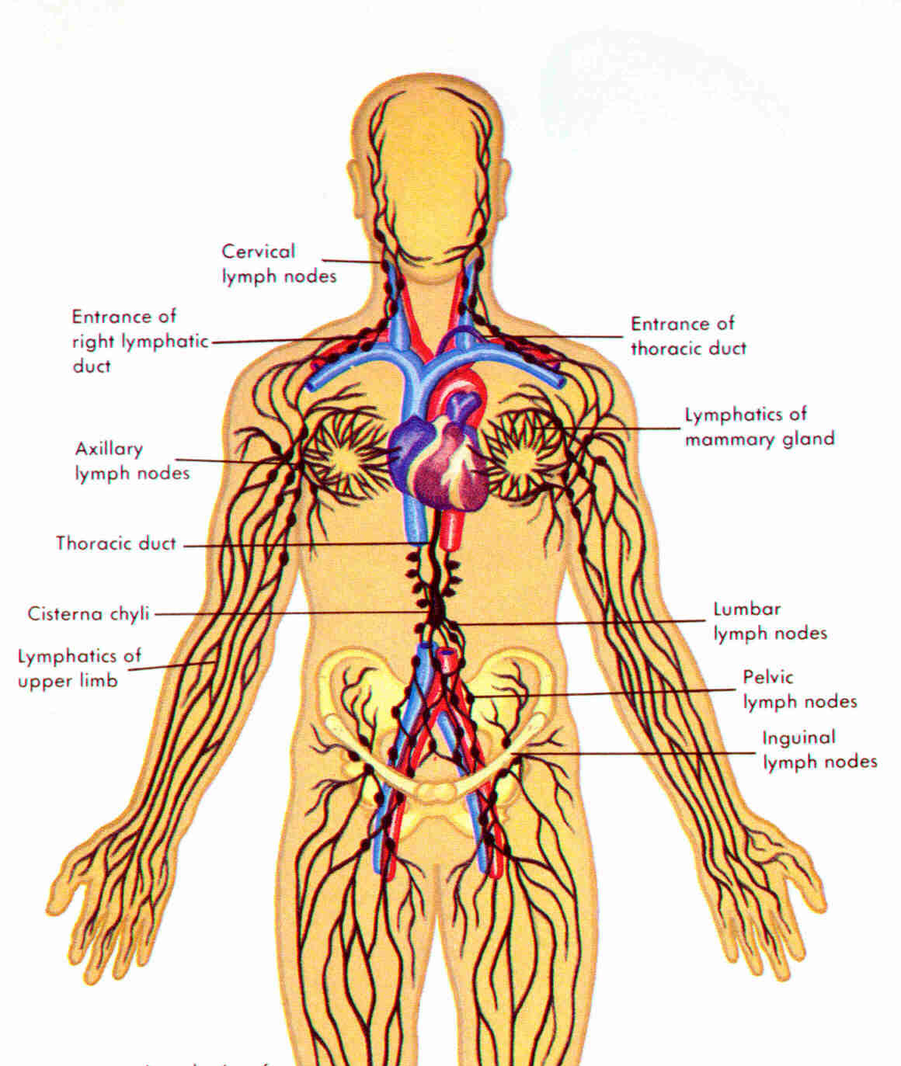
The Lymphatic System
Beyond the branching, tree-like vessels that make up the lymphatic system, there are also several organs that also play an important role…

Slide 8
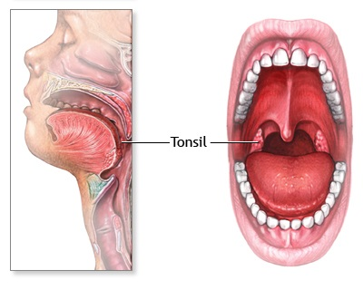
The Lymphatic System
The tonsils are a large cluster of lymphatic cells found in the back of your throat. The tonsils are your body’s first line of defense against harmful bacteria and viruses.

Slide 9
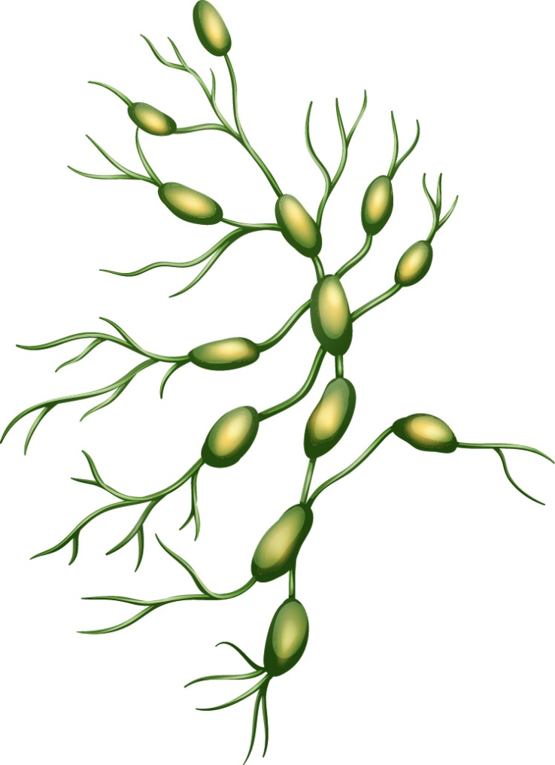
The Lymphatic System
The lymph nodes are small, bean-shaped structures that lie at the junctions between lymphatic vessels. They’re designed to filter the lymph that flows through them, thus fighting infection and disease.

Slide 10
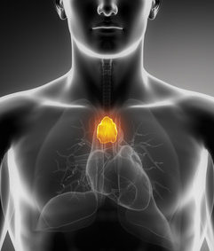
The Lymphatic System
The thymus is an organ that lies directly above the heart. It produces T-cells that help destroy infected or cancerous cells. It’s most active during childhood and early adolescence.

Slide 11
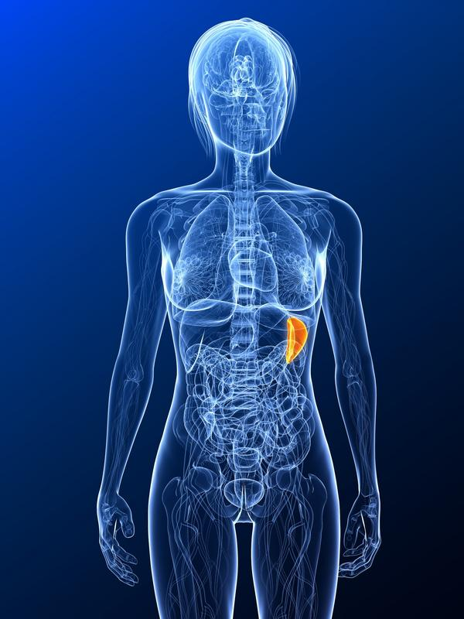
The Lymphatic System
The spleen is the largest organ in the lymphatic system. It’s similar in structure to a large lymph node. It plays an important role in removing old blood cells from circulation, producing important antibodies, and storing red blood cells/lymphocytes.

Slide 12
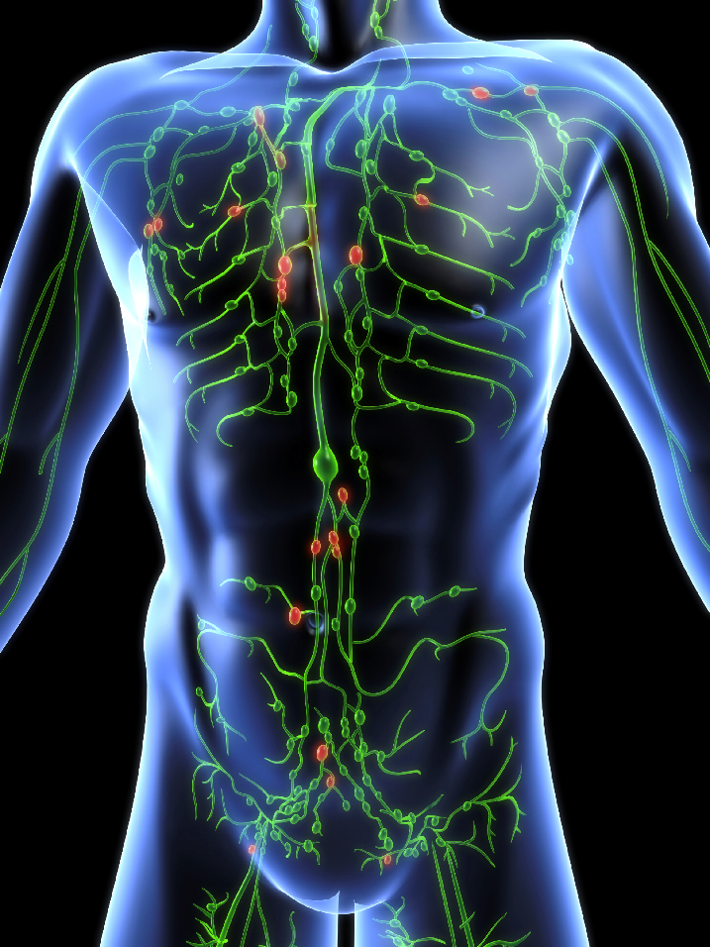
The Lymphatic System
Your lymphatic system is really pretty incredible. It plays an essential role in removing toxins from your body and protecting you from disease. However, it can only do its job if you stimulate healthy lymphatic flow on a daily basis.

Slide 13

Stimulating the Lymphatic System
Rebound exercises, deep breathing, and other forms of physical activity can all help to keep lymph fluid moving.

Slide 14
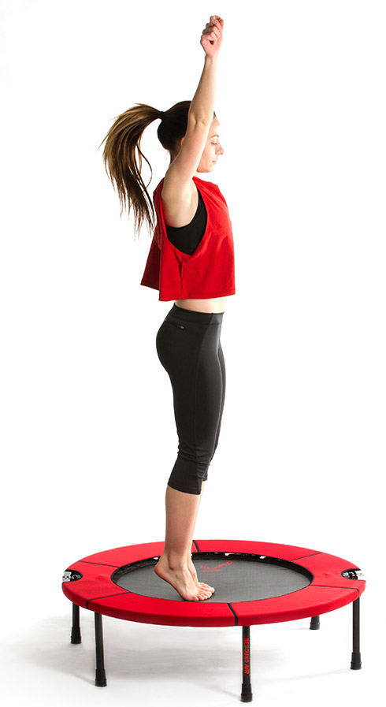
Stimulating the Lymphatic System
Rebound exercise is something you can do with a rebounder (a small trampoline) or an exercise ball. The vertical movement helps to move lymph fluid though lymphatic vessels.

Slide 15
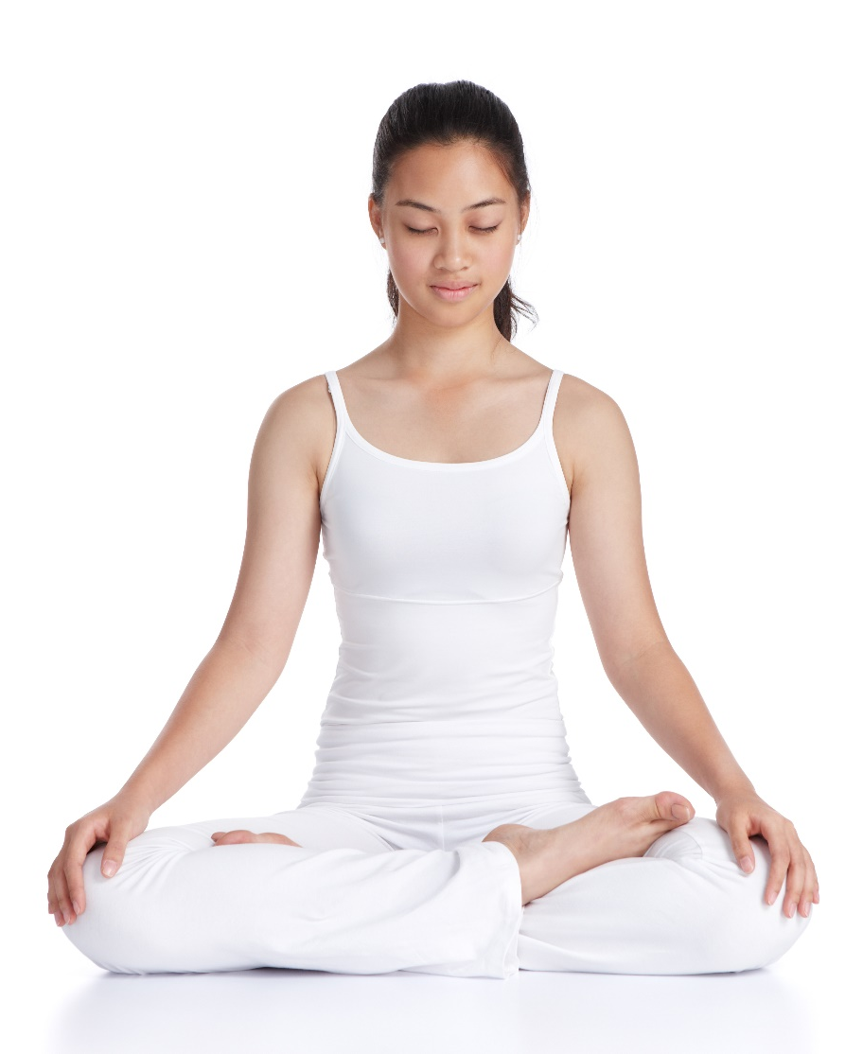
Stimulating the Lymphatic System
Deep breathing can also help to stimulate lymphatic flow. Pranayama is a type of yoga centered around deep, controlled breathing. In Sanskrit, “prana” means
“the extension of breath/life force,” while “ayama”
means “to extend or
draw out.”

Slide 16
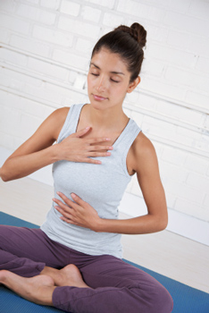
Stimulating the Lymphatic System
1. Place one hand on the chest.
2. Place the other hand on the mid-abdomen.
3. Breathe deeply.
4. Try to keep the hand on the chest still while making the hand on the abdomen rise and fall.

Slide 17
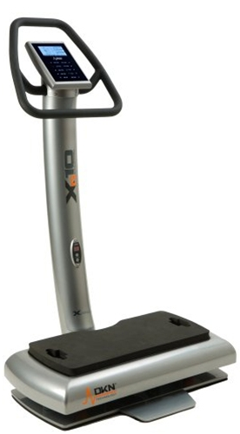
Stimulating the Lymphatic System
Whole Body Vibration helps to stimulate your lymphatic system to move toxins, fat, and other waste products out of your cells so that they can’t be reabsorbed. It also helps to reduce the appearance of cellulite, increases muscle strength, boosts the metabolism, and more!

Slide 18
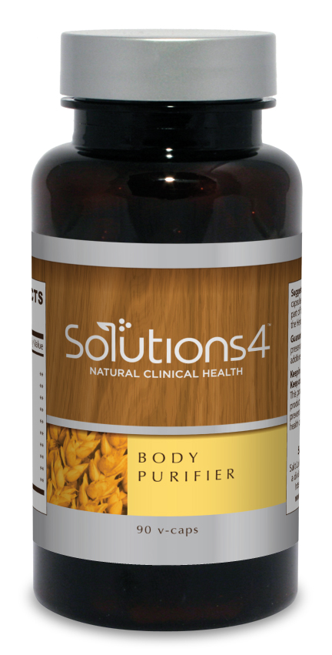
Stimulating the Lymphatic System
The Body Purifier is a supplement designed to cleanse the bloodstream and lymphatic system. It can be used to facilitate healthy detoxification or strengthen the immune system when it becomes compromised.

Slide 19
Summary:
The lymphatic system depends upon the movement of the body to function the way it should. Many people don’t move enough – or move in the right ways – to stimulate healthy lymphatic flow.
The lymphatic system is made up of a series of branching, tree-like tubes that run throughout your body. It also includes the tonsils, lymph nodes, thymus, and spleen.
You can stimulate the lymphatic system through rebound exercise, deep breathing, or other physical activities.
You can also boost the lymphatic system’s health through Whole Body Vibration or the Body Purifier!

Slide 20

On Sale This Week: Body Purifier

Slide 21
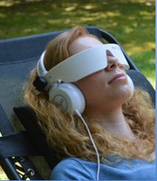
Integrate what you’ve learned today by listening to:
LHL015 —
Cleansing Your
Lymphatic System

