Slide 1
Welcome to
Club Reduce!

Slide 2

Today, we’re going to talk about a
few little-
known secrets for longevity.
Notes:
There are many ways to lose weight without first creating health and harmony, but these methods will lead you to gain the weight back and return to your original weight (or worse). Time has proven that health and harmony are foundational for long-term weight loss. A healthy body will not be able to hold onto excess weight! This is the key that needs to be stressed in our seminars. This seminar is an introduction to removing toxins and excess fluid from the body in order to create the right environment for weight loss and health.

Slide 3

All of the classes in this series build upon one another.
By attending regularly, you’ll learn the habits of a naturally thin person!

Slide 4

Life Expectancy in the 21st Century
Since the 1970s, the American lifespan has been steadily falling behind that of other developed countries.
We now rank 26th for life expectancy, right behind Slovenia and about on par with the Czech Republic.

Slide 5
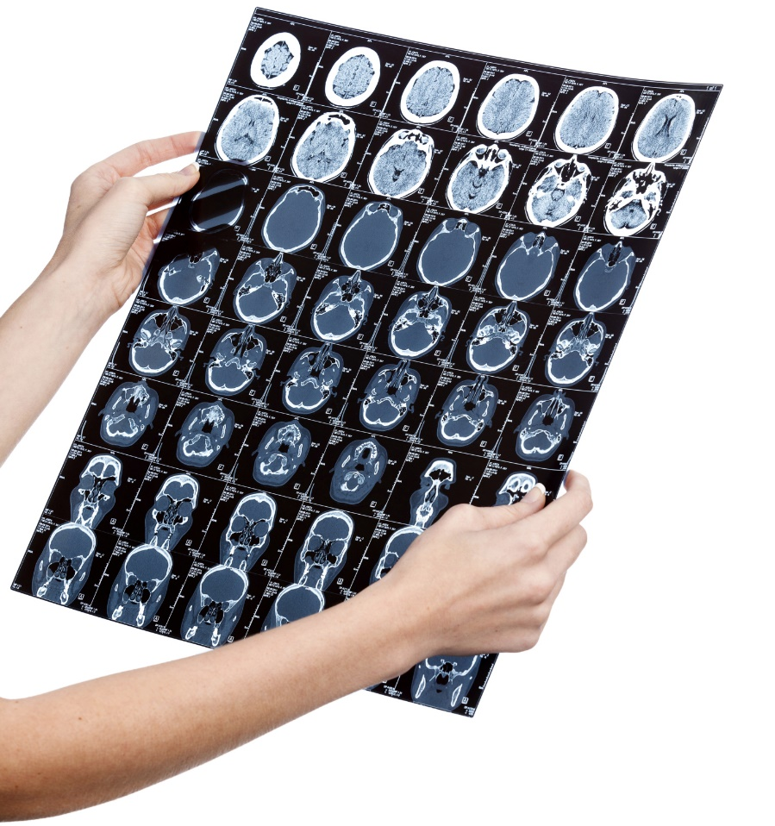
Life Expectancy in the 21st Century
Though Americans spend billions of dollars on healthcare, we’re not getting much back in return. We may have access to fancy medical technologies – MRI machines, for example – but we’re not using those resources to extend our lives.

Slide 6

So What’s Going On?

Slide 7
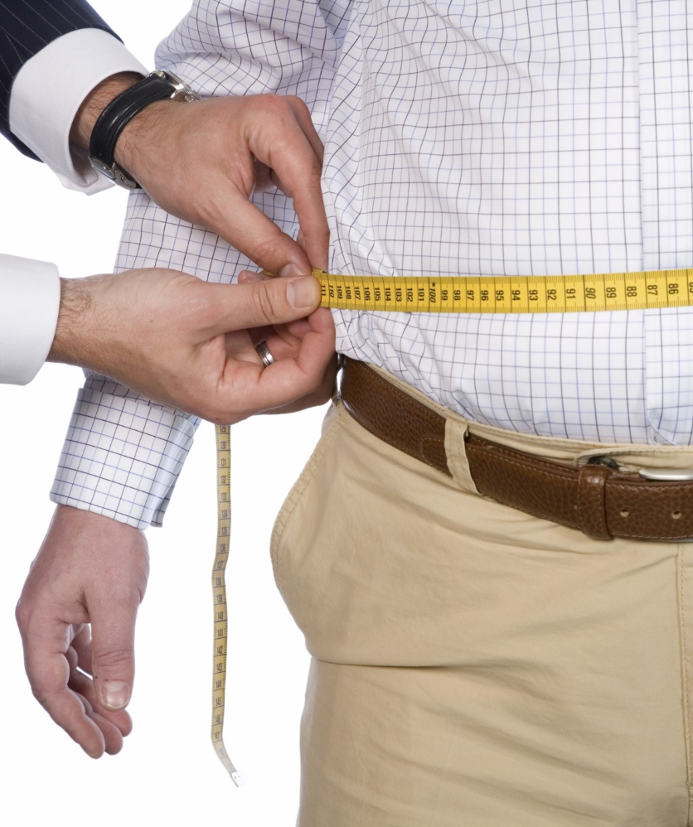
Life Expectancy in the 21st Century
For starters, the U.S. is home to the highest number of overweight and obese people in the world.
Nearly 40% of the population is obese, compared with an average of about 20% in other countries. Americans eat more and exercise less than citizens in any other country.

Slide 8
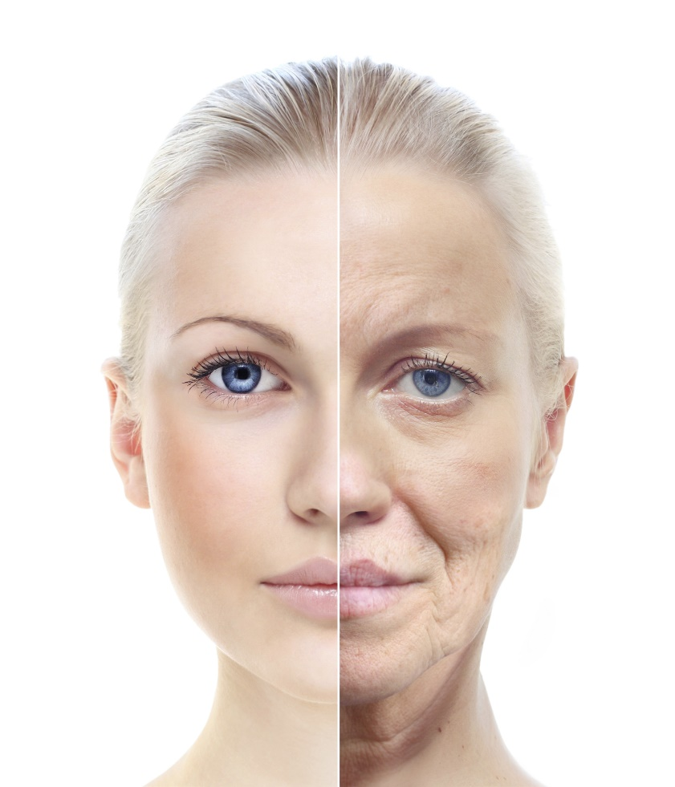
Life Expectancy in the 21st Century
Poor diet and lifestyle choices don’t just shorten our lives – they also affect our appearance. When we eat processed foods, we deplete our skin of the nutrients needed to stay young and healthy.

Slide 9

Life Expectancy in the 21st Century
When we don’t exercise, we miss out on the detoxifying, cleansing benefits that come when we sweat. On top of all this, most people are using toxic skincare products that contribute to dull and saggy skin.

Slide 10

What Can You Do?

Slide 11
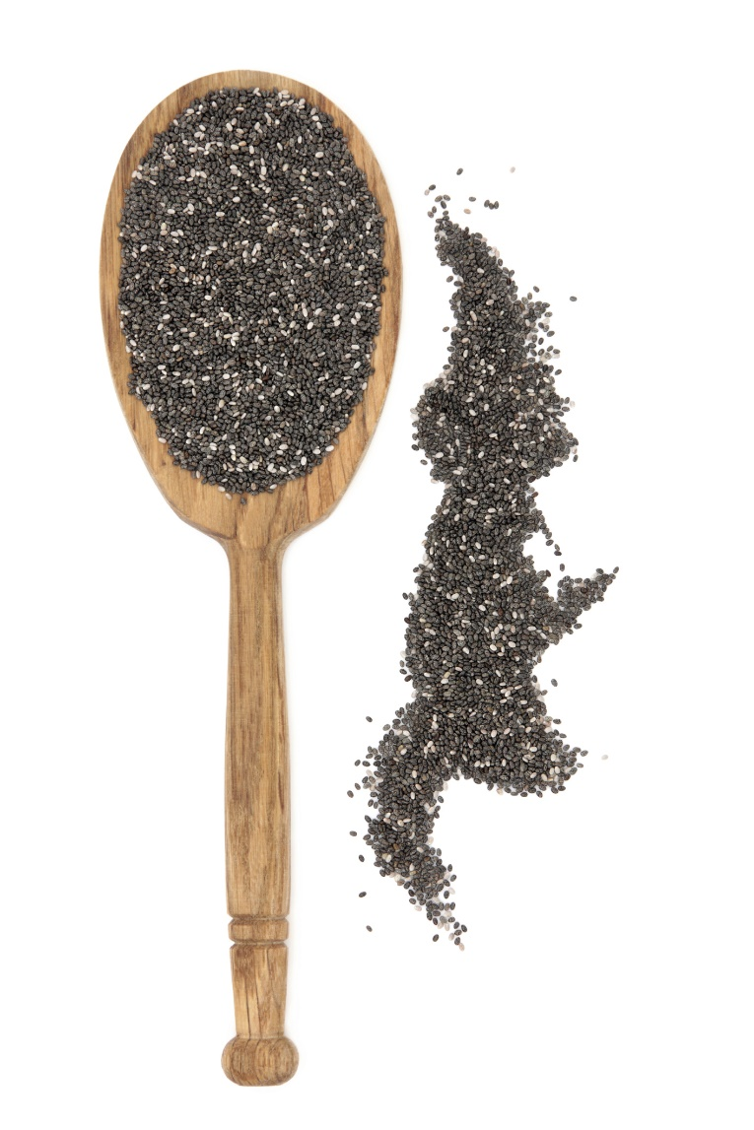
Load Up On Omega-3 Fatty Acids
These inflammation-reducing fats are essential for maintaining memory and preventing degenerative disease. You can find omega-3 fatty acids in fatty fish (salmon, sardines, anchovies, etc.) and in certain plant-based foods like chia and hemp seeds.

Slide 12
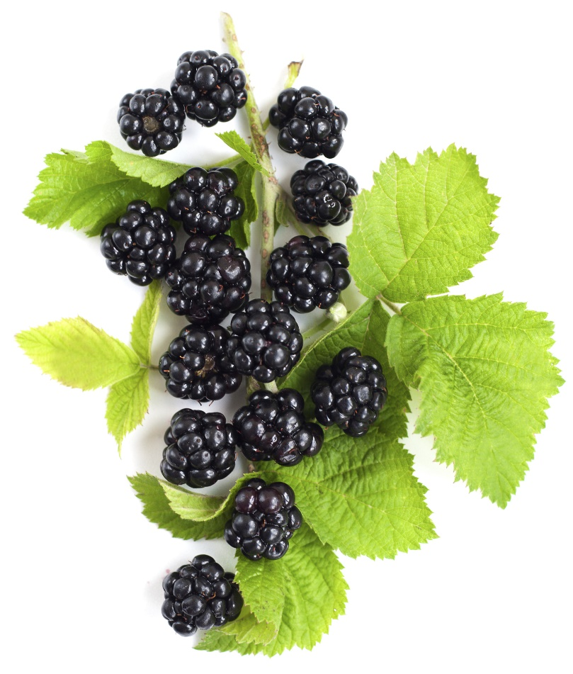
Don’t Skimp on Antioxidants
Antioxidants help to protect your body from the free-radicals that contribute to
the aging process. Some of the foods that are highest in antioxidants include berries (raspberries, blueberries, blackberries, etc.), broccoli, artichokes, cherries, prunes, grapes, and other types of produce.

Slide 13
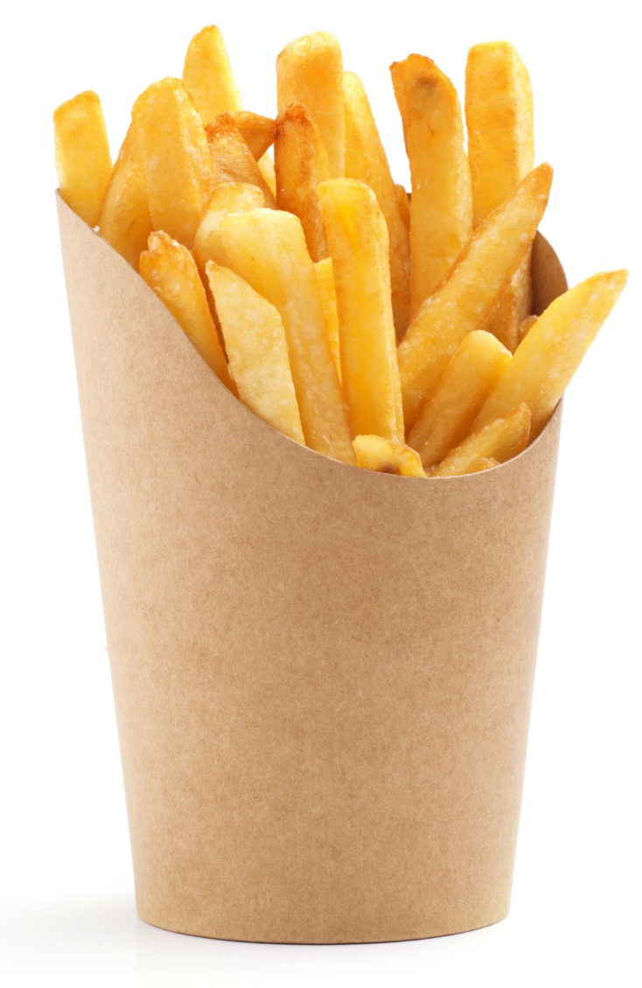
Avoid Processed Foods
Avoid processed foods, especially refined grains and sugars. Refined grains and sugars cause inflammation and cell damage, which catalyze the aging process. Try to replace these foods with healthy whole foods like fruits, meats, healthy fats, and vegetables.

Slide 14

Stay Physically Active
Regular physical activity is associated with a longer lifespan and increased quality of life. Exercise can help to ward off conditions ranging from heart disease to Alzheimer’s.

Slide 15

Cleanse Your Home of Toxins
You may want to toss out toxic household cleaners, personal care products,
bug sprays, lawn
pesticides, or other
substances that
could harm your
health and
shorten your
lifespan.

Slide 16
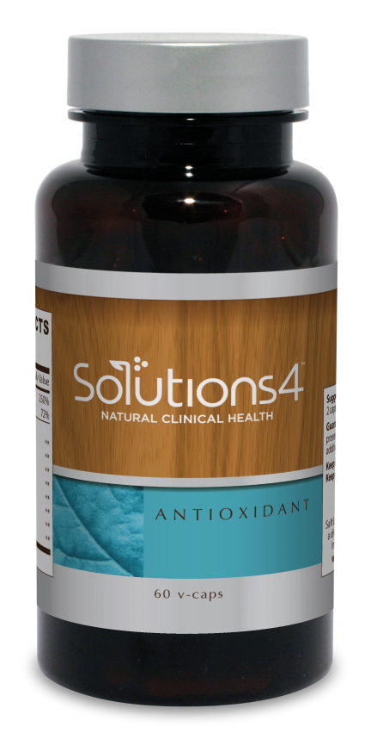
Try the Solutions4 Antioxidant!
Antioxidant contains some of the most powerful antioxidants found in nature! This includes antioxidants like astaxanthin, mozuku, gingko biloba, bilberry fruit, and milk thistle. These antioxidants prevent and reverse the damage caused by free radicals, leaving you looking younger and healthier than ever!

Slide 17

Try Daily Antioxidant Essentials!
Getting your daily dose of nutritious superfoods has never been so easy. Each serving of the Daily Antioxidant Essentials is packed with the essential
vitamins, minerals,
enzymes, antioxidants,
and phytonutrients that
your body needs to stay
youthful.

Slide 18
Summary:
Since the 1970s, the American lifespan has been steadily falling behind that of other developed countries. Our poor diet and lifestyle choices are shortening our lifespans and causing us to age prematurely.
When we make healthy choices, we’ll live longer and look better! It’s important to eat plenty of omega-3 fatty acids and antioxidants while avoiding processed foods. It’s also important to stay physically active and avoid exposure to toxins.
The S4 Antioxidant provides the body with antioxidants that slow the aging process.

Slide 19

On Sale This Week:
Daily Antioxidant Essentials!

Slide 20

Integrate what you’ve learned today by listening to:
LHL016 —
Little-Known Secrets
For Longevity

