Slide 1
Welcome to
Club Reduce!

Slide 2

Today, we’re going to talk about the importance of fiber for gut health.
Notes:
There are many ways to lose weight without first creating health and harmony, but these methods will lead you to gain the weight back and return to your original weight (or worse). Time has proven that health and harmony are foundational for long-term weight loss. A healthy body will not be able to hold onto excess weight! This is the key that needs to be stressed in our seminars. This seminar is an introduction to removing toxins and excess fluid from the body in order to create the right environment for weight loss and health.

Slide 3

All of the classes in this series build upon one another.
By attending regularly, you’ll learn the habits of a naturally thin person!

Slide 4

Why Is Fiber So Important?
Fiber is a type of carbohydrate that comes from the cell walls of plants. Unlike other carbohydrates,
fiber cannot be digested
and used for energy. It
passes through the
digestive system
largely intact.

Slide 5
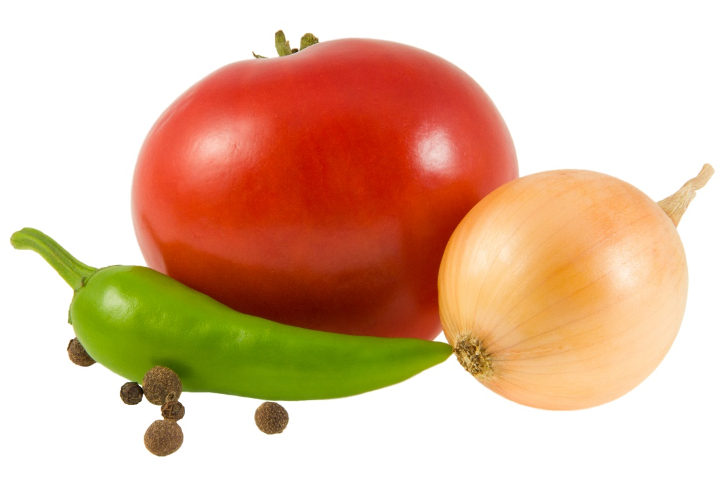
Why Is Fiber So Important?
Though you don’t digest fiber, it’s considered an essential micronutrient
because you can’t do
without it. Your body
relies on fiber to
accomplish several
important
functions…

Slide 6
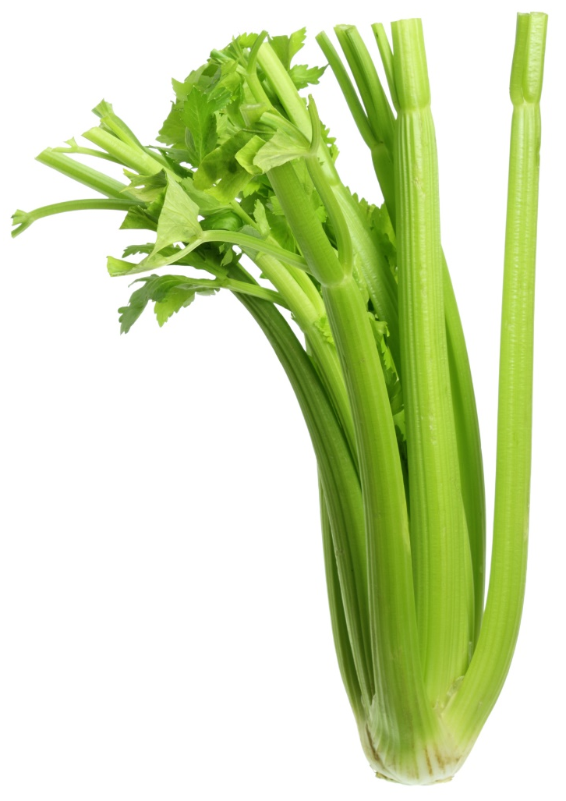
Functions of Fiber
Adds bulk to stool, facilitating healthy digestion
Regulates bowel movements
Stimulates the release of the appetite-satiating hormone ghrelin
Slows the absorption of simple sugars to regulate blood sugar
Feeds the healthy bacteria in the gut

Slide 7

Benefits of Fiber
Reduces risk for many cancers
Reduces risk for cardiovascular disease
Reduces inflammation
Improves immune function
Facilitates healthy weight loss

Slide 8
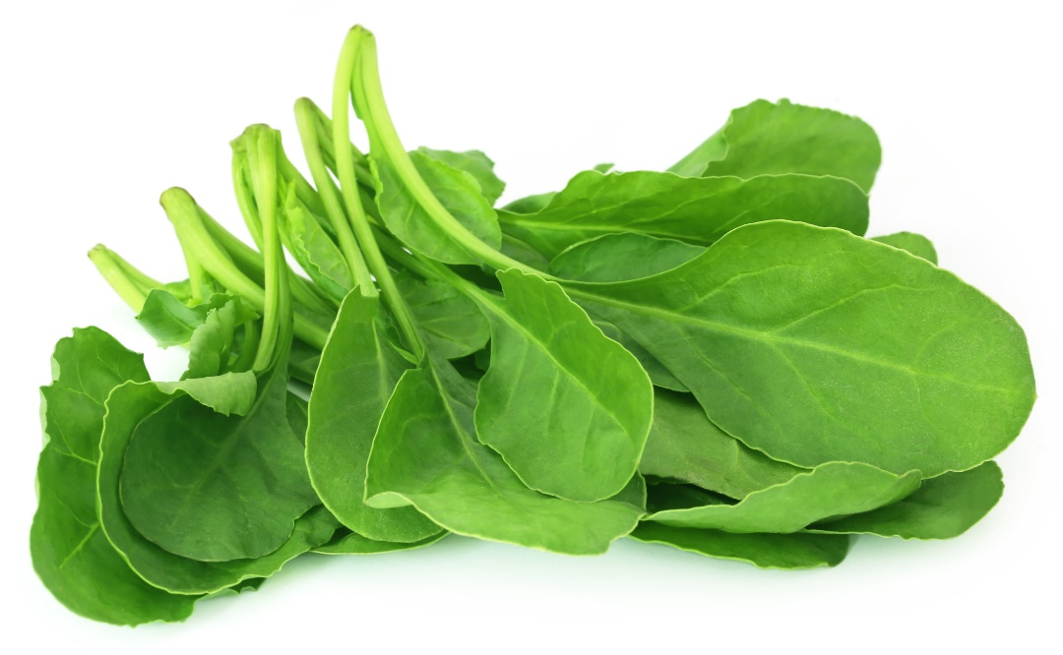
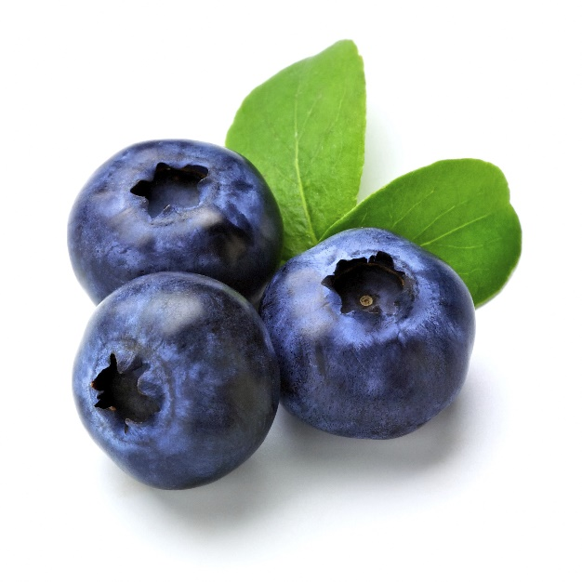
Soluble Vs. Insoluble Fiber
There are two main types of fiber: soluble and insoluble.

Slide 9

Soluble Vs. Insoluble Fiber
Soluble fiber dissolves in water to form a gel-like material in the gut. It feeds the healthy bacteria in the colon, encouraging microbiotic diversity and promoting optimal gut health.

Slide 10
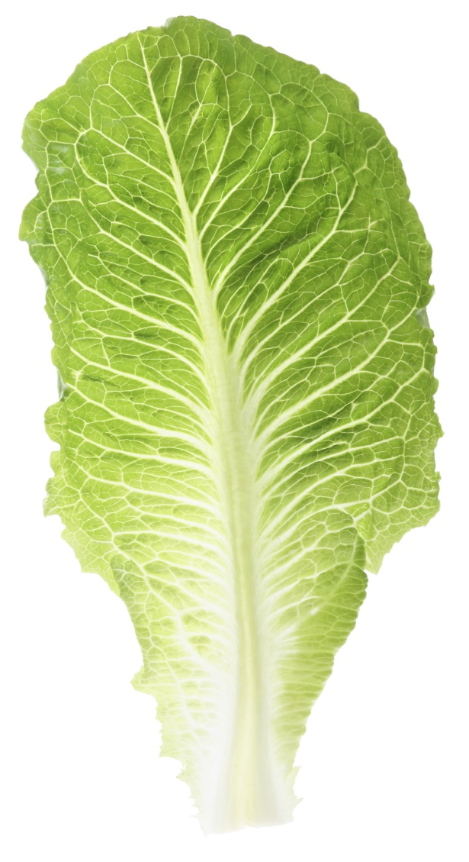
Soluble Vs. Insoluble Fiber
Insoluble fiber doesn’t dissolve in water. It speeds up the movement of material through the digestive system, increases stool bulk, and helps to regulate bowel movements. Some types of insoluble fiber can feed healthy gut bacteria as well.

Slide 11
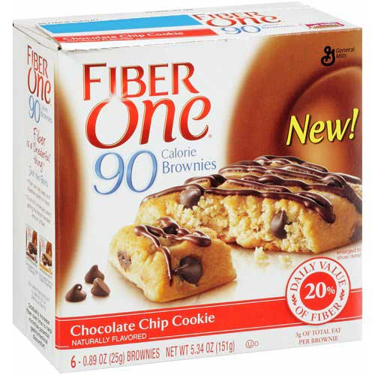
So What Can You Do?
Many processed grain products claim to supply a healthy dose of fiber, but these products are far from ideal. The best way to get enough fiber in the diet is by eating a diet rich in fresh produce.

Slide 12
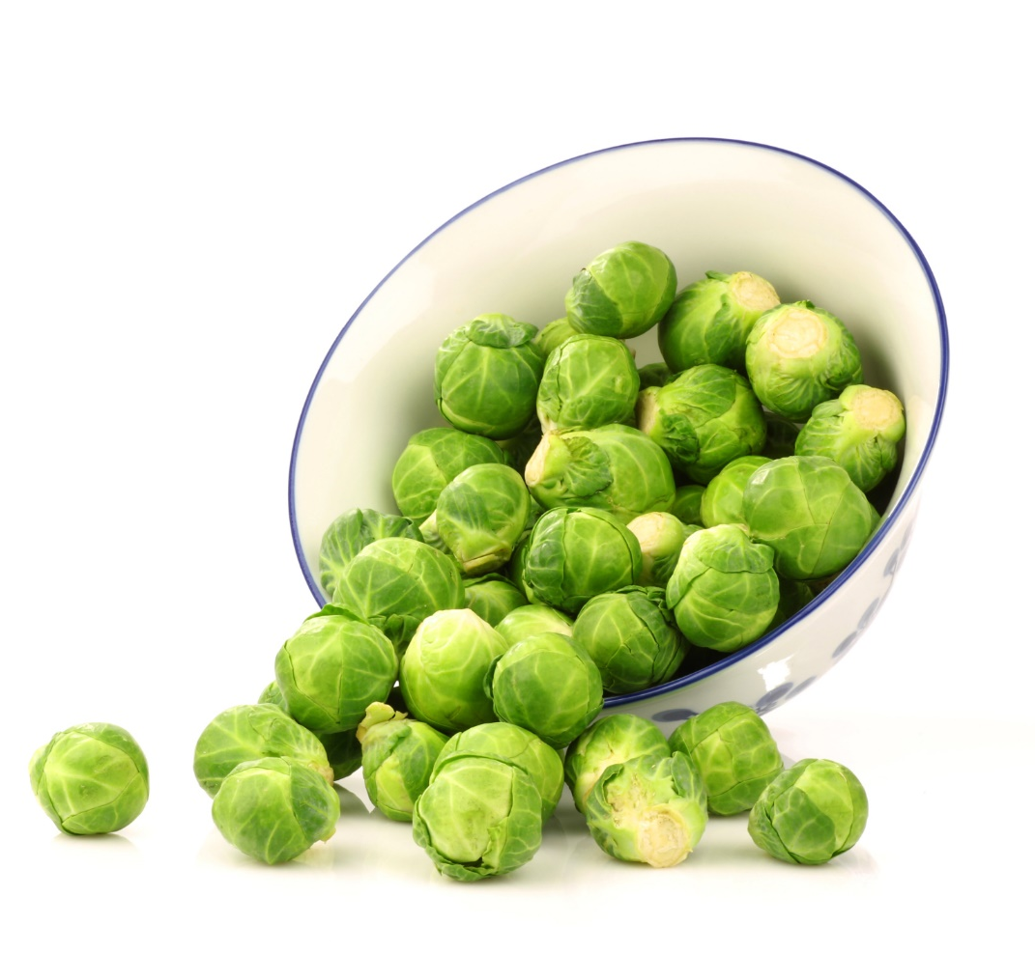
Dietary Sources of Fiber
Choose foods like:
Green beans
Cauliflower
Berries
Broccoli
Brussels sprouts
Flax seeds
Hemp seeds
Raw almonds

Slide 13
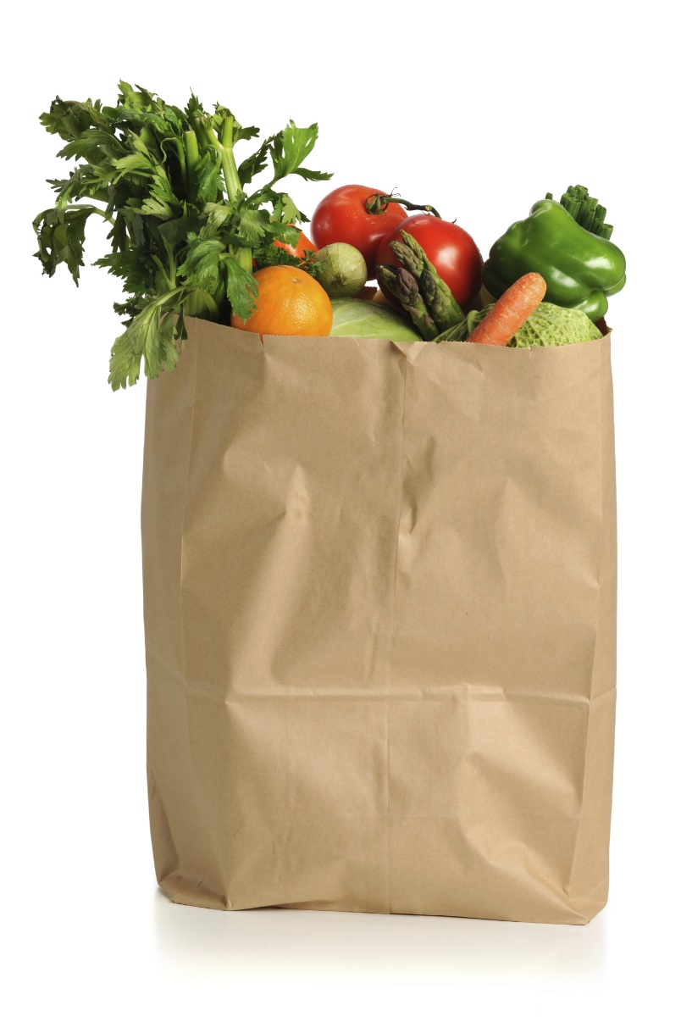
Dietary Sources of Fiber
Don’t forget to incorporate both soluble and insoluble fiber into your diet! Though many foods contain both types of fiber, others are rich in one or the other.

Slide 14
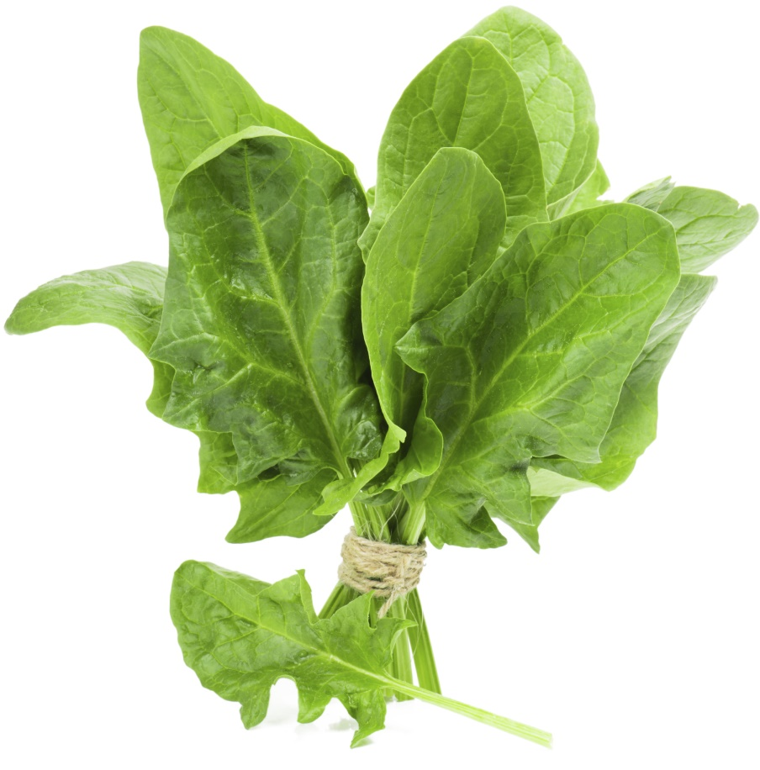
Dietary Sources of Fiber
Soluble fiber can be found in apples, cucumbers, blueberries, and pears, among other things. Insoluble fiber can be found in cabbage, lettuce, onions, bell peppers, and other types of produce.

Slide 15
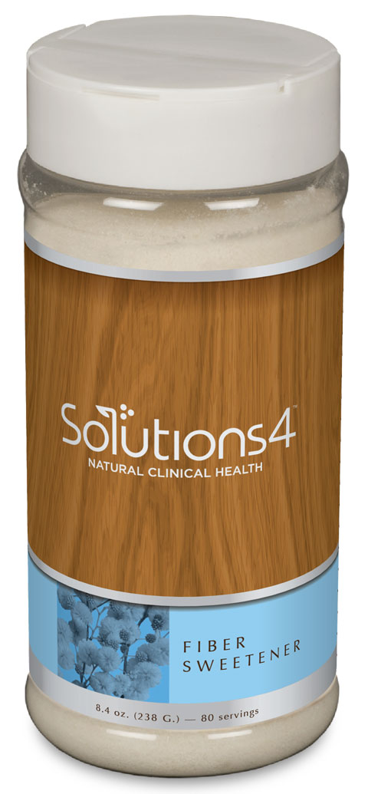
Solutions4 Fiber Sweetener
If you’re looking for a way to add more fiber to your diet, try the Fiber Sweetener! This incredible product is a sugar-free, chemical-free, low-calorie, low-glycemic soluble fiber supplement and sweetener. Though you can use this product to sweeten just about anything, it also contains a healthy dose of fiber!

Slide 16
Solutions4 Fiber Sweetener
Unlike other natural sweeteners, Simply Sweet also contains two special forms of fiber – chicory root and acacia – that help stabilize your blood sugar levels. This helps to reduce inflammation and prevents your energy levels from plummeting after a big meal!

Slide 17
Summary:
Unlike other carbohydrates, fiber cannot be digested and used for energy. However, it provides several other functions: It regulates bowel movements, feeds healthy bacteria in the gut, and more!
There are two main types of fiber: soluble and insoluble. Soluble fiber dissolves in water to form a gel-like material in the gut. Insoluble fiber increases stool bulk and helps to regulate bowel movements.
The Fiber Sweetener is a sugar-free, chemical-free, low-calorie, low-glycemic soluble fiber supplement and sweetener. Though you can use this product to sweeten just about anything, it also contains a healthy dose of fiber!

Slide 18

On Sale This Week:
The Solutions4 Fiber Sweetener!

Slide 19

Integrate what you’ve learned today by listening to:
LHL017 —
The Importance of
Fiber for Gut Health

