Slide 1
Welcome to
Club Reduce!

Slide 2

Today, we’re going to teach you how to boost your energy levels naturally.
Notes:
There are many ways to lose weight without first creating health and harmony, but these methods will lead you to gain the weight back and return to your original weight (or worse). Time has proven that health and harmony are foundational for long-term weight loss. A healthy body will not be able to hold onto excess weight! This is the key that needs to be stressed in our seminars. This seminar is an introduction to removing toxins and excess fluid from the body in order to create the right environment for weight loss and health.

Slide 3

All of the classes in this series build upon one another.
By attending regularly, you’ll learn the habits of a naturally thin person!

Slide 4

Are You Having An “Energy Crisis”?
If you’re like most
Americans, you
probably don’t
have as much
energy as you’d
like. You may
struggle to focus at
work, make it to the gym, or devote time to activities
that you love. So what can
you do?

Slide 5
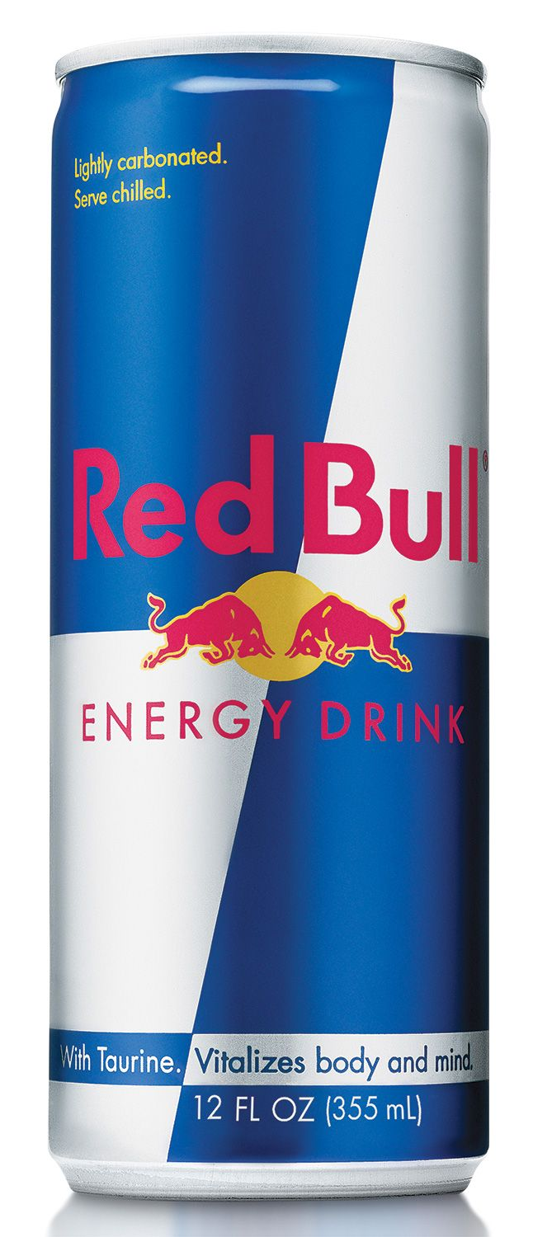
Are You Having An “Energy Crisis”?
Though caffeinated drinks
(coffee, tea, soda, energy
drinks, etc.) might seem like
a quick and appealing fix,
they “borrow” energy that you
don’t really have. You may feel
more energetic for a few hours,
but you’ll always end up right
back where you started.

Slide 6
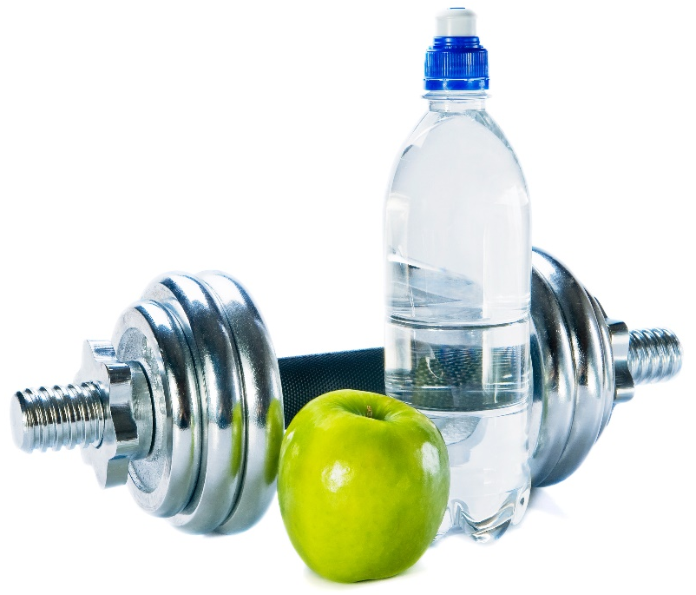
Key Lifestyle Choices
To boost your energy levels the all-natural way, begin by increasing your physical activity level, scheduling time for 7-8 hours of sleep per night, reducing your stress levels, and maximizing your nutritional intake. Let’s talk about each of these steps in turn…

Slide 7

Physical Activity
Did you know that only 22% of Americans meet the minimum requirements for physical activity each day? Inactivity makes you more likely to become obese and puts a major strain on your energy levels. Regular physical activity will make you leaner, healthier, happier, and more energetic!

Slide 8

Physical Activity
When you exercise, your body produces endorphins, giving you a feeling of euphoria that can provide a major energy boost. As our client, we recommend that you practice High-Intensity Interval Training (HIIT) for 20 minutes a day, three times each week (Mon/Wed/Fri).

Slide 9

Physical Activity
Though this only adds up
to one hour per week,
the high-intensity
sessions will
dramatically increase
your energy levels
and help you lose
weight throughout
the week!

Slide 10
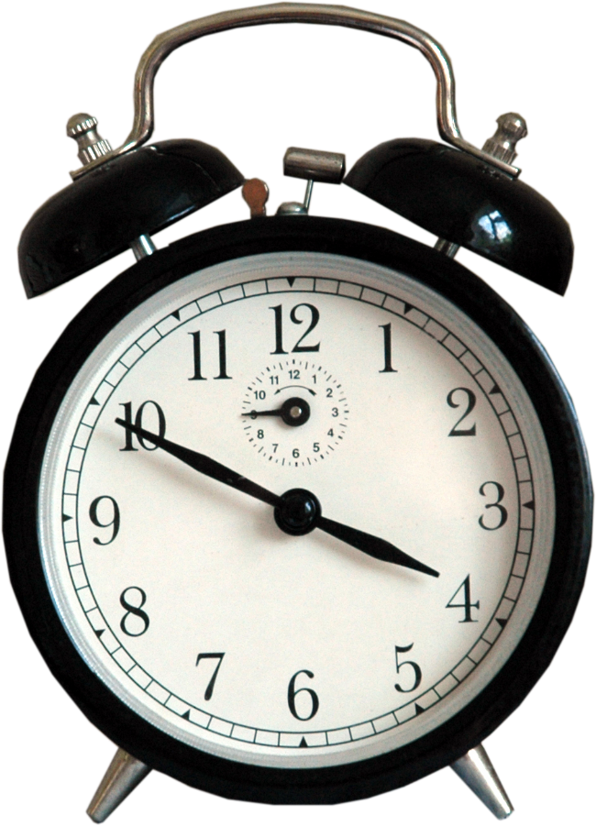
Quality Sleep
Insufficient sleep is a public health epidemic. Before the invention of the light bulb, people slept an average of 10 hours each night. Today, most Americans average a mere 6.9 hours each night! Getting enough sleep is essential if you want to have enough energy the next day.

Slide 11

Quality Sleep
Most people need at least 7-9 hours each night, beginning by at least 10 pm.
If you get in bed by 10
pm, your body will be
able to get into REM
sleep – the deep sleep
that your body needs –
from 12 to 2 am. You’ll
want to always be asleep
at this time of night.

Slide 12

Stress Reduction
Other lifestyle habits matter, too. High stress levels can sap your energy reserves and leave you feeling drained. Under chronic stress, you’ll never have the energy you need to truly succeed. So relax! Take time for yourself to pursue an activity that you love.

Slide 13

Stress Reduction
Find ways to lower your stress levels – whether that involves a spiritual practice, meditation, or some other calming activity. Be optimistic about your future! You’ve embarked on a journey of self-healing that will change your life.

Slide 14

Nutritional Intake
Without adequate nutrition, you’re bound to feel somewhat sluggish. If you’re looking to boost your energy levels in the long run, you’ll need to increase your nutritional intake. This means eating plenty of leafy greens, brightly colored vegetables, fresh fruits, nuts, seeds, and other foods that pack a large nutritional bang for your buck.

Slide 15

Nutritional Intake
As you add these foods into your diet, it’s also important to cut other things out.
Refined sugars and grains may
provide a temporary energy
boost to get you through a
rough morning or a slow
afternoon, but they come
at a price. Each time you
eat something like this,
you’ll end up with less energy
than you started out with.

Slide 16
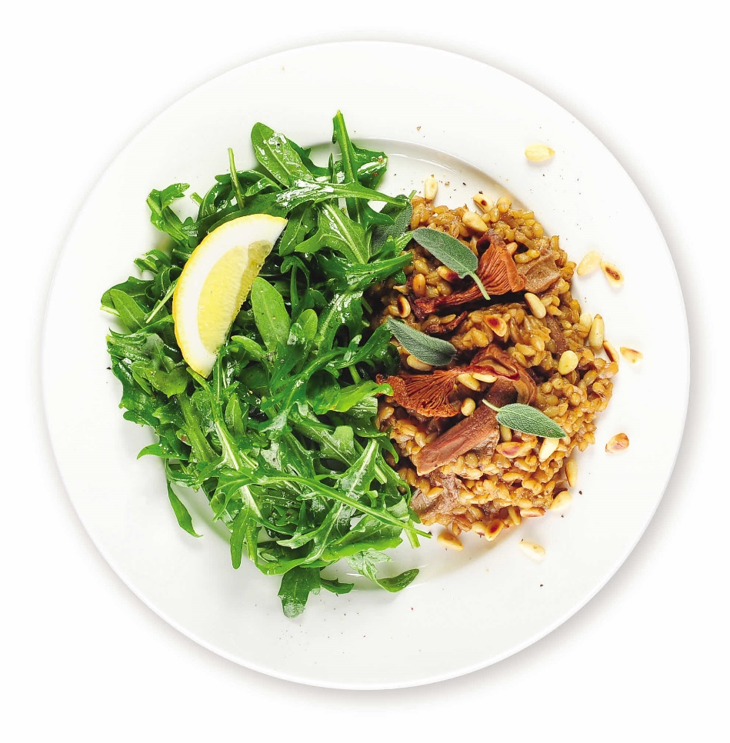
Nutritional Intake
It’s also important to eat at regular
intervals throughout the day.
Even if you’re not starving,
don’t skip a meal. You’ll
just make yourself hungrier
and more likely to make
poor choices at your next
meal. If you want to
maintain a balanced supply of
energy, eat regular meals and prepare healthy snacks in advance!

Slide 17
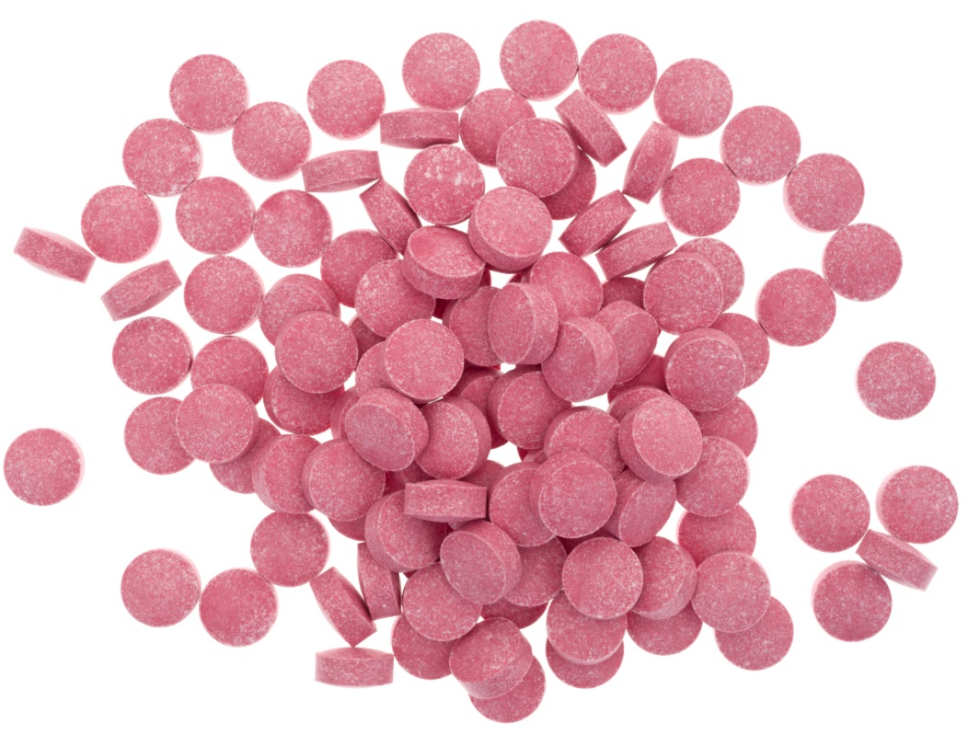
Vitamin B12
If you’ve tried to boost your energy levels but still feel drained,
you may want to start
supplementing with
Vitamin B12. Recent
studies suggest that
anywhere from 15-40%
of Americans lack the
B12 their bodies need to
function at peak performance.

Slide 18
Summary:
Most Americans don’t have as much energy as they’d like, and it shows! Nearly everybody struggles to make it to the gym, maintain focus at work, and feel “up for” other activities at the end of the day.
You can boost your energy levels by engaging in regular physical activity, getting enough sleep, managing your stress levels, and maximizing your nutritional intake.
For a quick, easy, and healthy energy boost, you can also use the Vitamin B12 supplement available through our office!

Slide 19

On Sale This Week:
Vitamin B12!

Slide 20

Integrate what you’ve learned today by listening to:
LHL018 —
How to Boost Your
Energy Levels
Naturally

