Slide 1
Welcome to
Club Reduce!

Slide 2

Today, we’re going to teach you how to improve your circulation in 6 easy steps.
Notes:
There are many ways to lose weight without first creating health and harmony, but these methods will lead you to gain the weight back and return to your original weight (or worse). Time has proven that health and harmony are foundational for long-term weight loss. A healthy body will not be able to hold onto excess weight! This is the key that needs to be stressed in our seminars. This seminar is an introduction to removing toxins and excess fluid from the body in order to create the right environment for weight loss and health.

Slide 3

All of the classes in this series build upon one another.
By attending regularly, you’ll learn the habits of a naturally thin person!

Slide 4
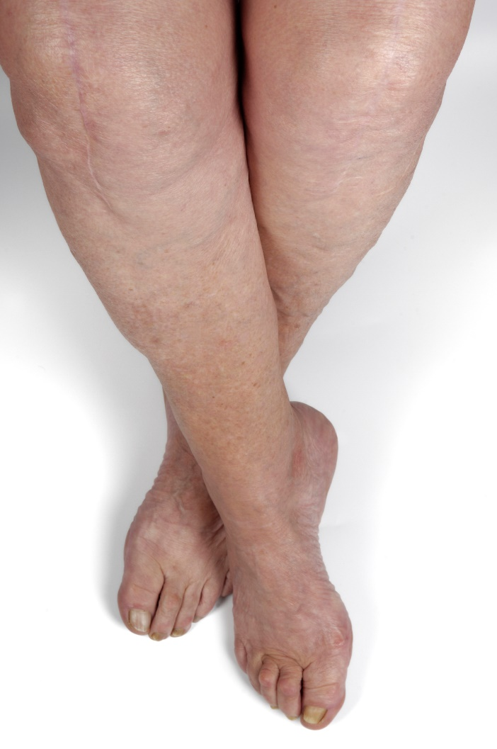
Suffering from Poor Circulation?
Millions of Americans suffer from foot and leg pain due to poor circulation. If you’re one of these Americans, you may experience numbness, tingling, burning, itching, or prickling sensations in your extremities.

Slide 5
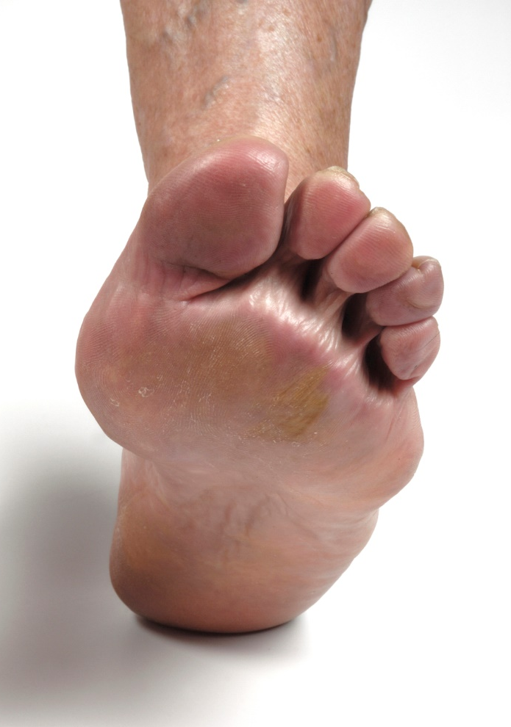
Suffering from Poor Circulation?
Though this discomfort may be caused by a variety of different factors (ranging from obesity to autoimmune disease), it often comes down to the same basic problem –
poor circulation.

Slide 6

Suffering from Poor Circulation?
The good news is that you don’t have to suffer from this discomfort forever! In this lesson, we’ll teach you six steps that you can take to find quick and
lasting relief.
First, it’s important to understand how your cardiovascular system works…

Slide 7
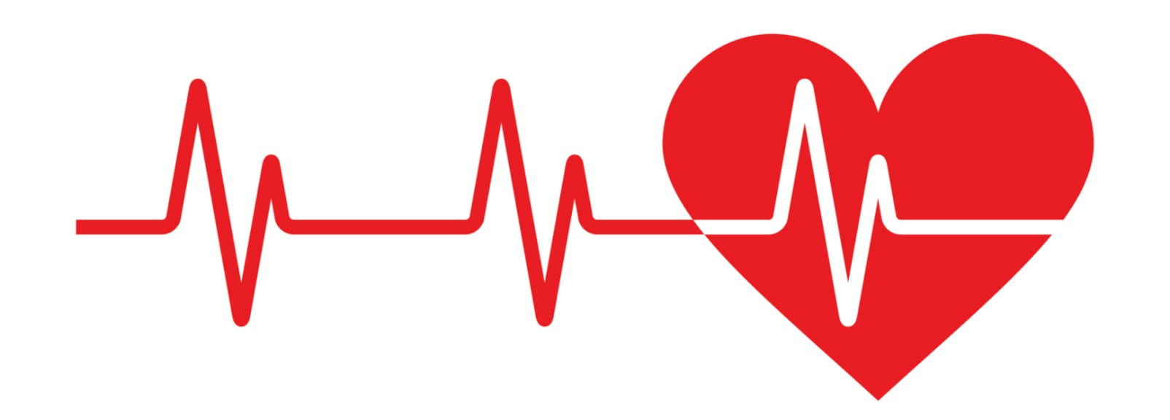
The Cardiovascular System
Your cardiovascular system is made up of your:
Heart
Blood vessels (arteries, veins, and capillaries)
Blood

Slide 8
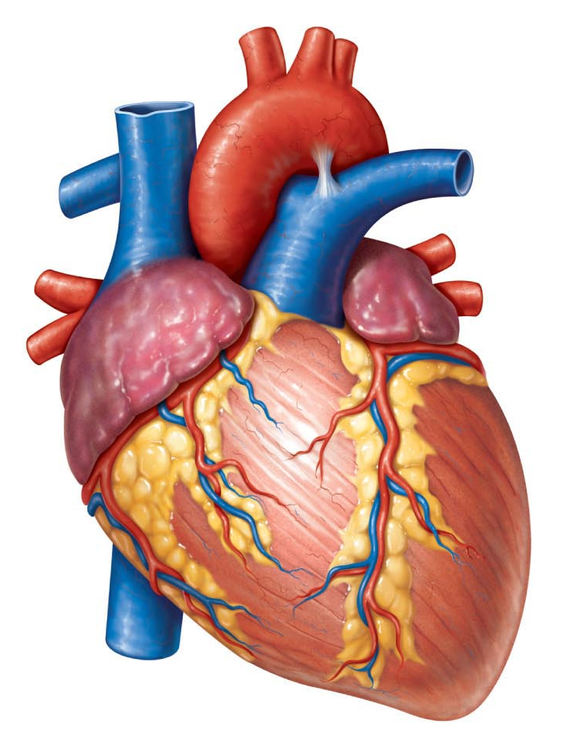
The Cardiovascular System
The heart is the pump for your cardiovascular system. It contracts to pump blood through arteries and veins. When blood reaches your tissues, it delivers oxygen and nutrients to individual cells. It also removes waste products so that they can be processed for removal.

Slide 9
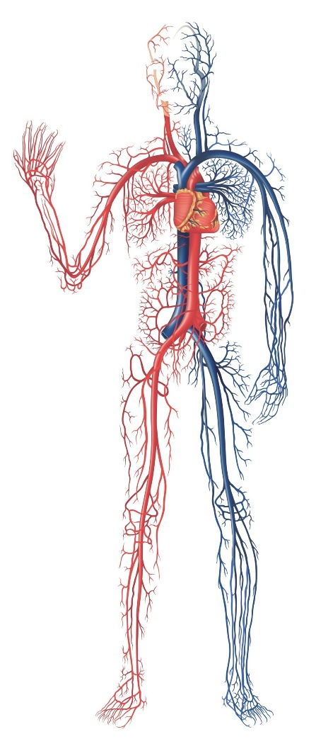
The Cardiovascular System
Without adequate circulation, your cells don’t get the oxygen and nutrients that they need. They also struggle to remove waste. These factors can all contribute to the uncomfortable symptoms that you experience when you have poor circulation.

Slide 10
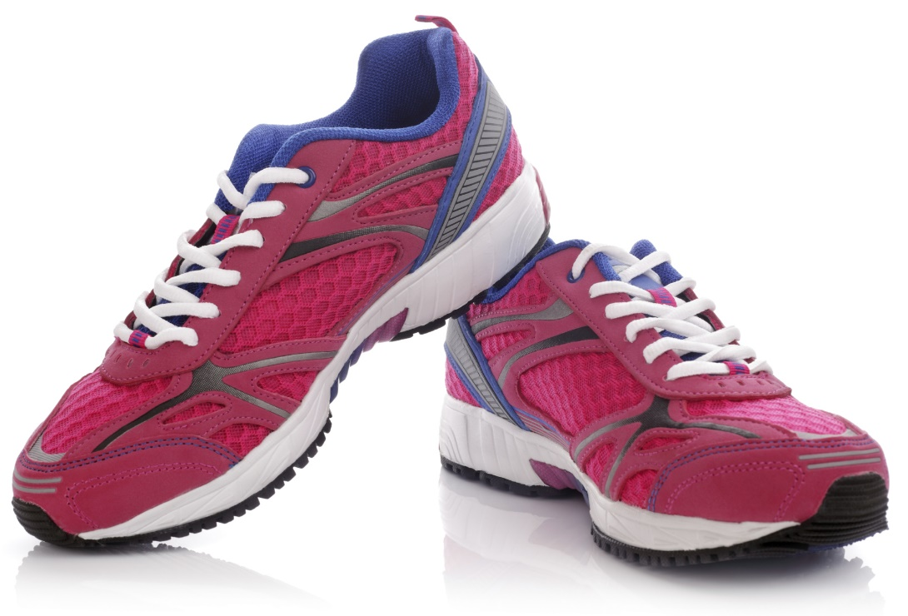
Step #1: Regular Physical Activity
Regular physical activity gets your blood moving the all-natural way. Each time you exercise, you increase circulation to every inch of your body. This can
help your body begin to heal from foot and leg pain
caused by poor
circulation.

Slide 11

Step #2: An Anti-Inflammatory,
Nutrient-Rich Diet
Inflammation can reduce blood flow to your extremities. Because many processed foods cause inflammation, it’s
important to avoid them as
much as possible. To see
big results, avoid processed
grains, sugars, and oils
(breads, pastries, potato
chips, crackers, etc.).

Slide 12

Step #2: An Anti-Inflammatory,
Nutrient-Rich Diet
Replace these unhealthy foods with nutrient-rich alternatives. Each
day, choose plenty of
brightly colored
vegetables, leafy
greens, fruits,
nuts, seeds,
and lean meats.

Slide 13
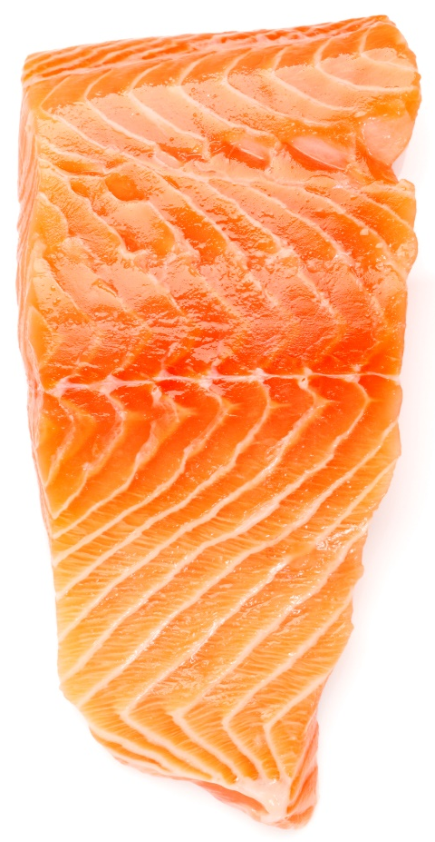
Step #2: An Anti-Inflammatory,
Nutrient-Rich Diet
Foods rich in omega-3 can be especially helpful when your body is healing because they dramatically reduce inflammation. You can find omega-3 fatty acids in oily fish (salmon, tuna, anchovies, sardines, etc.), hemp seeds, and chia seeds!

Slide 14
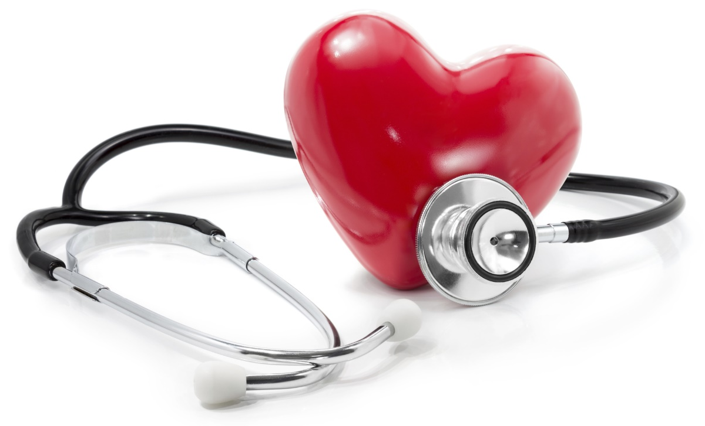
Step #3: Cardio Health Essentials
Cardio Health Essentials delivers huge healing benefits in just one easy-to-use power pack. Each pack provides an ample dose of nitric oxide, L-arginine, L-citruline, and CoQ10.
These heart-healthy
ingredients work together
to increase circulation,
thereby increasing
the flow of oxygen
and nutrients to every
inch of your body!

Slide 15
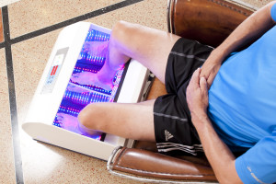
Step #4: The Vesna
The Vesna is a machine that
increases circulation to your
legs and feet. When you use
the Vesna, your body will
release nitric oxide from hemoglobin molecules in the targeted areas. Nitric oxide is a signaling molecule known to dilate blood vessels and increase circulation, thereby helping these areas of the body to heal. You can experience up to a 3,200% increase in circulation in just one sitting!

Slide 16
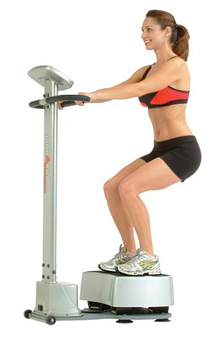
Step #5: Whole Body Vibration
Whole Body Vibration (WBV) improves circulation, strengthens collagen, and stimulates your muscles. WBV sessions are effective at restoring feeling to areas of numbness caused by poor circulation. WBV is excellent for people who don’t like exercising –
it increases muscle strength, and it’s easy to use! You don’t even have to put on workout clothes.

Slide 17

Step #6: Light Therapy
Our Light Therapy treatments utilize non-invasive, painless, infrared lights that increase blood flow to the extremities. The treatments dilate your blood vessels, allowing blood to flow more freely to your tissues. Each session will effectively reduce numbness, tingling, and pain!

Slide 18
Summary:
Millions of Americans suffer from foot and leg pain due to poor circulation. Though this discomfort may be caused by a variety of different factors (ranging from obesity to autoimmune disease), it often comes down to the same basic problem – poor circulation. You can improve your circulation with these six easy steps:
Engage in regular physical activity.
Eat an anti-inflammatory, nutrient-rich diet.
Use Cardio Health Essentials.
Try the Vesna.
Schedule a Whole Body Vibration session.
Take advantage of our Light Therapy treatments!

Slide 19


On Sale This Week:
Circulation-Boosting Nitric Oxide!

Slide 20
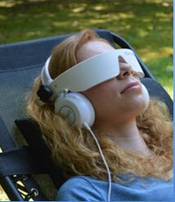
Integrate what you’ve learned today by listening to:
LHL019 —
How to Improve Your
Circulation in 6
Easy Steps

