Slide 1
Welcome to
Club Reduce!

Slide 2

Today, we’re going to teach you all about the Solutions4
Nutritional Shake!

Slide 3

All of the classes in
this series build
upon one another.
By attending
regularly, you’ll
learn the habits
of a naturally
thin person!

Slide 4
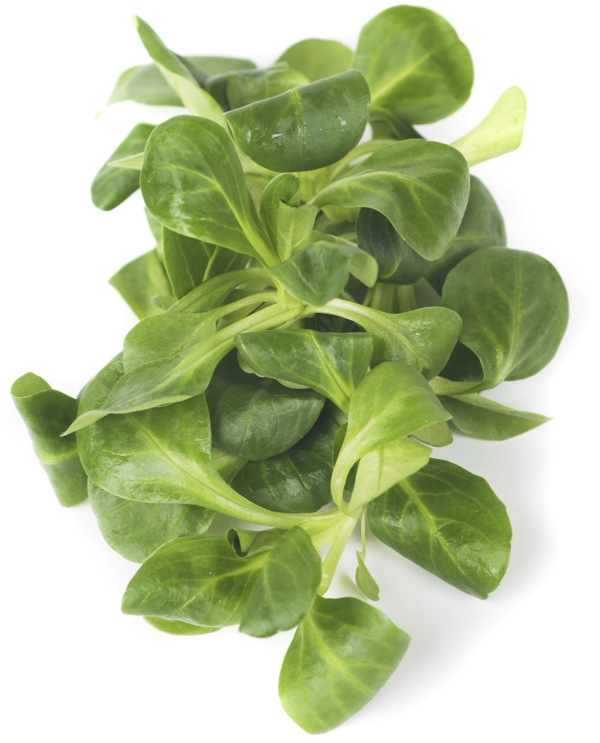
Your Body Needs 100% Nutrition
What you put into your mouth makes an enormous difference in your quality of life, your weight, and your health. It’s important for your body to get all of the nutrients it needs, every single day!

Slide 5

But Sometimes,
Life Gets In The Way…
We all know what it’s like to try to balance a healthy lifestyle with all of the chaos going on around us.
It isn’t always easy to prepare three healthy meals every day!

Slide 6

The Solutions4
Nutritional Shake Can Help!
That’s why Solutions4 designed the Nutritional Shake. Our patients needed something perfectly healthy that they could rely on when life gets in the way.

Slide 7


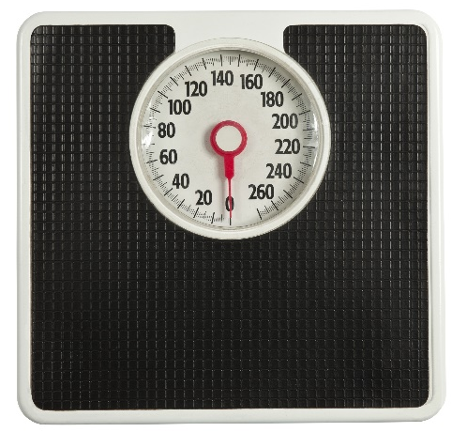
What Are the Benefits?
Besides the Nutritional Shake’s incredible nutritional value, it will also save you:
Time
Money
& Calories

Slide 8

The Shake Saves You Time
Though the shake is very
nutritious, it doesn’t take
much time to prepare.
You can simply mix it with
water or blend it with ice!
This only takes a matter of
minutes, and can even be
done on-the-go.

Slide 9
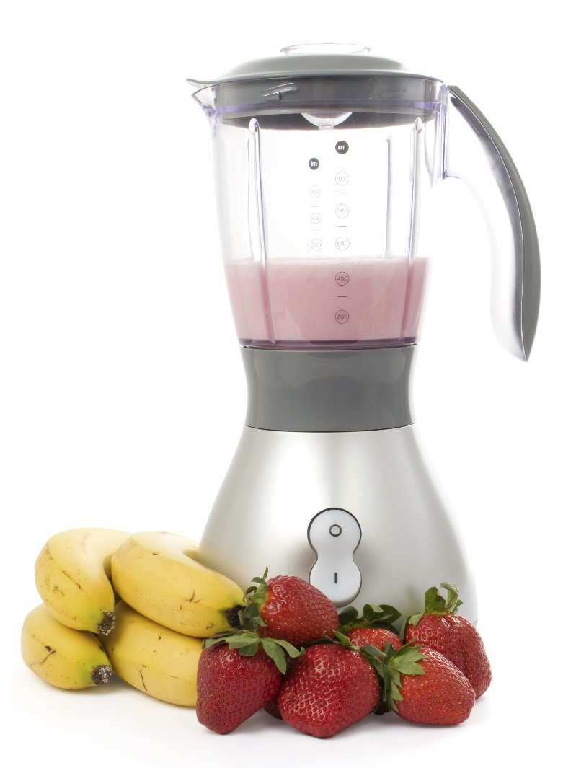
The Shake Saves You Time
For added variety, you can blend your shake with fruit, greens, or other vegetables. You’d be surprised what delicious combinations are possible! These creamy smoothies don’t take more than a few minutes to prepare.

Slide 10

The Shake Saves You Money
Though the Nutritional
Shake was designed
with optimal nutrition
in mind, it can also
be significantly less expensive
than a regular meal.

Slide 11

The Shake Saves You Money
A meal-sized serving of the shake only costs $3, while a healthy restaurant meal will run you upwards of $20! Even if you don’t eat out, you’ll still save several dollars per meal when you use the shake.

Slide 12

The Shake Saves You Money
This shake combines the benefits of taking many separate supplements
for the price of one. It
contains digestive enzymes, probiotics, fiber, vitamins, minerals, omega-3 fatty
acids, and a low-glycemic protein blend.

Slide 13
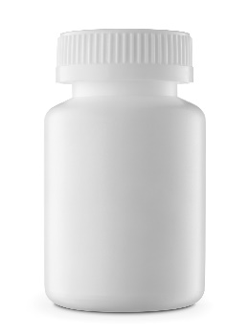
The Shake Saves You Money
If you were to purchase all of these supplements individually, you’d end up spending hundreds of dollars each month!
+
+
+
+
+
=
$200
Digestive
Enzymes
$25
Probiotics
$40
Fiber
$20
Multivitamin
& Mineral
$30
Omega-3
$30
Protein
Blend
$55

Slide 14

The Shake Helps You Cut Calories
Most Americans don’t realize how many calories they’re actually eating each day. The average American
restaurant meal packs
a whopping 1,128
calories! This
doesn’t even include
beverages, appetizers,
or desserts.

Slide 15
The Shake Helps You Cut Calories
When you compare this with how much you should be eating:
Between 1000-1600 calories for weight loss (depending on whether you’re male or female)
Between 2,000-2,500 calories for healthy, active individuals who don’t need to lose weight

Slide 16
The Shake Helps You Cut Calories
You can see that a 1000-calorie meal is way too much! If you ate out for every meal of the day (on top of your regular snacks), you could easily end up eating 4,000 calories in a day. And we wonder why obesity is an epidemic!
For maximum weight loss, you can use the Nutritional Shake to replace up to 2 meals each day.

Slide 17
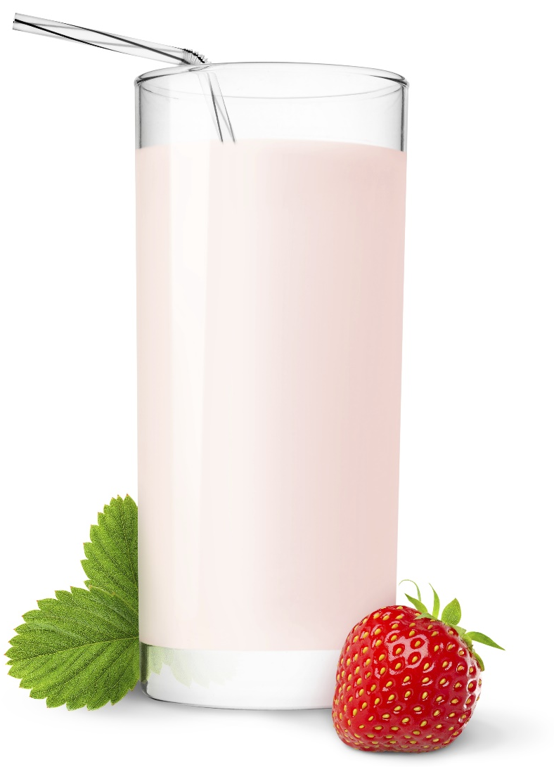
The Shake Helps You Cut Calories
With only 180 calories per serving, the Nutritional Shake can be an incredible tool for healthy weight loss or weight maintenance!

Slide 18

What Else Makes
This Shake So Special?
Grass-fed protein from New Zealand
Allergen-friendly
ingredients
An incredible
nutritional profile
Free of sugar and
artificial sweeteners

Slide 19

Grass-Fed New Zealand Protein
The protein in our shake comes from grass-fed, free-range cows in New Zealand. This ensures that the final product has a superior fatty acid profile (full of healthy omega-3) and is 100% free of all hormones, antibiotics, and pesticide residues.

Slide 20
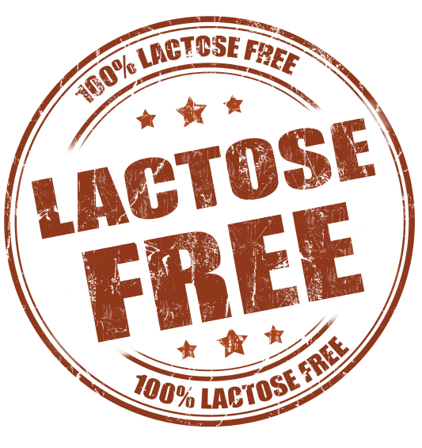
Allergen-Friendly Ingredients
We use a special process
to isolate our protein
and ensure that it is 100% lactose-free and casein-free. We’re also careful to ensure that the Nutritional Shake is free of gluten and other common allergens!

Slide 21
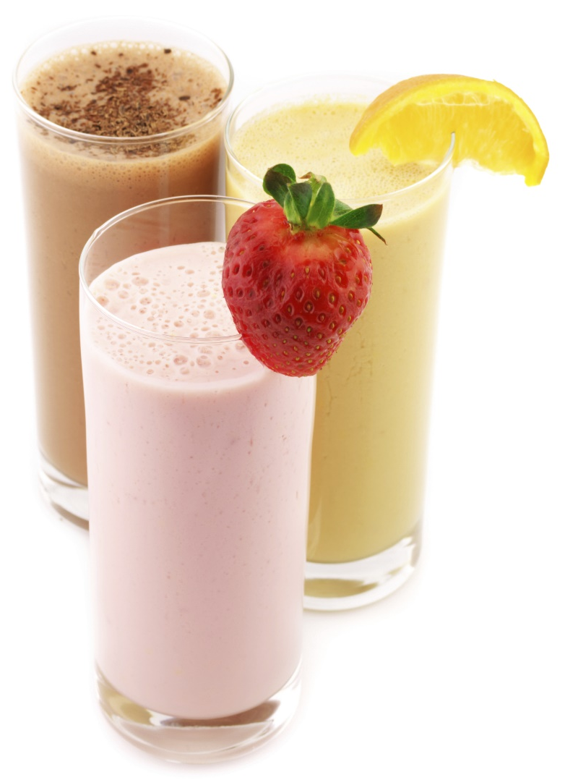
Incredible Nutritional Profile
The Nutritional Shake is packed with vitamins, minerals, and other nutrients that will give you an energy boost without a mid-afternoon crash!

Slide 22
Incredible Nutritional Profile
This incredible shake contains:
Digestive Enzymes to heighten absorption of nutrients from food.
Essential Vitamins and Minerals to ensure 100% nutrition in your daily diet.
Fibersource Plus™ to promote low blood sugar levels and a healthy weight.

Slide 23
Incredible Nutritional Profile
This incredible shake contains:
A Low-Glycemic Protein Blend to encourage satiety and a healthy weight.
Omega-3 Fatty Acids to reduce inflammation and improve the health of your hair, skin, and nails.
Probiotics to promote gut health and wellbeing.

Slide 24

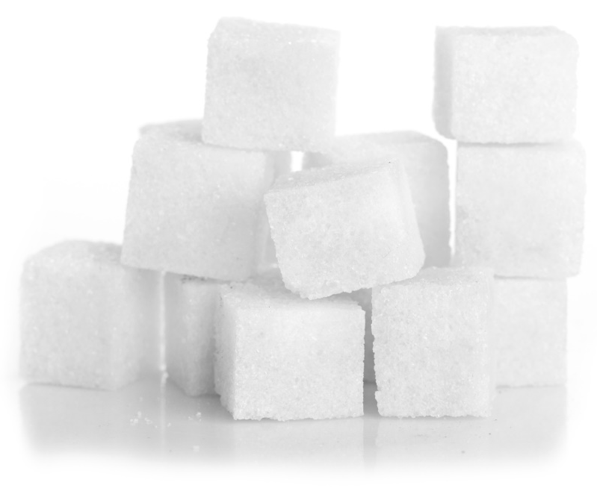
No Sugar or Artificial Sweeteners
The shake is completely free of all refined sugar and artificial sweeteners. It’s deliciously sweetened with natural alternatives like chicory root, stevia, lo han extract, and xylitol!

Slide 25
Nutritional Highlights
20 grams of protein
5 grams of fiber
10 grams of carbs
180 calories
8 billion units of probiotics
5 digestive enzymes
36 vitamins, minerals, & other nutrients

Slide 26
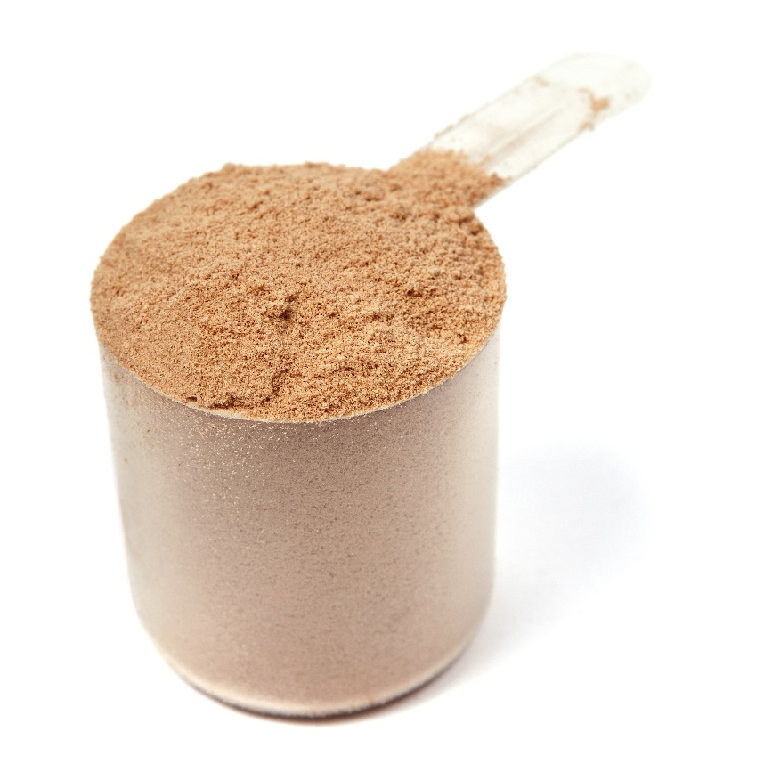
How to Use the Shake
For a meal, mix two scoops with a liquid base. For a snack, use one scoop.
You can always mix in
additional fruits or
veggies! For a
supercharged smoothie,
try blending greens with
the vanilla flavored shake.

Slide 27
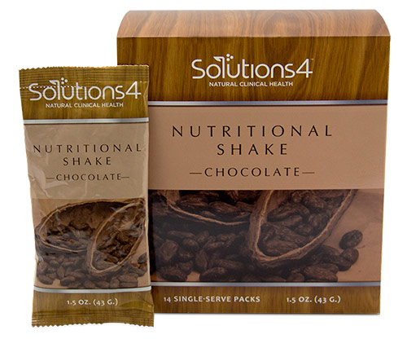
Also Available in Single-Serve Packs!
You can also take these single-serve packs with you wherever you go!
You can bring them with
you to the gym, to work,
or even on vacation!
Some parents even pack
them into their children’s
lunches to ensure that
they get 100% nutrition
away from home.

Slide 28
Summary:
When life gets in the way, you can use the Nutritional Shake to ensure that you’re getting 100% nutrition in your daily diet.
Each time you use it, you’ll save time, money, and calories!
You’ll also reap the benefits of its incredible nutritional profile.

Slide 29
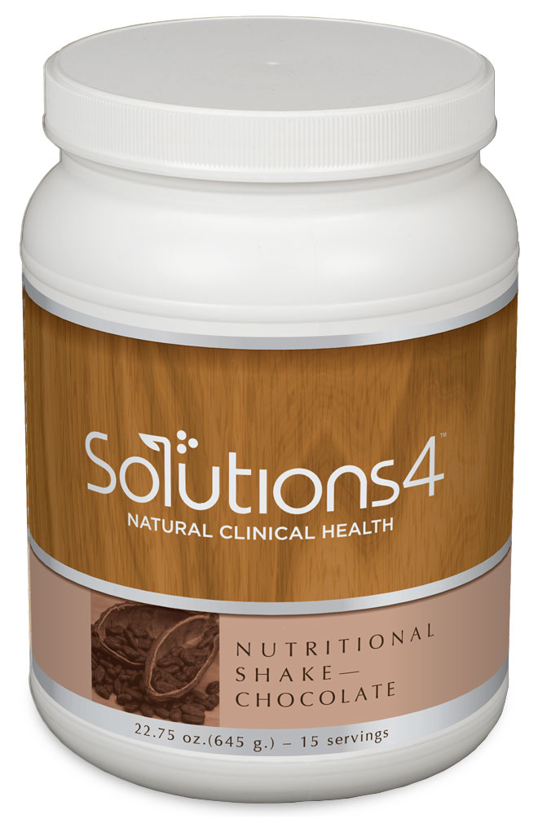
On Sale This Week:

Slide 30

Integrate what you’ve learned today by listening to:
LHL002 — Using the
Nutritional Shake

