Slide 1
Welcome to
Club Reduce!

Slide 2
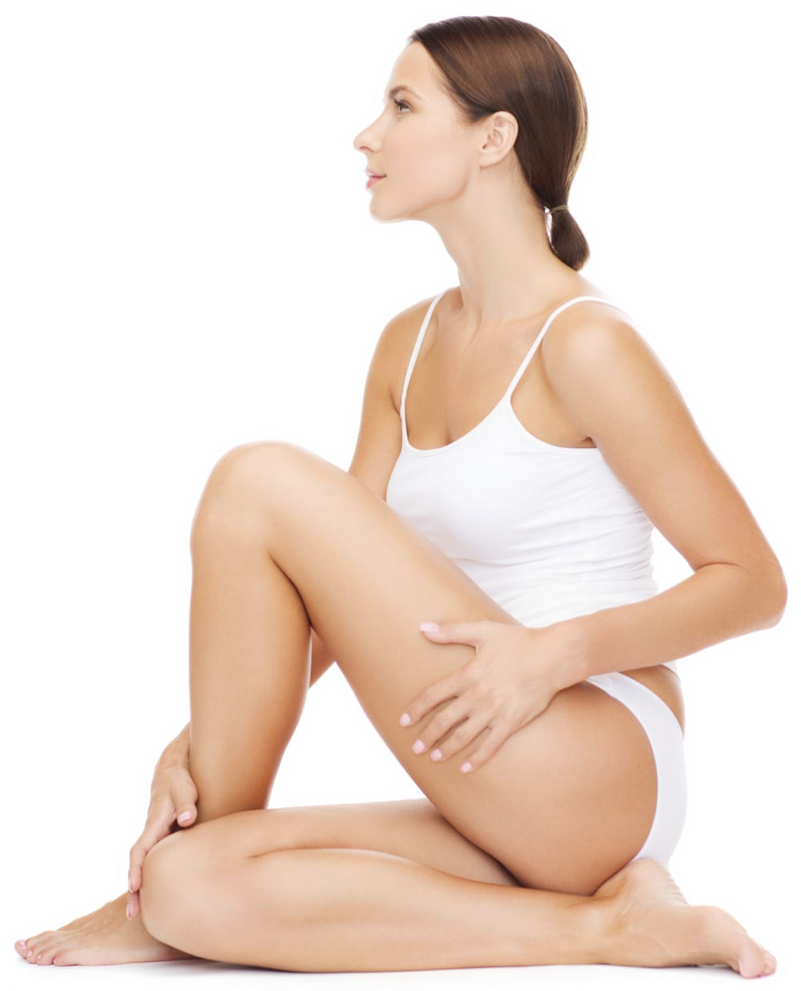
Today, we’re going to teach you how to get rid of cellulite naturally!

Slide 3

All of the classes in
this series build
upon one another.
By attending
regularly, you’ll
learn the habits
of a naturally
thin person!

Slide 4
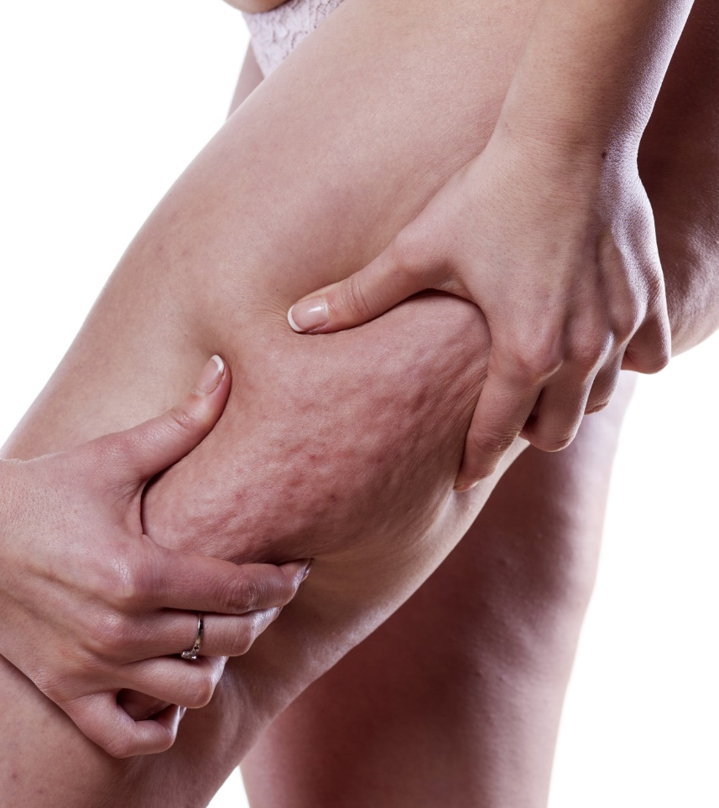
Got Cellulite?
Most women list cellulite as one of
the main things that they’d like to change about their bodies. Dimply, puckered skin just doesn’t make you feel your best!

Slide 5

We Can Zap Cellulite ASAP
Fortunately, you don’t have to live with cellulite forever. There are several steps you can take to smooth out your skin and banish cellulite for good!

Slide 6
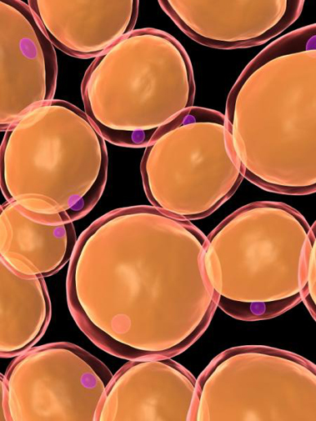
Detoxification
Studies show that most Americans have between 400 and 800 chemicals stored in their bodies, typically in fat cells and in connective tissues. These toxins cause unsightly cellulite to form.

Slide 7

Detoxification
Detoxification helps your body eliminate these toxins, and thus reduce the appearance of cellulite! You can detoxify your body through a combination of dietary strategies and in-clinic treatments.

Slide 8

Stress Reduction
If you experience stress throughout the day, your body has to cope with chronically elevated cortisol levels. Too much cortisol can switch on your “fat-storing hormones” and cause hormonal imbalances. This, in turn,
can make it difficult to
target unwanted cellulite.

Slide 9

Optimal Nutrition
The quality of your food
can also make a big
difference for cellulite reduction. Eating toxic
processed foods will make cellulite worse, while healthy fruits and vegetables will smooth things out and help you
look your best!

Slide 10
Effective Exercise
Exercise matters too. Strengthening the muscles beneath your fatty tissues will firm up the area so that unsightly dimples don’t have a chance to form. However, areas with existing cellulite can be difficult to target through exercise alone.

Slide 11
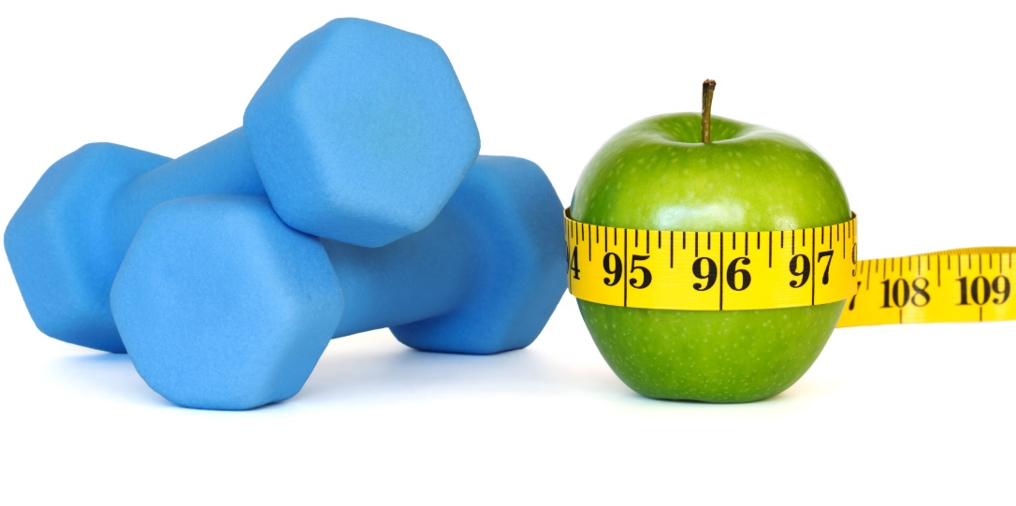
Lifestyle Strategies Are Important,
but They Can’t Do It All on Their Own…
Diet and exercise can make a big difference for your skin’s tone and texture, but they probably won’t eliminate cellulite all on their own. That’s why we’ve
designed a series of special
treatments that zap
cellulite and leave
your skin looking
flawlessly smooth!

Slide 12
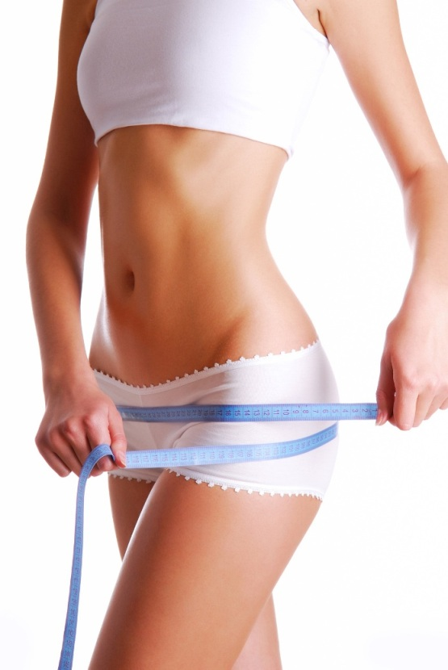
Detoxifying Body Wraps
Body Wraps aid in detoxification and reduce the appearance of cellulite. Your problem areas will look better immediately! The wraps remove cellulite by targeting and removing the toxins trapped in your connective tissue. You can expect to lose 4-14 inches in one hour!

Slide 13
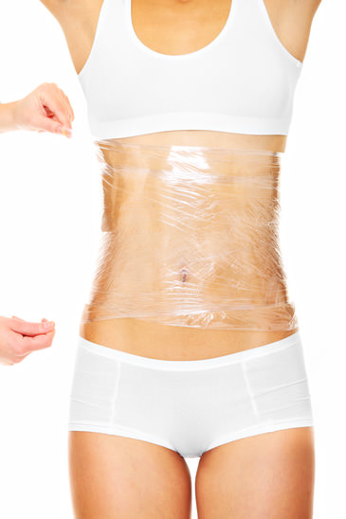
Detoxifying Body Wraps
The cream used in Body Wraps was developed by a biochemist from UCLA over
30 years ago! It contains the
B vitamin niacin, which is used to dilate blood vessels and encourage lymphatic flow. It also contains high-quality herbs that assist in the removal of toxic buildup.

Slide 14
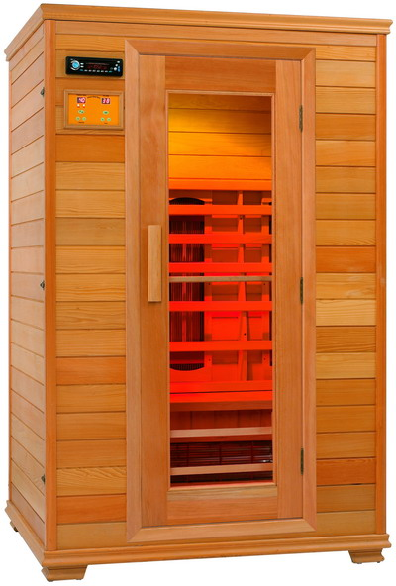
Infrared Sauna
Unlike a regular sauna, the Infrared Sauna causes a deep and detoxifying sweat at the cellular level (where toxins reside). This makes the Infrared Sauna uniquely able to help you lose weight and get rid of unsightly cellulite!

Slide 15
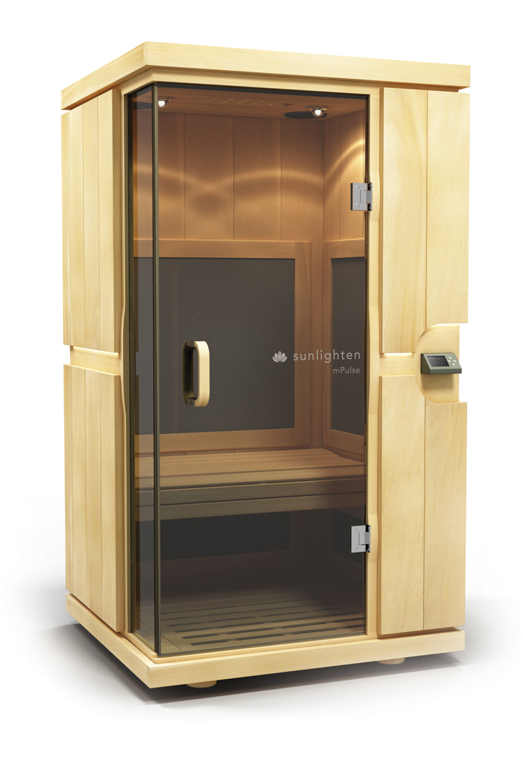
Infrared Sauna
In our sauna, the average person will sweat out 20% toxins and 80% water — while in a conventional sauna, the average is only 3% toxins and 97% water!
The average person can burn 500-600 calories in a 30 minute session, which helps reduce fatty deposits.

Slide 16
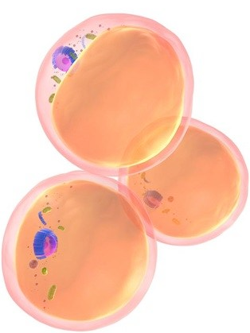
LipoLight/LipoLaser
You have the same number of fat cells throughout your entire life. The fat cells never disappear — they just get bigger or smaller. Cellulite forms when fat cells become too big (because of trapped toxins) or when connective tissues become stiff and inflexible.

Slide 17
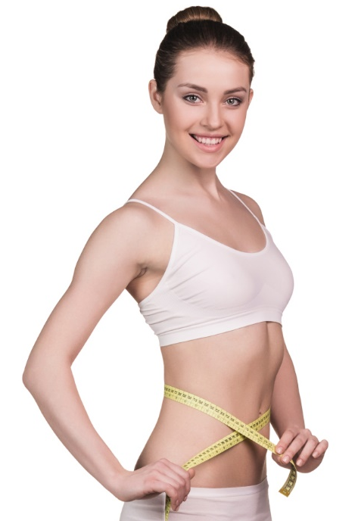
LipoLight/LipoLaser
To get rid of cellulite, you must get rid of toxins trapped in fat cells. LipoLight/LipoLaser technology forces your fat cells to unlock, allowing the contents to spill out and be naturally metabolized by your body. Unlike traditional liposuction, there is no pain,
no bruising, no drugs, and no downtime!

Slide 18
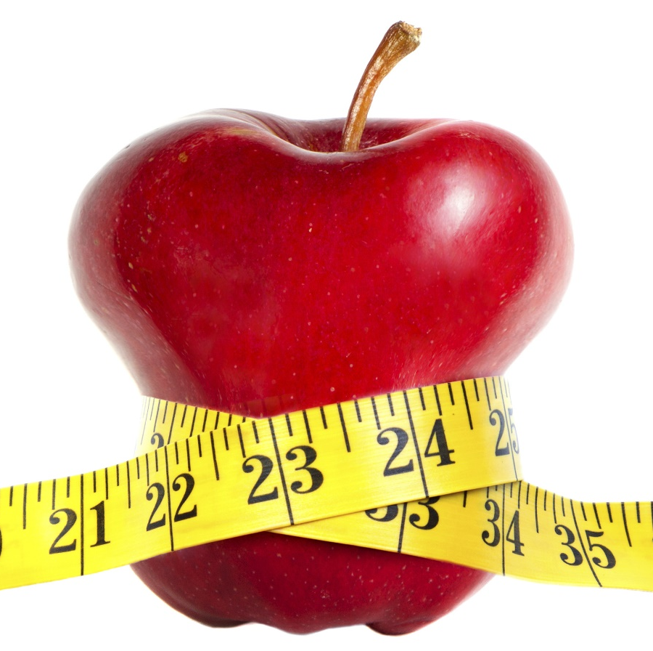
LipoLight/LipoLaser
It’s safe, simple, and highly effective! You’ll find that it’s just as relaxing as any spa treatment. LipoLight/LipoLaser technology allows us to spot-shrink any area of the body so that you can banish cellulite for good.

Slide 19
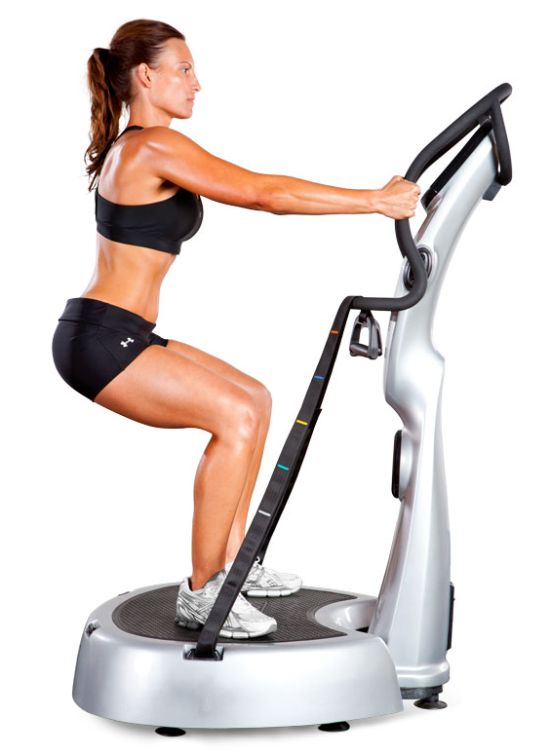
Whole Body Vibration
After a LipoLight/LipoLaser session, the contents extracted from your fat cells need to be expelled from the body. That’s where Whole Body Vibration (WBV) comes in! WBV helps to stimulate your lymphatic system so that discarded fat can be processed for removal.

Slide 20
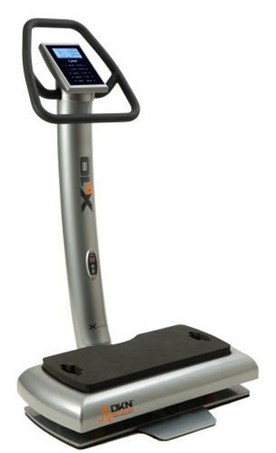
Whole Body Vibration
Whole Body Vibration (WBV) is also a time-efficient way to sneak in a workout at any time of the day! This machine is excellent for those who don’t have the time, energy, or motivation to hit the gym daily. All you have to do is stand on the vibrating platform and let the machine work its magic.

Slide 21
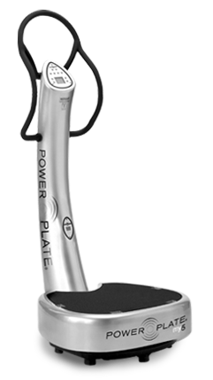
Whole Body Vibration
The WBV machine activates and strengthens your muscles, increases circulation, tones and firms fatty areas of the body, and helps your body activate your “fat burning” hormones. These benefits can make an enormous difference in smoothing the skin and zapping areas with cellulite!

Slide 22
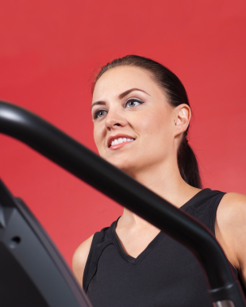
Whole Body Vibration
This state-of-the-art vibration system has been shown to reduce cellulite by 25% in just 24 weeks! You won’t see these kind of results anywhere else.

Slide 23
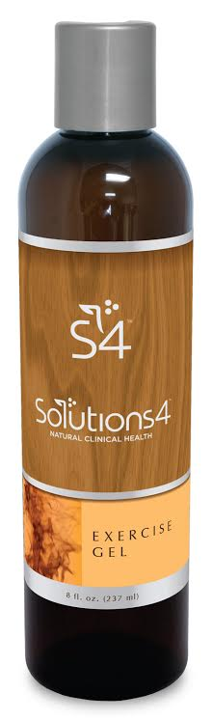
Solutions4 Exercise Gel
Exercise Gel helps you get the most out of every workout! When applied to problem areas before exercise, this innovative gel will warm your muscles and increase your circulation.

Slide 24
Solutions4 Exercise Gel
Typically, fatty tissues and areas with cellulite have less circulation, making these areas difficult to target. The Exercise Gel draws blood to these areas, helping you get maximum results from every treatment!
Using the gel will help to sculpt and tone areas of cellulite and facilitate the removal of toxic waste.

Slide 25
Summary:
Detoxification, healthy eating, exercise, and stress-reduction should all play a role in your cellulite-reduction strategy.
However, Solantis treatments can make a big difference for hard-to-target areas!
The Infrared Sauna, LipoLight/LipoLaser treatments, Whole Body Vibration sessions, and Detoxifying Body Wraps can all help you zap areas with cellulite ASAP.
Solutions4 Exercise Gel will help you get the most out of these treatments!

Slide 26

On Sale This Week:
Solutions4 Exercise Gel

Slide 27
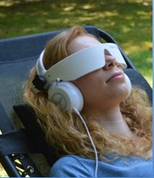
Integrate what you’ve learned today by listening to:
LHL003 — How to
Get Rid of Cellulite
Naturally

