Slide 1
Welcome to
Club Reduce!

Slide 2

All of the classes in this series build upon one another.
By attending regularly, you’ll learn the habits of a naturally thin person!

Slide 3

Today, we’re going to talk about the benefits of detoxification.

Slide 4
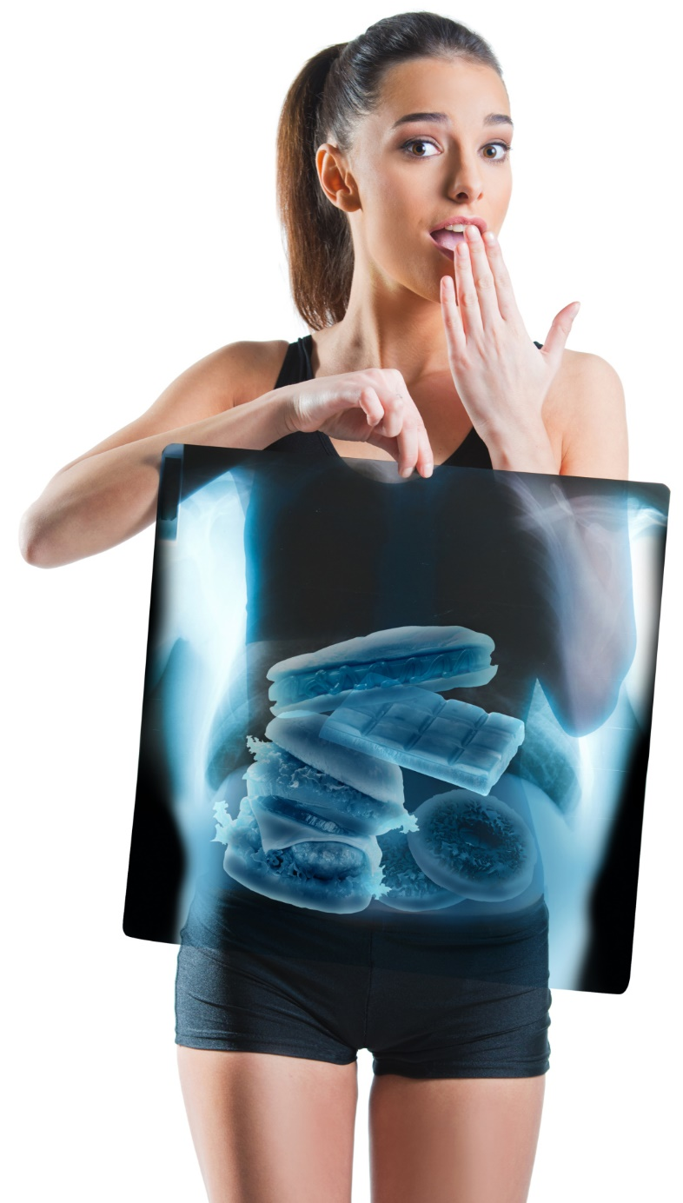
Did you know that detoxification causes you to expel between 2-8 pounds of waste materials, built-up fluids, and other toxins?

Slide 5
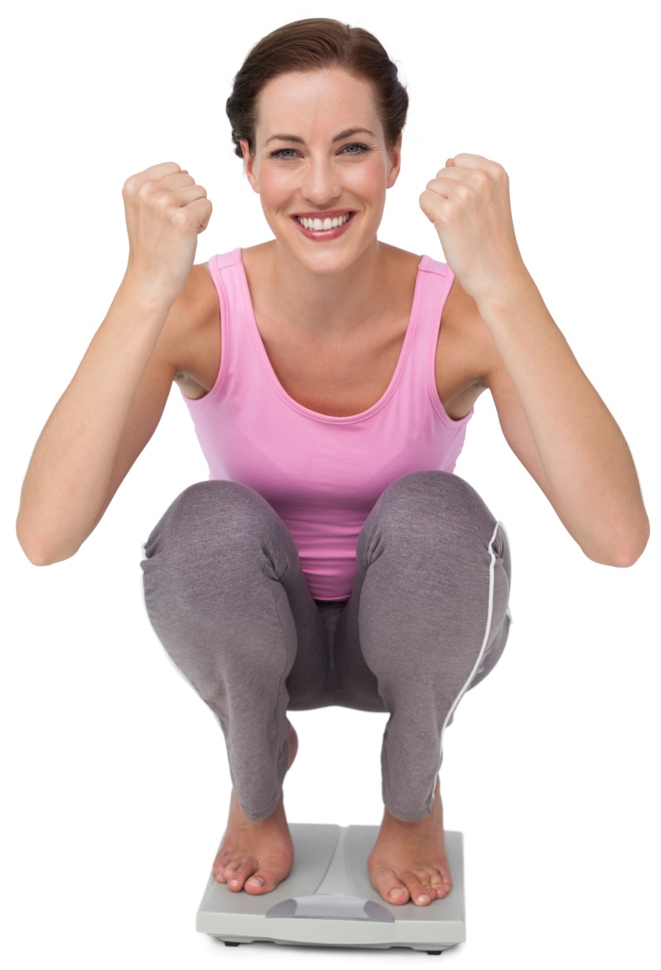
It’s true! Expelling this waste helps your body to function more effectively. This makes it easier to lose more weight!

Slide 6
Common Causes of Toxicity
Processed Foods
Air and Water Pollution
Pesticides & Herbicides
Home Cleaning Products
Poor Elimination
Overeating
Lack of Fiber
Sedentary Lifestyle
Sluggish Lymphatic System
Stress
Lack of Water
Commercial Skincare Products

Slide 7
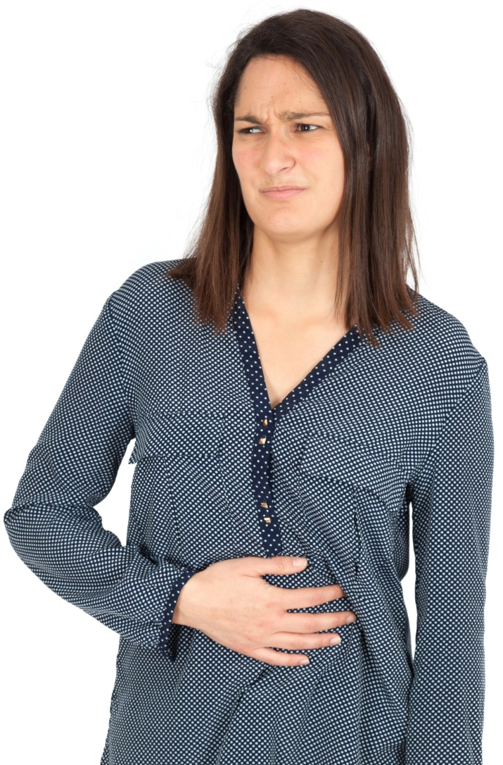
Natural Healing Abilities
Your body’s natural healing abilities are really quite incredible. When your body accumulates more toxins than it can handle, it tries to force them out so that they can’t do further damage.

Slide 8
You don’t even have to think about it. Your body knows how to do this automatically!

Slide 9
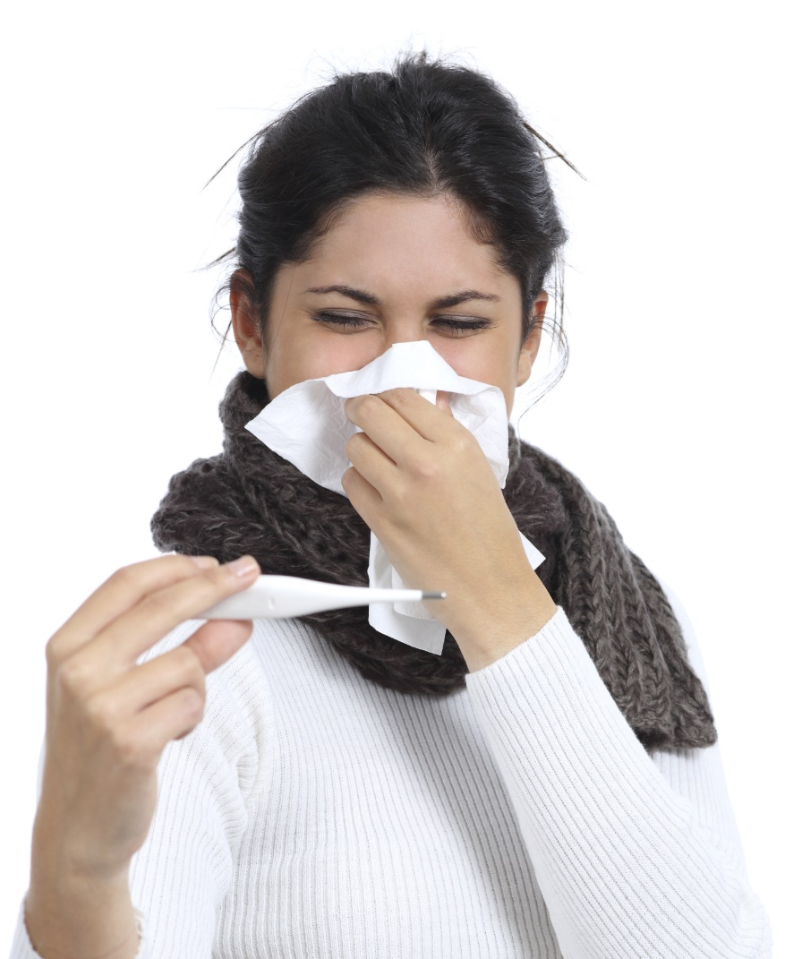
How Toxins are Eliminated
Toxins are eliminated through body openings – the pores of the skin, eyes, ears, nose, mouth, rectum, and urinary tract – as a part of your body’s natural cleansing system.

Slide 10

Toxins and Weight Gain
When we consume more toxins than our body is able to eliminate, we gain weight and develop cellulite!

Slide 11

Detoxification and Weight Loss
If you’re overweight, your body probably isn’t optimally healthy. Detoxification deep cleans your body and makes it much easier to lose weight.

Slide 12
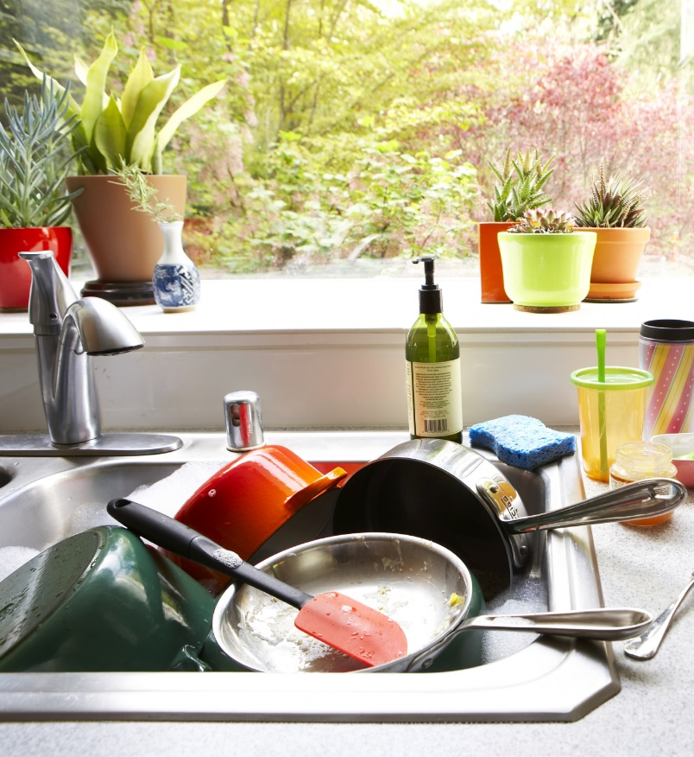
For Example…
Think about your kitchen sink. Over time, it can accumulate chunks of solid food, grime, and bad bacteria that clog the disposal and get all over your dishes.

Slide 13
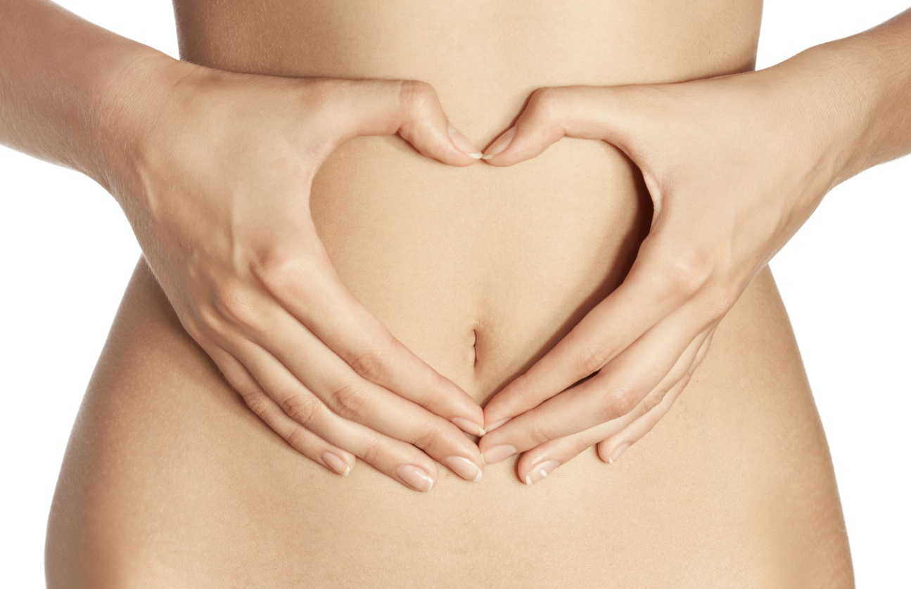
Your gut works in the same way! It needs to be cleaned periodically to function optimally.

Slide 14
Detoxification gives your body the chance to heal itself safely, naturally, and effectively.

Slide 15

How Often Should I Detoxify?
A 7-day detox done four times per year will do wonders! Scheduling a detox with the change of each season makes it easy to remember.

Slide 16
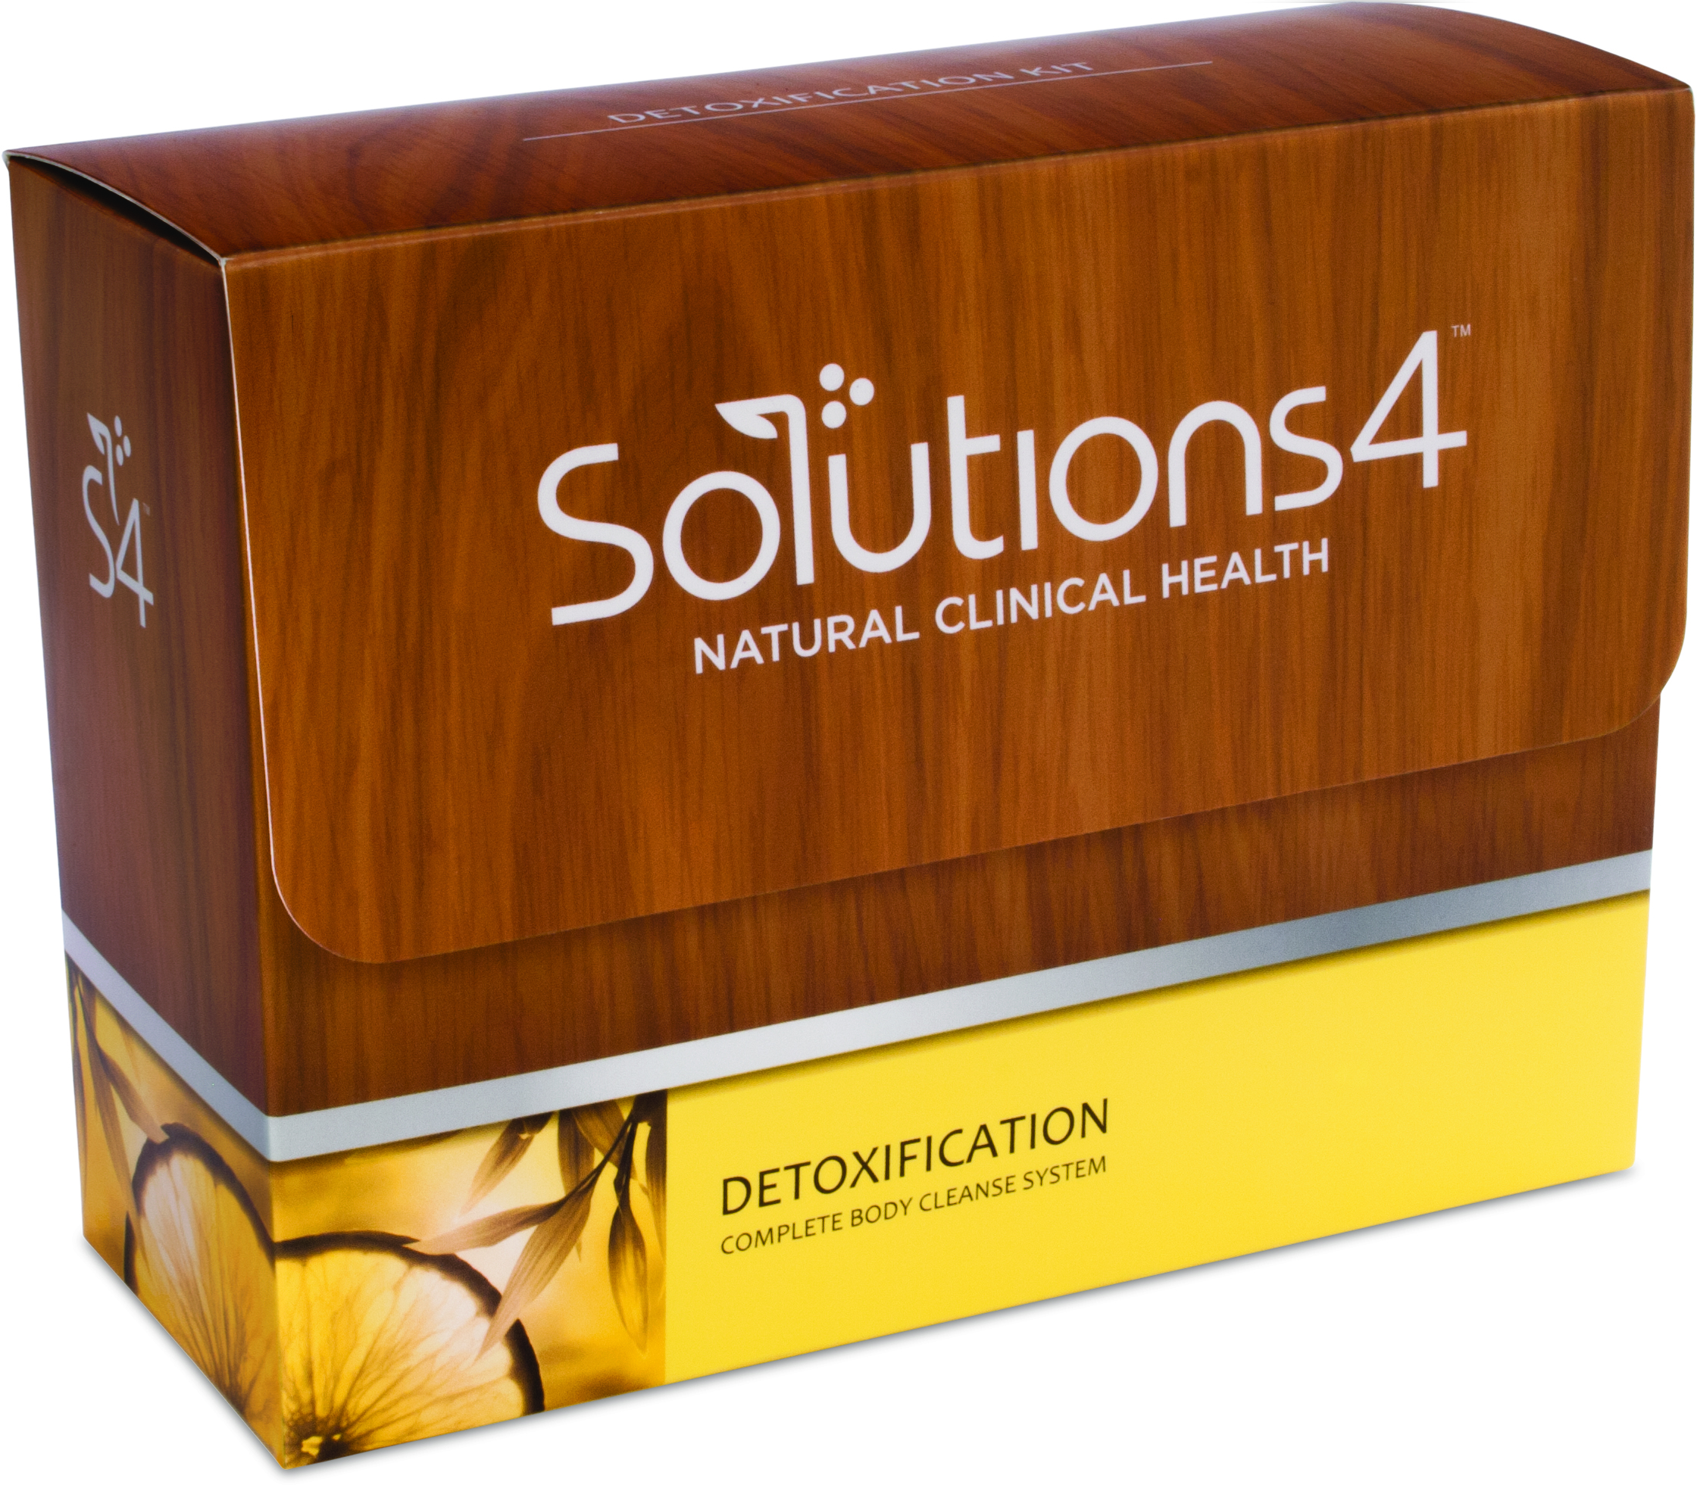
Solutions4 Detox Kit
The Solutions4 Detoxification Kit is designed to deep clean your body from the inside out.

Slide 17
Solutions4 Detox Kit
Unlike other supplements that you can find on a grocery store shelf, this kit is only sold by doctors. All ingredients are guaranteed to be 100% pure and extremely potent.

Slide 18

Detoxifying Treatments
Our Infrared Sauna is completely different from the sauna you might find at the gym. While a regular sauna penetrates about 1/8 of an inch deep, an Infrared Sauna penetrates all the way to the bone!

Slide 19
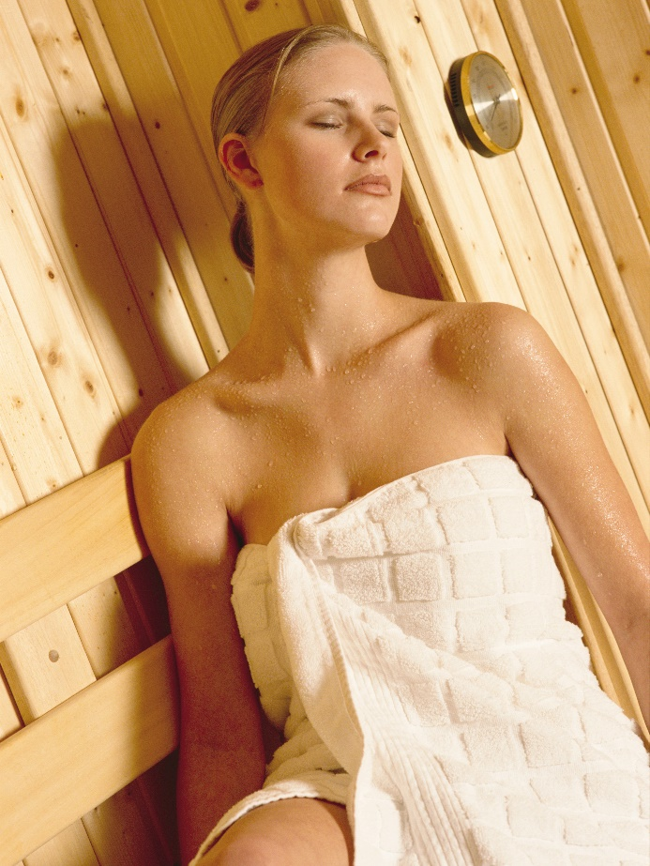
Detoxifying Treatments
Unlike a regular sauna, the Infrared Sauna causes a deep and detoxifying sweat at the cellular level (where toxins reside). This makes the Infrared Sauna uniquely able to produce weight loss, rejuvenation, and anti-aging benefits!

Slide 20
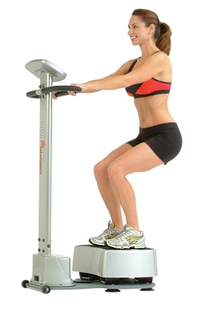
Detoxifying Treatments
Whole Body Vibration dramatically speeds up weight loss by promoting detoxification! This state-of-the-art vibration system has been shown to reduce cellulite by 27% in just 24 weeks! You won’t see these kind of results anywhere else.

Slide 21
Detoxifying Treatments
This one-of-a-kind system provides several additional benefits:
Decreased stress
Increased metabolism
Pain relief
Toning and tightening
Strengthening of core muscles
Increased posture and flexibility
Improved circulation

Slide 22
Summary:
Your body possesses a natural ability to eliminate harmful toxins.
When toxins are continually consumed, they build up faster than your body can eliminate them. This causes weight gain and sickness.
Detoxification removes all barriers to your body’s natural healing abilities. This makes it much easier to lose weight!

Slide 23
On Sale This Week:
The Solutions4 Detox Kit!

Slide 24

Integrate what you’ve learned today by listening to:
LHL004 —
Detoxifying the Body

