Slide 1
Welcome to
Club Reduce!

Slide 2

All of the classes in this series build upon one another.
By attending regularly, you’ll learn the habits of a naturally thin person!

Slide 3
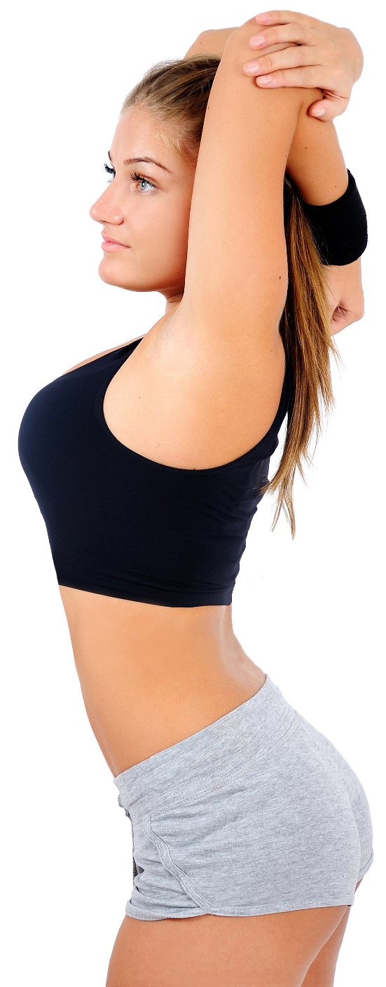
Today, we’re going to teach you how to exercise for optimum health and weight loss!
Notes:
There are many ways to lose weight without first creating health and harmony, but these methods will lead you to gain the weight back and return to your original weight (or worse). Time has proven that health and harmony are foundational for long-term weight loss. A healthy body will not be able to hold onto excess weight! This is the key that needs to be stressed in our seminars. This seminar is an introduction to removing toxins and excess fluid from the body in order to create the right environment for weight loss and health.

Slide 4
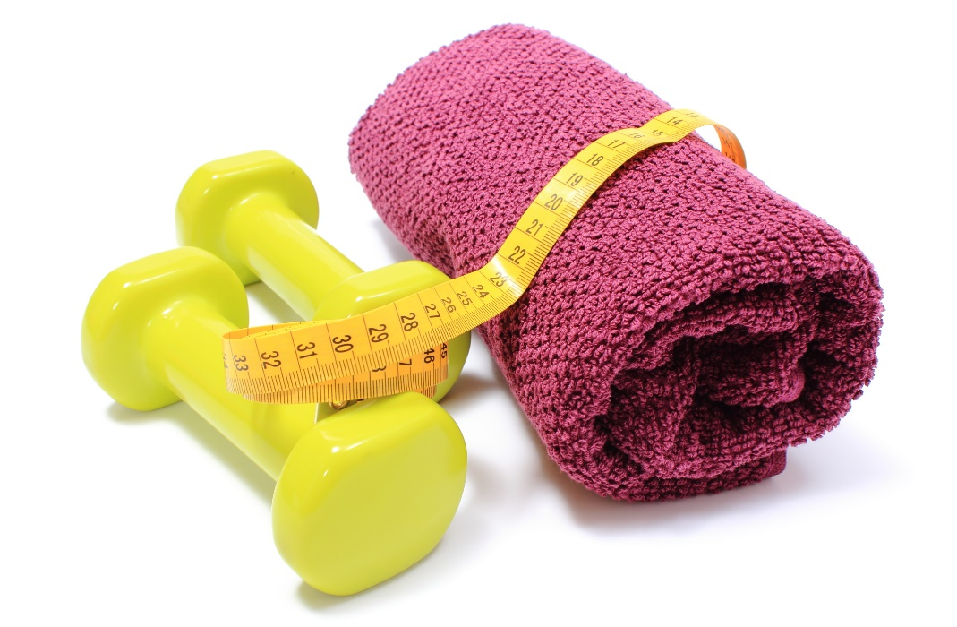
The Benefits of Exercise
We all know that exercise is important for optimal health and weight loss. Exercise
has so many benefits
that it’s difficult
to list them all!

Slide 5

The Benefits of Exercise
For one thing, exercise
reduces your risk of
developing
dangerous health
conditions like heart
disease, diabetes, and cancer.

Slide 6
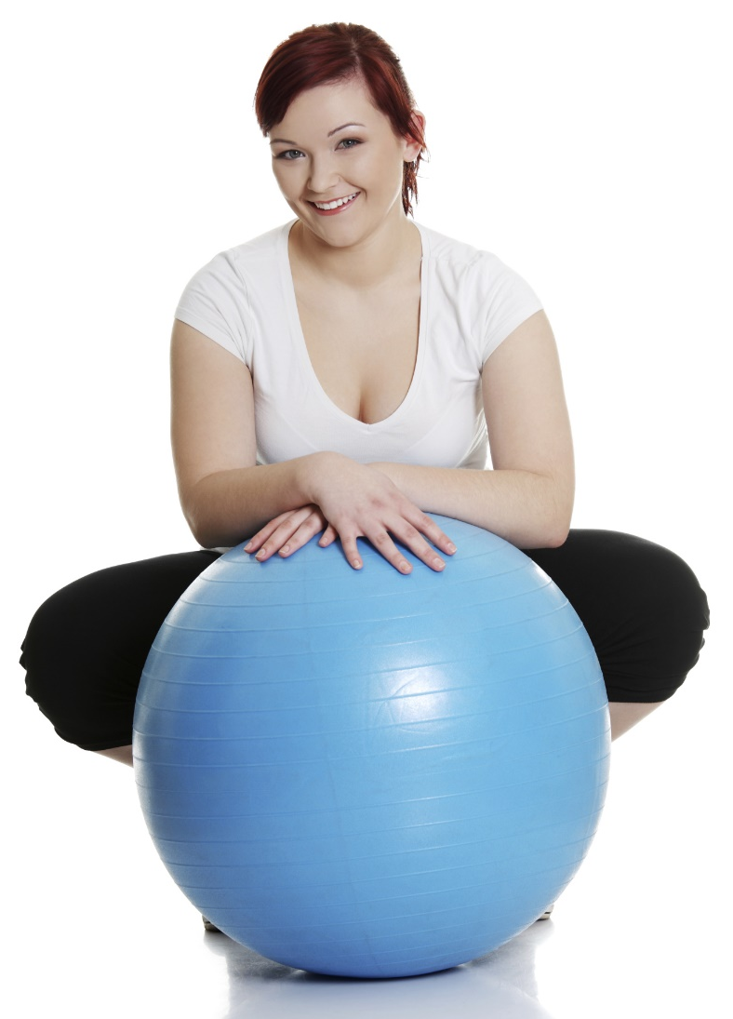
The Benefits of Exercise
If you already suffer from one of these conditions, exercise can improve the way that your body copes with the disease!

Slide 7
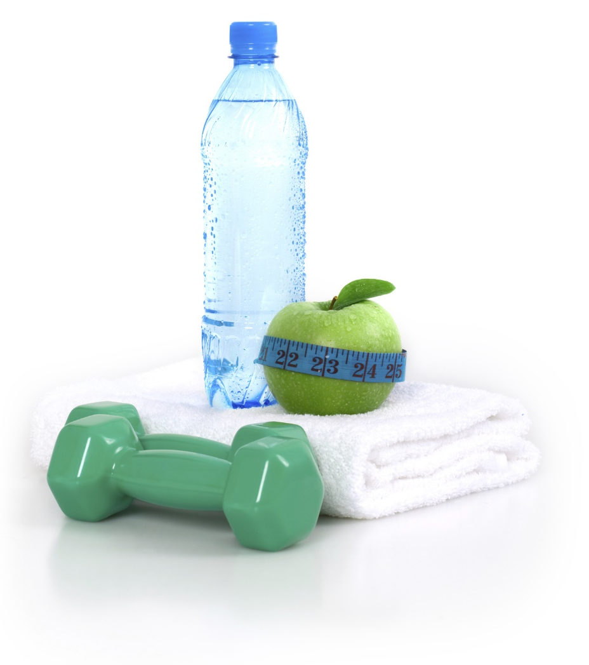
The Benefits of Exercise
Regular exercise strengthens your bones and muscles, increases your chances of living longer, and even improves your mental health and mood!

Slide 8

The Benefits of Exercise
Though nutrition makes a bigger difference when it comes to initial weight loss, exercise can
help ensure that you
keep the weight
off for good.

Slide 9
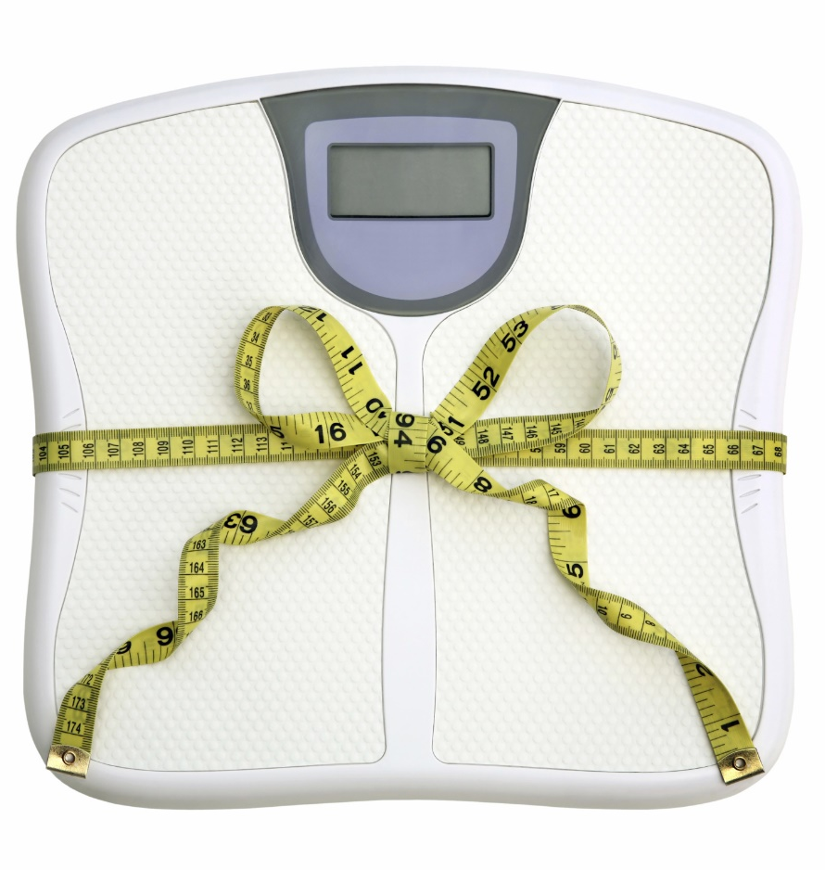
The Benefits of Exercise
This is because exercise increases your resting metabolic rate, helping you burn more calories throughout the day!

Slide 10
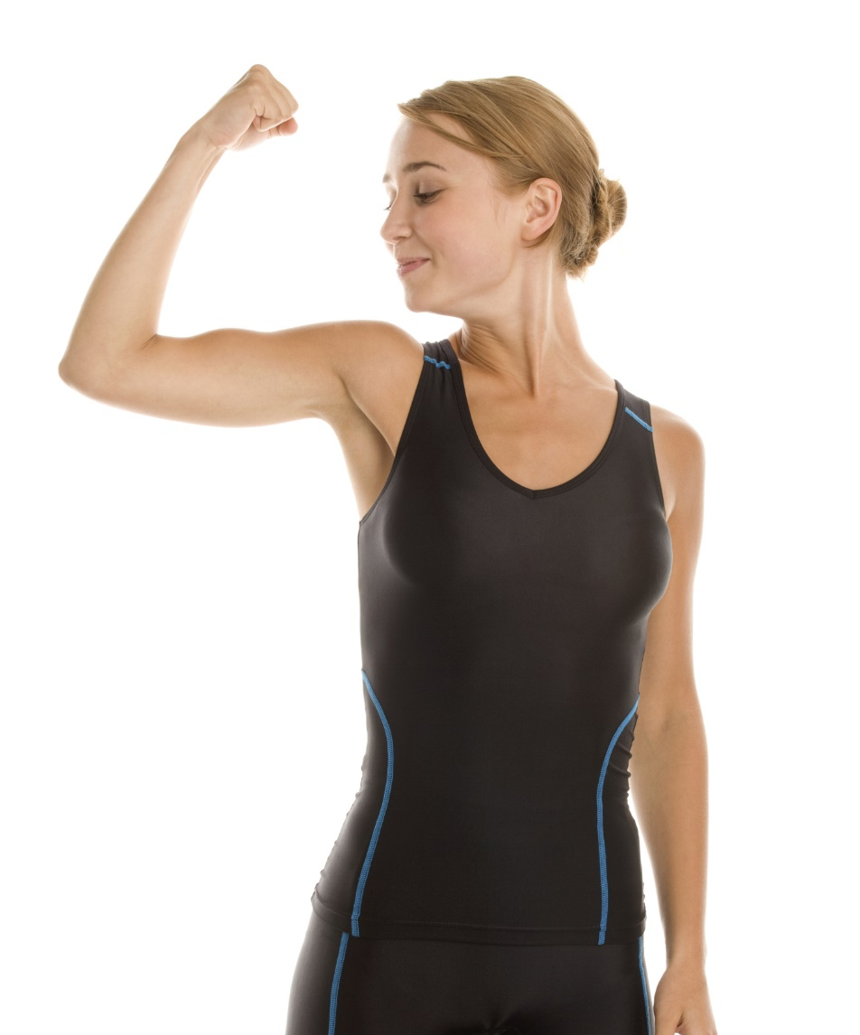
The Benefits of Exercise
It is estimated that for every pound of muscle added, the body burns
an extra 50-90 calories
per day. If you add 10 pounds of muscle, your body will burn 52 additional pounds of fat over the course of a year!

Slide 11
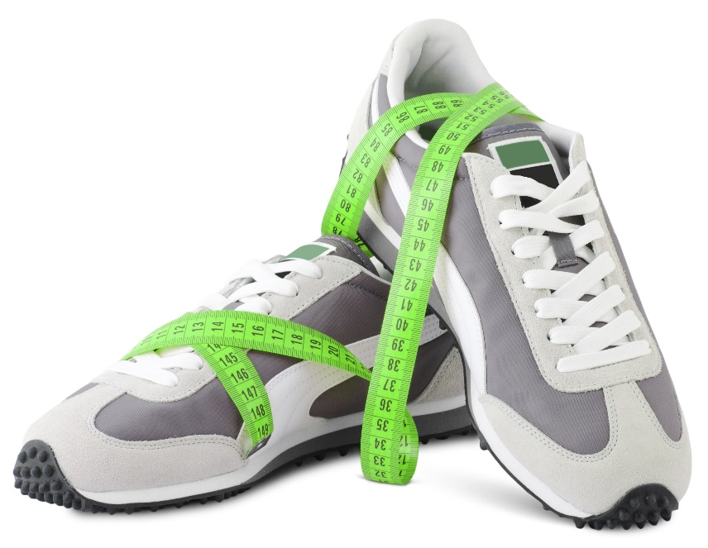
High-Intensity Interval Training
Here at Club Reduce, we recommend that you practice High-Intensity Interval
Training (HIIT) for 20 minutes a day, three times each week (Mon/Wed/Fri).
Monday | Wednesday | Friday
20 minutes | 20 minutes | 20 minutes

Slide 12
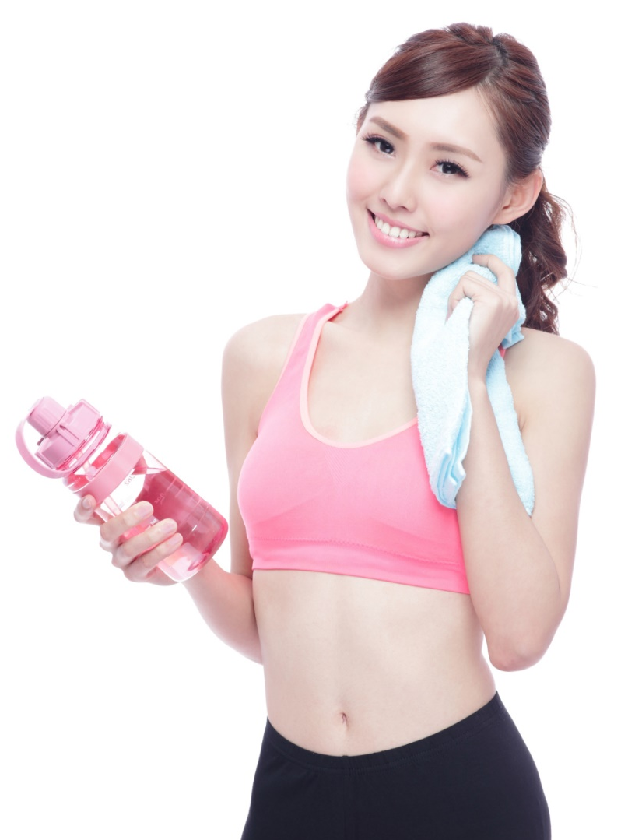
High-Intensity Interval Training
HIIT training involves short bursts of running (about 30 seconds) intermixed with periods of slow walking (1-2 minutes).

Slide 13
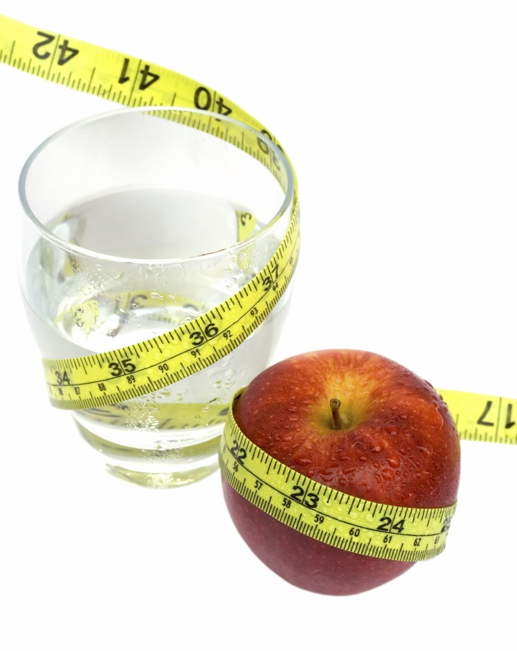
High-Intensity Interval Training
Though this only adds up to one hour each week, the high-intensity sessions will dramatically increase your production of fat-burning hormones and help you lose weight throughout the week!

Slide 14
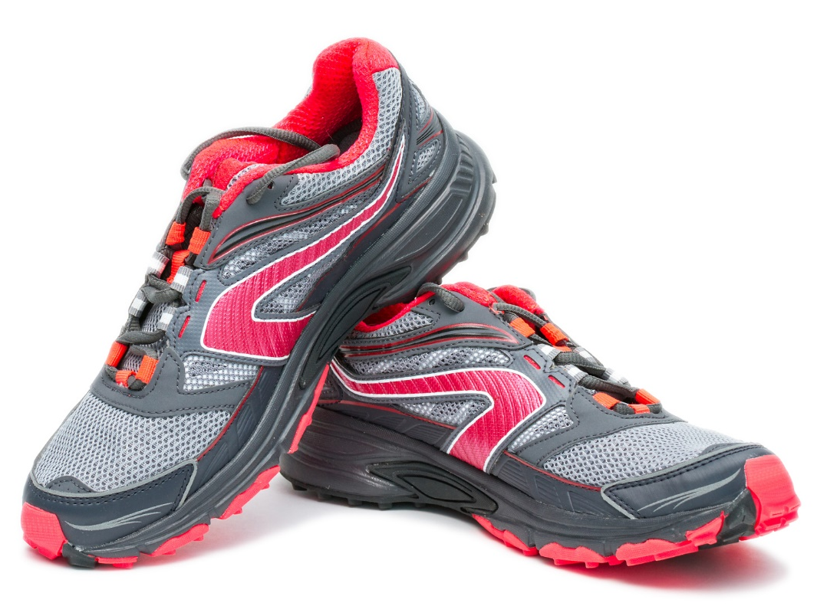
High-Intensity Interval Training
You can exercise at a high intensity in many different ways! You can go running outside, use a treadmill, or
pedal on an elliptical
machine. You don’t
have to own anything
more than a pair of
tennis shoes to
make it work!

Slide 15
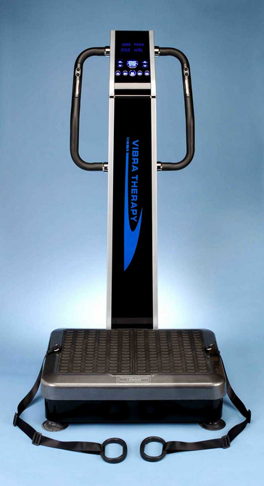
Whole Body Vibration
Whole Body Vibration (WBV) is also a time-efficient way to sneak in a workout at any time of the day! This machine is excellent for those who don’t have the time, energy, or motivation to hit the gym daily. All you have to do is stand on the vibrating platform and let the machine work its magic.

Slide 16


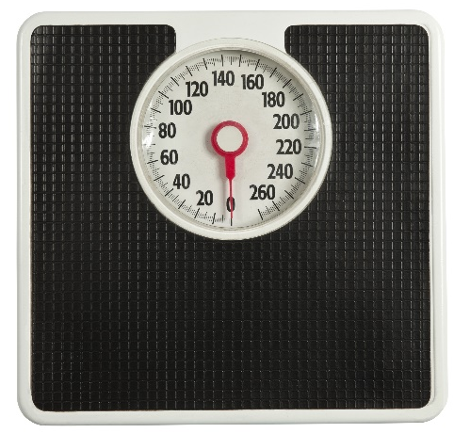
The Incredible Solutions4
Nutritional Shake
The Nutritional Shake is an incredible tool for post-workout recovery. Each time you use it, you’ll save yourself time, money, and calories!

Slide 17
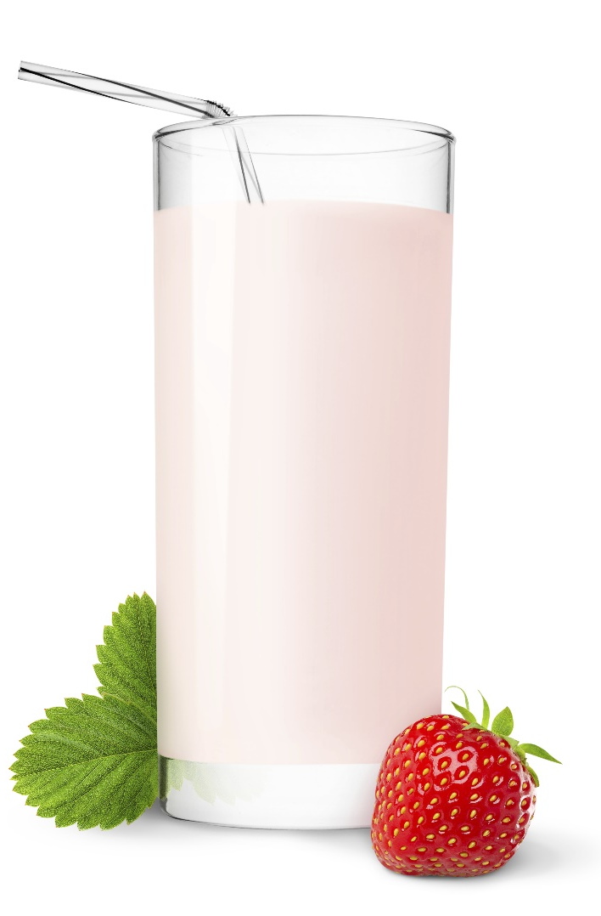
The Incredible Solutions4
Nutritional Shake
After you hit the gym (or the WBV machine), your body’s glycogen reserves are running low. Your blood sugar levels are also low, and your muscles are in a highly nutrient-receptive state. This is the perfect time for you to drink a Nutritional Shake!

Slide 18

The Incredible Solutions4
Nutritional Shake
The protein in our shake comes from grass-fed, free-range cows in New Zealand. This ensures that the final product has a superior fatty acid profile (full of healthy omega-3) and is 100% free of all hormones, antibiotics, and pesticide residues.

Slide 19
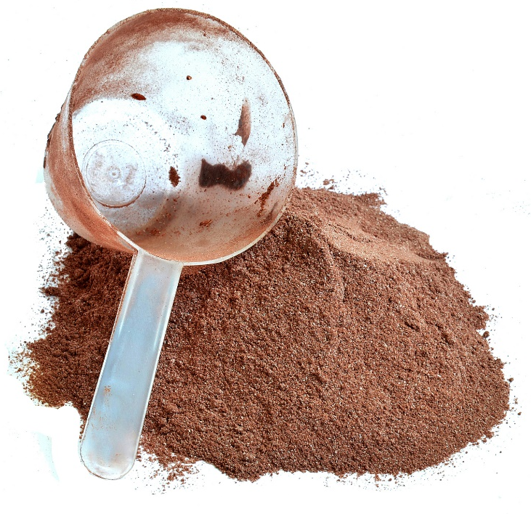
The Solutions4 Nutritional Shake:
Nutrition Information
20 grams of protein
5 grams of fiber
10 grams of carbs
180 calories
8 billion units of probiotics
5 digestive enzyme types
36 vitamins, minerals, & other nutrients

Slide 20
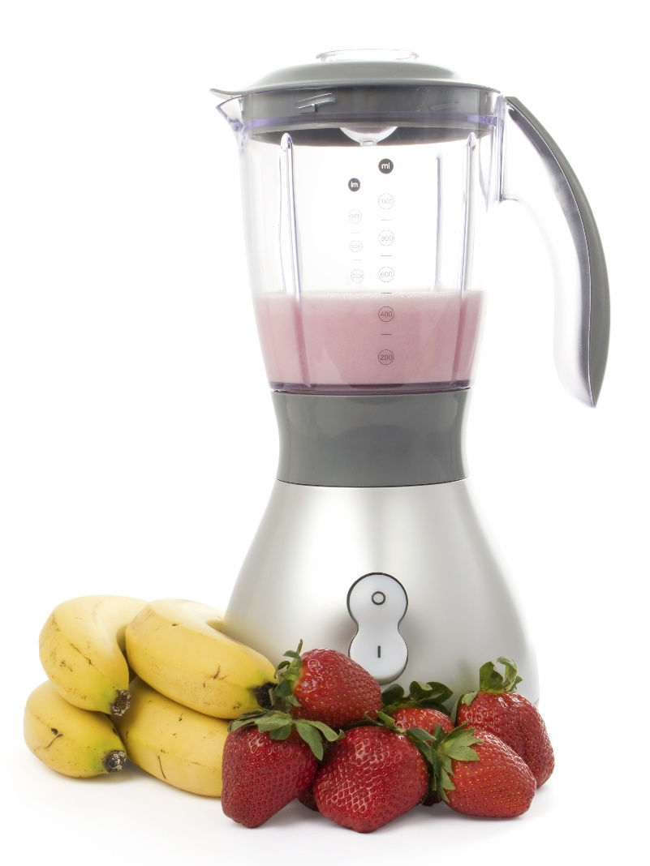
The Incredible Solutions4
Nutritional Shake
Though our protein is derived from dairy, we use a special process to remove all of the lactose and casein. Once this special process is complete, no reactive proteins are left in the final product — making it safe for those with dairy sensitivities.

Slide 21
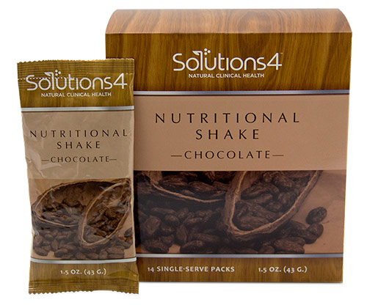
Also Available in Single-Serve Packs!
You can also take these single-serve packs with you wherever you go!
You can bring them with
you to the gym, to work,
or even on vacation!
Some parents even pack
them into their children’s
lunches to ensure that
they get 100% nutrition
away from home.

Slide 22
Summary:
Exercise prevents and alleviates a variety of health conditions. It’s also essential for weight maintenance!
You can use Whole Body Vibration when you don’t have time to hit the gym.
Don’t forget to use the Solutions4 Nutritional Shake for a perfect post-workout recovery beverage!

Slide 23
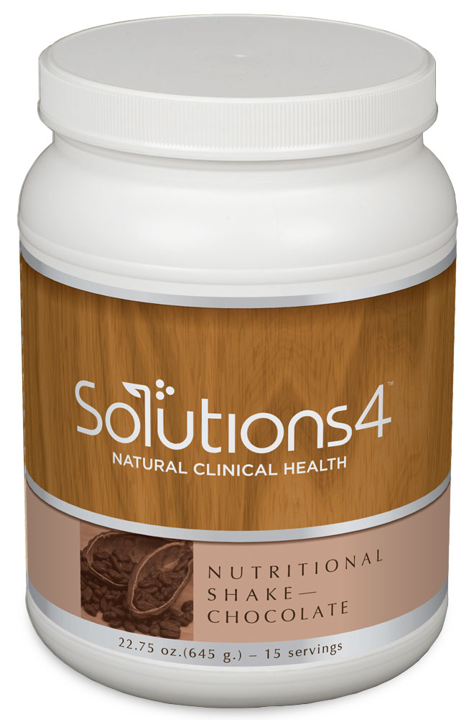
On Sale This Week:
The Solutions4 Nutritional Shake!

Slide 24
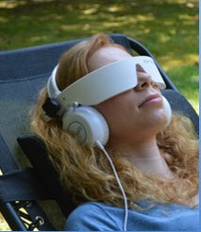
Integrate what you’ve learned today by listening to:
LHL005 — Get the
Most out of Your
Workout

