Slide 1
Welcome to
Club Reduce!

Slide 2

All of the classes in this series build upon one another.
By attending regularly, you’ll learn the habits of a naturally thin person!

Slide 3

Today, we’re going to teach you our all-natural secrets for silky smooth, ageless, radiant skin!

Slide 4

Want Healthy, Radiant Skin?
We all know that healthy, radiant skin requires a healthy lifestyle and a little bit of effort. But do you know exactly which steps you can take to improve your skin tone
and texture?
Keep listening to find out!

Slide 5
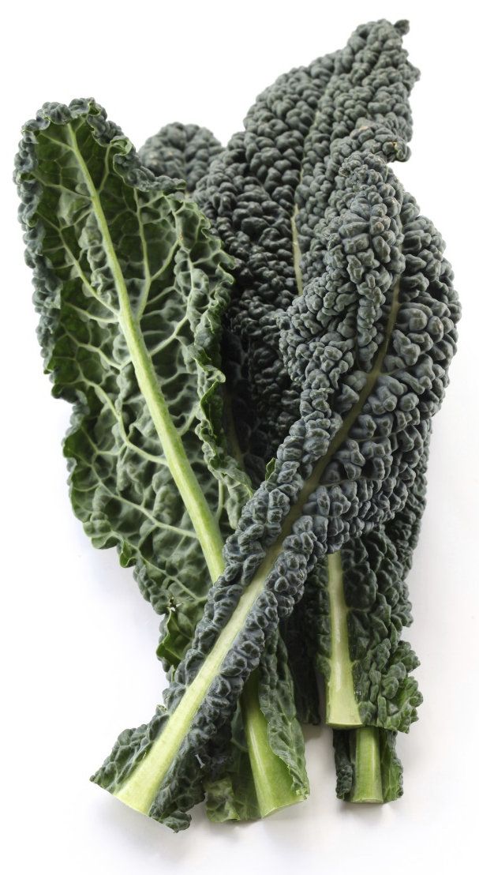
All-Natural Secret #1
Eat plenty of superfoods.
Superfoods include dark leafy greens (spinach, kale, watercress, etc.), brightly colored vegetables (tomatoes, peppers, etc.), antioxidant-rich fruits (blueberries, blackberries, etc.), and omega-3 rich fish!

Slide 6

All-Natural Secret #2
Don’t stress.
Stress plays a major role in the health of your skin. When you’re stressed, your body releases a hormone called cortisol. This hormone can accelerate the aging process, causing fine lines and wrinkles to become visible.

Slide 7

All-Natural Secret #3
Get plenty of sleep.
Sleep plays a big role in limiting your body’s production of cortisol. During sleep, your body also repairs any damage that’s been done during the day. Make sure that you’re getting at least 7-8 hours a night!

Slide 8

All-Natural Secret #4
Detox regularly.
Regular detoxification helps to cleanse the body of the toxins that contribute to dull, lifeless-looking skin. To optimize your health and let your skin really shine, we recommend that you detox on a quarterly basis.

Slide 9

All-Natural Secret #5
Sweat it out.
Sweating encourages the release of harmful toxins from the skin. Exercise also stimulates circulation, facilitating the removal
of toxins from within the body. This is why exercise is so
good for your complexion!

Slide 10
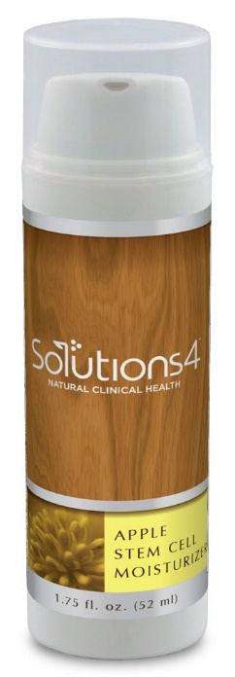
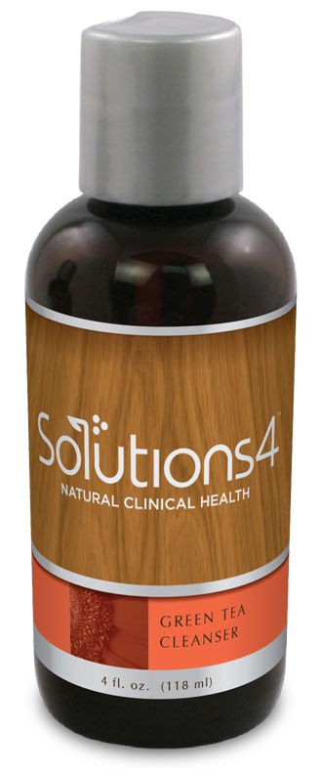
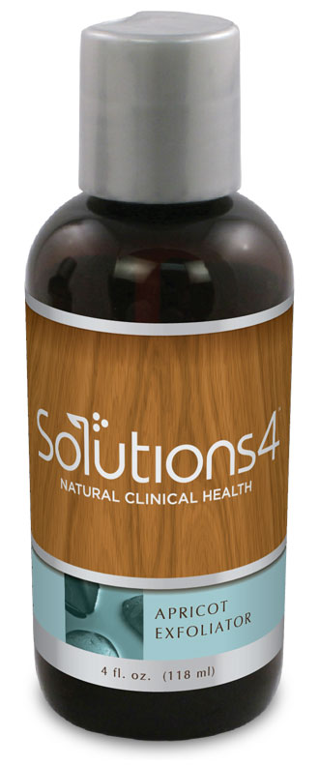
The Skincare Trio
The Solutions4 Skincare Trio includes our three most essential products:
Green Tea Cleanser
Apricot Exfoliator
Apple Stem Cell Moisturizer
You’ll love how radiant these all-natural products make you look and feel!

Slide 11
Green Tea Cleanser
The Green Tea Cleanser is a super-potent cleanser that heals and softens your skin. It includes antioxidants like green tea leaves, CoQ10, and vitamin C to fight off the free radicals that cause premature aging.

Slide 12
Apricot Exfoliator
The Apricot Exfoliator is a grapeseed-oil based scrub that uses apricot seeds to provide gentle exfoliation. It also contains collagen and elastin builders to prevent against fine lines and wrinkles!

Slide 13

Apple Stem Cell Moisturizer
The Apple Stem Cell Moisturizer uses stem cells derived from a rare Swiss apple (the Uttwiler Spätlauber) to restore skin to a state of youthful vibrancy. This allows us to literally give aging skin a fresh new start.

Slide 14
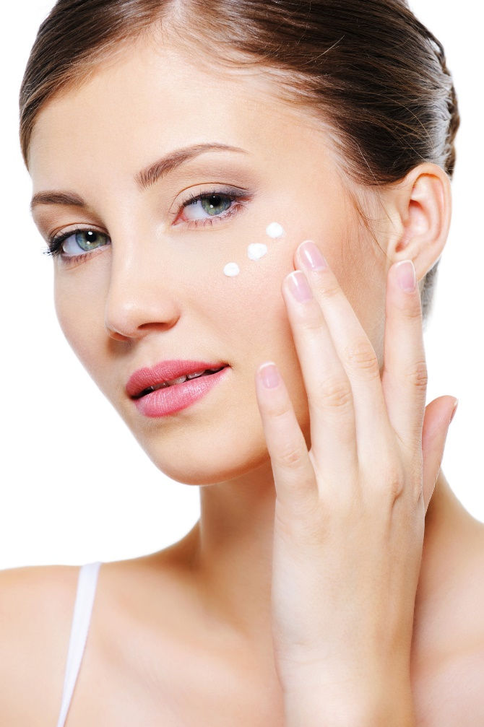
Eye Serum
In addition to these three basic products, we have a few more skincare products that will leave your skin looking radiant. If you suffer from dark circles or under-eye puffiness, you’ll love the Eye Serum!

Slide 15
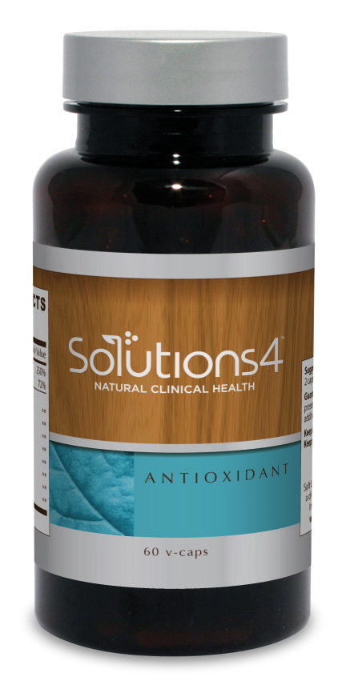
Antioxidant
We also offer some incredible skin-saving supplements that will leave you looking your very best! The Solutions4 Antioxidant contains some of the most powerful antioxidants found in nature (astaxanthin, mozuku, gingko biloba, bilberry fruit, etc.).

Slide 16
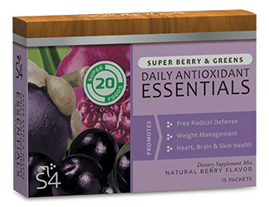
Daily Antioxidant Essentials
For a delicious dose of skin-saving antioxidants, you
can also try the Solutions4 Daily Antioxidant
Essentials! This products packs in the same healing benefits as the previous supplement, but in a convenient grab-and-go pack.

Slide 17

Luxana Light Therapy
When you use the Luxana Light Bed, the energy from hundreds of tiny LED lights will penetrate your skin and work its magic! A Luxana session will leave your skin looking tight, toned, and absolutely radiant.

Slide 18
Summary:
To unlock your skin’s natural beauty, it’s important to eat plenty of superfoods, avoid excess stress, get plenty of sleep, detox regularly, and engage in (sweaty) physical activity!
For an incredible skincare routine that will change your life (or at least, your skin), use the Skincare Trio and Eye Serum.
Use the Solutions4 Antioxidant supplement to provide your body with the nutrients it needs for vibrant skin.
Don’t forget to take advantage of our incredible Luxana light bed by scheduling an appointment today!

Slide 19
On Sale This Week:
The Skincare Trio
We’re offering a discount on our three most essential skincare products:
Green Tea Cleanser
Apricot Exfoliator
Apple Stem Cell Moisturizer
Don’t miss this incredible opportunity!

Slide 20
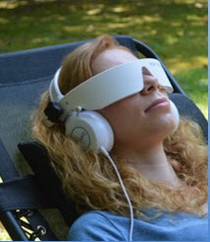
Integrate what you’ve learned today by listening to:
LHL006 — All-Natural
Secrets for Radiant
Skin

