Slide 1
Welcome to
Club Reduce!

Slide 2
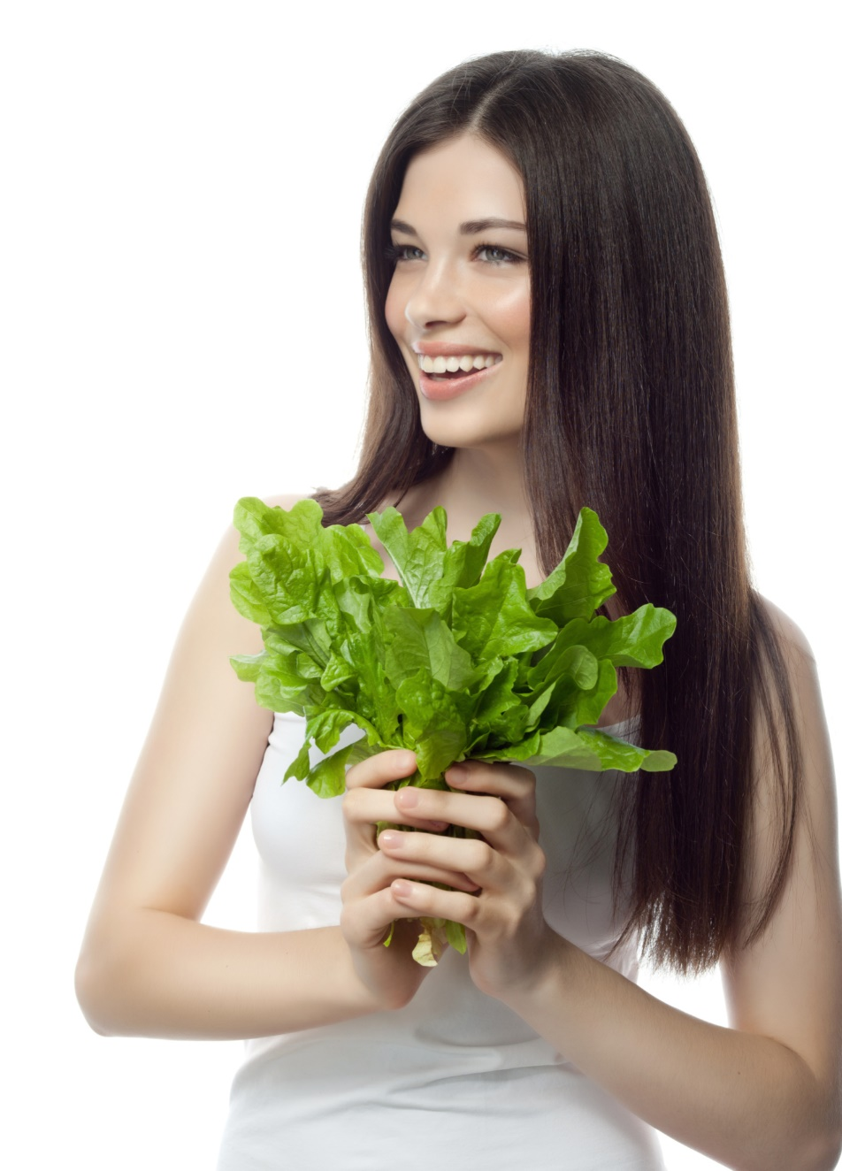
Today, we’re going to teach you how leafy greens can boost your nutritional intake and
change your
life!
Notes:
There are many ways to lose weight without first creating health and harmony, but these methods will lead you to gain the weight back and return to your original weight (or worse). Time has proven that health and harmony are foundational for long-term weight loss. A healthy body will not be able to hold onto excess weight! This is the key that needs to be stressed in our seminars. This seminar is an introduction to removing toxins and excess fluid from the body in order to create the right environment for weight loss and health.

Slide 3

All of the classes in this series build upon one another.
By attending regularly, you’ll learn the habits of a naturally thin person!

Slide 4
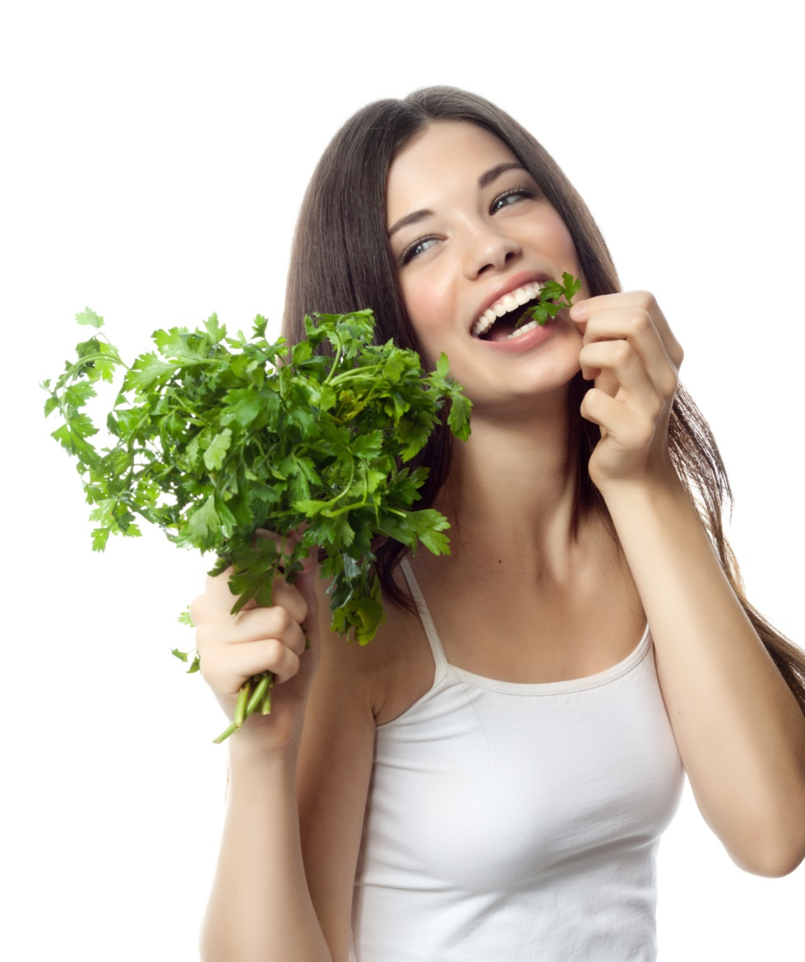
What Are Leafy Greens?
Leafy greens are nature’s multivitamin. They’re packed with vitamins, minerals, enzymes,
and antioxidants that nourish your body and rejuvenate your mind.

Slide 5
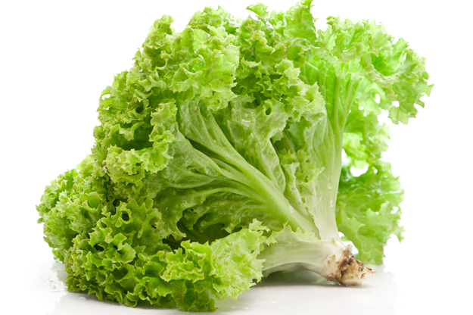
What Are Leafy Greens?
Leafy greens include vegetables like:
Kale
Chard
Romaine Lettuce
Red/Green Leaf Lettuce
Collards
Spinach
Arugula
Bok Choy
And so much more!

Slide 6
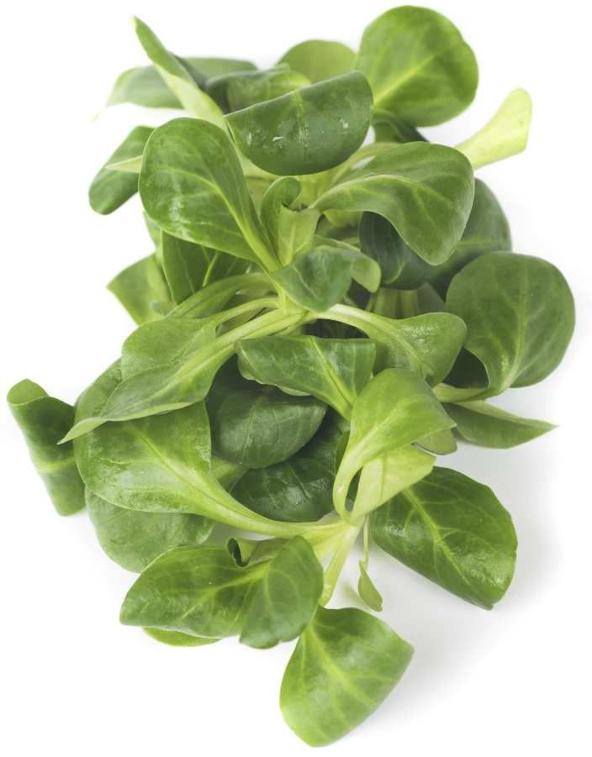
Why Are They So Important?
Leafy greens are an unparalleled source of nutrition. Leafy greens are packed with essential nutrients like magnesium, calcium, potassium, manganese, and folate. Your body needs these nutrients to maintain a steady supply of energy and feel good throughout the day!

Slide 7
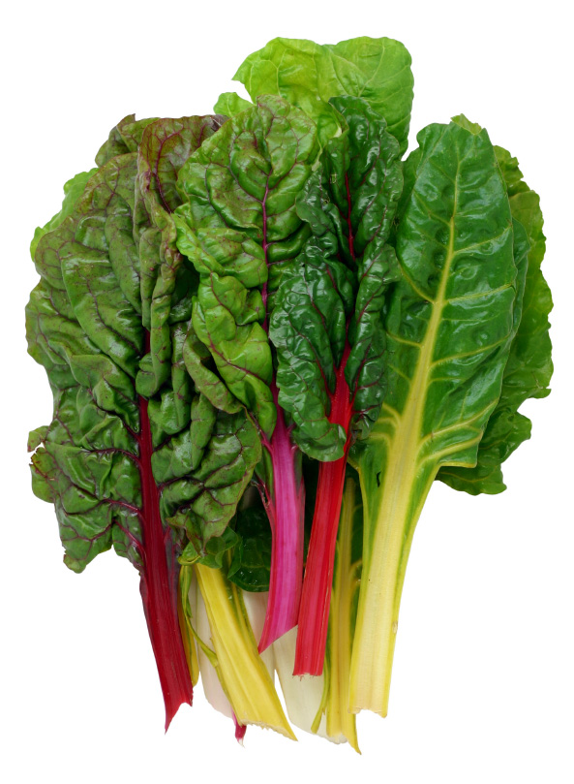
Why Are They So Important?
Leafy greens are necessary for optimum brain function. Studies show that adding leafy greens to your diet can slow cognitive decline and prevent brain-based diseases (like Alzheimer’s). To keep your mind sharp, a daily serving of leafy greens can go a very long way!

Slide 8
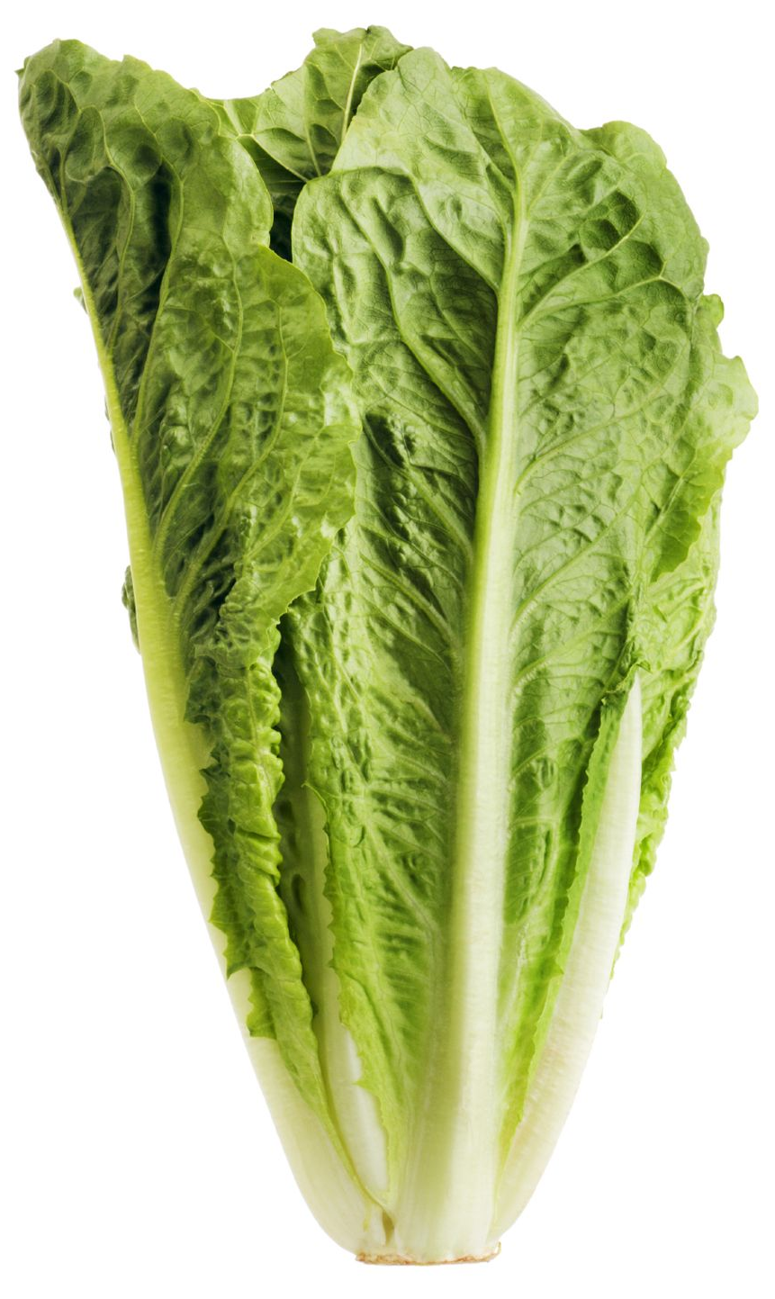
Why Are They So Important?
Leafy greens are useful for weight control. Leafy greens are packed with the fiber that your body needs to feel full and satisfied. They also contain thylakoids — a substance known to trigger satiety signals and help you regulate your food intake!

Slide 9
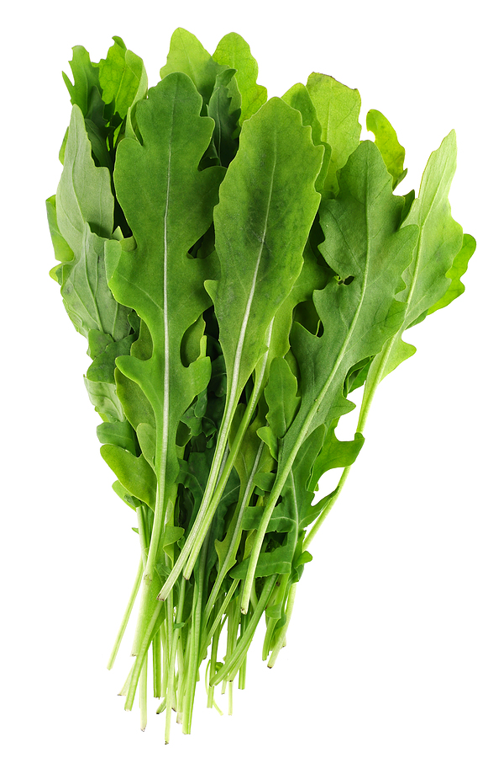
Why Are They So Important?
Leafy greens protect against disease. They’re known for their ability to protect against cardiovascular disease, stroke, high blood pressure, and even cancer! In the immediate future, leafy greens can increase exercise performance and help you meet your fitness goals.

Slide 10
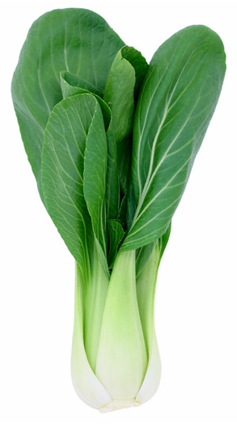
Why Are They So Important?
Leafy greens are important for strong bones. Though most people associate dairy products with bone health, leafy greens are actually a much healthier alternative. The calcium in leafy greens (like spinach and kale) is actually far more bioavailable than the calcium you would get from cow’s milk.

Slide 11
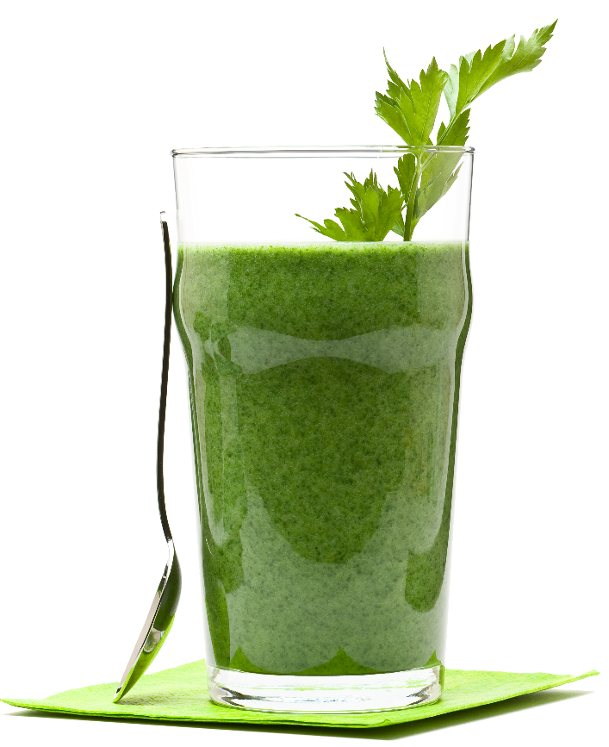
How Can You Eat More?
There are several ways that you can get more greens in your diet. Here are some of our favorites:
Make a green smoothie for
breakfast in the morning.
Make your own cold-pressed
green juice.
Mix greens into a vegetable soup.
Eat a salad once a day.

Slide 12
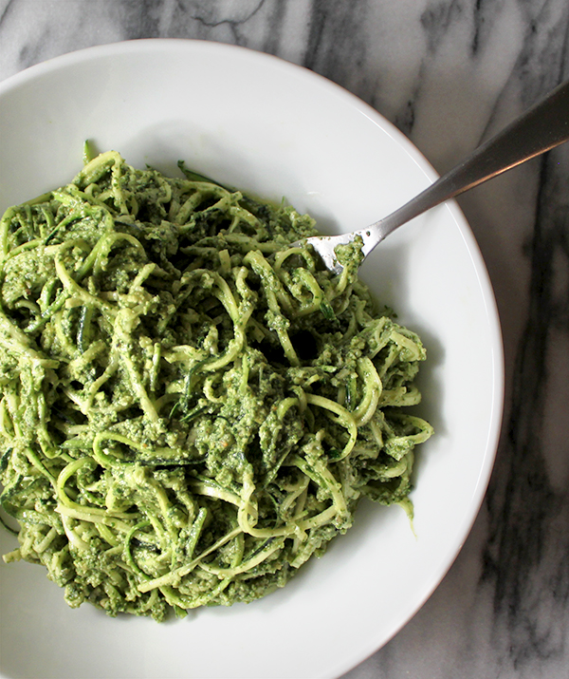
How Can You Eat More?
Add several large handfuls of leafy greens into your eggs in the morning.
Sneak greens into homemade desserts (brownies, for example).
Put greens in a pesto-flavored pasta sauce.
Make lettuce wraps (with a meat and/or vegetable filling).

Slide 13
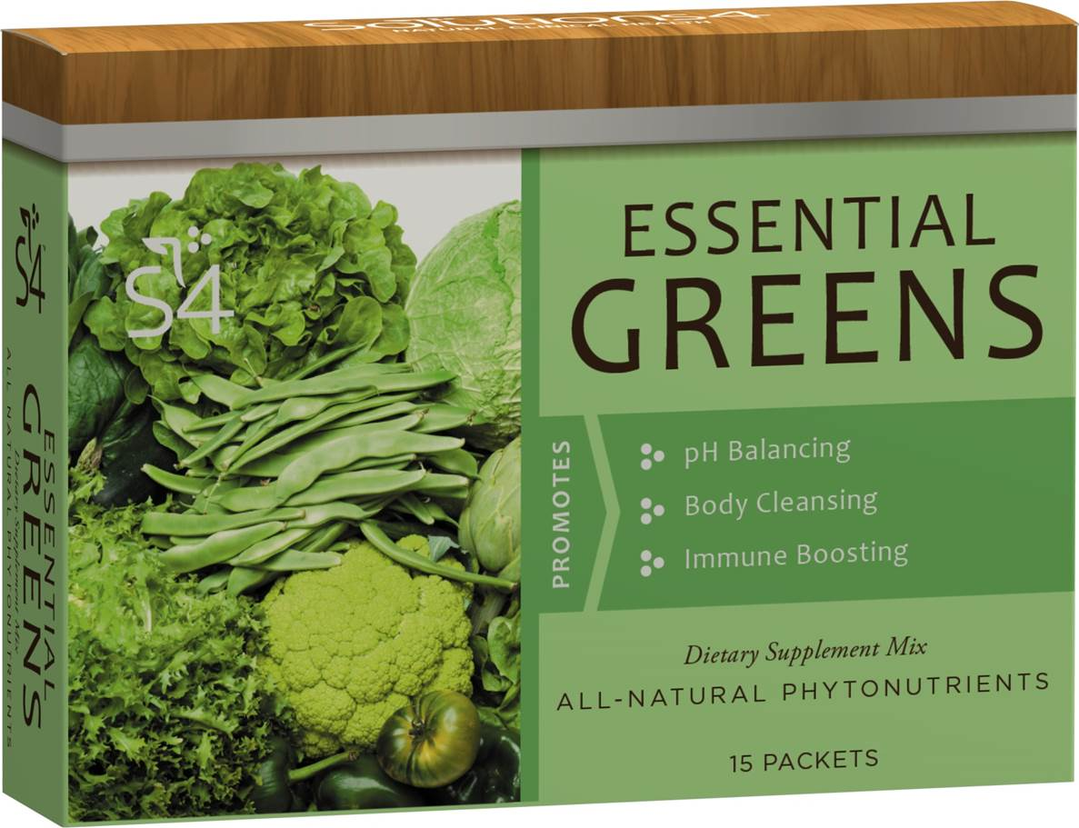
An Easy Solution:
Essential Greens
If you’re struggling to get enough greens in your diet each day, don’t
despair! We’ve created
a simple and delicious
supplement that you
can use at any point
throughout the day.
Just mix with water
and enjoy!

Slide 14

Essential Greens
Each time you drink your greens, you’ll feel cleaner, healthier, and more mentally aware. You may find that this gives you just the energy boost you need to cut out your morning coffee! You will absolutely love the way this drink makes you feel.

Slide 15
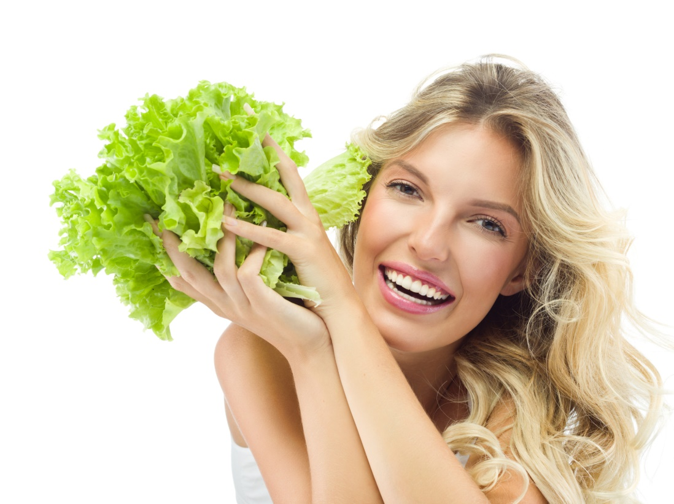
Essential Greens
When you drink your greens, you’ll receive all of these incredible benefits:
Increased natural immunity
More energy
Better mental clarity
Clearer skin
Healthier blood sugar levels
Improved detoxification

Slide 16

Another Easy Solution:
Daily Antioxidant Essentials
To get greens into your diet on a daily basis, we have another incredible tool at your disposal:
Daily Antioxidant
Essentials! Each serving
of this delicious
beverage is packed with
essential nutrients that
your body needs!

Slide 17
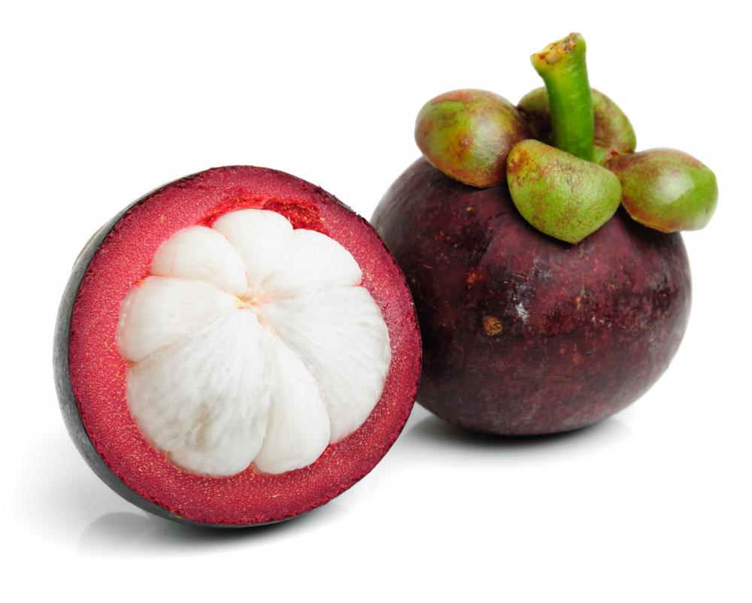
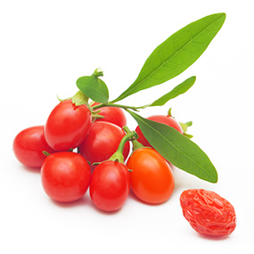
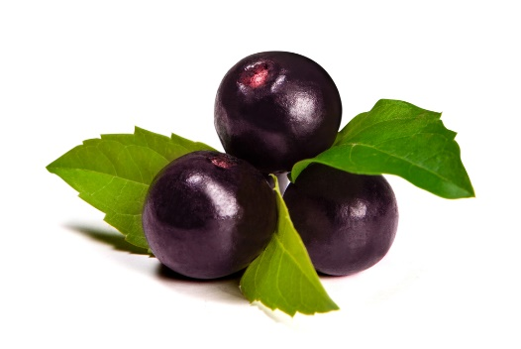
Daily Antioxidant Essentials
This one-of-a-kind supplement contains healthy sea greens like chlorella and spirulina.
As an added bonus, it also contains a variety of other superfoods (acai berry, mangosteen, goji berry, golden kiwi, etc.).

Slide 18
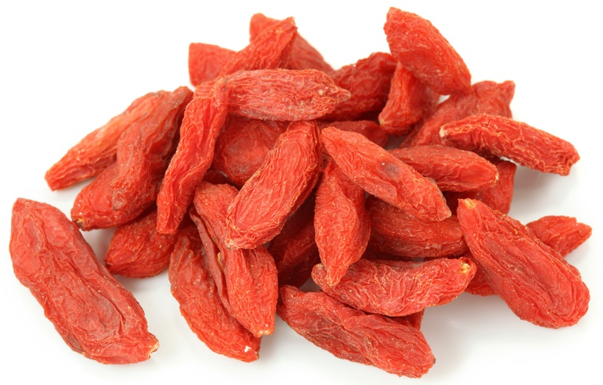
Daily Antioxidant Essentials
Each time you drink the Daily Antioxidant Essentials, you’ll feel instantly revitalized and ready to tackle whatever comes your way! You’ll also receive these incredible benefits:
More energy
Easier weight management
Improved skin tone
Healthier immune system
Better digestion
Reduced free-radical damage

Slide 19
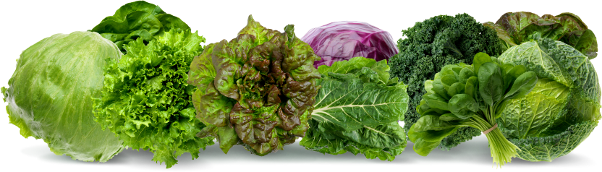
No Excuses!
With so many quick-and-easy ways to get greens into your diet, there are no excuses not to succeed! When you start incorporating these super-nutritious greens into your diet, you’ll start feeling like 100%.

Slide 20
Summary:
Leafy greens provide an unparalleled source of nutrition that is essential for a healthy diet. They boost your brain function, help you lose weight, protect against disease, and even strengthen your bones!
There are many ways to get greens into your daily diet, even if you don’t like salads. To balance optimum health with a busy life, use the Energizing Greens or Daily Antioxidant Essentials! Your body will thank you.

Slide 21
On Sale This Week:
Essential Greens!

Slide 22

Integrate what you’ve learned today by listening to:
LHL007 — Leafy
Greens: Nature’s
Multivitamin

