Slide 1
Welcome to
Club Reduce!

Slide 2

Today, we’re going to talk about three simple tips you can use to improve your digestive health.
Notes:
There are many ways to lose weight without first creating health and harmony, but these methods will lead you to gain the weight back and return to your original weight (or worse). Time has proven that health and harmony are foundational for long-term weight loss. A healthy body will not be able to hold onto excess weight! This is the key that needs to be stressed in our seminars. This seminar is an introduction to removing toxins and excess fluid from the body in order to create the right environment for weight loss and health.

Slide 3

All of the classes in this series build upon one another.
By attending regularly, you’ll learn the habits of a naturally thin person!

Slide 4

Digestion Gone Awry
In the United States today, digestive disorders are more prevalent than ever. 60-70 million Americans suffer from some type of digestive disease, and millions more suffer from occasional bloating, gas, constipation, or diarrhea. So why are these conditions on the rise?

Slide 5
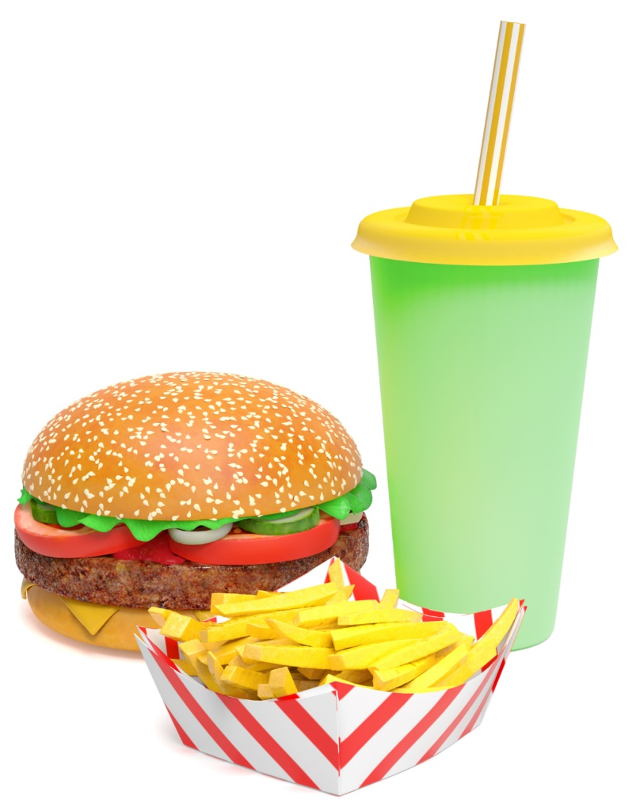
Digestion Gone Awry
Today, many people eat processed foods that have been stripped of important nutrients (fiber, enzymes, etc.). People are also more likely to eat meals too quickly or eat snacks on-the-go. These choices can wreak havoc on the digestive system.

Slide 6

Digestion Gone Awry
To make matters even worse, many of our foods are exposed to ionizing radiation that’s designed to kill bacteria and extend shelf life. Though this may seem desirable, irradiation depletes many important nutrients from food — including essential enzymes.

Slide 7
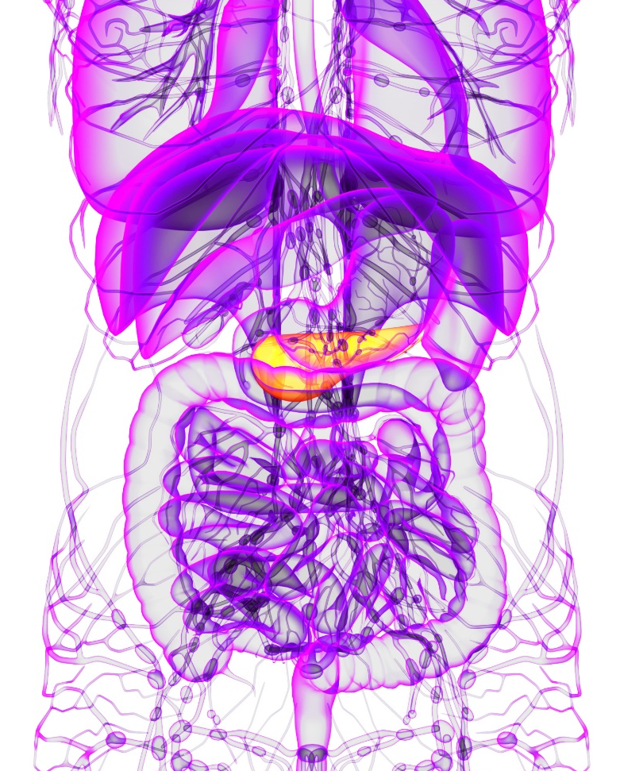
Digestion Gone Awry
The natural enzymes in raw foods help to facilitate healthy digestion. Without them, your body has to work harder to absorb the same nutrients from food.

Slide 8
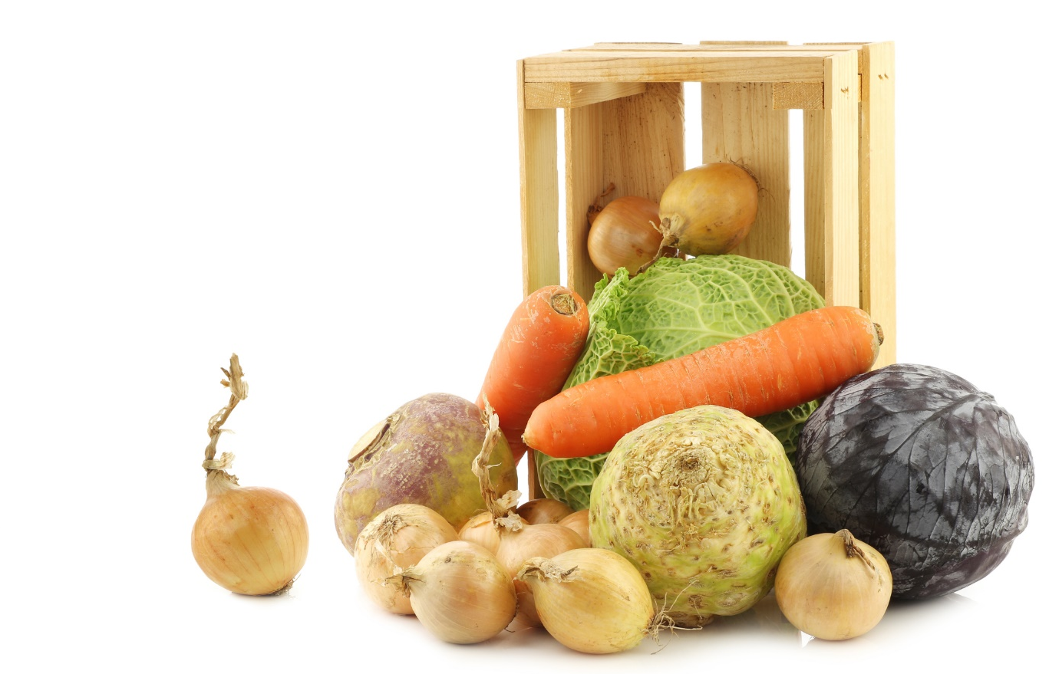

Digestion Gone Awry
Unfortunately, irradiated foods are
almost impossible to avoid.
Meats, fruits, vegetables, spices,
and other foods frequently
undergo this process before
they’re shipped out to
your local supermarket.
Only a small icon
distinguishes these
foods from others.

Slide 9

So What Can You Do?
With all of this going on around you, what can you do to take back your digestive health and start feeling better? We’d like to share three simple tips that will make all the difference in the world…

Slide 10
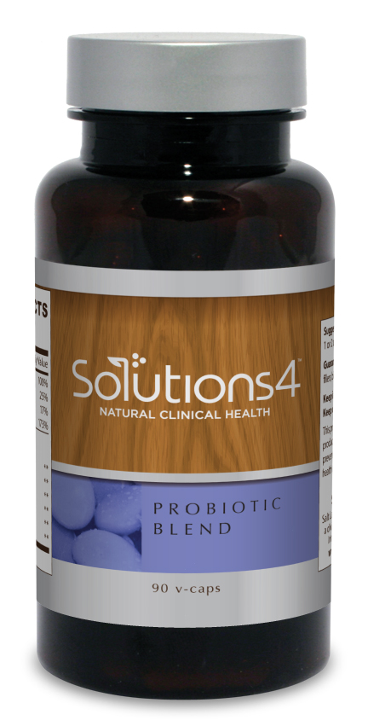
A Good Approach (Tip #1)
If you don’t always eat a 100% perfect diet (and avoid all irradiated foods), try the Probiotic Blend! Taking a high-quality probiotic can relieve digestive problems, boost immunity, facilitate healthy weight loss, and provide a number of other important benefits!

Slide 11
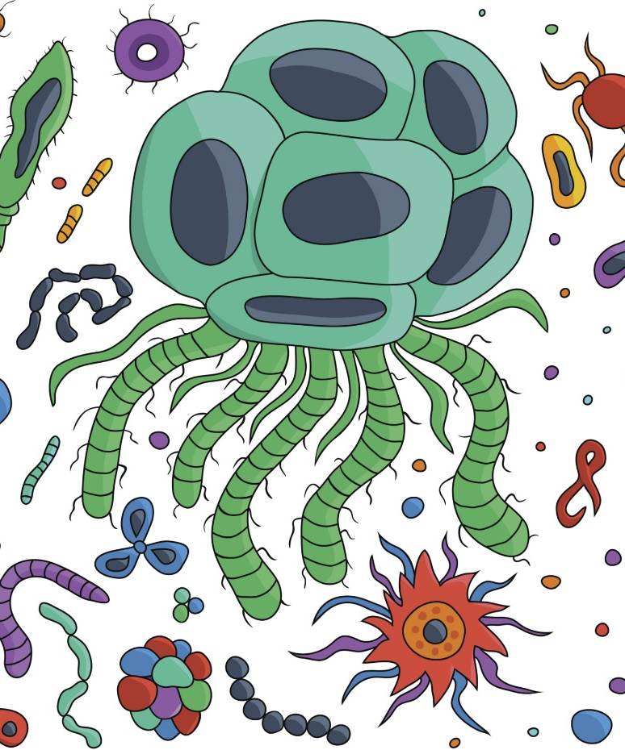
A Good Approach (Tip #1)
Your gut is home to hundreds of trillions of tiny bacteria that assist you in performing many vital bodily functions. They help your immune system keep “bad” bacteria at bay, help you digest food, and play a role in the absorption of important nutrients.

Slide 12
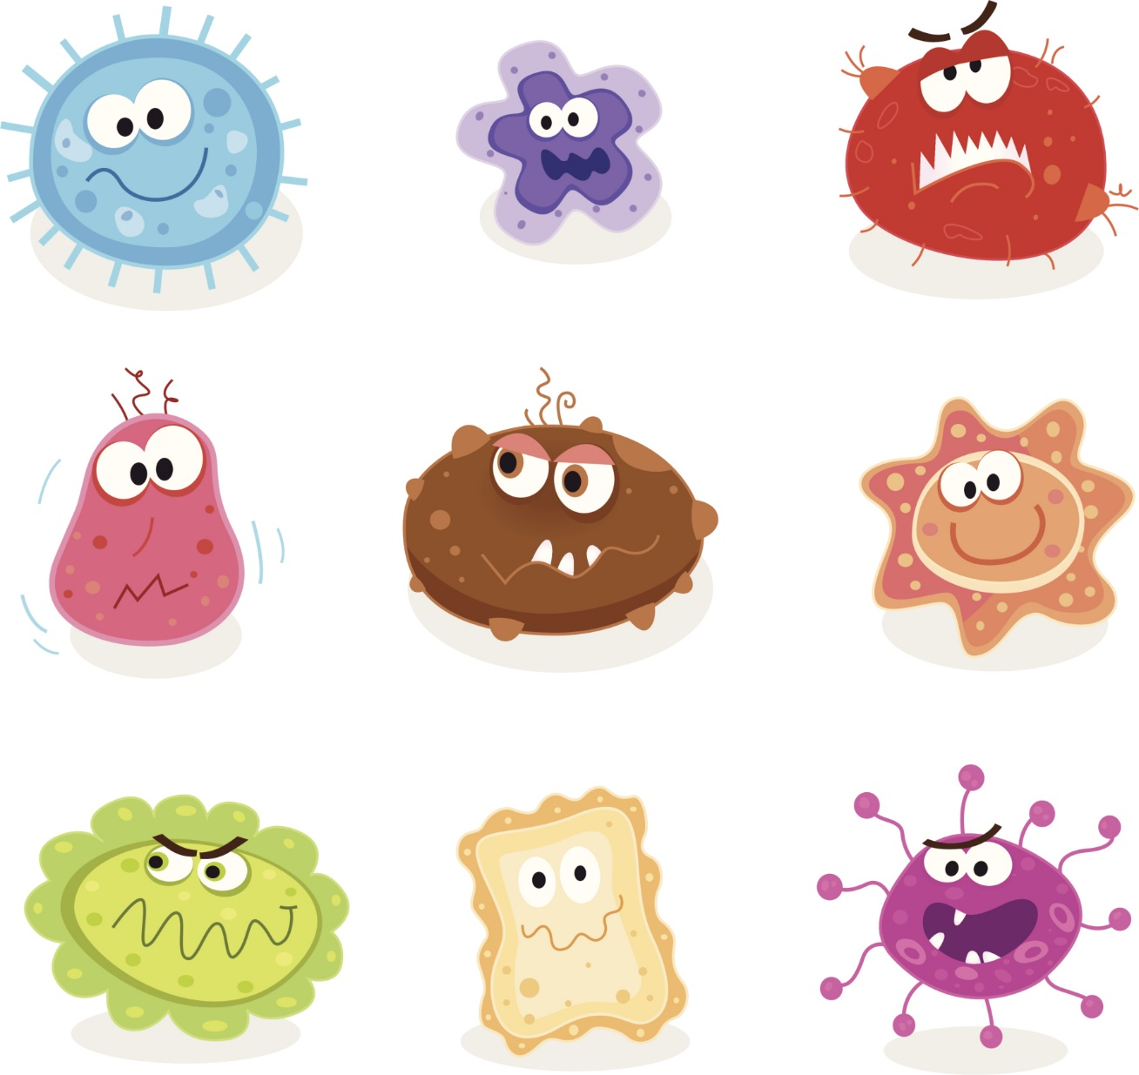

A Good Approach (Tip #1)
When your diet isn’t optimally healthy, these bacteria suffer — and so does your health. To help you replenish the good bacteria that belong in your gut, we’ve designed a perfect probiotic blend. Each serving contains 10 billion units of the good bacteria that your body needs!

Slide 13
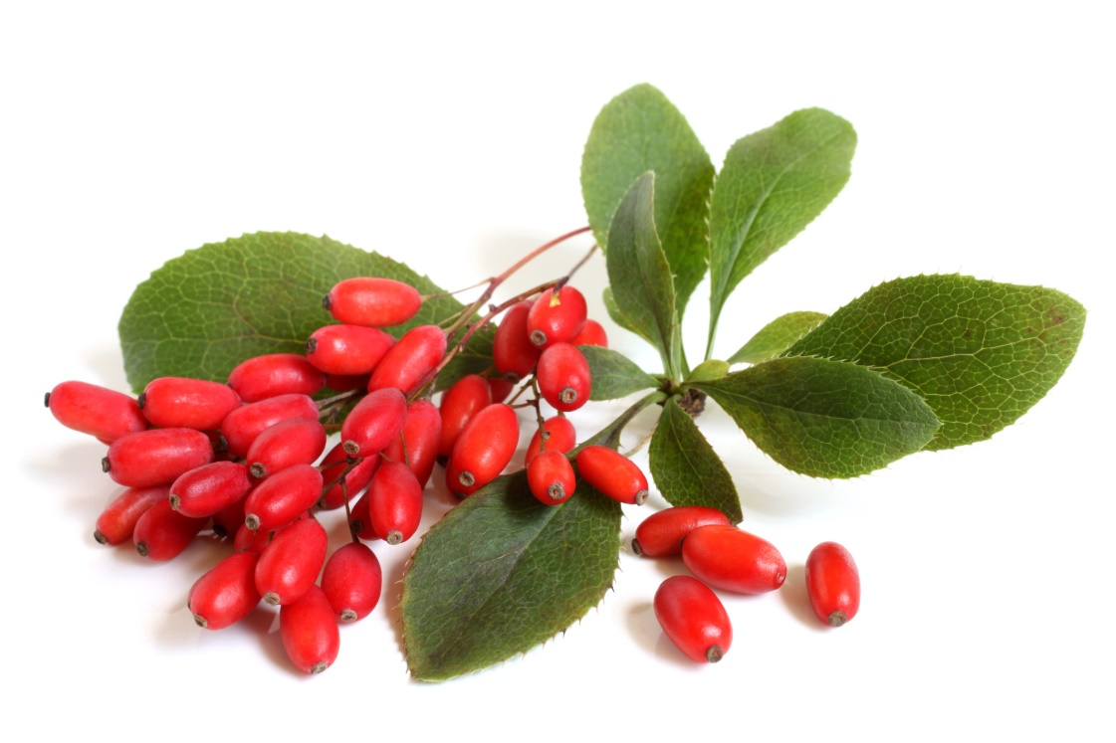
A Good Approach (Tip #1)
Unlike other probiotics on the market, we’ve “supercharged” ours by adding herbs and nutrients that facilitate the growth of
healthy bacteria and inhibit the
growth of harmful bacteria in the
gut. This ensures that
this probiotic
accomplishes exactly
what it’s designed to do.

Slide 14

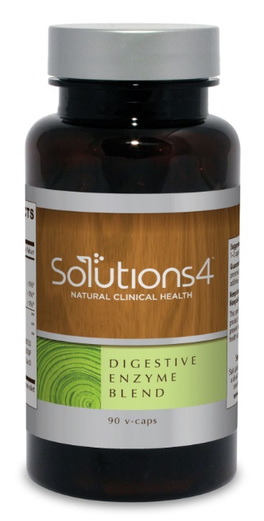
A Better Approach (Tip #2)
For even better results, you can take the Probiotic Blend in combination with the Digestive Enzyme Blend. These two supplements are a powerful duo that you can use to relieve digestive discomfort and absorb more nutrients from food!
+

Slide 15
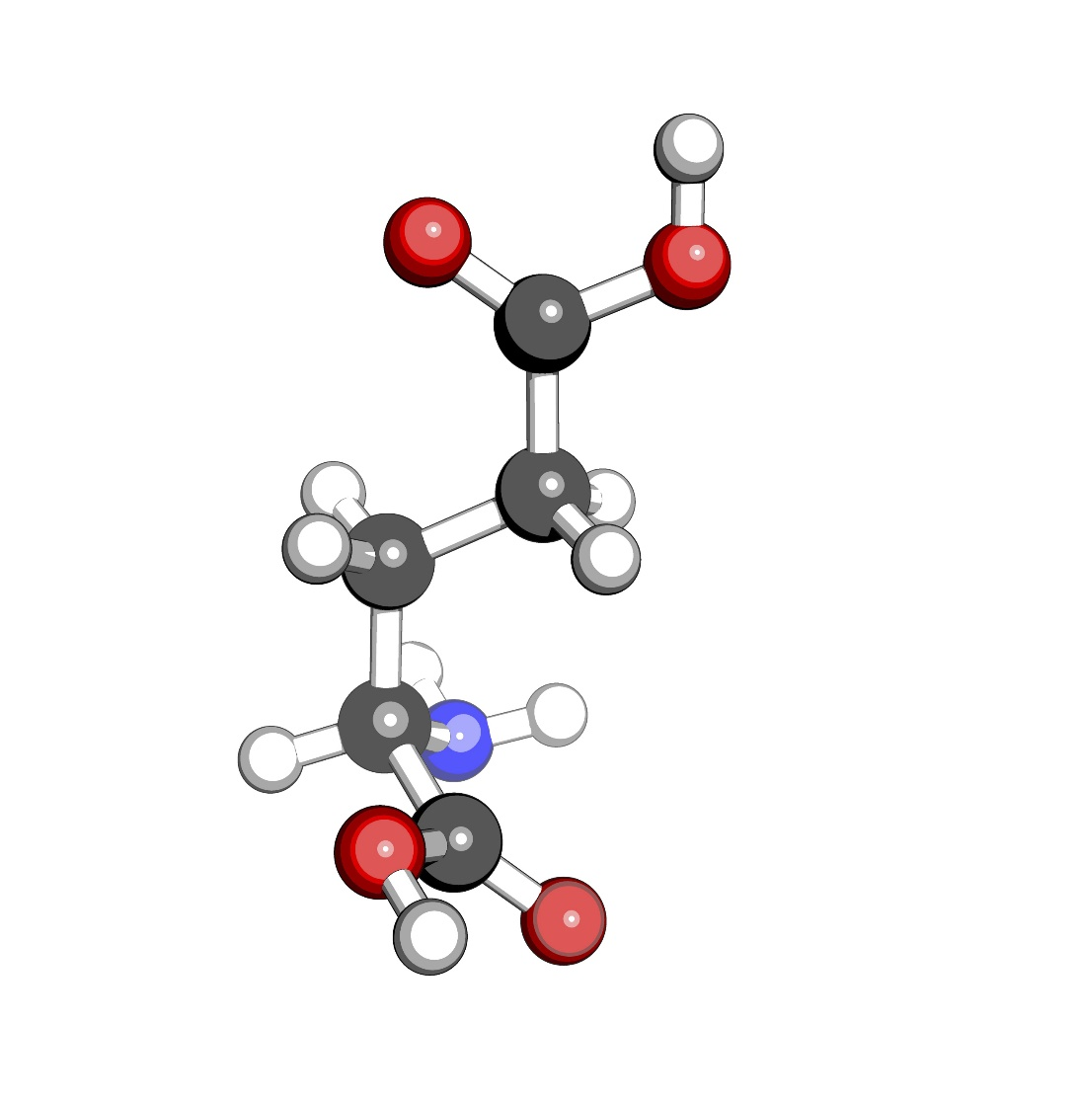
A Better Approach (Tip #2)
Here’s why: You eat food, but your body doesn’t absorb food. It absorbs nutrients. Food has to be broken down into individual nutrients (amino acids, fatty acids, simple sugars, etc.) before your body can use it. Usually, your body produces digestive enzymes (and utilizes enzymes from food) that make this possible.

Slide 16

A Better Approach (Tip #2)
However, many people do not produce enough digestive enzymes to effectively absorb nutrients from food (because of inflammation, aging, stress, etc.). Our food also contains fewer natural enzymes than it once did (because of irradiation and processing).

Slide 17

A Better Approach (Tip #2)
Though the enzymes that your body produces are different than those found in unprocessed foods, they both play an important role in facilitating healthy digestion. Without enough enzymes, your body won’t be able to absorb nutrients from food – even if you’re eating the healthiest diet possible!

Slide 18

A Better Approach (Tip #2)
The Digestive Enzyme Blend adds enzymes that help your body digest and assimilate all nutrients from food. This, in turn, can facilitate healthy weight loss or healing from a variety of uncomfortable conditions. When used with the probiotic, you’ll start to see some incredible results.

Slide 19
The Best Approach (Tip #3)
The very best thing that you can do for your digestive health involves three steps:
Taking a high-quality probiotic to provide your gut with the “friendly” bacteria it needs to function well
Using digestive enzymes to absorb more nutrients from food
Making dietary changes to maximize your digestive system’s potential
Let’s talk more about the last item on this list…

Slide 20
The Best Approach (Tip #3)
Eating foods rich in certain nutrients can improve your digestive health. These are three of the very best:
Fiber: found in leafy greens, berries, nuts, seeds, and many different vegetables
Enzymes: found in raw fruits and vegetables
Probiotics: found in fermented foods (coconut kefir, sauerkraut, kimchi, etc.)

Slide 21
The Best Approach (Tip #3)
For optimal digestion, you can make several additional changes:
Limit exposure to irradiated foods by buying produce that’s organic and in season.
Eat slowly and mindfully, chewing food as thoroughly as possible.
Avoid eating on-the-go.
Eat reasonable portion sizes. Don’t binge!

Slide 22
Summary:
Digestive problems are widespread in the United States today. This is largely because essential nutrients and enzymes have been stripped from food.
To improve your digestive health, you can supplement with the Probiotic Blend and Digestive Enzyme Blend.
You can also change the way you eat. Eat slowly, mindfully, and not too much! Look for foods rich in fiber, enzymes, and probiotics. Try to limit exposure to foods that have undergone irradiation.

Slide 23
On Sale This Week:
The Digestive Enzyme Blend!

Slide 24

Integrate what you’ve learned today by listening to:
LHL008 — Three
Simple Tips to
Improve Digestion

