Slide 1
Welcome to
Club Reduce!

Slide 2

Today, we’re going to talk about what you can do to curb your cravings
and finally lose weight.
Notes:
There are many ways to lose weight without first creating health and harmony, but these methods will lead you to gain the weight back and return to your original weight (or worse). Time has proven that health and harmony are foundational for long-term weight loss. A healthy body will not be able to hold onto excess weight! This is the key that needs to be stressed in our seminars. This seminar is an introduction to removing toxins and excess fluid from the body in order to create the right environment for weight loss and health.

Slide 3

All of the classes in this series build upon one another.
By attending regularly, you’ll learn the habits of a naturally thin person!

Slide 4

What Causes Food Cravings?
When it comes to excess weight and obesity, studies show that food addiction (particularly an addiction to sugar) is often to blame.
Food addiction involves a frequent craving for foods that activate the brain’s pleasure center and produce temporary satisfaction
(a type of “high”).

Slide 5
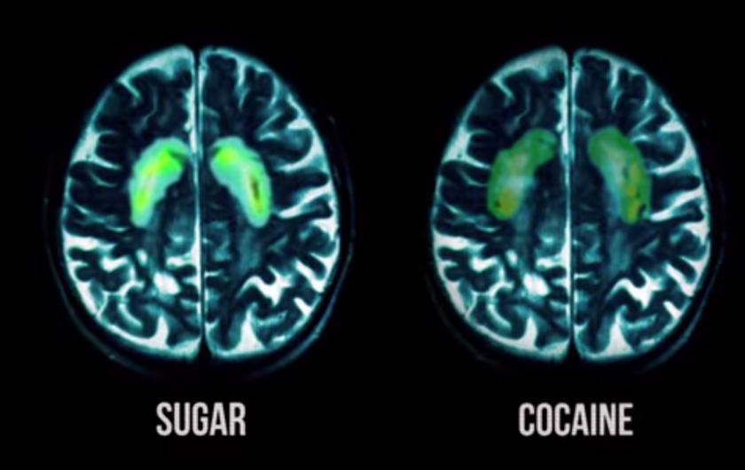
What Causes Food Cravings?
Some studies suggest that refined sugar is even more addictive than cocaine!

Slide 6
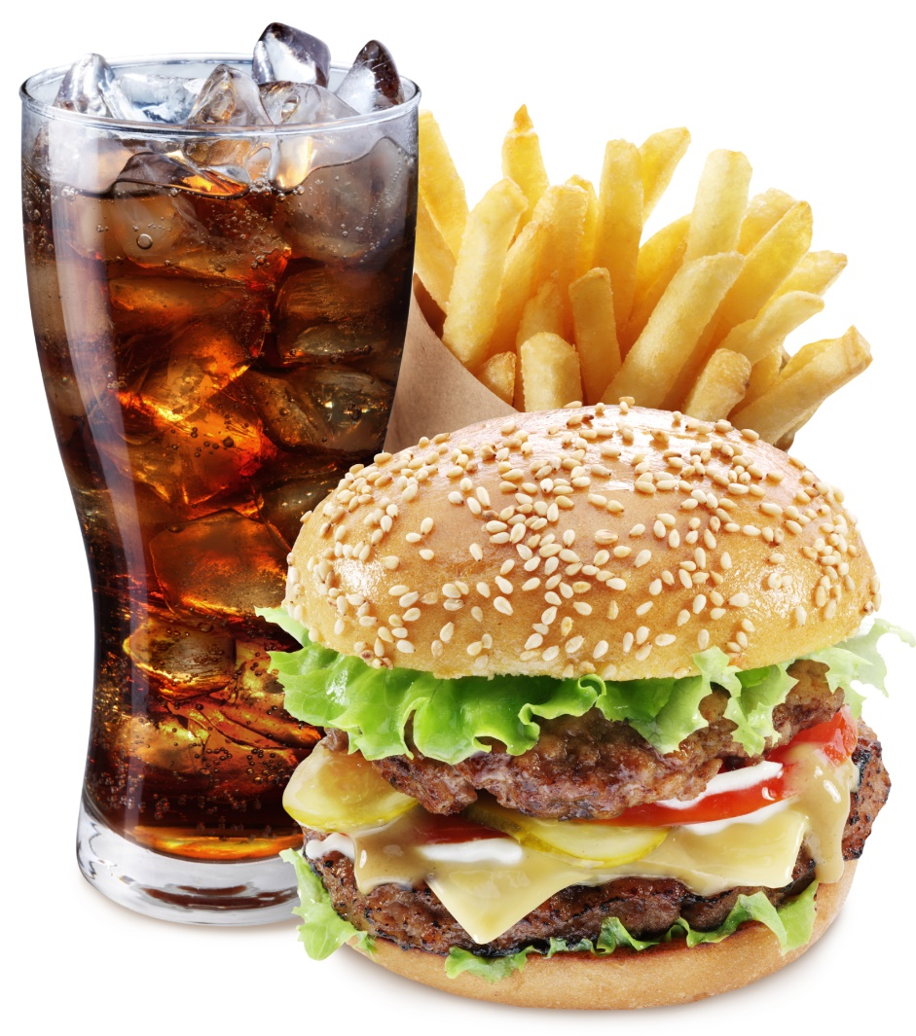
Food Is Designed to Be Addictive
If you find yourself trapped in a vicious cycle of food craving and addiction, know that you’re not alone. Millions of Americans feel the same way! Food companies have designed processed foods to be enormously addictive. It’s no surprise that you can’t have just one!

Slide 7
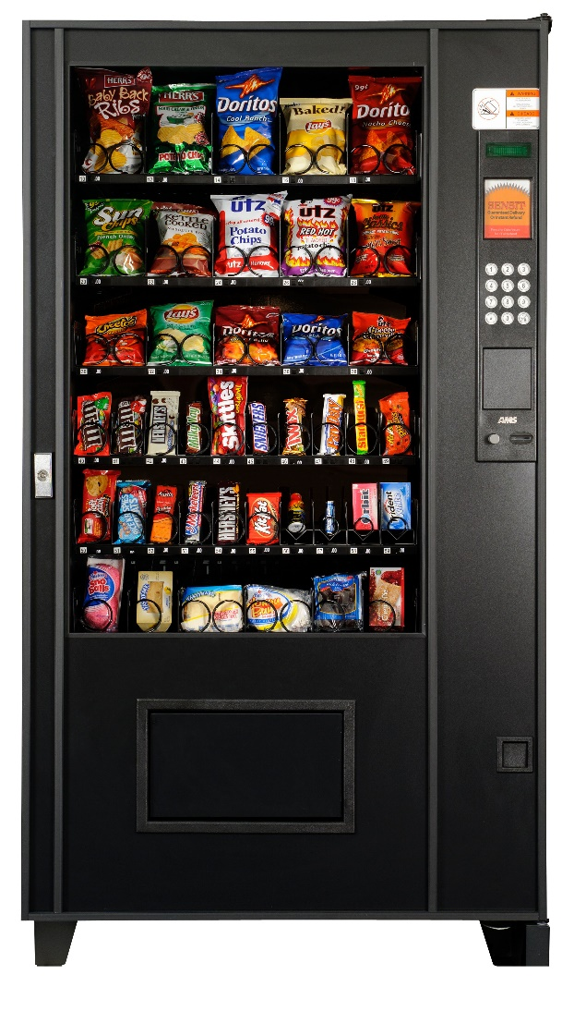
Addictive Foods are Everywhere
But processed foods aren’t just highly addictive – they’re everywhere. Junk foods line the aisles in grocery stores, await you in the checkout lane, and maybe even stock a vending machine in your place of work. As a child, you probably even grew up eating these foods as a part of your school lunch!

Slide 8

Addictive Foods are Everywhere
Everyone knows that it’s hard to break an addiction, but it’s even harder when the addictive substance is everywhere you turn.

Slide 9

How to Curb Your Cravings
Fortunately, we have the resources you need to finally conquer your food cravings and start
shedding inches. Let’s talk about some steps you can take to curb your cravings by making different diet and lifestyle choices…

Slide 10
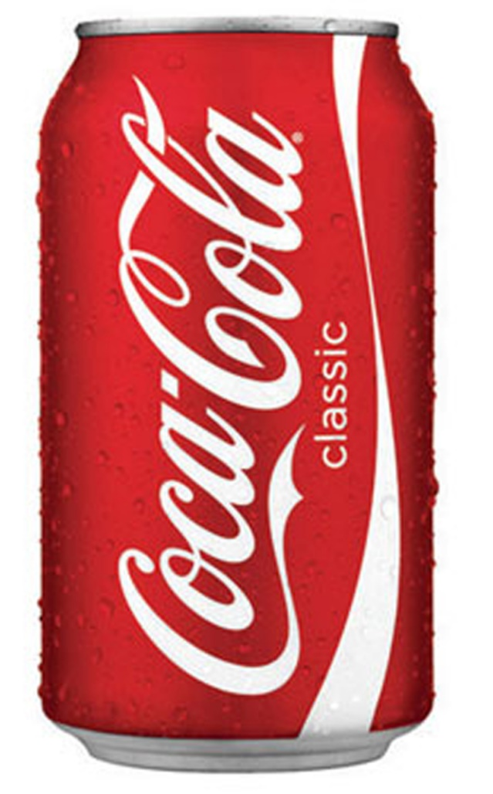
Tip #1: Balance Your Blood Sugar
Foods that spike your blood sugar (simple carbohydrates and sugars) are quickly metabolized by the body, leaving you hungrier and less energetic than before! When you’re on the downswing of a blood sugar rollercoaster ride, you’ll be much more likely to reach for an unhealthy snack to make it through the day.

Slide 11
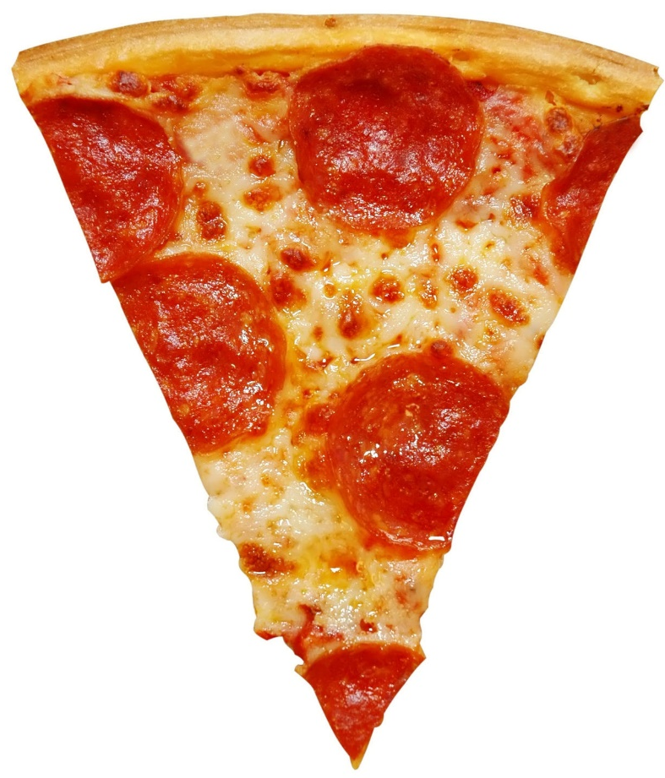
Tip #2: Maximize Your Nutritional Intake
You probably know what it’s like to eat a large meal and still feel unsatisfied when you’re done. This is because many foods only provide “empty calories” that fill you up without meeting your nutritional needs.

Slide 12
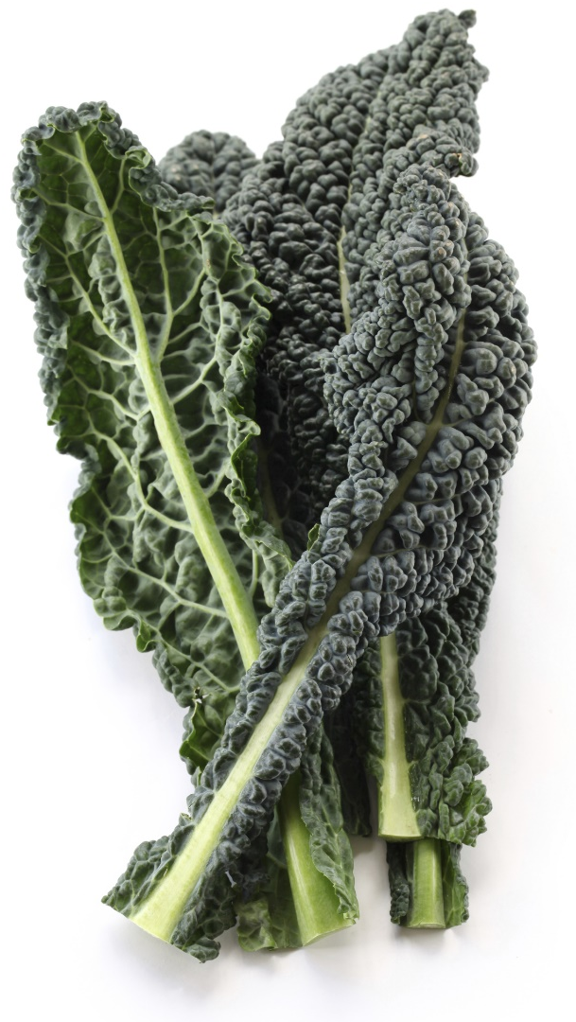
Tip #2: Maximize Your Nutritional Intake
Your body knows that it still needs something, so it tells you to keep eating! Your body will continue to crave more food until you provide it with the nutrients it desperately needs.

Slide 13

Tip #3: Manage Stress
Heightened stress levels can be exhausting. To cope, you’re far more likely to reach for a sugary or fatty comfort food that helps calm you down. If you can manage stress before it gets to this point, you’ll find that healthy food choices come far more naturally.

Slide 14

Tip #4: Get to Sleep
If your body isn’t ready for a new day, you’ll have difficulty making wise decisions. For example, not getting enough sleep might tempt you into one (or several) cups of coffee! You might eat something sugary for a quick rush of energy to get you through the day.

Slide 15

Tip #4: Get to Sleep
When you’re tired, you’re more likely to skip the gym. You’re also much more likely to eat something prepackaged or processed when you’re too tired to cook. At the end of the night when you get in bed, you’re probably too stressed to sleep well. It’s a vicious cycle!

Slide 16

Tip #5: Use the Appetite Appeaser
To make things even easier, we’ve created an appetite-satiating supplement designed to keep you feeling full even while cutting calories. The Appetite Appeaser provides a potent blend of herbs that make it easier for you to reduce your calorie intake and give your stomach a chance to return to a normal size.

Slide 17

Tip #6: Take the Multivitamin/Mineral
The Multivitamin/Mineral will boost your energy levels and provide your body with 100% nutrition on a daily basis. When your body is getting all of the nutrients it needs, you’ll be less likely to crave empty calories. This can make it much easier to make healthy choices and lose weight!

Slide 18

Success Is Just Around the Corner!
When you take the steps we’ve outlined here, you’ll be well on your way to conquering your food cravings once and for all! You’ll be healthier, happier, slimmer, and more confident in your ability to say “no” to unhealthy processed foods.

Slide 19
Summary:
Food cravings are difficult to beat because many unhealthy foods activate the brain’s pleasure center and produce a type of “high.” These foods are so prevalent that they’re nearly impossible to avoid!
To conquer your food cravings once and for all, you should balance your blood sugar, maximize your nutritional intake, manage your stress levels, and get enough sleep each night.
For an extra boost, you can use the Appetite Appeaser and Multivitamin/Mineral!

Slide 20

On Sale This Week:
Appetite Appeaser

Slide 21

Integrate what you’ve learned today by listening to:
LHL009 — Curb
Cravings to Lose
Weight

