Slide 1
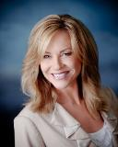
Broadcast Media
Television and Radio Advertising
Why you may want to consider adding Television and Radio advertising into your marketing mix and how to do it right.
Shar Lewis
Vice President, Business Development
Club Reduce Consultant

Slide 2
Does Broadcast Media-Television and Radio-still work?
Yes!
3 Reasons WHY you may want add Television and Radio back into your Marketing Mix
Television and radio ads may be TARGETED EFFECTIVELY for your specific demographic
Unmatched for DEMONSTRATING product and/or SERVICE RESULTS
Effectively PROMPTS PEOPLE TO ACTION for your specific service

Slide 3
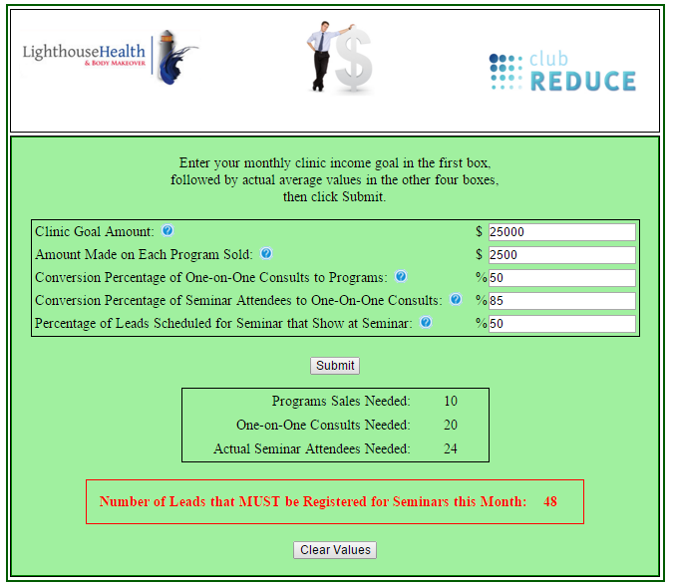
Determine Cost and Goals
EXPENSES:
How much money are you going to spend? ($15,000/$5,000 each)
What other costs are involved: production, photo shoot, talent fees, etc? (none)
What is your desired revenue? (cover $15,000 cost and make $20,000 profit = $75,000/$25,000 per clinic)
GOALS:
Sell 10 programs
Schedule 20 evaluations (50% close rate)
24 attendees show for Seminar (75% close rate)
32 people register for Seminar (50% close rate)
48 leads gathered (This becomes your goal)

Slide 4
Pre-Planning
Name of Campaign – if other than your clinic name
  Healthy Weight Loss Utah (joint partnership with 2 other clinics in Utah – Elmore & Roberts)
Vanity Phone Number
  Something that will be easy for people to remember when they hear or see
  A number specific for your campaign to track results
  Our regular one is 888-BurnFat
  1-844-NoFat4U
URL and Landing Page
  Something easy to remember
  Can find and purchase on Go Daddy or similar site
  Our regular one is www.BurnFatUtah.com
  www.HealthyWeightLossUtah.com
Determine Offer or Give A Way
Identify who will take calls, receive opt-in notifications and manage leads
  Calls go directly to marketing cell - phone answered by telemarketer
  Track all calls on a Google Doc – Now can directly inside Club Reduce!

Slide 5

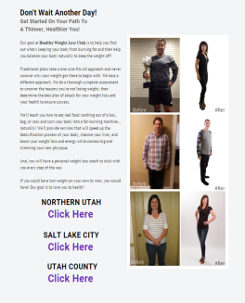
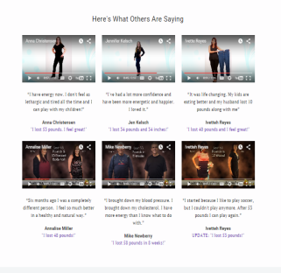
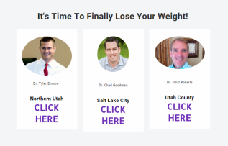
Landing Page
www.HealthyWeightLossUtah.com

Slide 6

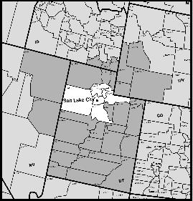
Proposal
Get a Proposal from one or several of your television stations
Look at the station that meets your demographic needs
  Programming geared towards women
  Women ages 35-65
SALT LAKE CITY DMA
#33 of 210 Markets / Largest Geographic DMA

Slide 7
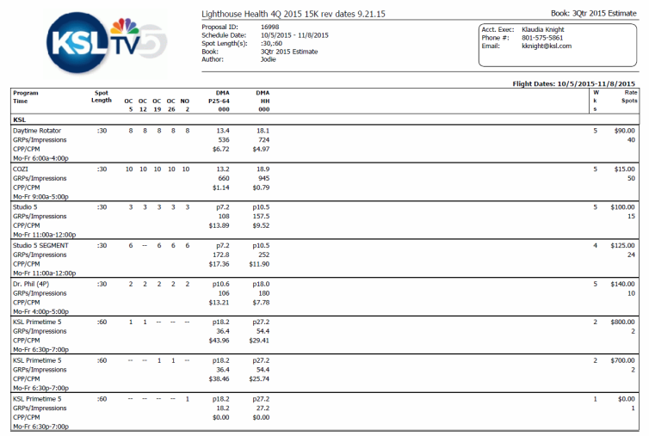
Lighthouse Health will reach over 486,862 Adults 25-64 3.8 times!

Slide 8
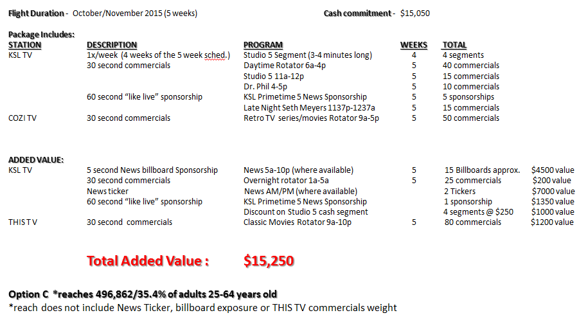
Summary of Proposal

Slide 9
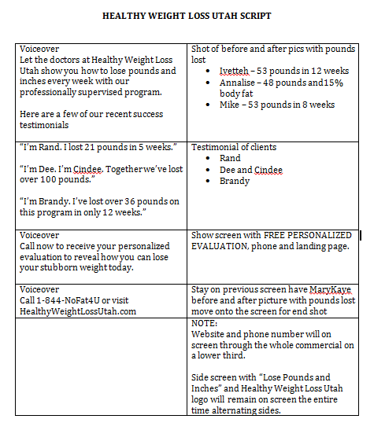
Produce the Commercial
Find someone to produce your spot
In-house producers at TV station or referrals they trust
Create a SCRIPT based on your goals and strategy
Identify successful patients
Video shoot with patients
Photo shoot for AFTER pics
Be sure to get Photo/Video release signed
Voiceover

Slide 10
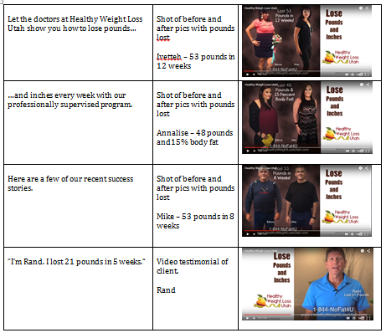
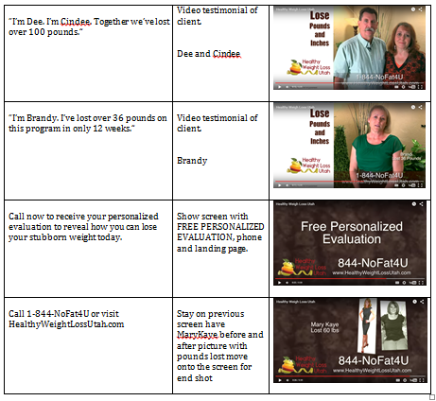
Commercial Storyboard

Slide 11

Final Commercial
www.HealthyWeightLossUtah.com

Slide 12
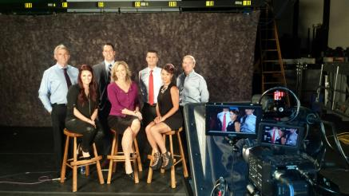
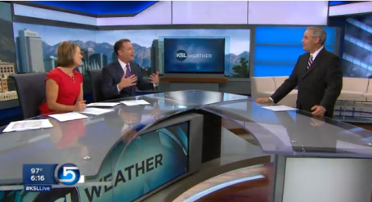
6:30 pm News Weekly Sponsorship
:60 Second “Like-Live”
Lighthouse Health will have a 60 second weekly segment (Total of 5) in our 6:30 evening news. KSL will throw one in for free.
Value $1,350 each

Slide 13
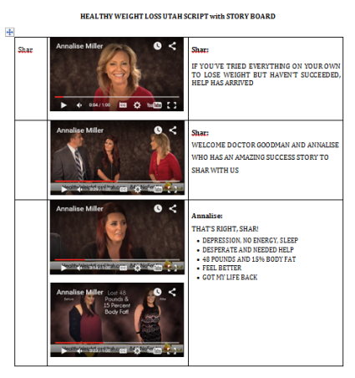
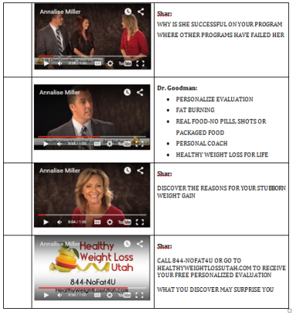
Create :60 Like-Live Script & Storyboard

Slide 14
Final :60 Like-Live Spot
www.HealthyWeightLossUtah.com

Slide 15

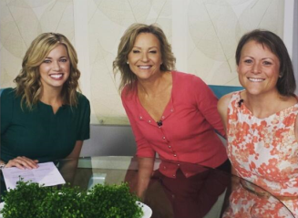
Studio 5 Segments
Lighthouse Health will receive 4/ 3-5 minute health segment “as live” on Studio 5 which airs daily at 11am reaching over 8,000 female viewers per day ( Date TBD). The segment will then be viewable on KSL.com Studio 5 page for up to 24 hours then archived for life linkable to your website.
http://studio5.ksl.com/?title=studio-5-
Value $1,000 each

Slide 16
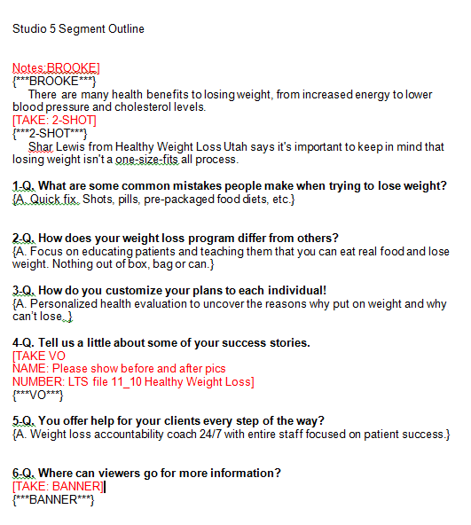
Studio 5 Segment Preparation
What is name of presenter and/ or guest?
What is your main promotional message?
Support your message with “talking points” – What specific details or expertise can you share that relates to main message?
TV is about visuals – What display items, models, photos or video do you have to support speaking points?
What website do you want to show on-screen?
What is your offer or discount?

Slide 17
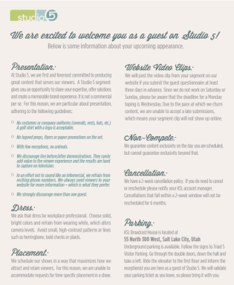
Appearance Info - What to Wear
Dress in work professional attire
Solid, bright colors
Refrain from wearing white, as it alters the camera levels
No logos on clothing
Avoid high-contrast patterns such as herringbone, plaid or polka dots.

Slide 18

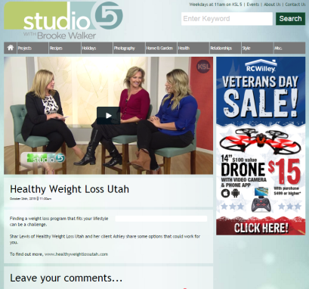
Links on Television Website

Slide 19
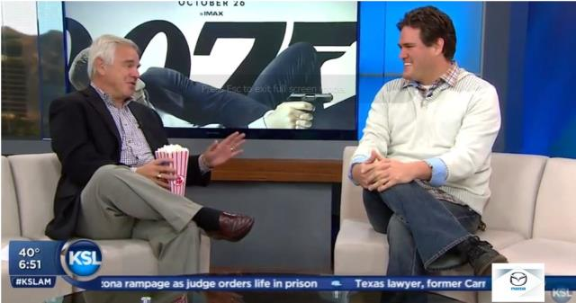

News Ticker
Your logo remains on the screen for up to 40 minutes in am News.
news tickers valued at $3500 each

Slide 20

News Billboard Sponsorships
Live 5 Weather sponsored by Lighthouse Health…..10-12 words ( KSL produces for free). Light House Health will receive weekly sponsorships within our news products
$100-$400 value per billboard

Slide 21
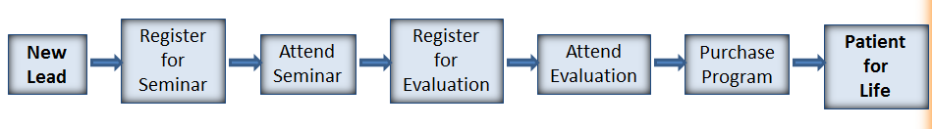
Don’t Forget to Track Your Leads!
NEW LEAD TRACKIN SYSTEM IN CLUB REDUCE 4.0
Club Reduce 4.0 allows you to track your leads by CAMPAIGN
Club Reduce 4.0 now allows you to put your leads in at first contact not just at register for seminar.
Cool things it can do
HEALTHY WEIGHTLOSS UTATH LEADS
320 leads in 5 weeks
Cost per lead $46
Continue to track # leads scheduled, #leads show, # leads purchase, $ Amount purchased, $ Total from campaign

Slide 22

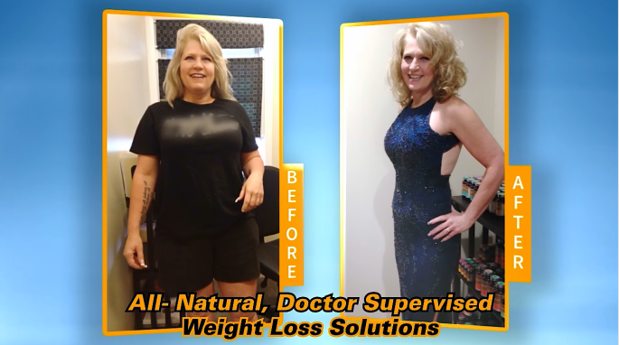
Weight Loss Commercial – Dr. Augello

Slide 23
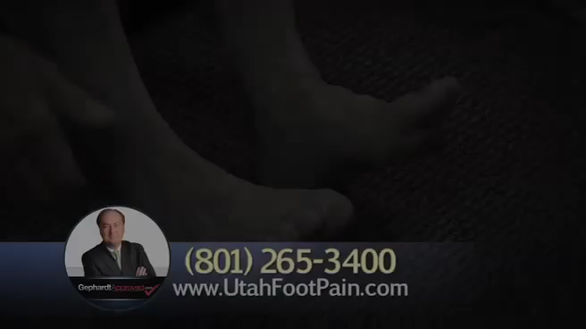
Additional Commercials - Neuropathy

Slide 24
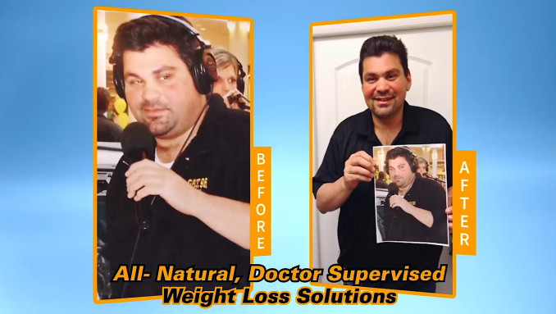

Radio – Weight Loss
Dr. Augello

Slide 25
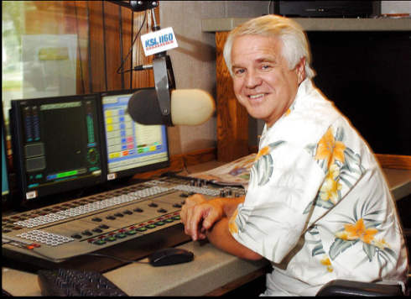
Radio - Neuropathy

Slide 26
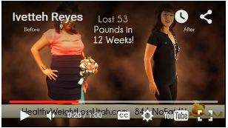
TV Weight Loss Commercial may be Personalized for your Clinic
You may use our Healthy Weight Loss Utah commercial and personalize it with your own logo, URL, phone, music, and voiceover for minimal editing fee.
$150 talent fee for voice-over recorded with your information
$150 to purchase music license
$450 to edit in logo, phone, website, adding in music, voiceover, Codex, and send to TV station in proper format
$750 total
CONTACT
Chris Crowder
Kingdom Films
(801) 549-8603
cmcrowder@aol.com

Slide 27
Broadcast Media – Take A Ways
Have a STRATEGY and a GOAL
Have an easy to remember URL and VANITY PHONE NUMBER
Be sure it DEMONSTRATES RESULTS
Have an OFFER that PROMPT PEOPLE TO ACT
Identify WHO will be MANAGING LEADS and TRACK! TRACK! TRACK!
Get a PROPOSAL and NEGOTIATE the price and ADDED VALUE
Use BEFORE and AFTER PICTURES and VIDEO TESTIMONIALS
Know your COMMERCIAL RUN DATES and TIMES
Know your INTERVIEW dates and be prepared
Stay on top of the CONTRACT to ensure all promises are kept
Require a SUMMARY – PROOF OF PERFORMANCE document after the campaign ends
WORK YOUR LEADS, see the money roll in and CELEBRATE YOUR SUCCESS!

Slide 28
Three Things You Need to Succeed
#1- THE BELIEF YOU CAN DO THIS (It’s all in your head!)
“Once you make a decision, the universe conspires to make it happen.” –Ralph Waldo Emerson
#2 - THE RIGHT SYSTEM (Club Reduce is all you need!)
“In order for any business to succeed, it must first become a system so that the business functions exactly the same way every time down to the last detail.” –Rick Harshaw
#3 – IMPLEMENTING THE SYSTEM! (Just do it!)
“The biggest difference between an average income and financial freedom is…Implementation!” – Nancy Singleton

Slide 29

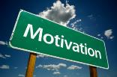

I Can Help You!
Personal
training and coaching
at your clinic
for you and your staff
specific to your needs
and goals

Slide 30

Sign Up Today!
www.ClubReduceConsulting.com
801.917.0900

