Slide 1
Pregnancy Dos and Don’ts
With Dr. Todd Singleton

Slide 2

In this webinar we are going to go over what Pregnant and Nursing woman can and can’t do while visiting your clinic, doing a program and taking supplements.

Slide 3
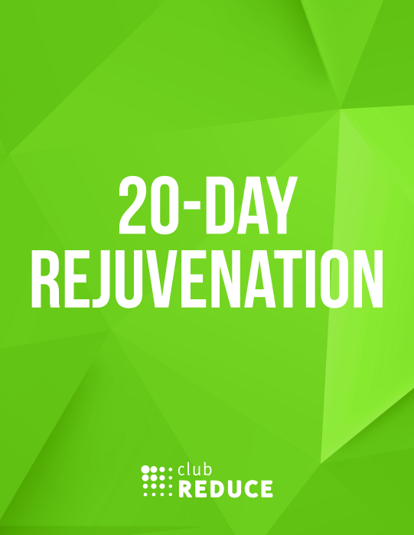
Question:
Is it safe to complete a Club Reduce program while pregnant?
Yes!
20 Day Rejuvenation WITHOUT the detox.

Slide 4
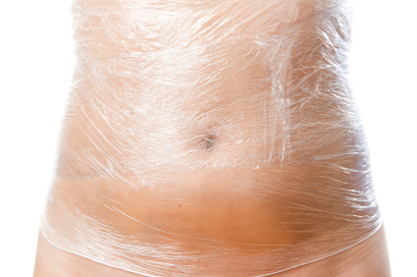
Question:
Is it safe to receive a Body Wrap while pregnant AND nursing?
No!
Toxins from the Body Wrap get to the mothers blood stream. The baby shares the same blood.

Slide 5
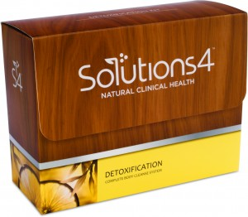
Question:
Is it safe for a pregnant and nursing woman to do a detox?
No!
A pregnant mother needs to eat to get nutrition to the baby.
A nursing mother needs to eat have milk for the baby.

Slide 6
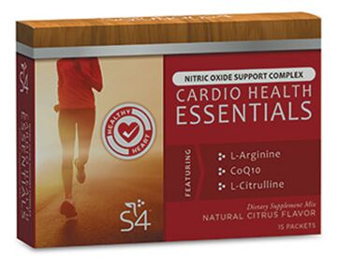
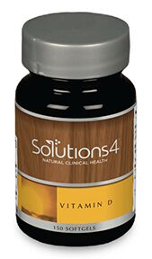
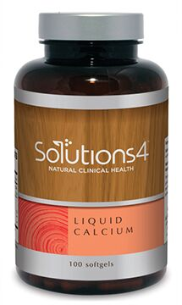
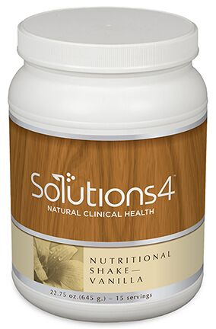
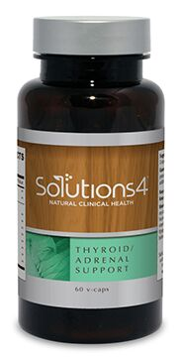
Question:
Does Solutions4 offer prenatal supplements?
Yes!
The following are great prenatal supplements for your patient to take.
  1 Cardio Health
  2 Vitamin D
  2 Liquid Calcium
  2 Multivitamin/Multimineral
  2 Thyroid/Adrenal (Iodine)
  3 Flax Seed Oil
  1 Nutritional Shake

Slide 7
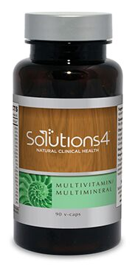
Importance of Folic Acid
It is important for a woman who is pregnant to get enough folic acid because it helps prevent neural tube defects (NDTs). It also helps prevent serious birth defects of the spinal cord like spina bifida and the brain.
Solutions4 supplements that have folic acid:
  Multiviatmin/Multimineral
  Soluitons4 Nutritional Shake

Slide 8
Folic Acid USP
What does the USP Verified Mark tell you?
The distinctive USP Verified Mark is awarded by USP to dietary supplement products that successfully undergo and meet the stringent requirements of its voluntary USP Dietary Supplements Verification Process.
The USP Verified Mark on the label indicated that the product:
Contains the ingredients listed on the label, in the declared potency and amount
Does not contain harmful levels of specified contaminants
Will break down and release into the body within specified amount of time
Has been made using safe, sanitary and well-controlled manufacturing practices according to FDA and USP guildeline

Slide 9
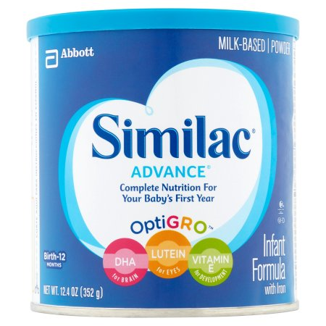
Infants Nutrition
The greatest nutrients an infant can receive is from the mothers breast milk.
Some mothers are not able to breast feed for different reasons.
Do not give your infants Similac or other related formulas!
  42.6% corn syrup solids (very first ingredient)
  11.5 % high oleic safflower oil
  10.1% sugar
  8.4% GMO soy oil

Slide 10

Infants Nutrition
Sugar Free
Daily Free
Soy Free
Lactose Free
Needed Enzyme blends
Vitamin A, C, E, K, B1, B2, B5, B6, B12 and K
Folic Acid

Slide 11

Are the Following Treatments Safe?
Infrared Sanua
  NO
Lipo
  NO
SMT
  YES
WBV
  YES – In 3rd trimester then NO

Slide 12
Thank You
Text or call with any questions #801-903-7141

