Slide 1
How to Increase Potential Patient Show Rate In Your Office
By Dr. Todd Singleton

Slide 2

Phone Scripts and Techniques
Each call may take 3-15 minutes.
Use a mirror to make sure that you smile.
Bring your “A” game.
Remember that the way you say “hello” and the tone that you use will determine whether they hang up on your or not.

Slide 3

How to Introduce Yourself
“My name is _________ and I work with Dr. ________.”
“You ran across our site through your search for ______” (or whatever you are listing).
“I’m sorry you have to suffer with this.”

Slide 4

Let Potential Patients Talk
“Please tell me a little about your _____ and what it is that you have difficulty with. Are there things that you cannot do anymore?”
Listen and let them talk.
“Well, I have great news for you… the program that we use in our office has helped thousands of patients recover from ______ and get back to doing what they love.”

Slide 5
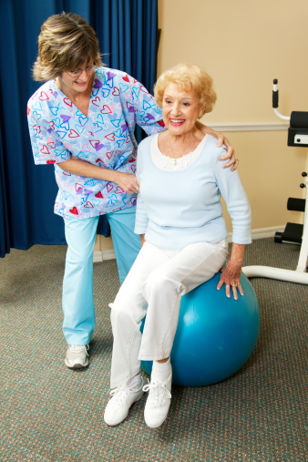
Share Success Stories
Share a personal story if you’ve worked in the clinic or talked with patients that have seen results.
Note: If you have not worked in the clinic, you should spend 5-10 minutes each week visiting with patients to hear success stories. These stories are powerful when you report back to potential patients.

Slide 6

Share Success Stories
For example: “I was in the clinic yesterday, and a man said that he didn’t need his cane anymore and can walk his dog around the entire block.”
You can use any success stories that you have from other programs in your office!
“I would like to invite you into our office as soon as possible so that you can have an amazing experience too.”

Slide 7

Responding to Objections
If your potential patient wants to check with their doctor before making an appointment, ask them:
“How long has he/she been your doctor?”
“Has your ______ gotten better or worse under their care?”
Your doctor may be good at running tests and prescribing medications, but they haven’t fixed your underlying problem.

Slide 8

Responding to Objections
If a potential patient wants to check their schedule first…
“Can we at least pencil you in? Dr. _____ has a full schedule, and we’re mostly booking appointments three weeks out. We could have you walking around the block by then!”

Slide 9

Don’t Ask “If” — Ask “When”
“What day works best for you?”
  Always give two options (Monday or Wednesday, for example).
“What time works best for you?”
  Give two options: morning or afternoon.
  “Would 9:15 or 11:15 work for you?”
  If they ask for a 10:00, ask “Would 10:15 work for you?”

Slide 10

Discussing Insurance
If a potential patient asks whether or not insurance covers your services: “If it did, you wouldn’t have this problem.”
Insurance covers medication, DMEs, and surgery, which will not alleviate your ______ in the long-term.
“Would you agree with me that what you are doing now is not working?”
Many people with this same condition end up in assisted living centers that cost $5K to $8K per month.

Slide 11

The Problem with Medicare
A rule made effective in October of 2011 (section 2251.3 of the Medicare Manual) states that:
“A treatment plan that seeks to prevent disease, promote health, and prolong and enhance the quality of life; or therapy that is performed to maintain or prevent deterioration of a chronic condition is deemed NOT medically necessary.”

Slide 12

Explaining the Process
If a potential patient asks you what you do in your office…
“Well, first of all, we need to see if you are one of the patients that can be helped. We’ve successfully helped thousands of patients, and we want to see if we can help you too..”

Slide 13
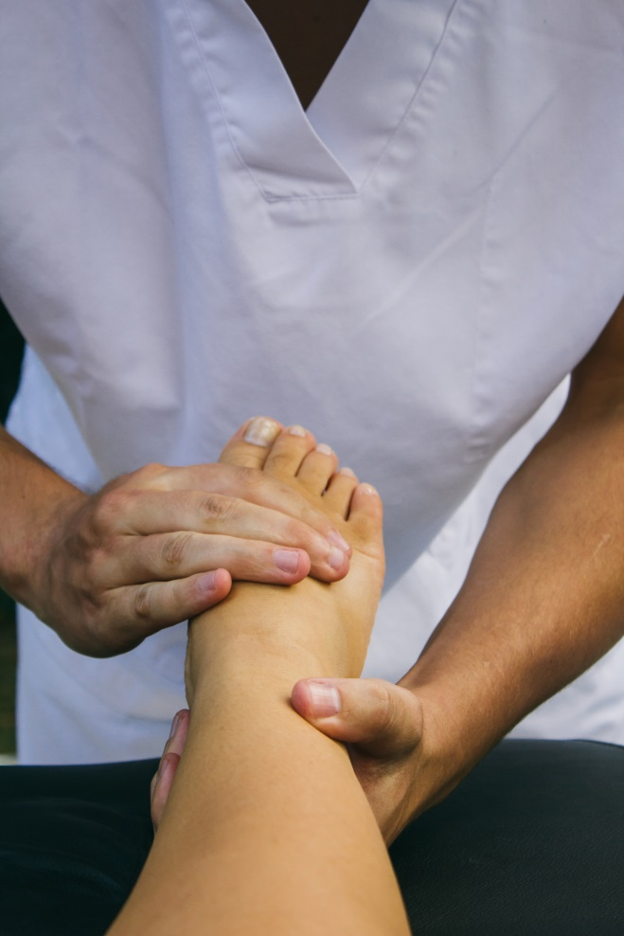
Explaining the Process
“We will do a thorough evaluation to get to the cause of your problem. This will let the doctor know if you are a candidate for any of our programs”

Slide 14


Send Additional Information
“Let me get your address and phone number so that we can send you our newsletter! This will give you a little more information about what we do here.”
If the potential patient still hasn’t scheduled, refer back to the script on scheduling.
“Feel free to discuss what we do here with your friends and family!”

Slide 15

Don’t Forget Free Services!
For a Weight Loss patient invite them to the Free Weight Loss Seminar.
For a neuropathy patient let them know that the first evaluation is free. They may also have up to 1-2 free treatments to see if they qualify to become a patient.

Slide 16


Where to Find Scripts on Club Reduce

Slide 17
Thank you!
Any Question?
Call or text me at 801-903-7141

