Slide 1
How to Help Your Patients Through a Healing Crisis
With Dr. Todd Singleton

Slide 2
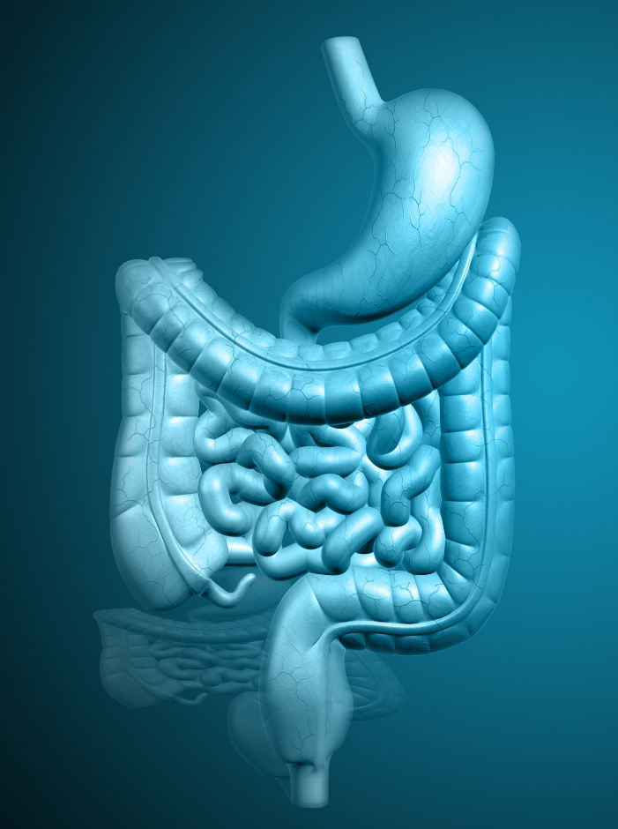
The Process of Detoxification
A detoxification program removes all barriers to the body’s natural healing abilities.
On a detoxification program, the gut is given a rest and energy is conserved.
The body uses this energy to rid itself of toxins and accumulated waste.

Slide 3

Detoxification: How It Works
On a detoxification program, a patient will drink a simple lemonade mixture sweetened with pure maple syrup.
This provides a source of easily absorbable nutrition.
Herbal supplements are used to provide additional nutrients and facilitate the healing process.

Slide 4

The Healing Crisis
The consumption of caffeine, refined sugar, alcohol, and junk foods each contribute to the need to detoxify regularly.
When we detoxify, our bodies pull these substances out of long-term storage and into circulation (where they can be processed for removal).
This occasionally causes unpleasant symptoms known as a “healing crisis.”

Slide 5



Healing Crisis Symptoms
If your patient is having a healing crisis, symptoms may include:
Headaches
Skin breakouts
Bowel sluggishness
Diarrhea
Fatigue
Sweating
Frequent urination
Congestion
Nasal discharge
Body aches
Anxiety/irritability

Slide 6

The Healing Crisis: What to Expect
While unpleasant, a healing crisis is actually a good thing! It lets you know that the detoxification program is really working.
The healing crisis generally lasts from just a few hours to a few days.
The healthier your body is to begin with, the fewer symptoms there will be. The more your body has to clean up, the harder and longer the cleansing side effects will be.

Slide 7
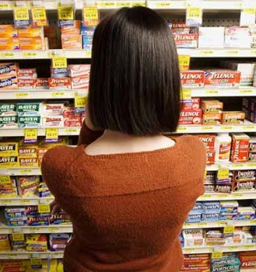
What About Medication?
The best way for a patient to get through a healing crisis is to let it run its course. If they take symptom-relieving drugs (cough suppressants, decongestants, anti-diarrheal medications, etc.), their body’s natural healing abilities will be hindered.
Though healing crises are challenging, they’re also incredibly rewarding!

Slide 8



How to Help with Specific Symptoms

Slide 9

Education Matters!
In the beginning, and also week to week, you’ll want to remind your patients that they may experience these “cleansing side effects.” You never want a healing crisis to come as a surprise!

Slide 10
Any Questions?

