Slide 1
Using the
Body Contouring Package at Trade Shows
With Nanette Pututau

Slide 2


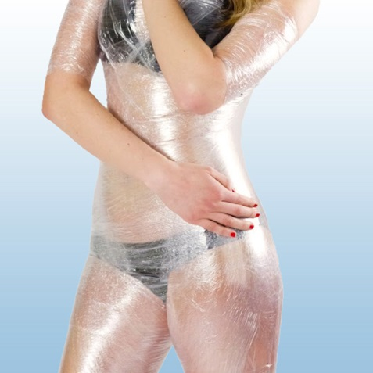
Purpose of Body Contouring Packages
Offering the Body Contouring Package is an amazing package to offer because the new patients will receive…
Free Weight Loss Seminar
Free One-on-One Evaluation
Free Body Wrap
If one of your main focusses in your office is weight loss, this is a great way to acquire new patients in your office and get them educated so they will buy a program!

Slide 3
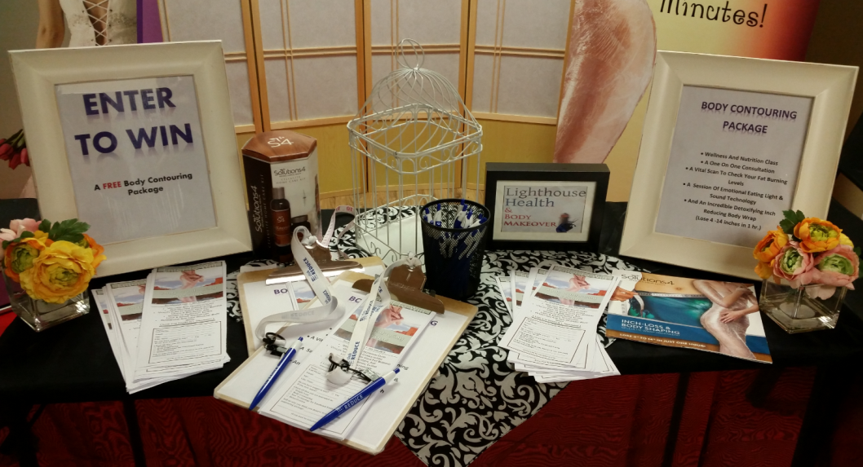
Setting Up
You have everything you need to set up your booth for the Body Contouring Package on Club Reduce
The most important things you will need are the following…
  Banner
  Entry Lead Forms
  Body Contouring Package Signs
  Script
  Clip Boards and Pens

Slide 4
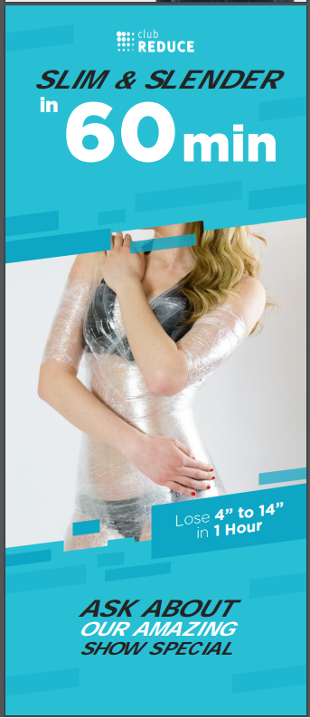

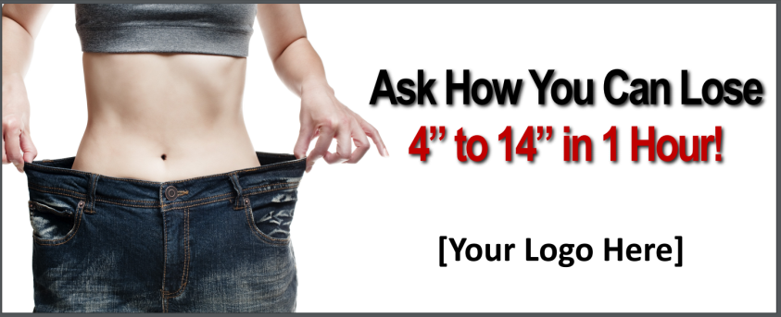
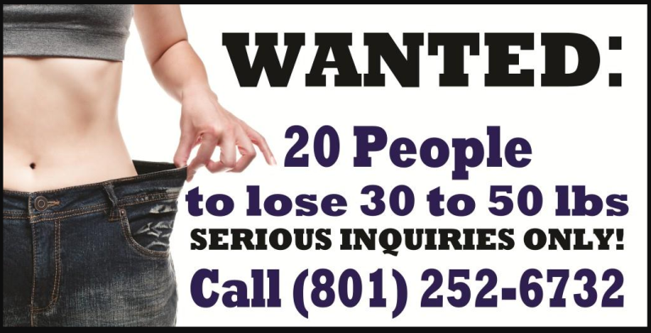
Banners
Marketing > All > Banners

Slide 5
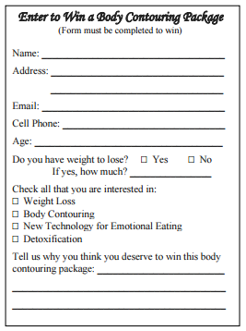
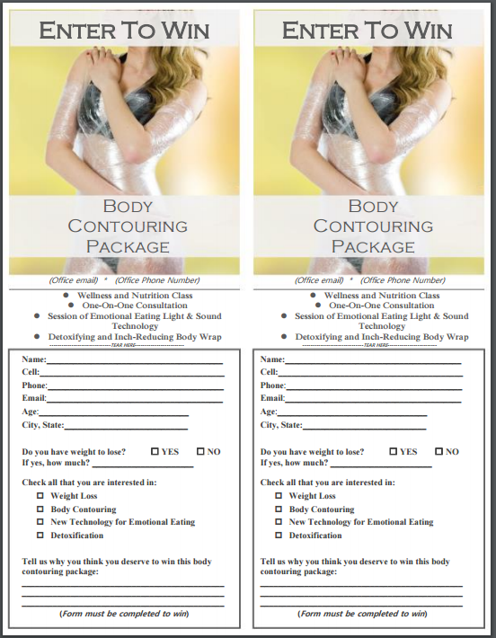
Entry Lead Forms
Marketing > All > Tradeshow > Handouts

Slide 6
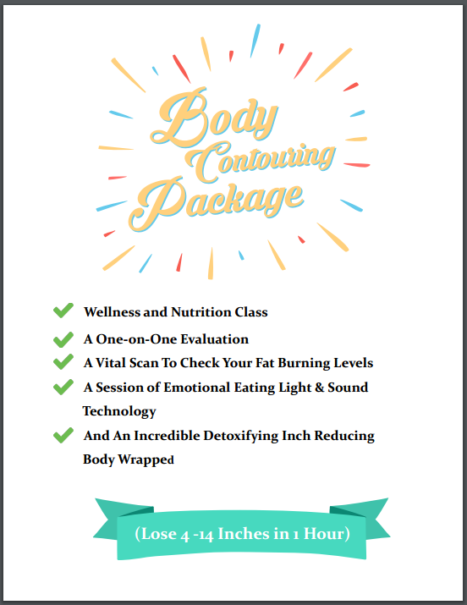
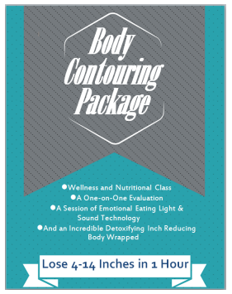
Body Contouring Package Signs
Marketing > All > Tradeshows > Set Up Materials

Slide 7
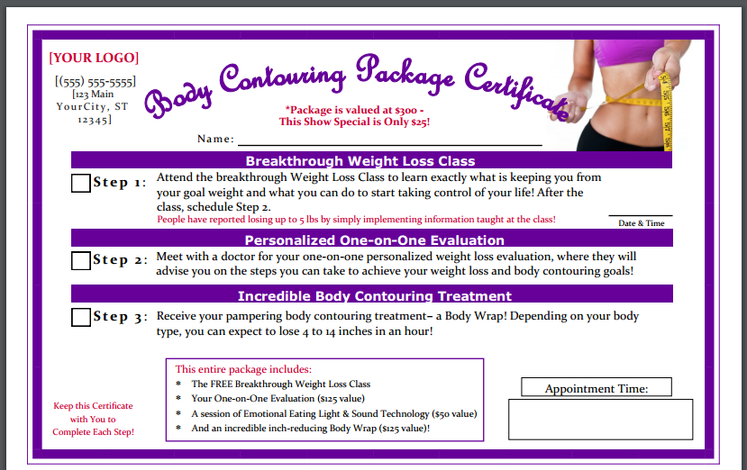
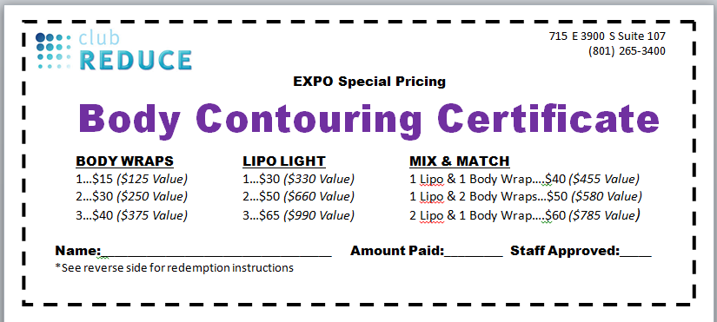
Other Materials

Slide 8
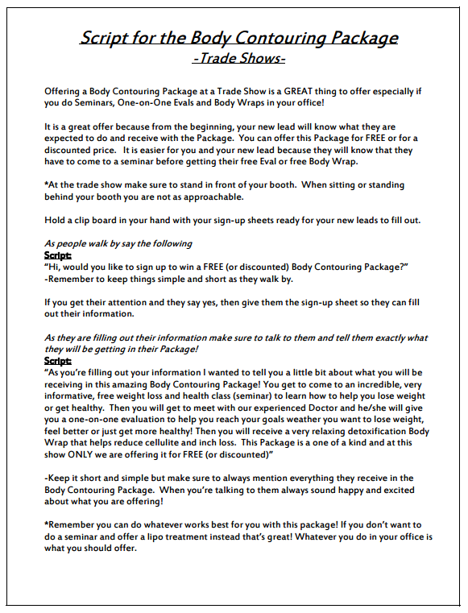
Scripts at the Trade Show
We have created a script for exactly what you need to say at a trade show!
Like always, cater the script to fit your clinics needs but this is a great place to start
It is always important to stop them in the isle and NEVER sit or stay behind your desk. It is not approachable.
Whoever works your trade shows will always need to be happy and excited about the package that you are offering and the amazing deal that it is.
Stop them with simple phrases like
  Hello! At this show only you can win a free body wrap! Sign up to now to win!
  Hi, come on over and enter to win a free body contouring package!
Try not to say yes or no phrases or questions

Slide 9

Who is a Winner?
Deciding who is a winner from your leads is entirely up to you!
Remember on your Enter To Win form there are certain questions to help decide who you would want to ‘win’ the package
We usually called most of the entries back as we wanted to help all of them and the more we called the more we were able to get to come in
If they marked that they want to lose more than 10 lbs, interested in weight loss, or put down any weight loss issues they should be a winner
The more people you call to say that they ‘won the body contouring package’, the more patients you will receive and have a chance to sell them a program
Anyone that put that they just want this for free or they don’t have weight to lose, don’t call them!

Slide 10

Scripts for Calling the Winners
It is really important when calling your trade show winners that you are EXCITED on the phone when calling them!
Never say the words
  You HAVE to come to the seminar
  You HAVE to do all of this before you get the body wrap
  Sorry I know it’s a lot in order to get your body wrap
Remember to sound enthusiastic that they won the package and say things like they GET to come to a free seminar, and they GET to receive a free body wrap.
Always talk about the amazing value and even cost of the services and treatments that they are getting for FREE.
  This package is valued at $350, but you were our trade show winner so for you everything is FREE!
We also have scripts on Club Reduce to help you follow exactly what to say.

Slide 11
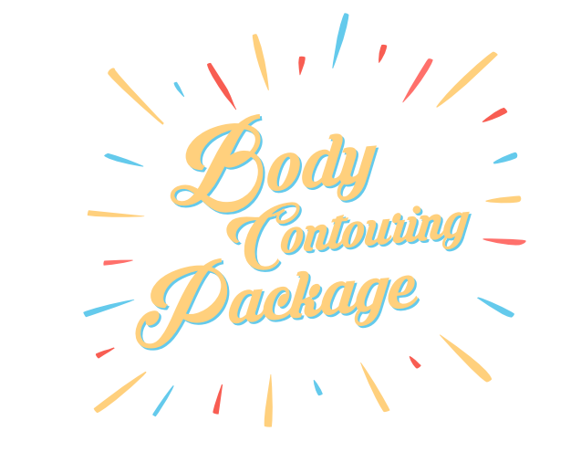
Using the Body Contouring Package at Trade Shows has been very successful for a lot of Club Reduce doctors.
One of the main things we teach at Club Reduce is the importance of doing a Weight Loss Seminar. When you offer that with a One-on-One evaluation with the amazing inch loss, detoxification body wrap you are offering them in a nut shell the services and treatments that can help them most
It is a great introduction to what you can offer your new patient and get them on a program

Slide 12
Thank you!
Any questions please call #801-590-0880
Email at support@singletonsystems.com

