Slide 1
Build Your Business Using the Skincare Trio!
With Shar Lewis and Trish Salisbury

Slide 2
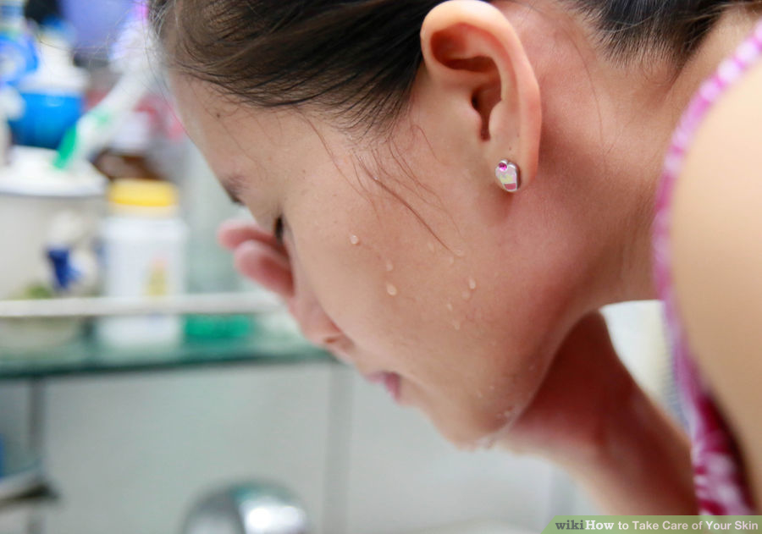
Why is Skincare Important?
To look your best with vibrant youthful skin be sure to take care of it.
The skin is the largest organ in the human body and shows what is going on inside.
You cannot hide a bad diet and poor skincare routine on your face!

Slide 3

Set the Stage for Beautiful Skin
Nutrition – eat clean with lots of brightly colored fruits and veggies for a beautiful and bright complexion.
Exercise – this will increase blood flow and circulation that nourishes skin and keeps it healthy and vibrant.
Hydrate – drink half your body weight in ounces of water to keep your skin moist and lessen the signs of wrinkles.

Slide 4
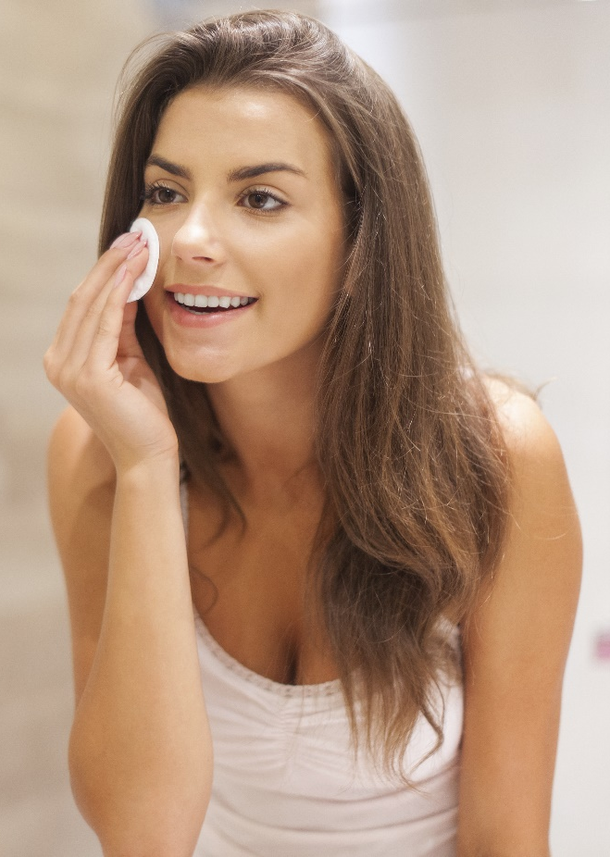
About Solutions4 Skincare
Solutions4 skincare products are organic, all natural and pH balanced, so they work for patients with both dry and oily skin.
Good skincare products should be absorbed by the skin quickly. You shouldn’t feel sticky or tacky after applying it. If you do, you might be using too much product.

Slide 5
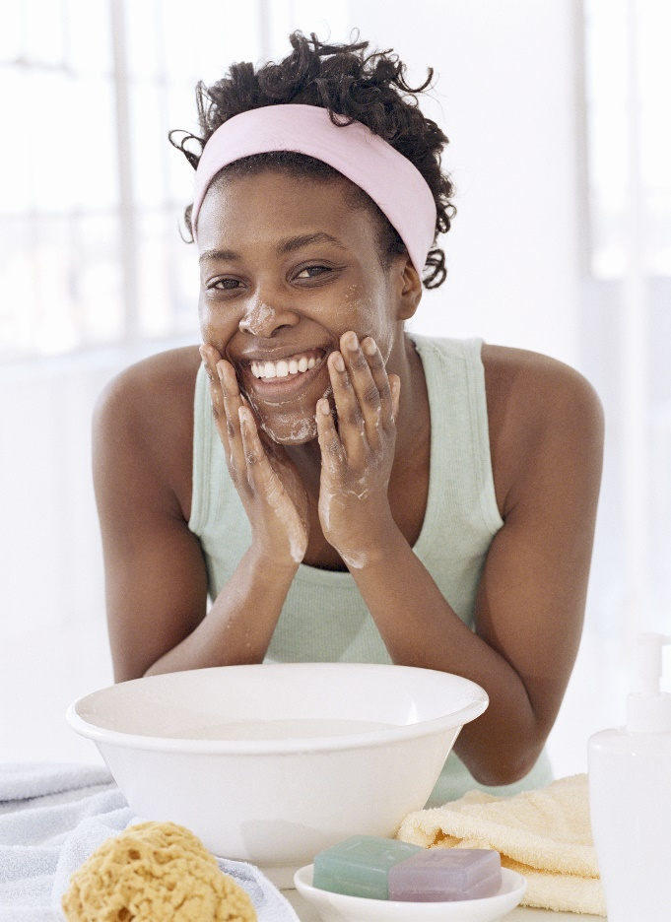
About Solutions4 Skincare
These products are a great add-on for patients on a wellness program.
They are also great for patients who are trying to lose weight and worry about sagging skin.
These products will tone and tighten the face without using harsh chemicals.

Slide 6
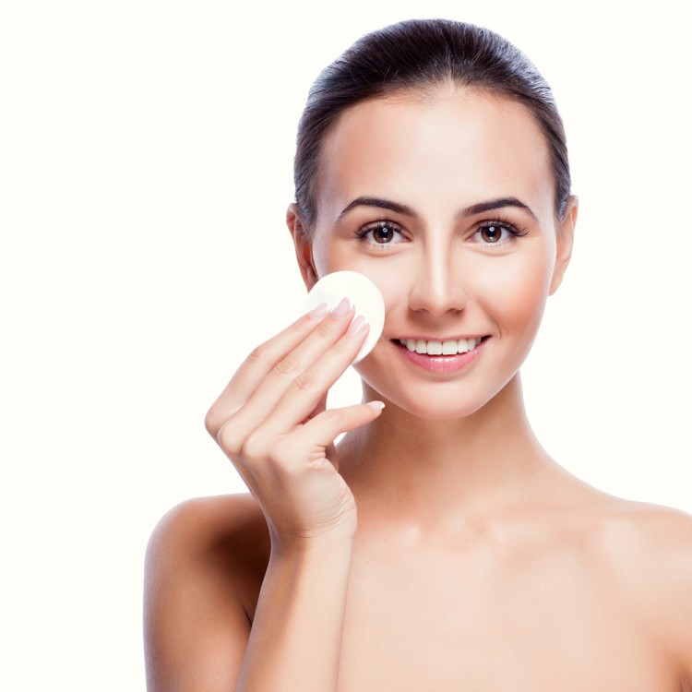
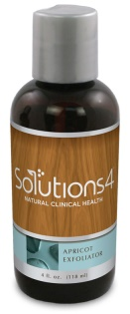
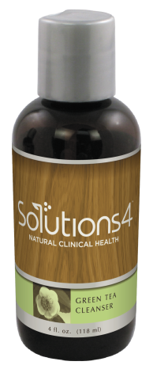
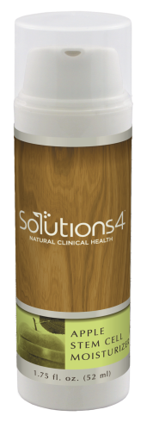
Basic Skincare Routine
Cleanse: Green Tea Cleanser
Exfoliate: Apricot Exfoliator
Moisturize: Apple Stem Cell Moisturizer

Slide 7
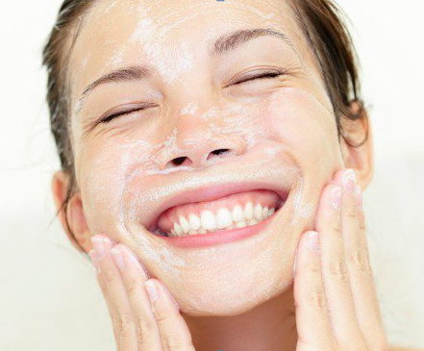
Step 1: Cleanse
Proper cleansing to remove dirt, makeup and pollution should be the core of every skin care routine.
Wash your face twice daily in the morning and then again before going to bed at night.
Use lukewarm water to keep irritation to a minimum. Always use a gentle touch and don’t rub too much.

Slide 8

Green Tea Cleanser
Part of the Skincare Trio
Like the name suggests, the Green Tea Cleanser is packed with antioxidants and anti-inflammatory ingredients (like those occurring naturally in green tea).
It also contains CoQ10, which is another natural antioxidant.

Slide 9
Green Tea Cleanser
Part of the Skincare Trio
Both of these ingredients (green tea and CoQ10) are excellent because they protect the skin and help to reduce visible signs of aging.
They combat the free radicals and environmental toxins that you’re exposed to every day.

Slide 10
Green Tea Cleanser
Part of the Skincare Trio
The Green Tea Cleanser can work wonders for abnormal skin conditions like acne, psoriasis, and eczema.
It’s formulated for all skin types.
It promotes balanced protection on a daily basis.

Slide 11
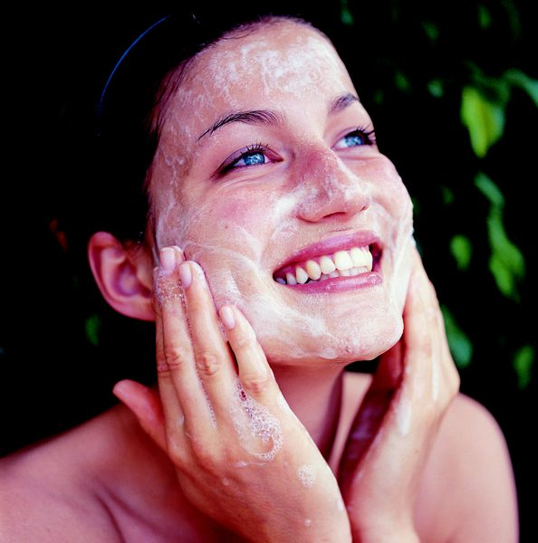
Step 2: Exfoliate
Your skin is constantly renewing itself and shedding off dead cells.
As you age, however, the rate at which your cells turn over slows down, resulting in a dull, dreary skin tone.
Exfoliating, or sloughing, speeds up the process and produces a brighter, rosier complexion.

Slide 12
Apricot Exfoliator
Part of the Skincare Trio
Typically, the top two layers of a person’s skin look pretty dull and unimpressive.
If you apply great moisturizers to dead skin, you won’t see big results.
But, if you exfoliate first, you can remove those dull outer layers and reveal the younger, healthier-looking skin that lies beneath.

Slide 13
Apricot Exfoliator
Part of the Skincare Trio
Our Apricot Exfoliator is a grapeseed oil-based scrub that combines a perfect blend of vitamins, antioxidants, UV protectors, and hydrators to provide superior protection and gentle exfoliation through the use of perfectly rounded apricot seeds.

Slide 14
Apricot Exfoliator
Part of the Skincare Trio
The Apricot Exfoliator also provides the skin with a type of natural “chemical peel” from the alpha-hydroxy acid contained in the grapeseed oil.
We recommend exfoliating 2-3 times a week, right after cleansing.
This product is environmentally-friendly. It’s doesn’t contain the plastic microbeads that are clogging up our oceans, lakes, and streams.

Slide 15
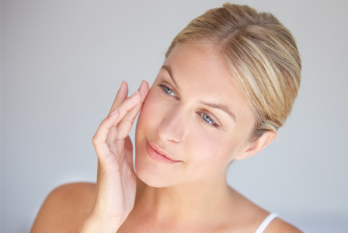
Step 3: Moisturize
Both men and women will benefit from moisturizing every day.
Moisturizing your face will help you to look and feel younger, you will have softer, more elastic skin, and it will keep your skin hydrated.
Taking care of your skin is the best way to fight the signs of aging and you will reap the benefits for years to come!

Slide 16
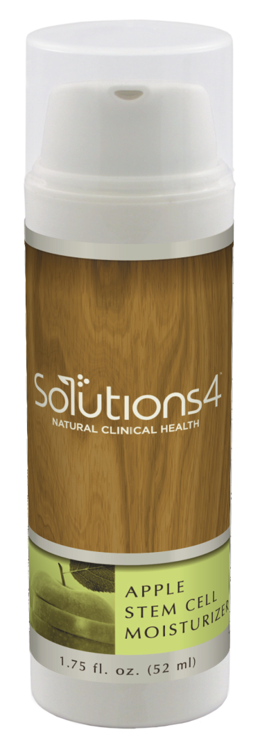
Apple Stem Cell Moisturizer
Part of the Skincare Trio
Back in stock!
Plant stem cells in facial products are incredibly popular because they can rejuvenate skin cell DNA.
This taps into the source of cell renewal processes and literally gives aging skin a fresh new start!
The Apple Stem Cell Moisturizer is our top selling facial product because of its robust ingredient list.

Slide 17
Apple Stem Cell Moisturizer
Part of the Skincare Trio
The plant stem cells in this moisturizer combine with antioxidants, anti-inflammatory botanicals, and UV protectors to produce amazing results.
It also includes plant extracts, peptides, and shea butter to nourish the skin.

Slide 18
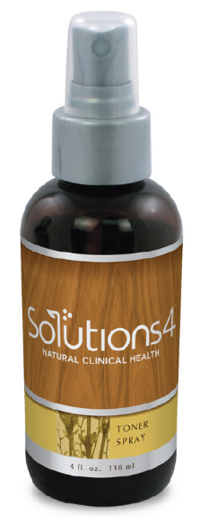
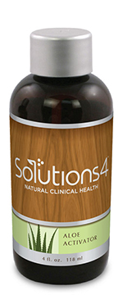
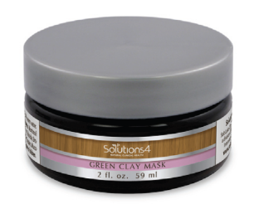
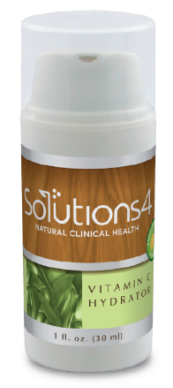
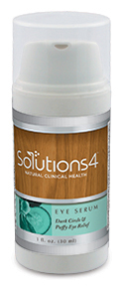
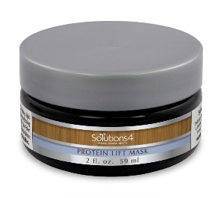
But, There’s More…
Beyond these three basic skincare products, Solutions4 offers a broad range of products that can help patients manage specific issues with their skin.
If a patient purchases the skincare trio, you can “upsell” them additional S4 skincare products.

Slide 19

Toner Spray
Contains botanical extracts from witch hazel, chamomile, peppermint, and aloe vera.
When spritzed on the face, the Toner Spray instantly hydrates and enlivens the skin.
This product is especially useful when traveling. It’s also excellent for skin that’s prone to dehydration.
Can be used both under and over makeup, or specifically to set makeup.

Slide 20
Eye Serum
Great for dark circles, bags under the eye, puffiness, and wrinkles!
Formulated with all-natural extracts and proteins (cucumber extract, shiitake extract, peptides, green tea, and even our famous apple stem cells).
You will feel a cooling and tightening effect. Can be applied both under and over makeup.

Slide 21
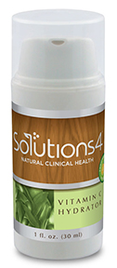
Vitamin C Hydrator
The antioxidant benefits of Vitamin C in topical products are well known. But, because vitamin C can be unstable, it can lose up to 90% of its potency in the first 30 days.
Until now! Our ester-C formula is a technological breakthrough that allows our vitamin C to remain active for up to two years.
Also, because this product contains hyaluronic acid, the vitamin C will be more effectively absorbed.

Slide 22
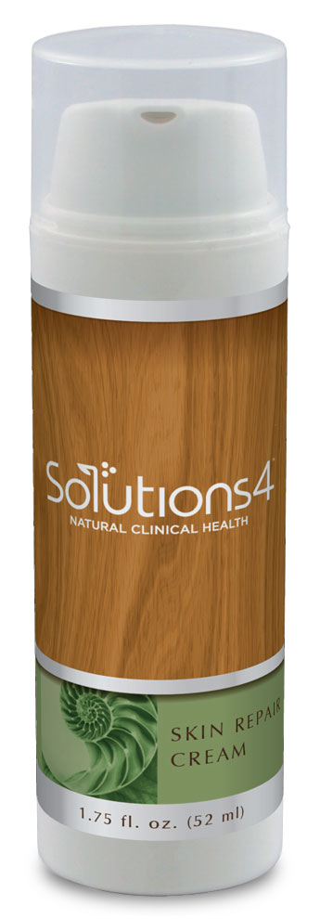
Skin Repair Cream
Solutions4 Skin Repair cream is an amazing cream with powerful natural tissue re-builders.
Originally formulated to minimize scar tissue following surgery, Skin Repair Cream can also help to soothe dry, damaged, or irritated skin on the face.
Especially helpful for rosacea, eczema or scars.
This cream will penetrate up to 25 cell layers to moisturize and provide nutrients to help skin to naturally restore itself.
Best used as a night cream.
Not recommended for acne skin.

Slide 23
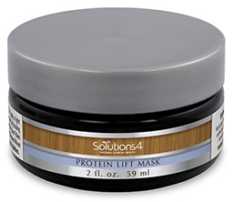
Protein Lift Mask with Aloe Activator
A superior lifting and tightening facial mask that stimulates cell renewal without dehydrating.
Draws impurities out of the pores of the skin through reverse osmosis.
Specialized enzymes and amino acids induce fibroblast cells to produce new collagen fibers and elastin strands. This restores the skin’s elasticity and resilience.
This mask is a natural alternative to a surgical face lift. No down time and immediate results!

Slide 24
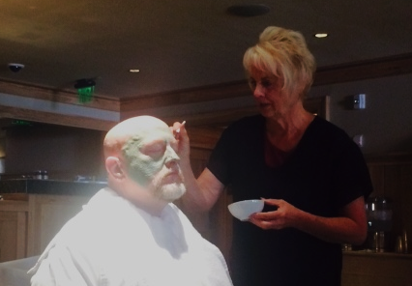
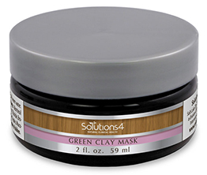
Green Clay Mask
This mask removes impurities from the pores and tightens the skin.
With French green clay and Hawaiian white ginger, this mask is great for acne-prone skin.
The Green Clay Mask can be used as an all-over mask, or spot treatment.
Dr. Singleton uses it on his scalp!

Slide 25
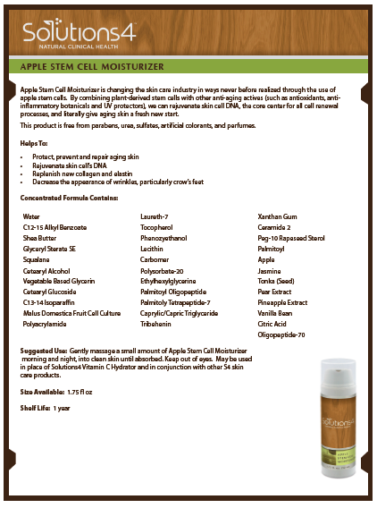
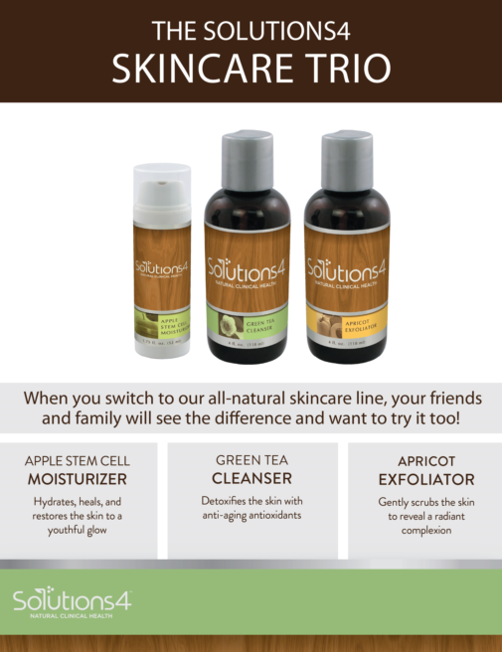
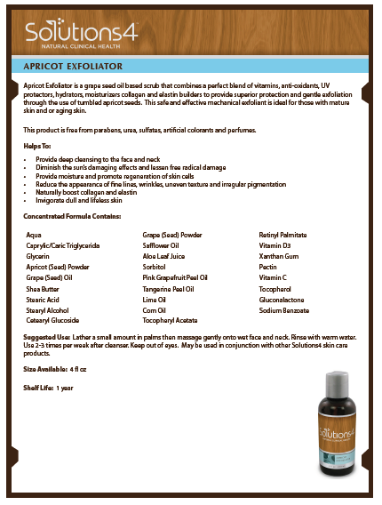
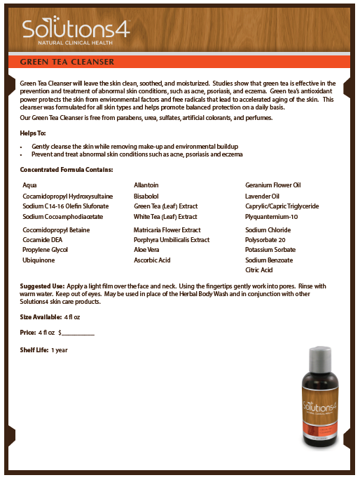
Short Sheets & POP Display

Slide 26

Offer Facials to Increase Sales

Slide 27
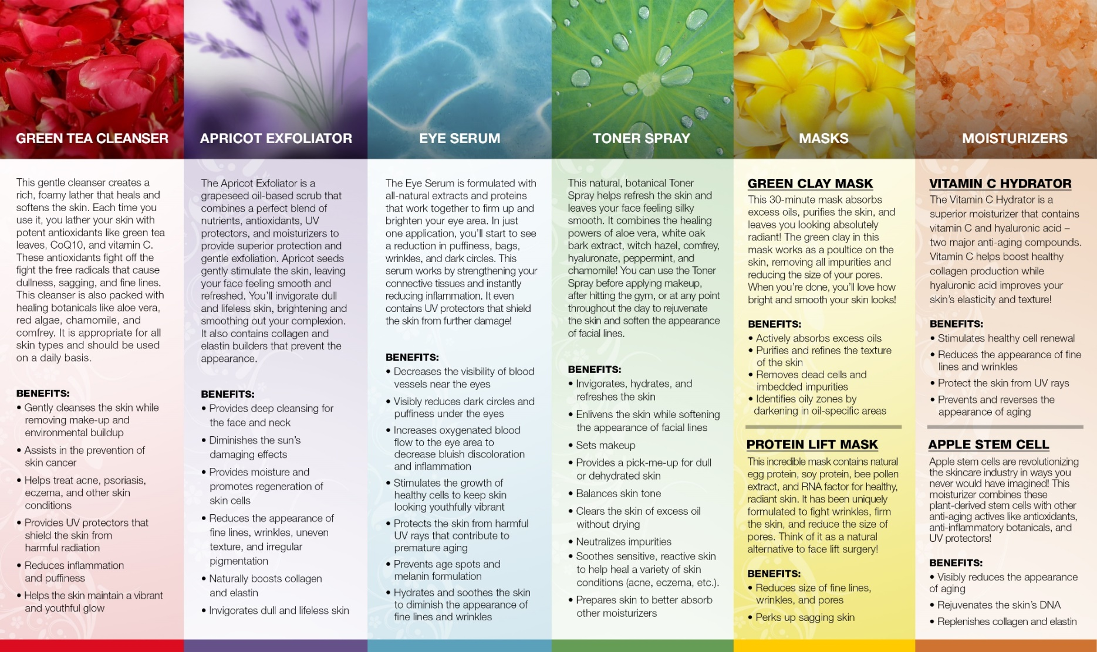
Offer Facials to Increase Sales

Slide 28
Try these other Solutions4 easy to use kits and products for pain, weight loss and health.
It’s a win-win!

Slide 29

Have FUN with these S4 PRODUCTS

Slide 30
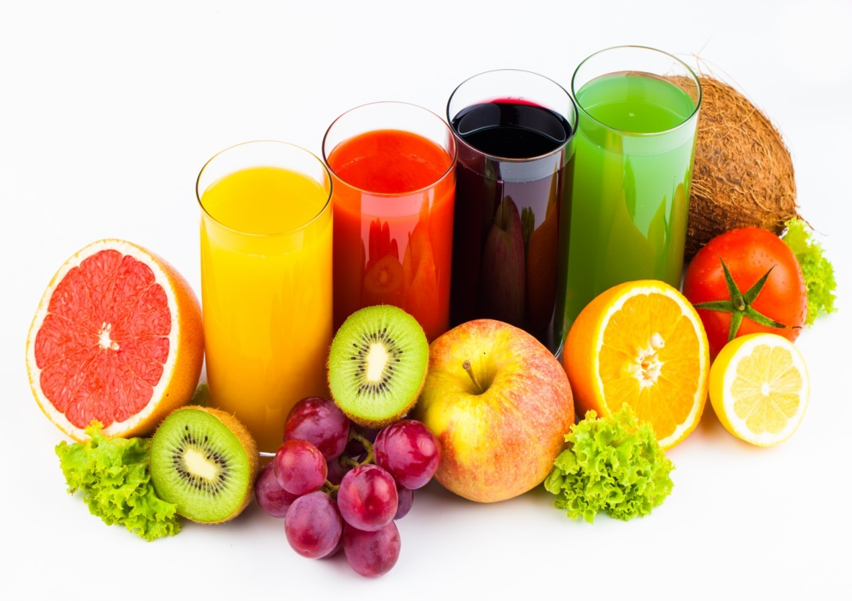
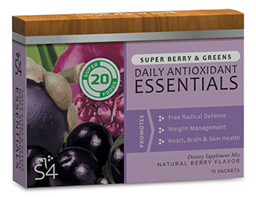

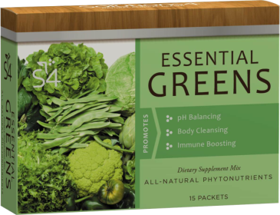
Mix-and-Match Combinations with the Essentials
1 Daily Antioxidant Essentials (Berry & Greens) stick pack combined with 1 Cardio Health Essentials stick pack makes a great pre-workout drink
2 Daily Antioxidant Essentials (Berry & Greens) stick packs combined with 1 Essential Greens
1 Essential Greens stick pack with 1 Cardio Health
1 each of Essential Greens, Antioxidant Essentials (Berry & Greens), and Cardio Health stick packs

Slide 31

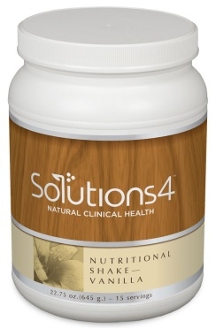
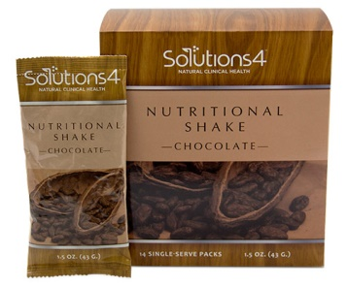
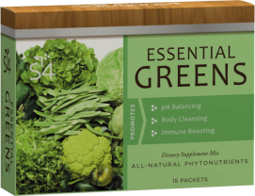

Mix-and-Match Combinations with the Essentials and Nutritional Shakes
Orange shake with Essential Greens
Orange shake with Antioxidant Essentials (Berry & Greens)
Strawberry shake with Daily Antioxidant Essentials (Berry & Greens)
Vanilla shake with Essential Greens
Vanilla shake with Cardio Health Essentials and Essential Greens
Vanilla shake with Daily Antioxidant Essentials (Berry & Greens)
Chocolate shake with Daily Antioxidant Essentials (Berry & Greens) and Essential Greens
Watch the webinar on Club Reduce titled “Mix-and-Match Solutions4 Products to Increase Sales”

Slide 32

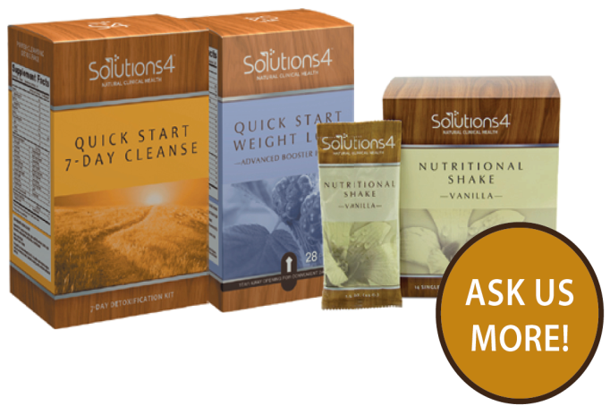
The 7, 14 and 21 Day Quick Start Kits
are Good for your PATIENTS and Good for YOU!
Watch the webinar on Club Reduce titled “Quick Start Kits: 7, 14 and 21 Day Options
Product Education and Sales Training”

Slide 33
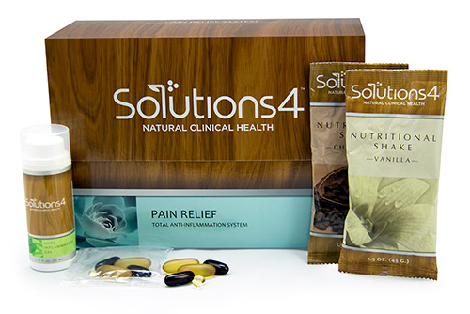

The Pain Relief Kit to Manage Pain from the Inside Out
Watch the webinar on Club Reduce titled “S4 Pain Relief System: Turn Pain into Profit”

Slide 34

Call Solutions4 Today to Place your Order for the Quick Start Kits Today! (877) 817-6074

Slide 35


Remember to… Practice What You Preach

Slide 36

Love your Patients to Health and Make them Patients for Life!

Slide 37

Do you Need Help Growing Your
Club Reduce Business
to Increase your CASH Income and Help your Patients HEAL?
www.ClubReduceConsulting.com
801.917.0900

Slide 38

May Newsletter

Slide 39

May Newsletter

Slide 40

May Newsletter

Slide 41
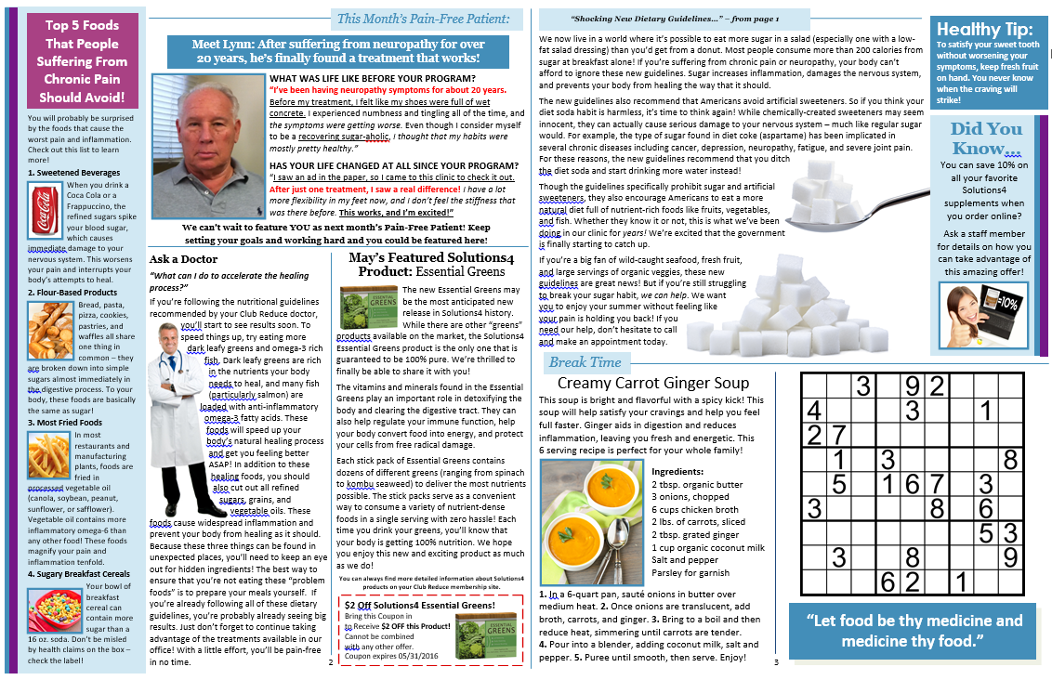
May Newsletter

Slide 42

Thank You!

