Slide 1
Implementing the New NP Neuropathy Kit with New Patients
With Dr. Todd Singleton

Slide 2
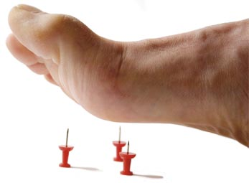
What is Neuropathy?
Neuropathy may be diffuse — affecting many parts of the body — or focal — affecting a single, specific nerve and part of the body.

Slide 3
Goal for a Potential Patient
The goal is to identify neuropathy far upstream from the first acute event, then apply proven treatment (including the nutritional protocols) that will prevent and/or reverse these problems before hospitalization is necessary, thus eliminating multiple hospitalizations, surgeries, and amputations.

Slide 4

Educate!
We need to educate new patients and give them options to help their years ahead. If they do not do a treatment plan, it will be devastating to them and their family.
If they continue eating in the same way, not only will their symptoms get worse, but they will also develop diabetes type 3. It will cost them up to $100,000 per year for care.
$167 now OR $5000 to $8000 per month in a few years

Slide 5

Other things to mention during your first Evaluation…
Nursing home costs top 80K a year.
Over the past 5 years, the median annual cost of private nursing home care has jumped 24% from 67,527 to 83,950 according to Glenworth's 2013 Cost of Care Survey.
It’s not much cheaper for a semi-private room at a nursing home.

Slide 6
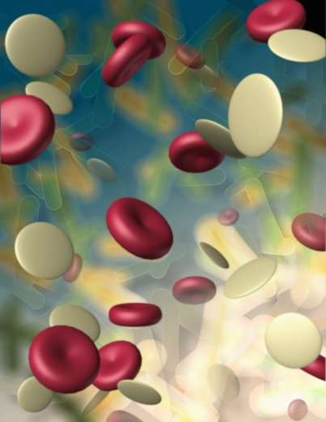
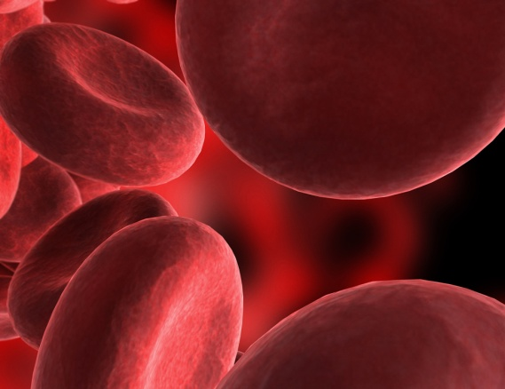
Once a patient who has neuropathy and/or diabetes moves to dialysis, there is a 10 fold increase of developing ulcers and amputation. Within 1 year after this result, 50% will die. Thus an intense treatment from your office is imperative to prevent the downward slide to dialysis and then death.

Slide 7
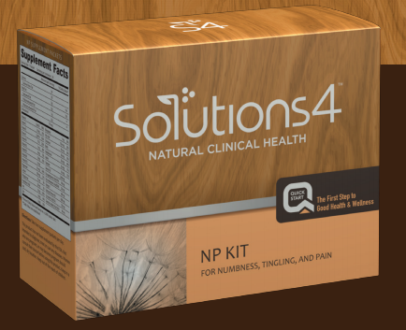
Introducing the New NP Neuropathy Kit!

Slide 8
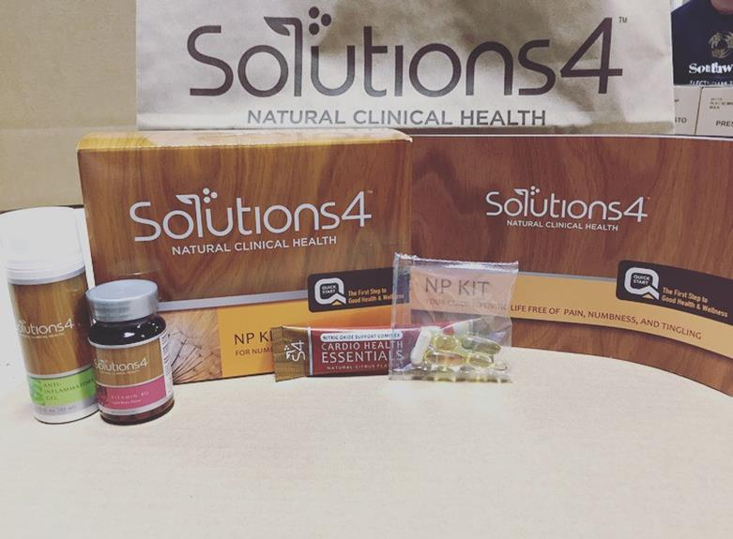
What Comes In the NP Kit?
28 Supplement Packets
Cardio Health Essentials
Vitamin B12
Anti-Inflammatory Gel
Guide Book

Slide 9
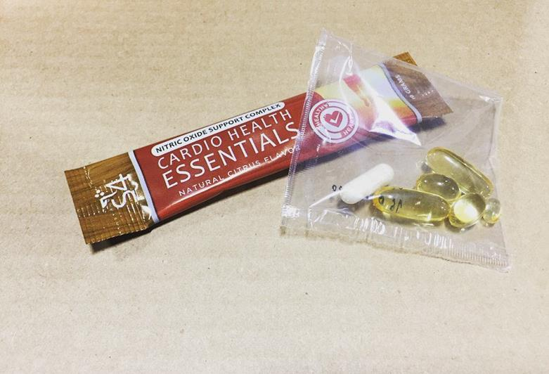
Cardio Health Essentials:
L-arginine
L-citrulline
CoQ10
This formula helps the body produce nitric oxide and supports the entire circulatory system
Supplements:
Vitamin D
Multivitamin/Multimineral
Salmon Oil
Evening Primrose Oil
28 Packets

Slide 10
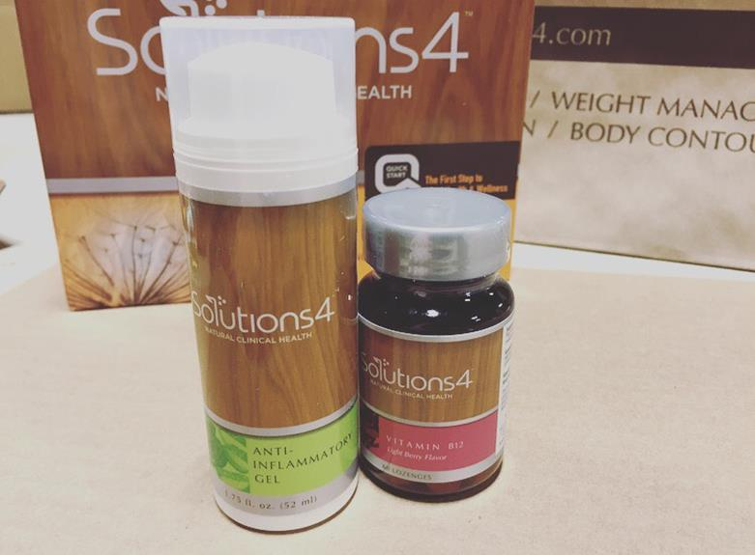
Anti-Inflammatory Gel:
Helps calm muscle and nerve pain
Natural ingredients: Capsaicin and Camphor
Reduce Inflammation
Vitamin B12:
Vital role in the functioning of the brain
Low vitamin B12 levels can contribute to neuropathy, weakness, and other problems with the nervous system

Slide 11
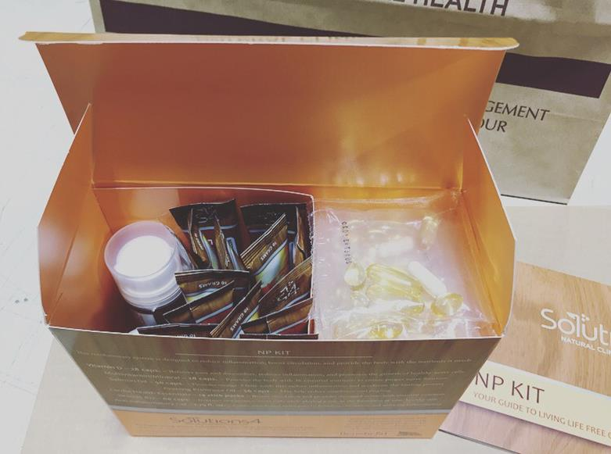
Using for Potential Patients
4 Bags of the Vitamins
1 AM – 1 PM
2 Cardio Sticks
1 per day

Slide 12

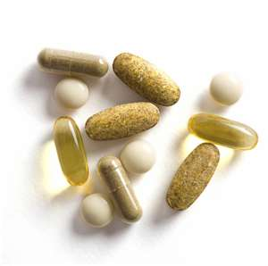
Benefits of Taking Supplements
By giving these nutrients and supplements to your potential patients they will see an acceleration in their healing and pain!
If your patients see results they will buy a program!
Remember you are essentially giving your patients their lives, well-being, health and happiness back!
Remind your patients that when the body starts to heal from the inside, it decreases the degenerative process of nervous system.

Slide 13
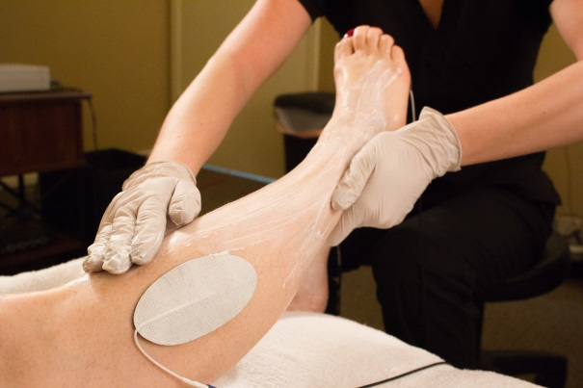
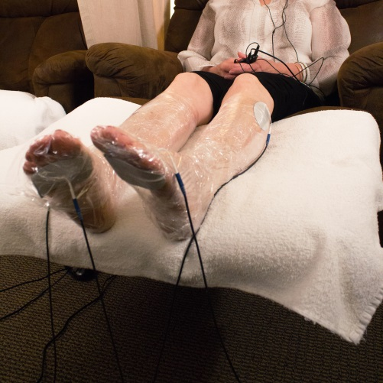
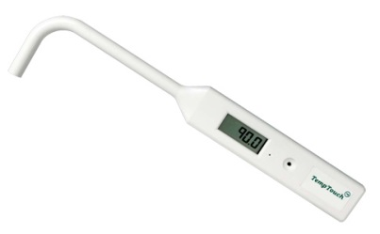
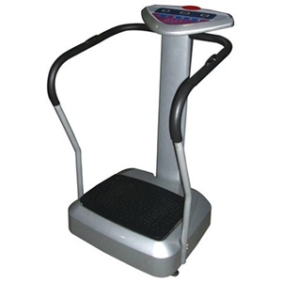
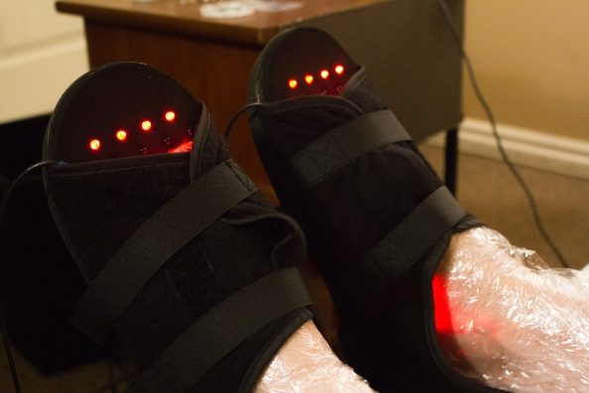
Treatment
TESLA MAX TM-4 Technology
LED Light Therapy
Cold Lasers and/or 10-Watt Laser
Whole Body Vibration
Leg Wraps

Slide 14
Thank you!
Dr. Todd Singleton Cell Phone Number: 801-903-7141

