Slide 1
How to Use the
Program Enhancement Brochures!
With Karolyn Campbell
Content Manager

Slide 2
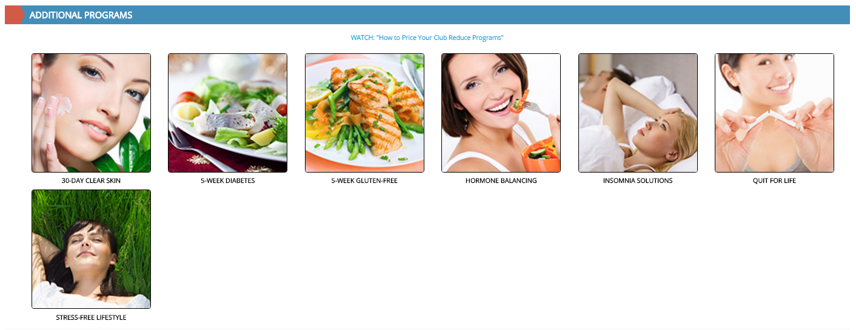
In the Past…
We created a new program manual whenever we wanted to help doctors treat a new condition.

Slide 3
Now, We’re Doing Something Different…
For the last two years, we’ve been working hard to make our core programs the best that they can possibly be.
All of our condition-specific programs are really just modifications of these core programs.
So, instead of writing a program manual for every condition on the face of the planet, we decided to create brochures that can be used to customize our core programs for specific conditions or treatments.

Slide 4
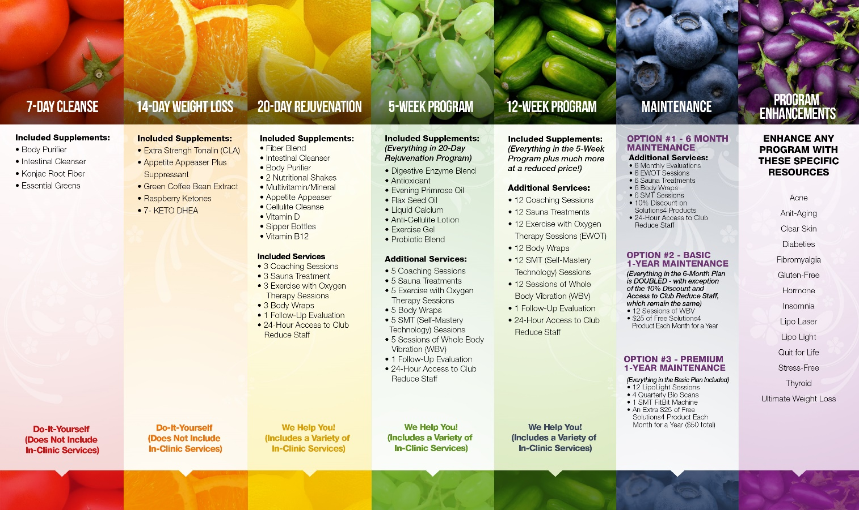
Our Core Programs:
+ Neuropathy

Slide 5

Benefits to You: More Options, Better Care
This will make it possible for us to expand the range of conditions for which we offer customized help!
For example, we created a “Thyroid” Enhancement Brochure last fall.
It should also make it easier for you, as a doctor, to manage patients with complex needs.

Slide 6
Here Are Some Examples:
If you have a patient who needs to lose a significant amount of weight (and also struggles with fibromyalgia), you can put them on the core program that best suits their needs (in this case, the 12-Week Candida) and give them the brochures about fibromyalgia and “ultimate weight loss.”
Or, if a patient has diabetic neuropathy, you can place them on the Neuropathy program and then give them a “Diabetes” Enhancement Brochure.

Slide 7
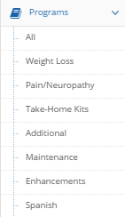
Use the Brochures or the Original Condition-Specific Manuals
If you’re happy with this new, streamlined system, you can use all of the resources that we’ve provided on Club Reduce 4.0!
If you prefer to use the full-length manuals, you can do that too. Many condition-specific manuals are filed under Programs > Additional on the left-hand menu.

Slide 8
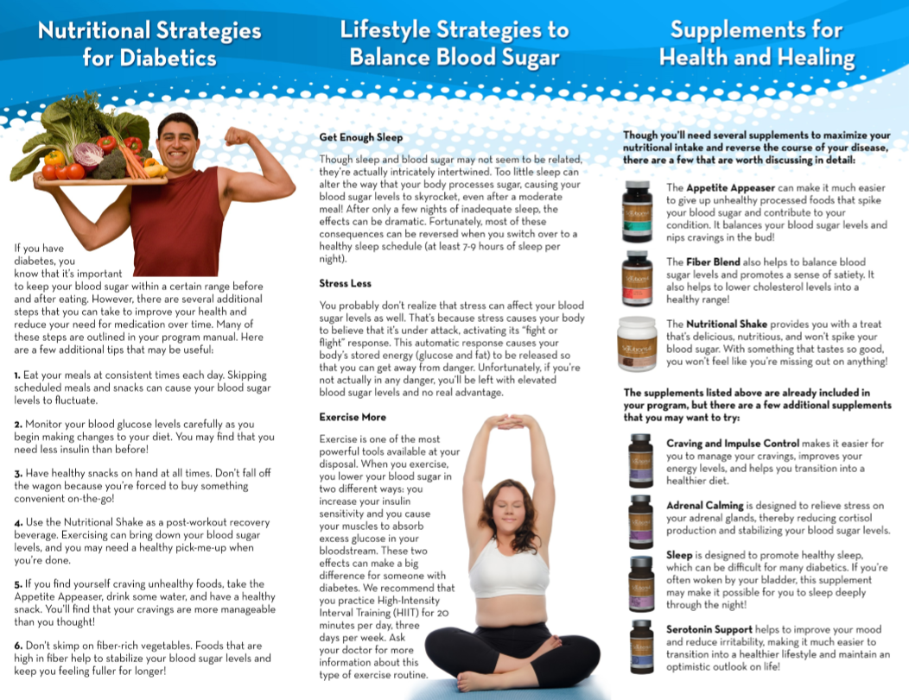
What’s in a Brochure?
Each brochure contains nutritional strategies, lifestyle strategies, and supplements that can help a patient with a specific health condition (or can help them get the most out of a treatment, like LipoLight).

Slide 9
So, Without Further Ado, Let’s Talk About Each of the Brochures…

Slide 10
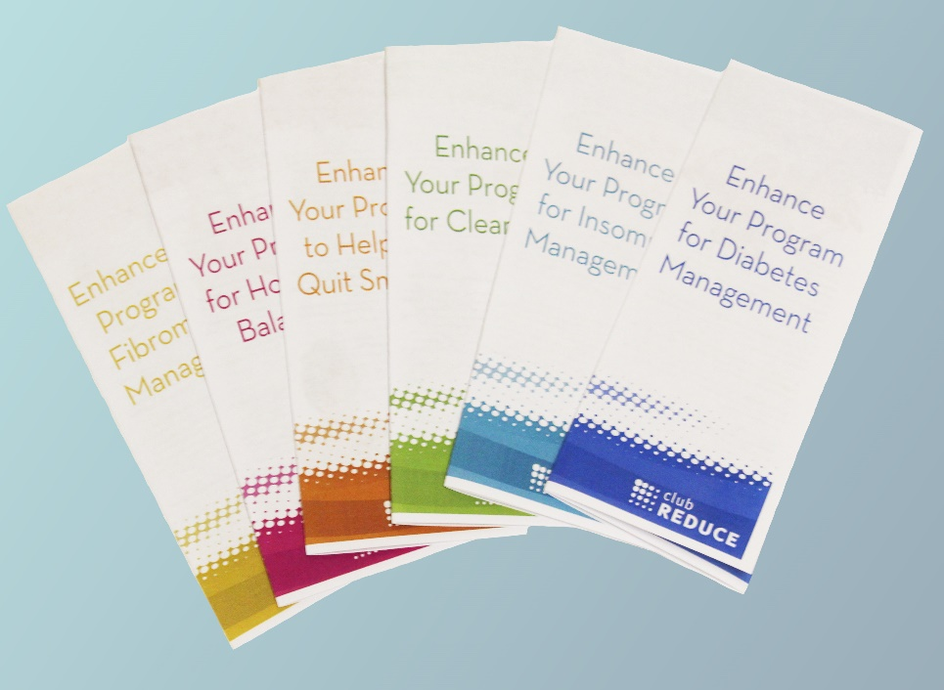

Slide 11


Slide 13


Slide 14


Slide 15


Slide 16
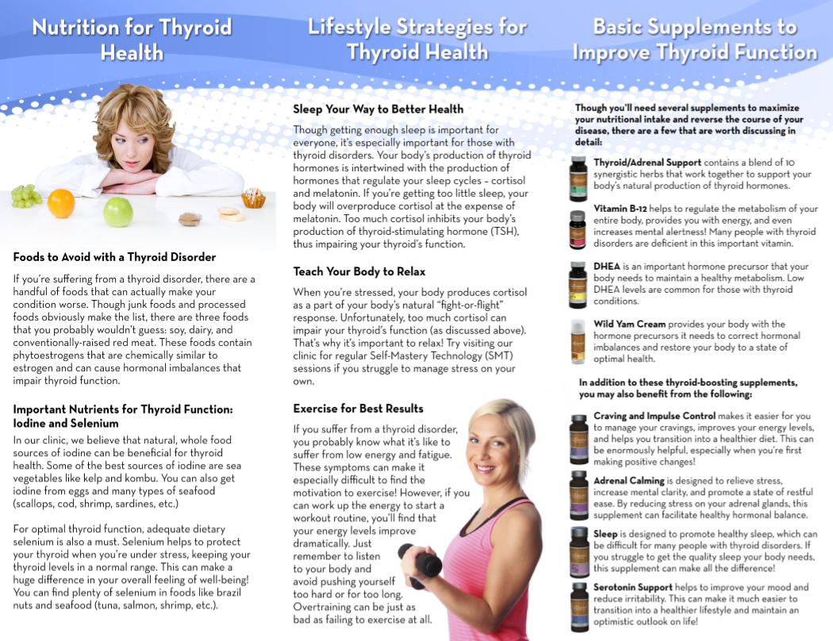

Slide 17


Slide 18


Slide 19


Slide 20
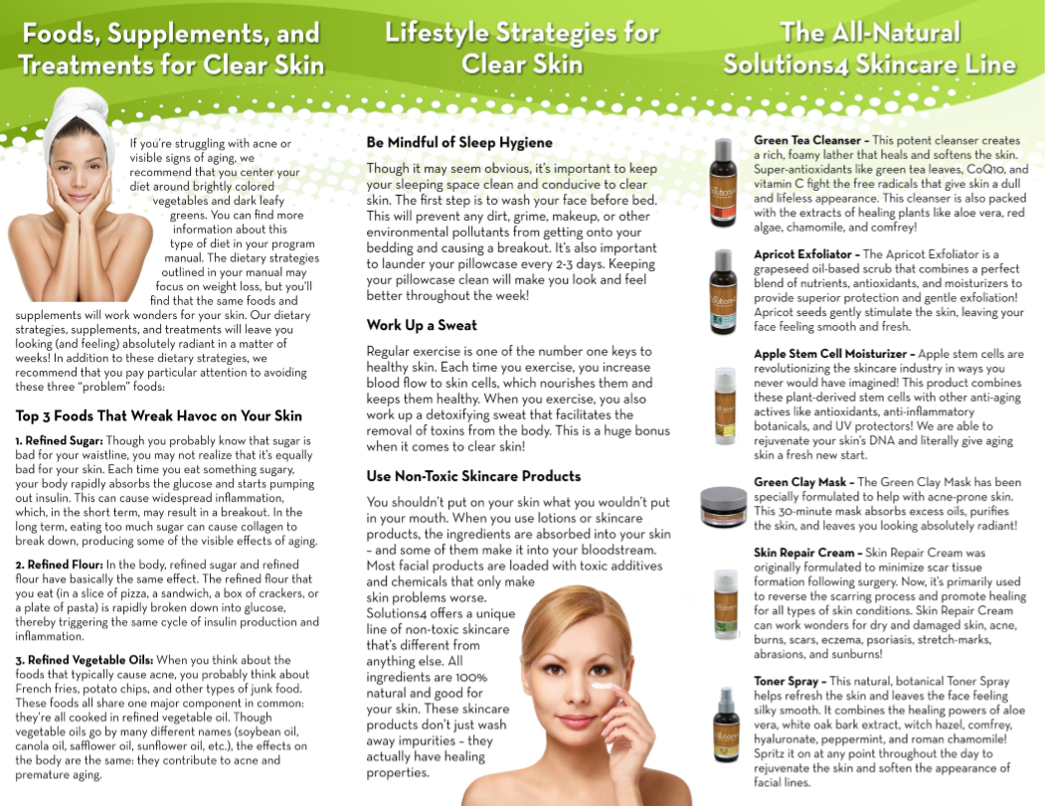

Slide 21


Slide 22
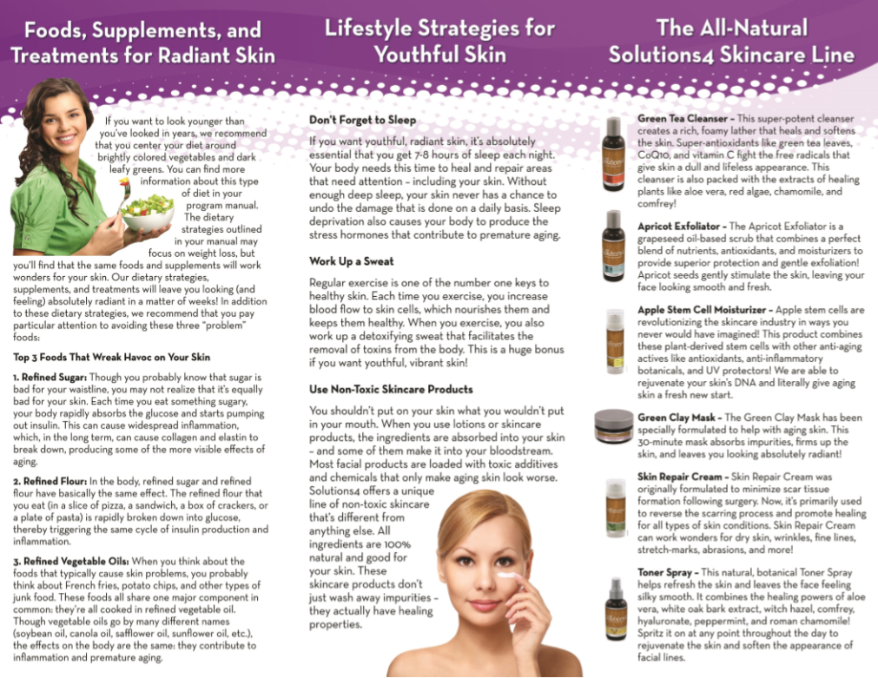

Slide 23


Slide 24
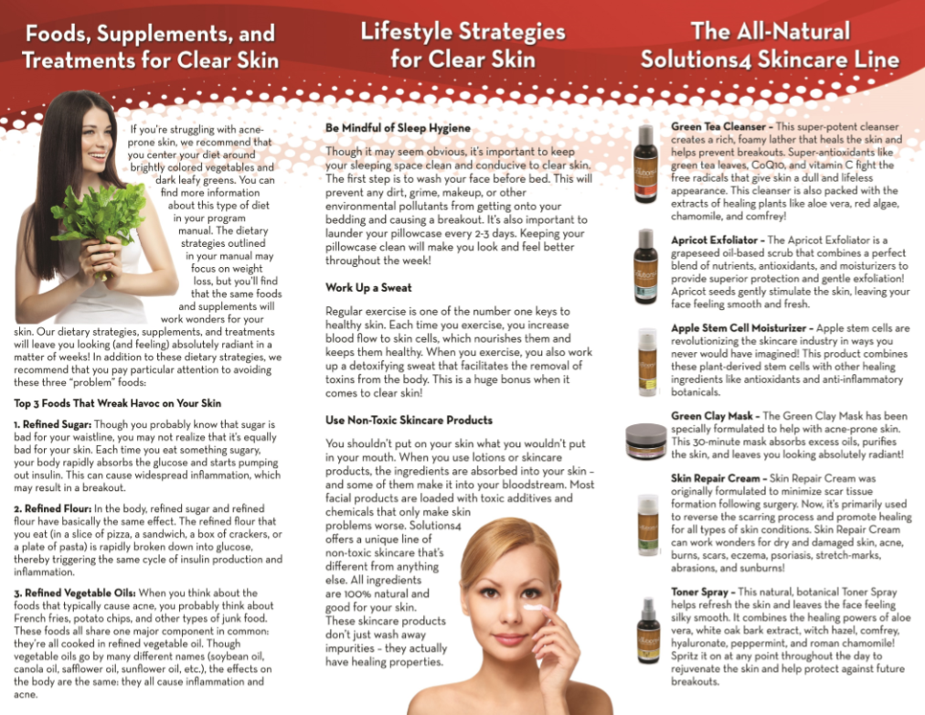

Slide 25


Slide 26


Slide 27
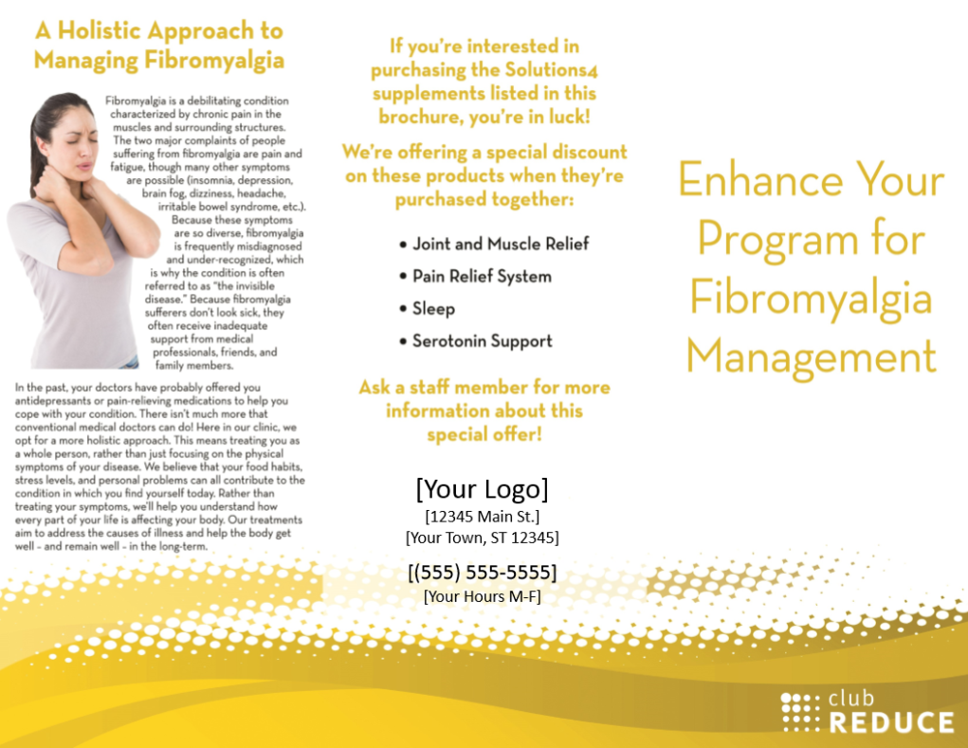

Slide 28


Slide 29


Slide 30
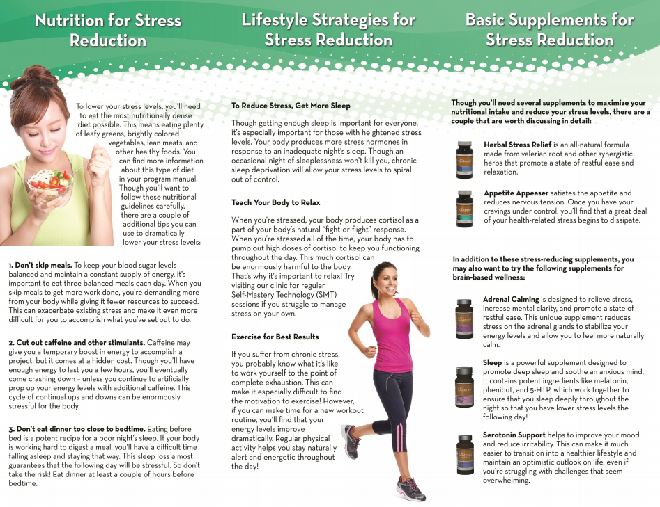

Slide 31


Slide 32
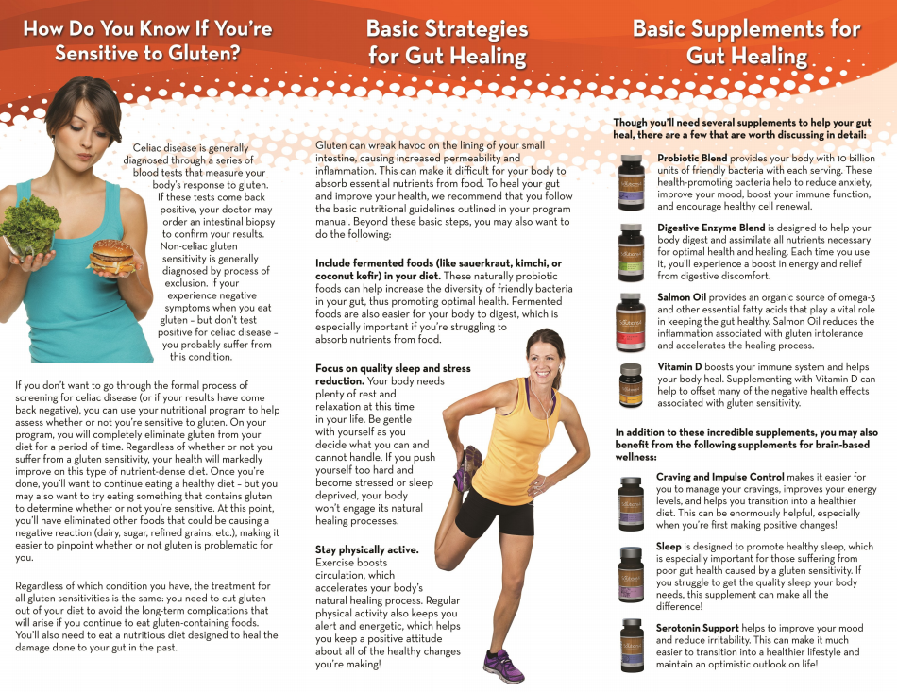

Slide 33


Slide 34
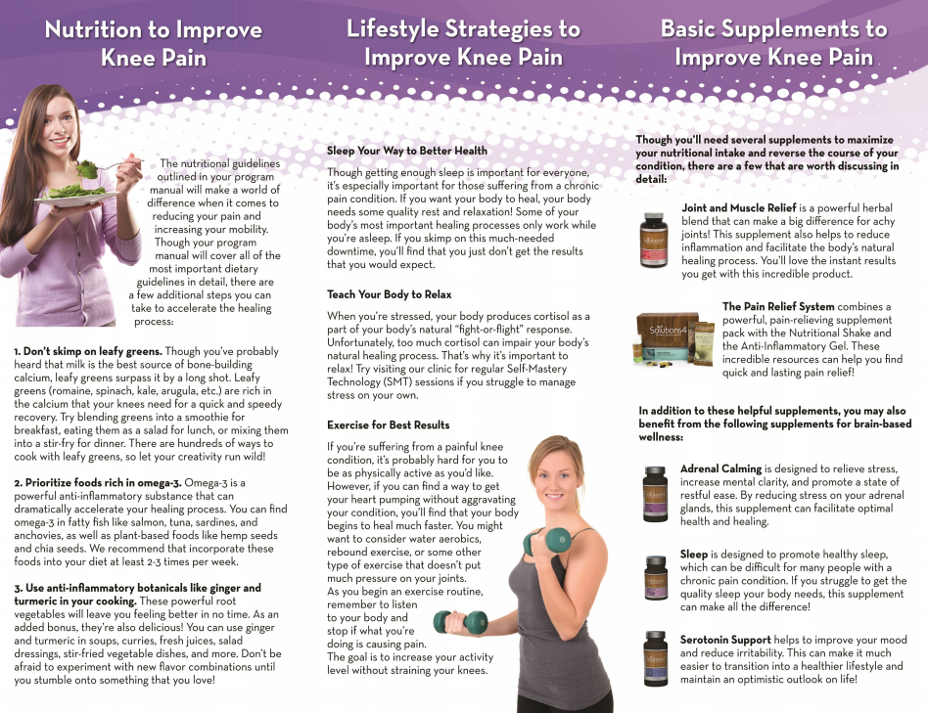

Slide 35
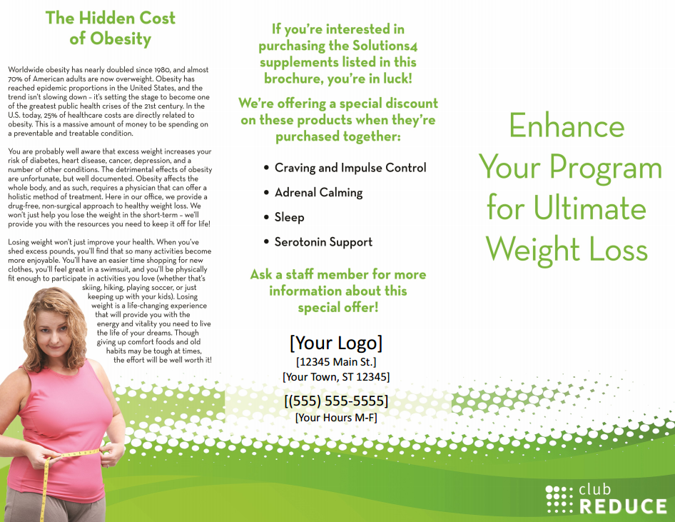

Slide 36
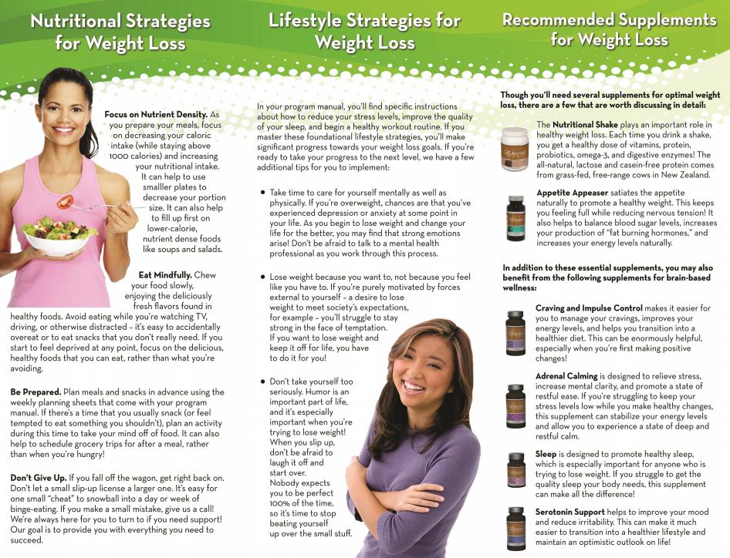

Slide 37
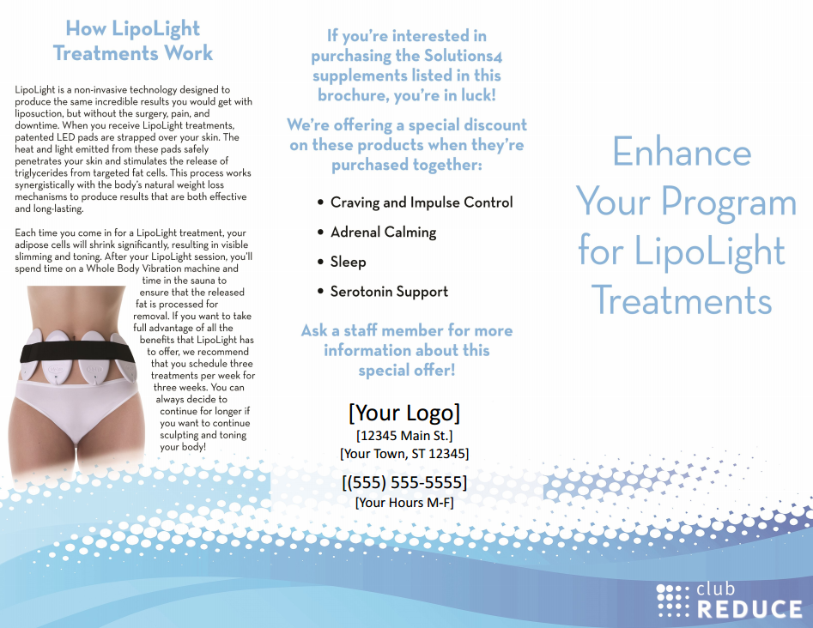

Slide 38
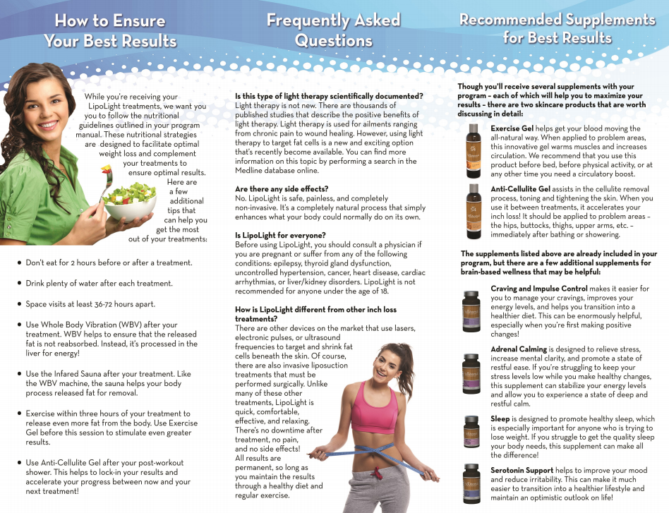

Slide 39
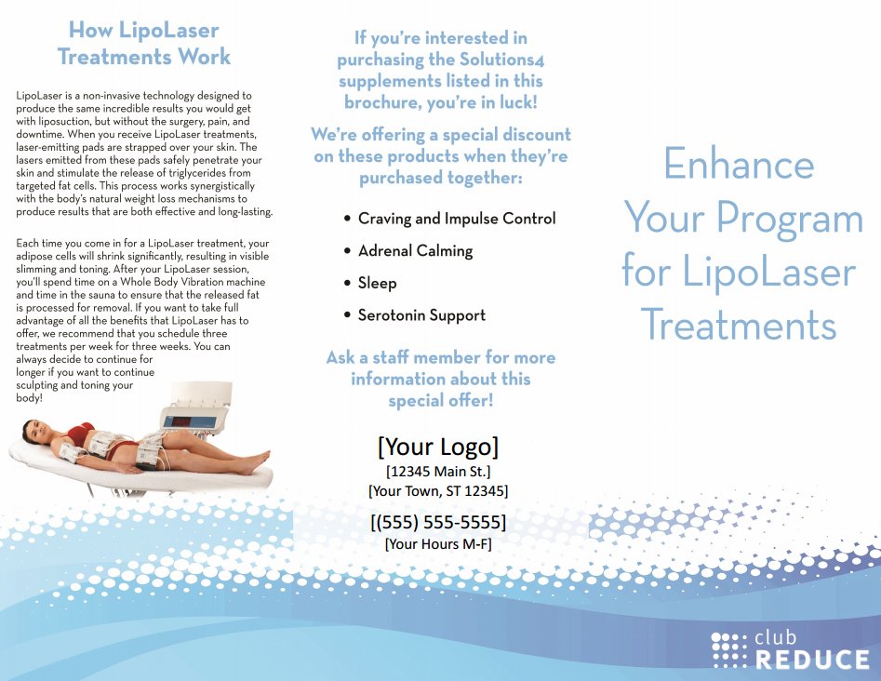

Slide 40


Slide 41
Any Questions?

