Slide 1

Ladies Night!
With Nanette Pututau

Slide 2
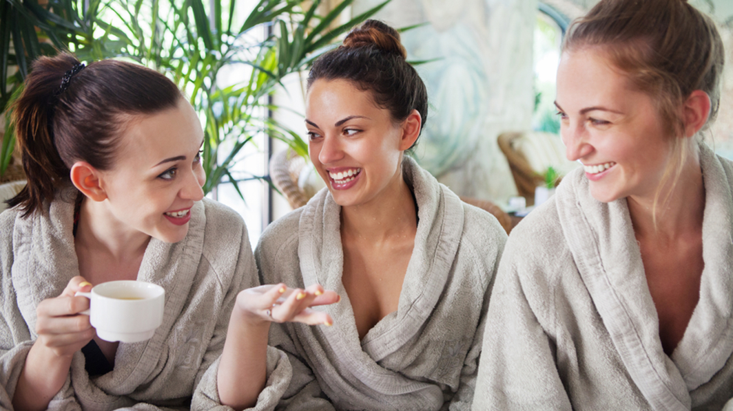
What is Ladies Night?
Ladies Night at Club Reduce is a pampering evening for your clients and their girlfriends.
This is such a great way to introduce your services and programs to new clients in a fun and relaxing environment.
The ladies that attend will receive different treatments you offer and become educated about your programs and services and want to start one themselves.

Slide 3
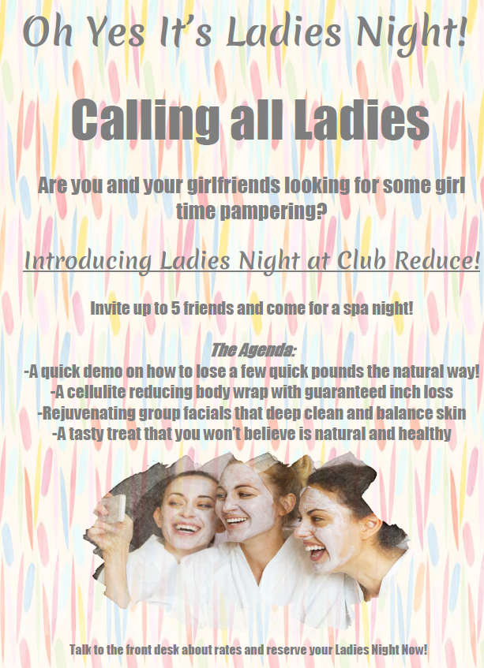

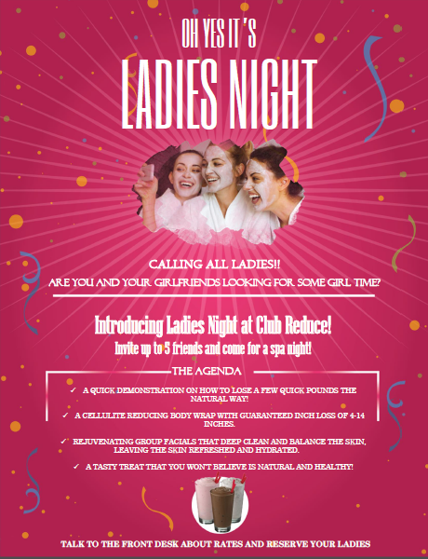
How to Market Ladies Night?
It is VERY EASY to market Ladies Night!
All you have to do is print out flyers that are available on Club Reduce and put them around your office
Front Desk
Treatment Rooms
Bathroom
Sauna
Employees talking to patients

Slide 4
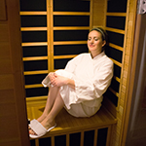
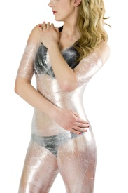
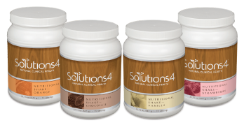
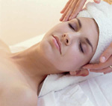
Decide What to Offer
With Club Reduce we already have exactly what you can do for a Ladies Night but the Manager and Doctor should go over exactly what treatments and services they will offer at Ladies Night.
What you should offer…
A quick demo/mini seminar on how to lose a few quick pounds
A Body Wrap with Self Mastery Technology
A Facial (this can be a hand facial on each other or the face)
Nutritional shake samples
You can also offer other services you do in your office such as…
Sauna
Lipo
Massage
Adjustment

Slide 5

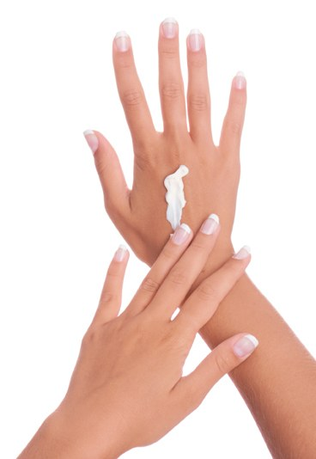
Body Wraps and Facials
Body Wraps
You can either do full body wraps or a mid wrap
You can do body wraps in groups if you have a big enough room or do one at a time (as long as the other ladies are doing other services or in a rotation)
Facials
You can do a hand facial on your ladies – If you don’t have enough employees for this you could have them do it on each other
You can also do a 10-20 min facial if you have an aesthetician
Make sure to have the S4 facial product on hand if they want to buy the product!

Slide 6
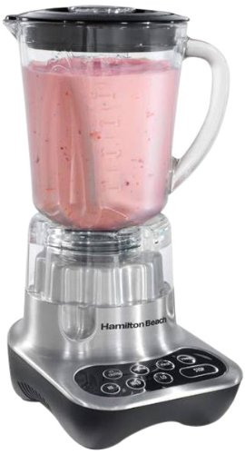
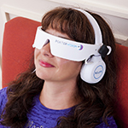
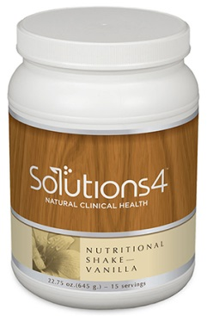
Nutrition Shakes and SMT
Nutrition Shake
You can buy the small sample shakes from Solutions 4 or get a blender and mix different flavors with ice and fruit
It’s best to have different flavors so they have a variety to choose from – make sure you have shakes on hand if they want to buy it!
Self-Mastery Technology
It is usually best to have them listen to SMT while layind down during the body wrap
If you don’t do a full body wrap then make sure you have comfy chairs or tables set up to have the ladies listen to SMT

Slide 7
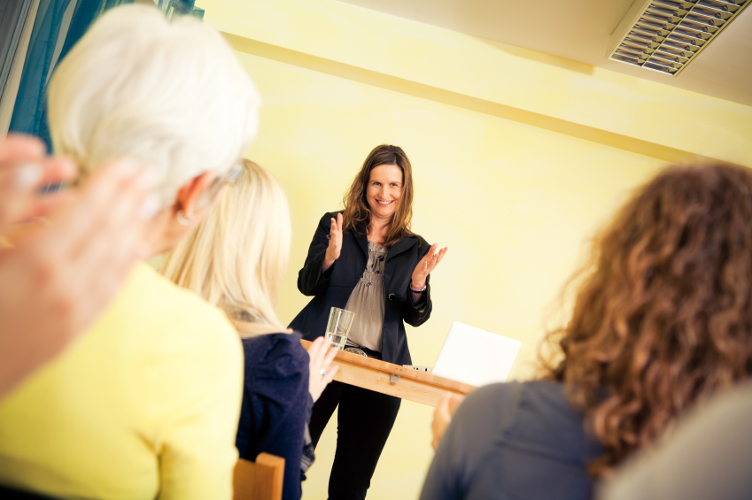
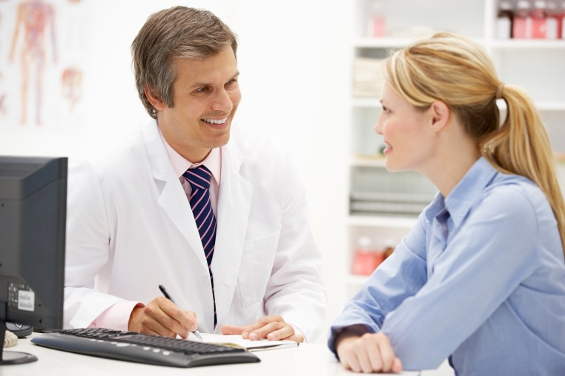
Mini Seminar and Eval
Seminar
The mini seminar should be mandatory to Ladies Night. It should be short and sweet but it should also give enough information on your clinic and how incredible your services and programs are!
Keep it 10-20 min.
Eval
This can either be done the night of or another day.
The eval can be done in a rotation with other services.
This is a great opportunity to see if they are interested in doing a program. Or have any questions

Slide 8
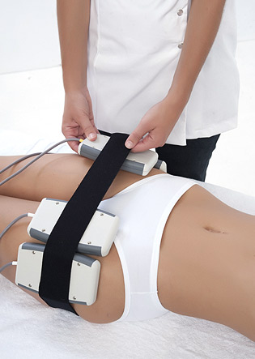
Sauna and Lipo Laser
Sauna
If you have a sauna it’s a great addition to Ladies Night. This is best to do if you do rotations and have some ladies in the sauna and some doing body wraps – keep in mind they can’t do a sauna after a body wrap.
Lipo Laser
If you have a Lipo machine it is a very easy service to offer.
This is also great to offer in rotations as well as doctors usually on have one machine.

Slide 9
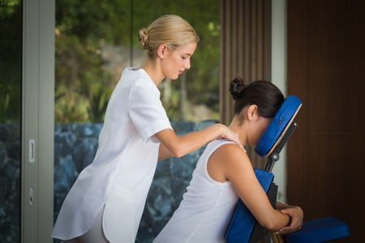
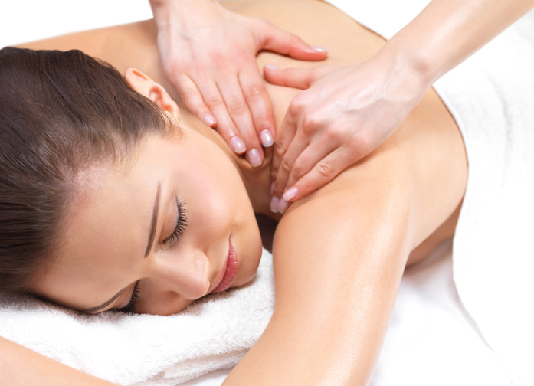
Extra Services to Offer
Massage
If your office has a massage therapist this is a great and exciting service to offer
You can either do 10-15 min spot massages on a table OR do 10-15 min seated massage

Slide 10
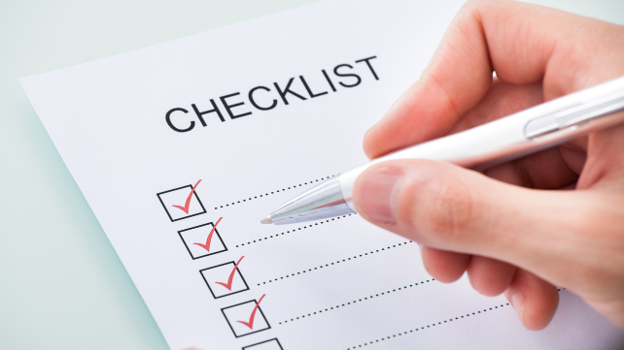
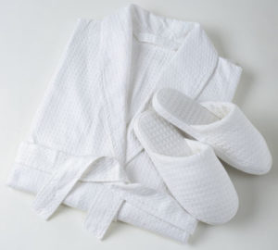
Setting Up Ladies Night
Make sure to schedule it on a night that all of your employees and doctor are available
All of the documents you need are found on the Club Reduce checklist – MARKETING > ALL > LADIES NIGHT
Make sure all the rooms are ready and you have supplies needed
Body Wrap cream – wrap
Nutritional shake – cups
PowerPoint for mini seminar
Other nice things to include could be healthy snacks like a veggie or fruit tray
Nice soothing music
Robes and slippers – during the body wraps and facials
Note: Doing rotations is a great way to keep your attendees interested and not waiting

Slide 11
Rotations
*Quick Seminar*
Evaluation
Sauna
Everyone Start Here
Facial
Body Wrap

Slide 12
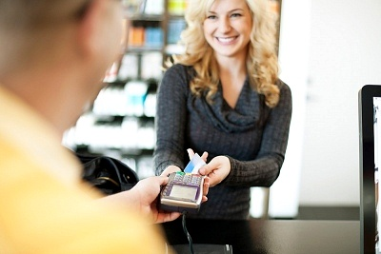
Charging for Ladies Night
It is totally up to you and your office if you charge and how much.
It is usually best to have them pay some fee to cover supplies, products and to make sure they attend.
We charged anywhere from $25-$45 a person. You can charge whatever you would like but keep in mind to not charge a huge amount as this is mainly to introduce new clients to your programs and services.

Slide 13

Make It Fun and Educational!
The main purpose behind Ladies Night is to give a taste to the new clients on how amazing your programs and services are and how they change lives.
Sell them on a program.
Make sure you praise and talk up your existing patient that invited her girlfriends.
This is an easy thing to get started in your office – just start putting up the flyers to market now!

Slide 14
Thank you!
Any questions please call us at 801-590-0880
or email at support@singletonsystems.com

