Slide 1
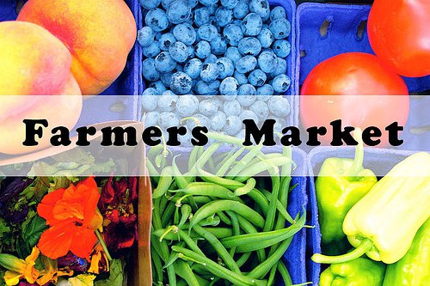
Marketing at Farmer’s Markets
With Dr. Todd Singleton

Slide 2
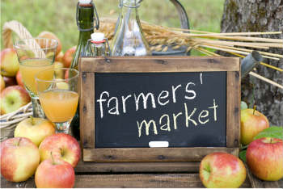
Why Farmers Markets?
Farmers markets allow consumers to have access to locally grown, farm fresh produce, and meeting local businesses to have the opportunity to develop a personal relationship with their customers, and cultivate consumer loyalty with the farmers or other businesses.

Slide 3
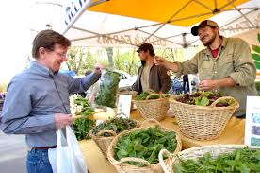
Getting Involved
Why is it important to get involved in your community?
A community becomes your place in the world. You have the opportunity to meet great people and let them know the amazing things you offer.
Your involvement in your community can make a difference!
Helping people lose weight
Helping people get rid of pain
Helping people sleep better
Helping people get healthy
Being involved in your community allows you to connect with others and show them how you can help improve their lives!

Slide 4
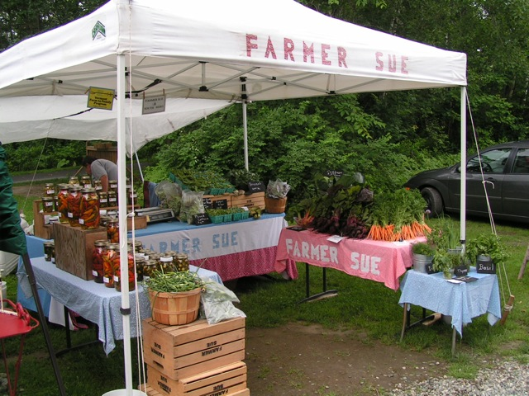
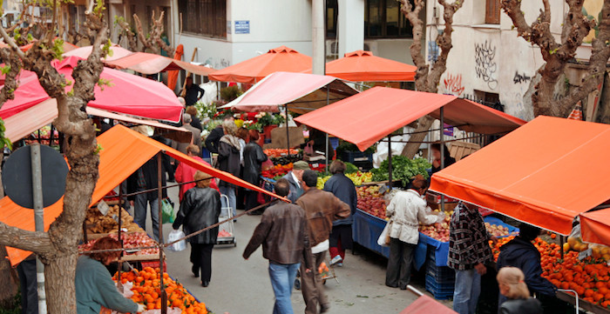
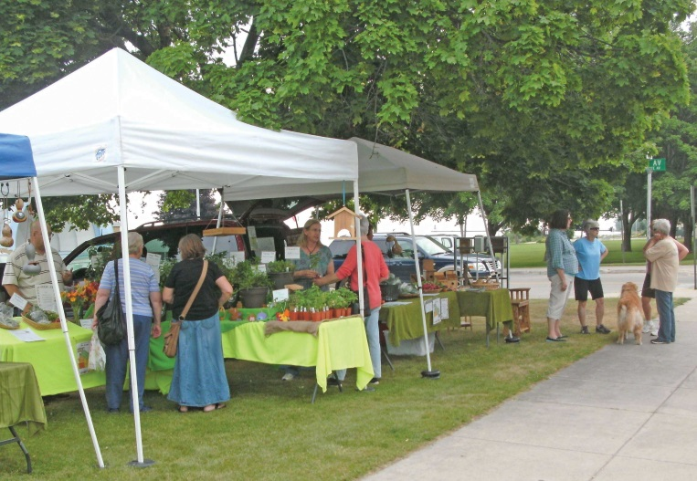
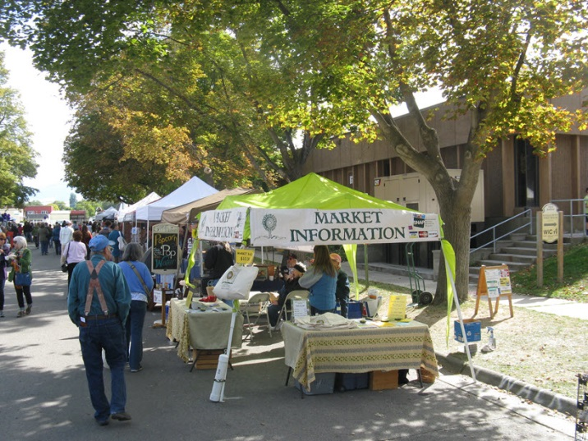

Slide 5
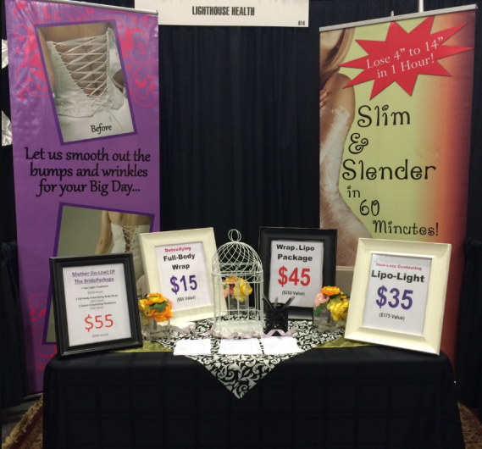
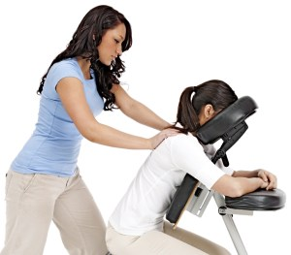
Setting Up Your Booth
On average it takes at least six exposures before a consumer responds to an advertisement. In your set up you will want to prominently place, uncluttered signs as your first marketing priority.
Having a logo or a clip art image you consistently use to symbolize the market will increase the likelihood your shoppers will notice and remember your ads and signs.

Slide 6
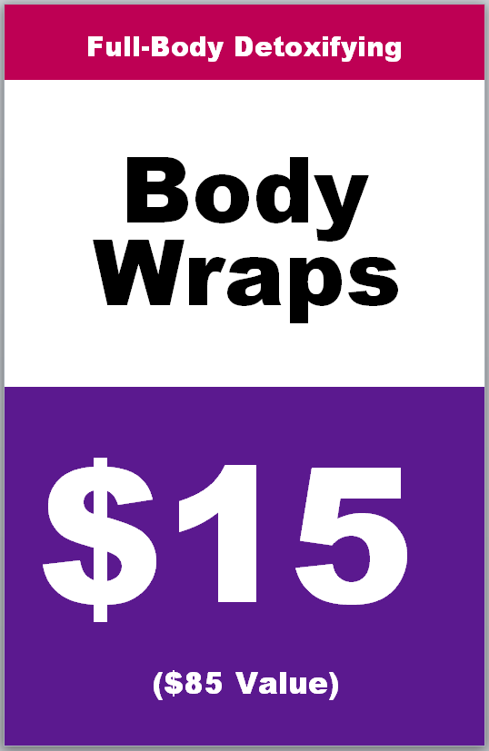
Same Set Up as a Trade Show
The set up for a famers market is pretty much the same as a Trade Show
Remember your two strategies for every event are:
Enter to Win
Buy it for Cheap
Decide what promotion you want to have
Body Contouring Package
Free Body Wrap
Discounted Lipo Light Session
Free Weight Loss Seminar
Keep it simple! Once you master that and it is successful then you can test other strategies.

Slide 7

For a Farmers Market it is important to include that you are a local business.
It is also a good idea to put that the specials or deals that you are offering are good for local customers only. It helps those customers that walk by feel a sense of community and that you are trying to give back. This will make the customer feel more motivated to sign up!

Slide 8
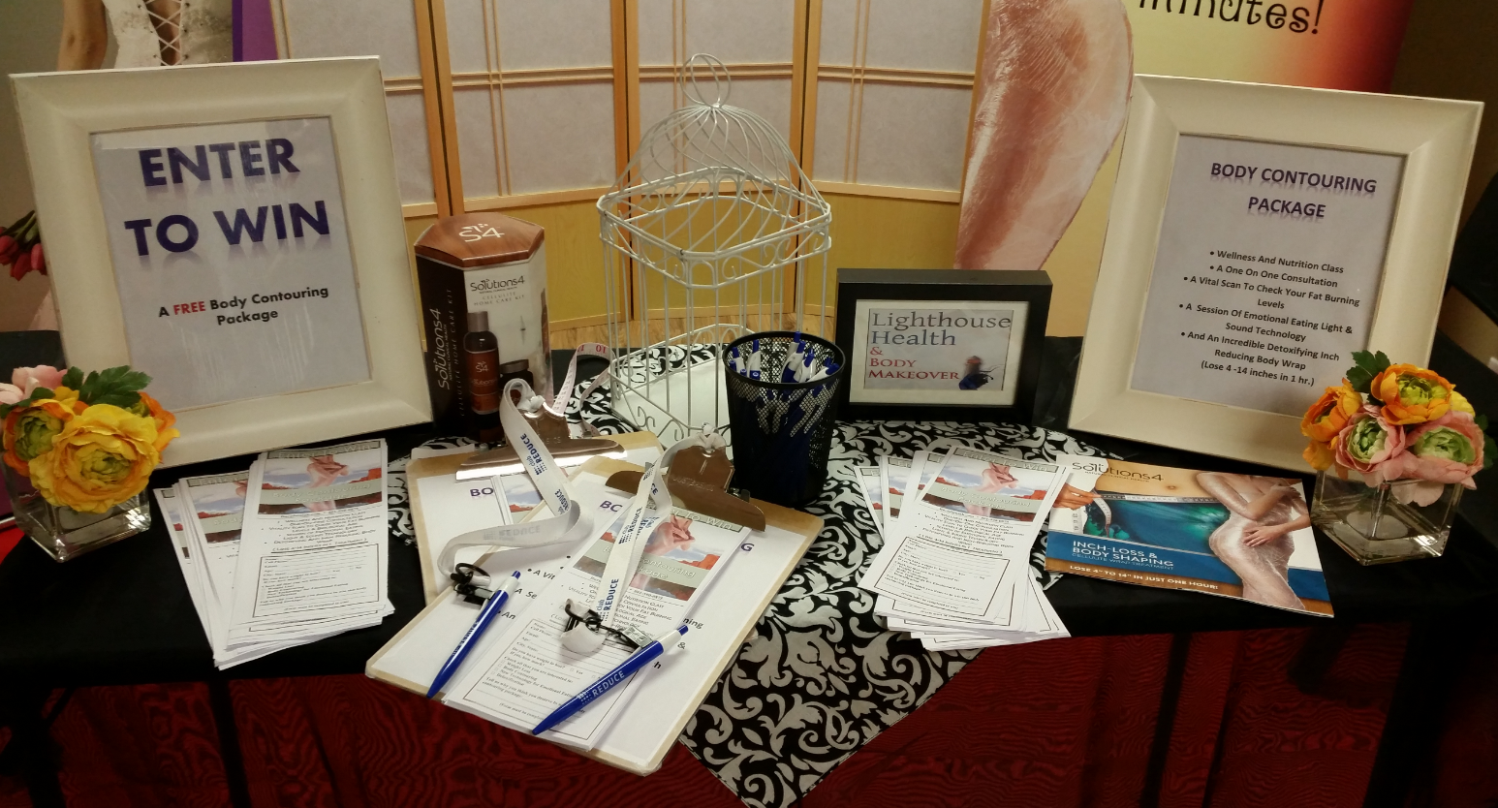
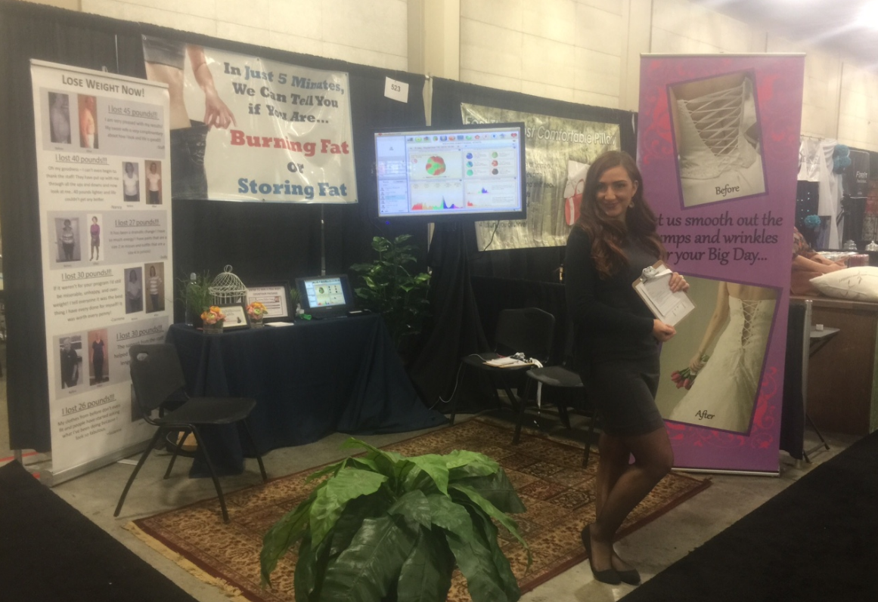
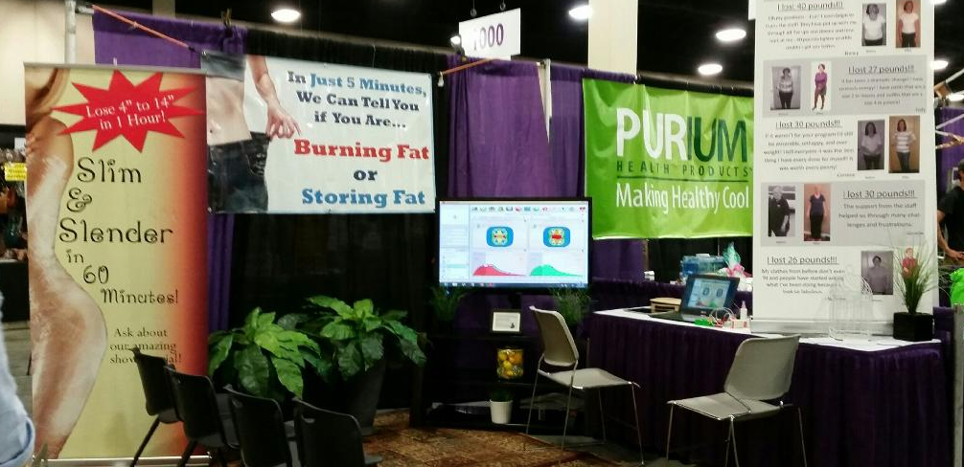
Everything You Need is on Club Reduce

Slide 9

Where to Sign Up?
Go to your own city’s websites for community events that are coming up
You can also google local events happening in your area
Find out the process to become a vender at your local farmers market

Slide 10
Thank you!
Call or Text with Questions!
Dr. Todd Singleton: #801-903-7141

