Slide 1

Take Your Website From “Good” To “Great”
10 Easy Tips To Help Your Clinic Website Get You More Patients

Slide 2
Google Search Console
Google Search Console is a free service offered by Google that helps you monitor and maintain your site's presence in Google Search results.
Visit: https://www.google.com/webmasters

Slide 3
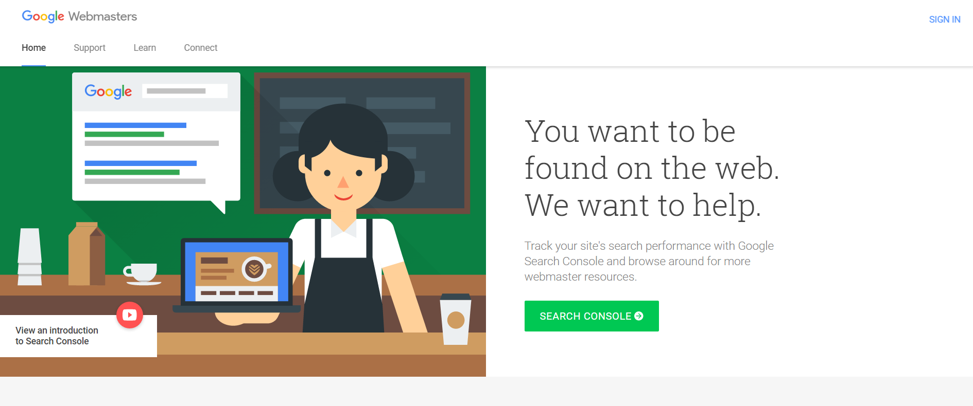

Slide 4
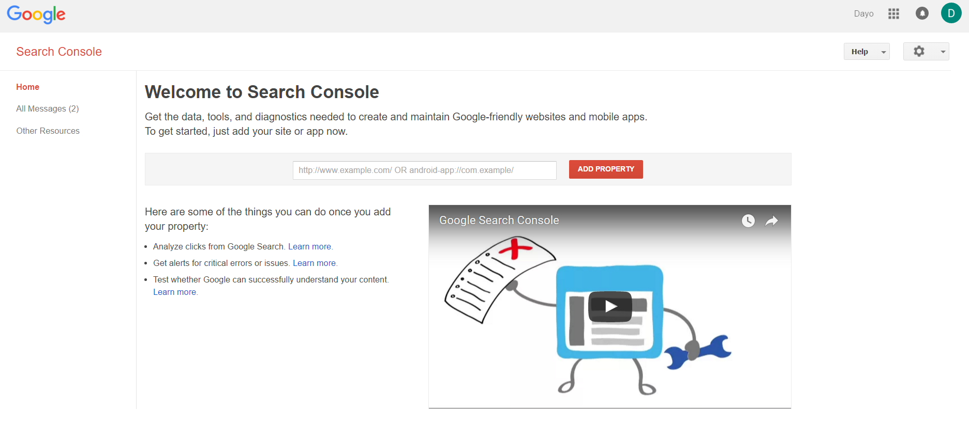

Slide 5
2. Create A Google Analytics Account
Google Analytics is an analytics service offered by Google that tracks and reports website traffic.
Visit: https://www.google.com/analytics

Slide 6
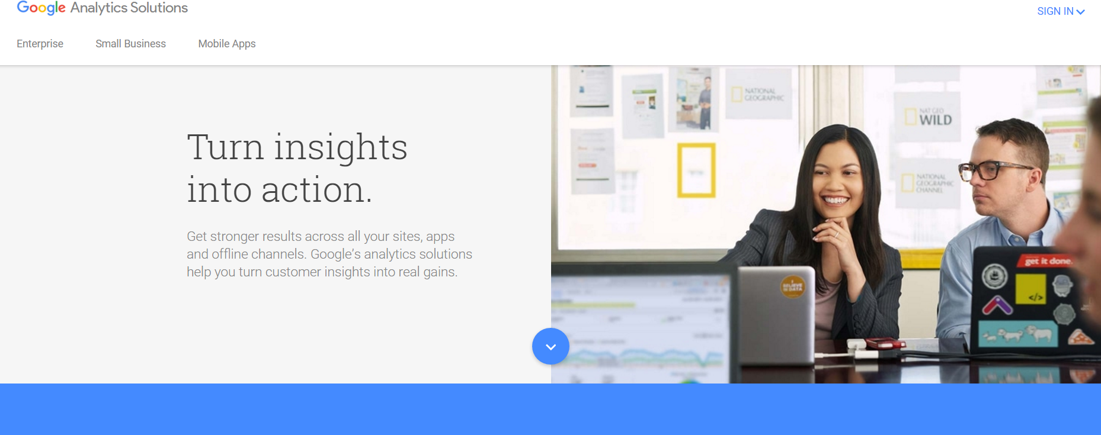

Slide 7
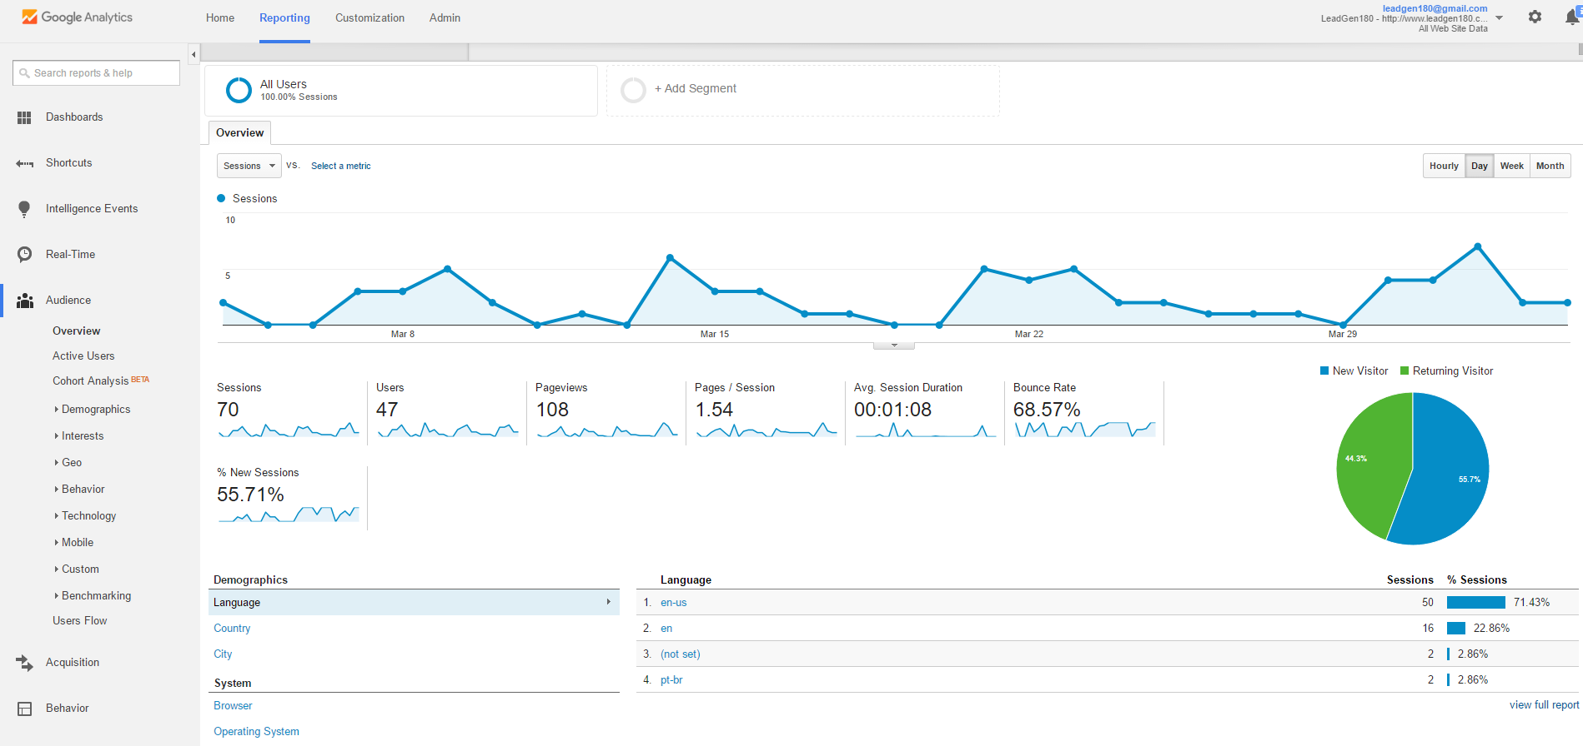

Slide 8
2. Create A Google Analytics Account
Google Analytics is an analytics service offered by Google that tracks and reports website traffic.
Visit: https://www.google.com/analytics
Website Visits
Popular Pages
Where Visitors Come From
Actions Visitors Take On Your Site

Slide 9
3. Optimize Above The Fold?
The most important content on your website should be above the fold. This is "content that is visible on initial page load."

Slide 10
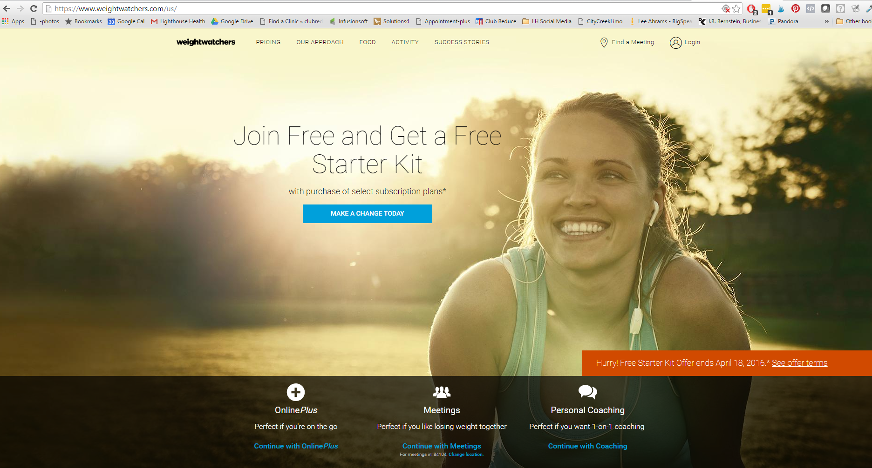

Slide 11
3. What’s Above The Fold?
The most important content on your website should be above the fold. This is "content that is visible on initial page load." Once a visitor hits your website, they should know exactly where they are.
Here are some suggestions for what to put above the fold.
Opt-Ins
Navigation
Call To Action

Slide 12
4. Opt-Ins
Opt-Ins are widgets on your website that allow you to collect the information of your visitors. Why are they important?
Allow you to follow up
Help take online traffic offline
Encourage visitors to take an action

Slide 13
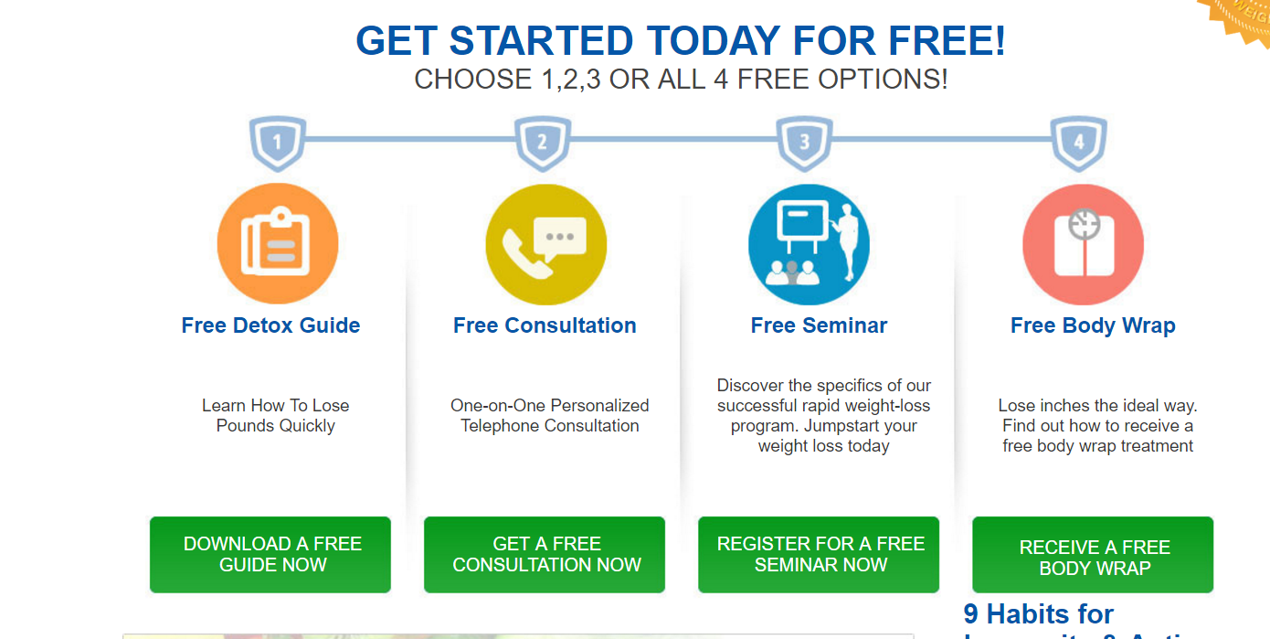

Slide 14
5. Updated Content
Make sure the information on your website is updated. This includes:
Contact Information
Services
Staff
Blog

Slide 15
6. Blog
The presences of a blog shows that your business is current and operational. Search engines love blogs! Here are content ideas:
Relevant News
Achievements
Product Highlights
Events
Testimonials
Pictures

Slide 16
7. Link To Social Media
Social Media helps promote your website and business. The more people that follow you online, the more people that can see updates and share content.
Facebook
Twitter
Linkedin
Youtube
Instagram

Slide 17
8. Mobile Friendly
Increasingly your patients are accessing the web from their mobile devices.
Why Is This Important?
Search Rankings - Google prefers mobile friendly websites
Bounce Rate - You’ll lose business
Stay Competitive
https://www.google.com/webmasters/tools/mobile-friendly/

Slide 18
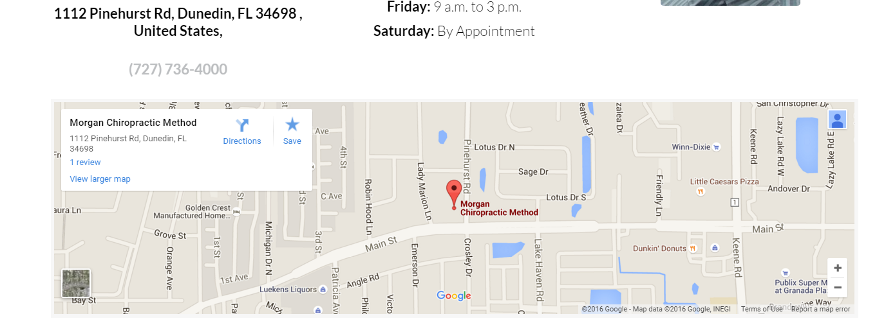
9. Google Maps + Clickable Number

Slide 19
10. Increase Website Load Time
A 1-second delay in page load time yields:
11% fewer page views
16% decrease in customer satisfaction
7% loss in conversions (source: Aberdeen Group)
A study by Akamai found that:
47% of people expect a web page to load in two seconds or less.
40% will abandon a web page if it takes more than three seconds to load.
52% of online shoppers say quick page loads are important for their loyalty to a site.

Slide 20
10. Increase Website Load Time
Optimize Images - WP-SmushIt
Reduce size and quality
Remove comments
Prioritize Above The Fold
Decrease Number of Plugins
Reduce Re-Directs
Get Better Hosting
Enable Caching - W3 Total Cache

Slide 21

www.LeadGen180.com
https://leadgen180.youcanbook.me

