Slide 1
September 2015 Patient Newsletters and Monthly Promotion
With Content Manager Tessa Ryser

Slide 2

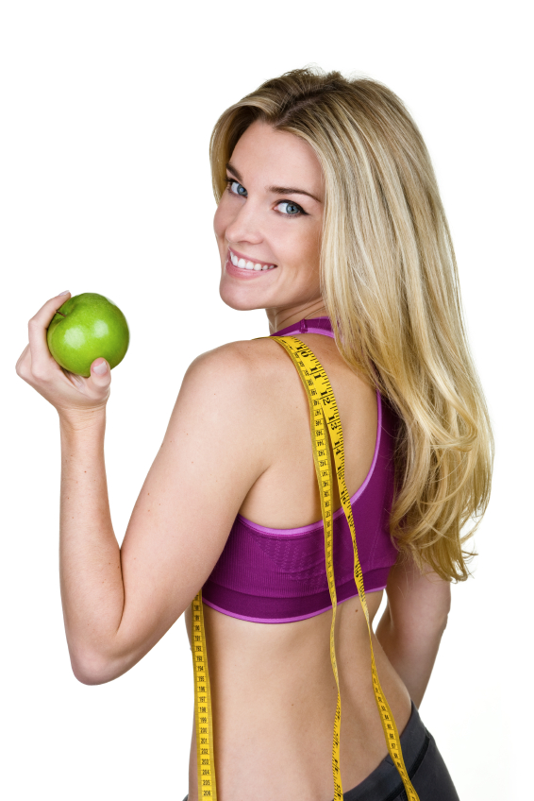
Weight Loss
Patient Newsletter!

Slide 3


Slide 4
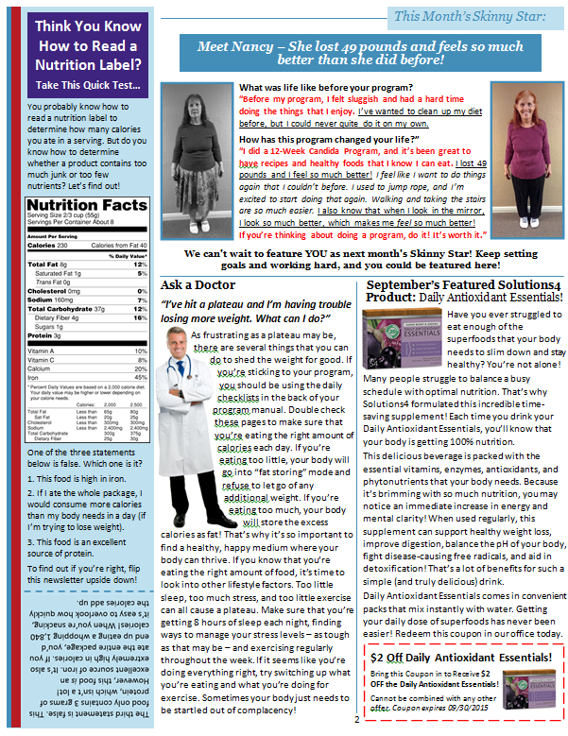

Slide 5
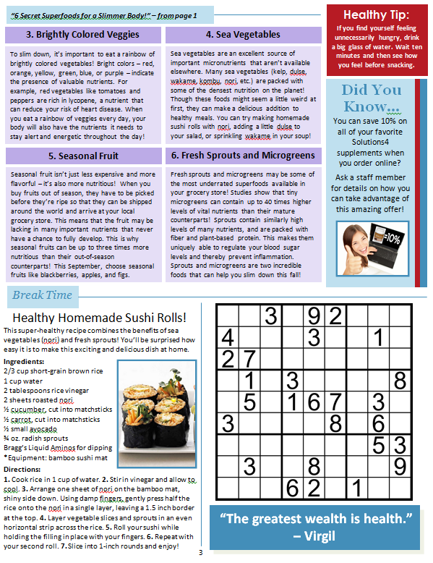

Slide 6
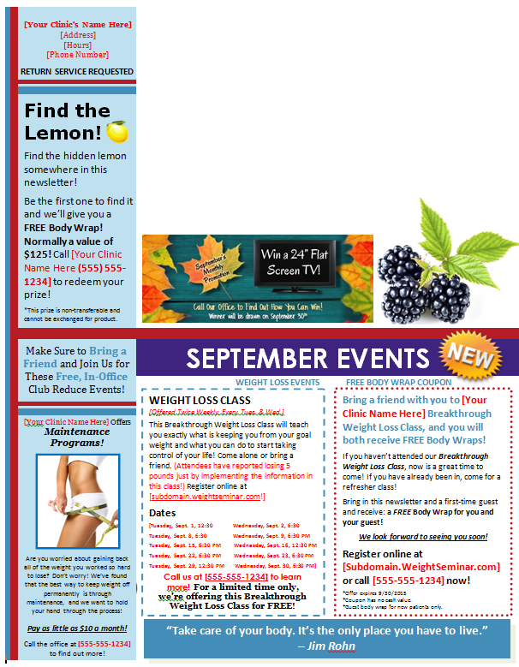

Slide 7
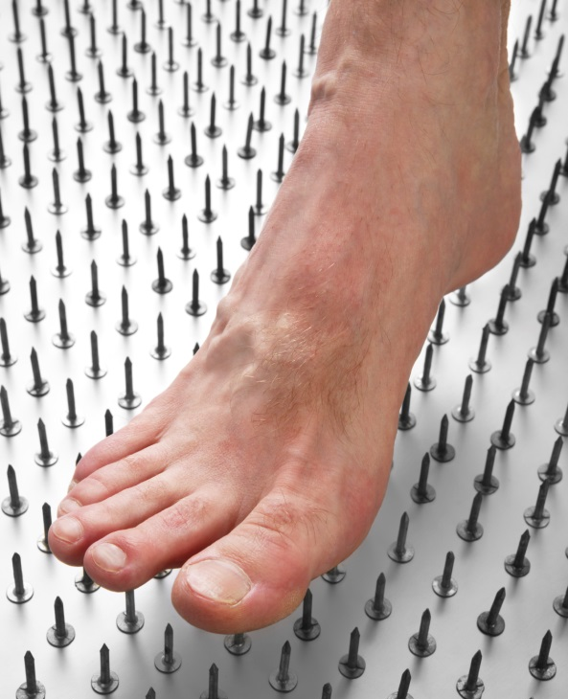

Neuropathy/Pain
Patient Newsletter!

Slide 8


Slide 9
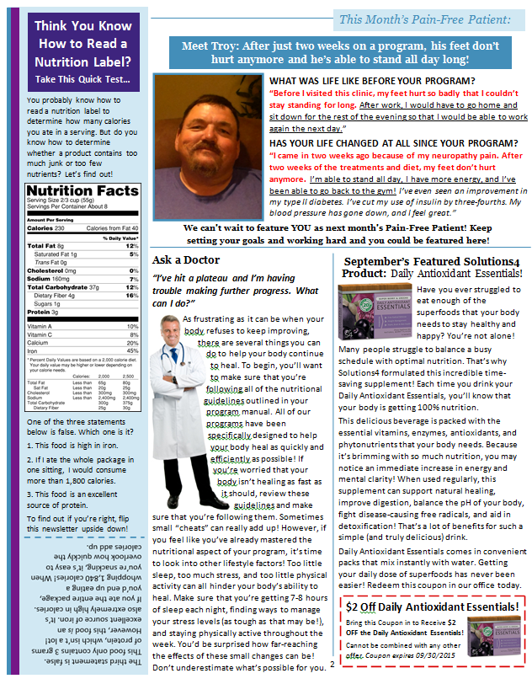

Slide 10
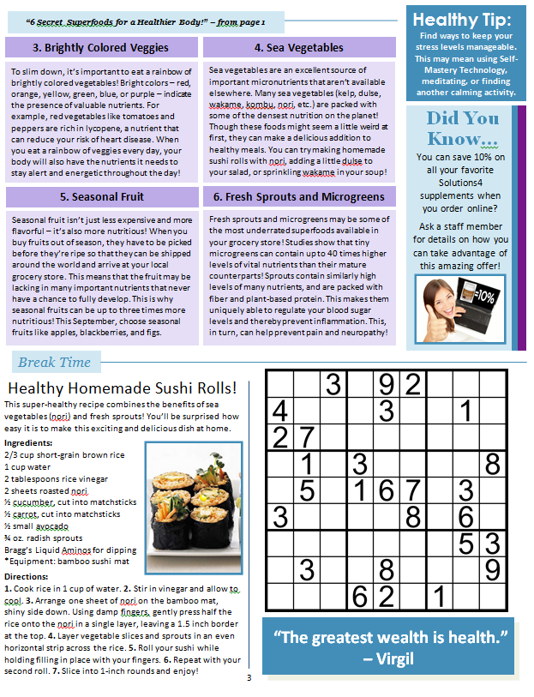

Slide 11
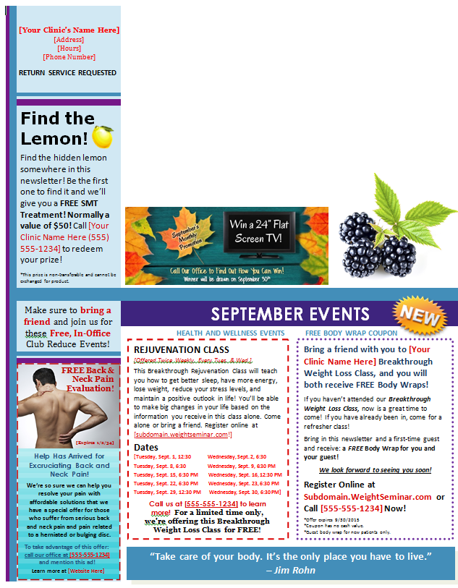

Slide 12
Make Them Your Own!
1) Read the entire newsletter! Have your staff read the entire newsletter.
2) Anything that is written in bold, red font must be changed! These will mostly be clinic names and contact information. However, there are exceptions. Part of the Skinny Star testimonial may be in bold, red font, and/or underlined to add extra emphasis for the reader. The same goes for certain words or phrases in the main article. These sections should not be revised unless it’s a clinic name or phone number.
3) The Events Section will need to be customized to your clinic. Otherwise, all other changes and/or revisions are optional.

Slide 13
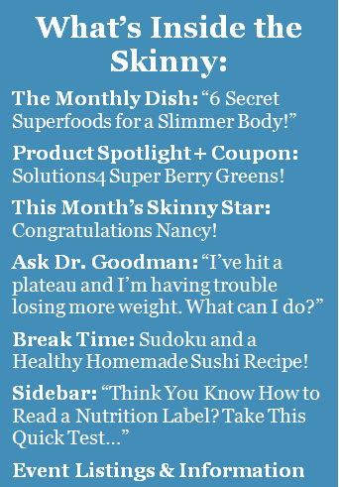
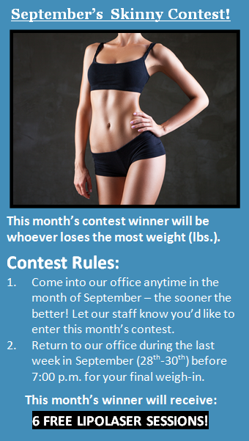
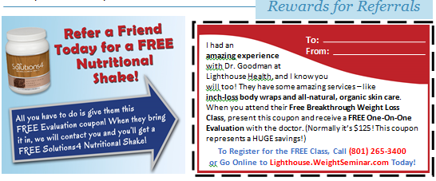
Weight Loss Newsletter Edits

Slide 14
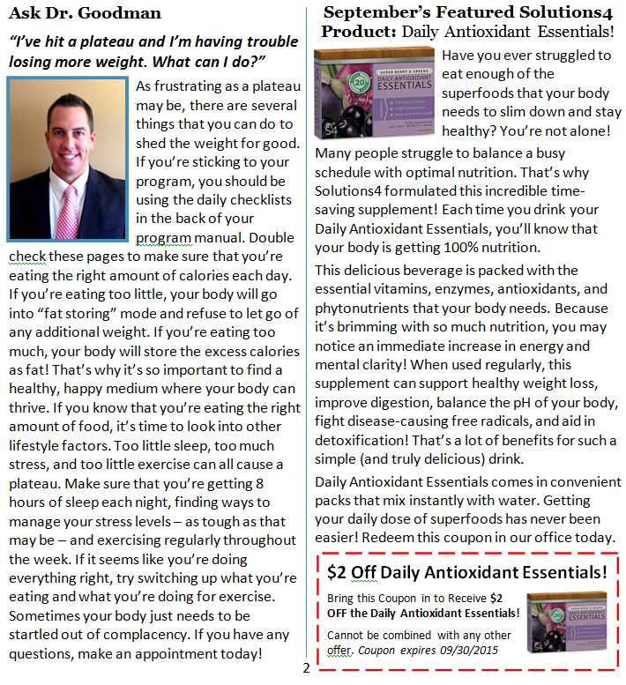

Slide 15
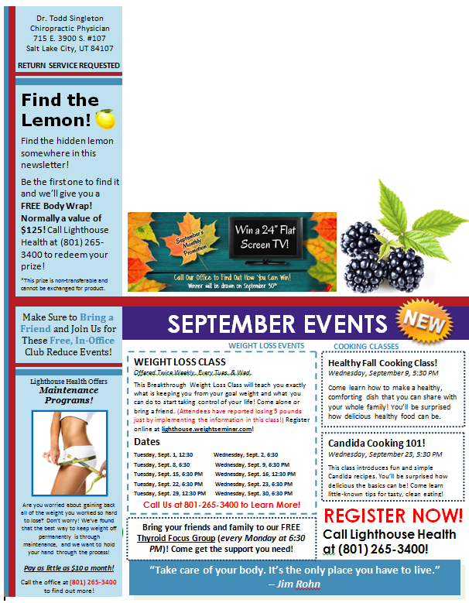
Customize Your Events

Slide 16
Printing the Newsletter
Option #1 (The Old Way)
Check around your area for smaller, local printers. Call several places to get prices. It’s better not to go to big companies like Kinkos as they charge very high prices.
Gather contacts and print mailing labels. (We use Avery 5160 labels.) Send to everyone.
Call the Post Office to see what postage and mailing seals are required. We use Avery 5248 mailing seals (2 for each newsletter). Buy stamps!

Slide 17
Printing the Newsletter
Option #2 (The New Way)
Done-For-You Print and Mail Service!
We print and mail all of our marketing through Richard Selby. We are excited to offer this Done-For-You service to all our Club Reduce doctors as well!
Selby Marketing Associates, Inc. will cover the entire printing and mailing process for you!
Contact Richard Selby for more information and specific pricing! (Contact info on next slide.)

Slide 18
Richard Selby
Selby Marketing Associates, Inc.
1387 Fairport Road, Suite 800
Fairport, NY 14450
Tel: 585-377-0750
Cell: 585-738-0581
Fax: 585-377-0763
rselby1@rochester.rr.com

Slide 19

Monthly Promotions!

Slide 20

The Purpose of Monthly Promotions
Goal #1 - Patient Success
You want to encourage and reward your patients to help them be successful on their programs.
You can do this by handing out:
1 Ticket for Arriving on Time
1 Ticket for Keeping their Weekly Appt.
1 Ticket for Each Pound Lost

Slide 21
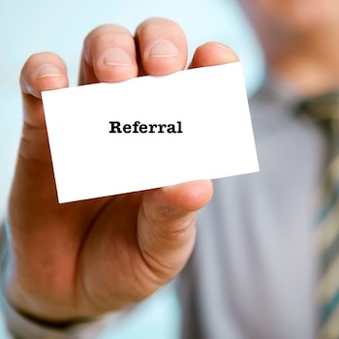
The Purpose of Monthly Promotions
Goal #2 – Build the Business
You encourage and reward your patients for helping you build your business by giving you referrals.
You can do this by handing out:
10 Tickets for Each Referral That Attends the Weight Loss Class/Seminar

Slide 22
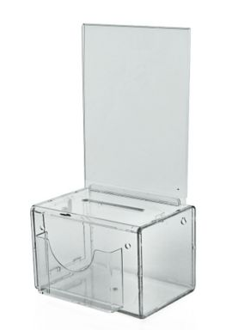
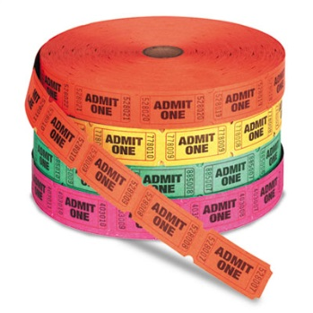
Everything You Need
Find all the content you need under Marketing > Internal Marketing > Monthly Promotions
Purchase raffle tickets and a clear ticket box. We use one called “My Charity Box” that is 6.5 x 5 x 13.5 inches, which you can purchase from Amazon at http://www.amazon.com/gp/product/B00F7NEWG8/ref=oh_aui_detailpage_o05_s02?ie=UTF8&psc=1

Slide 23
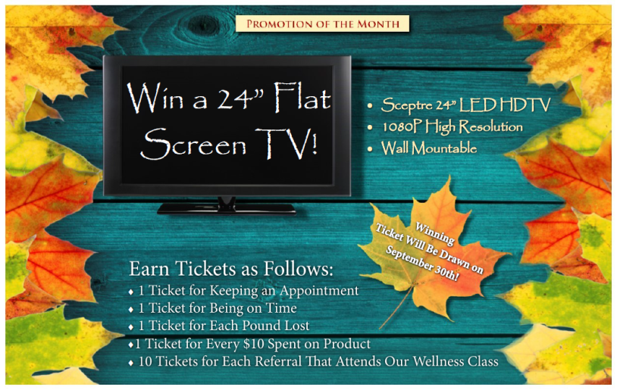


Start Now with September!

Slide 24

Additional Tips for Success
Hold the drawing every month and make a big deal about it!
Decorate the front office according to the theme of the month!
Use the prize we use, or pick your own!

Slide 25
Thanks for Joining Us!

