Slide 1
In-Depth Training on the Symptom Assessment
with Dr. Todd Singleton

Slide 2

Why Did I Create the Symptom Assessment?

Slide 3
Why Use the Assessment?
Why is it so valuable to use it in your office for your patients?
Using it as a tool to chart progress

Slide 4
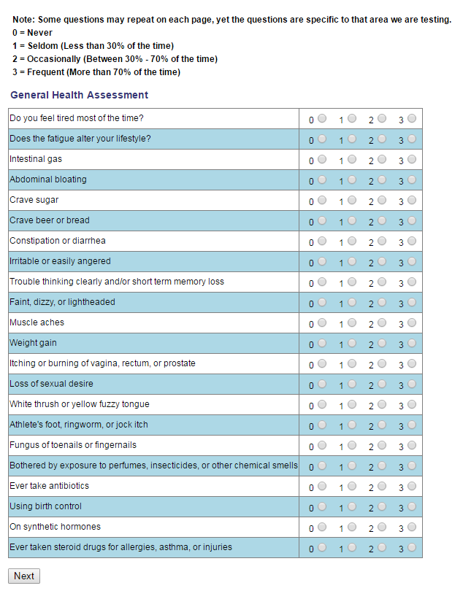

Slide 5
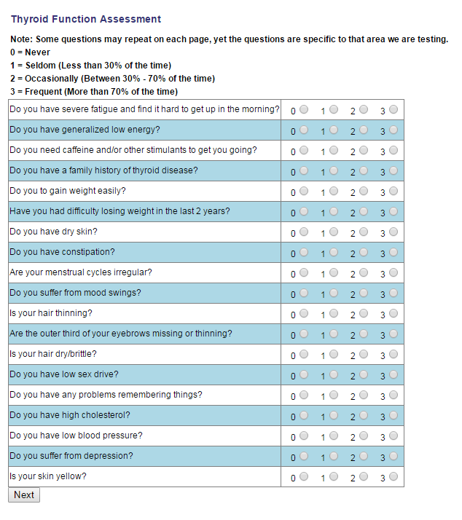

Slide 6
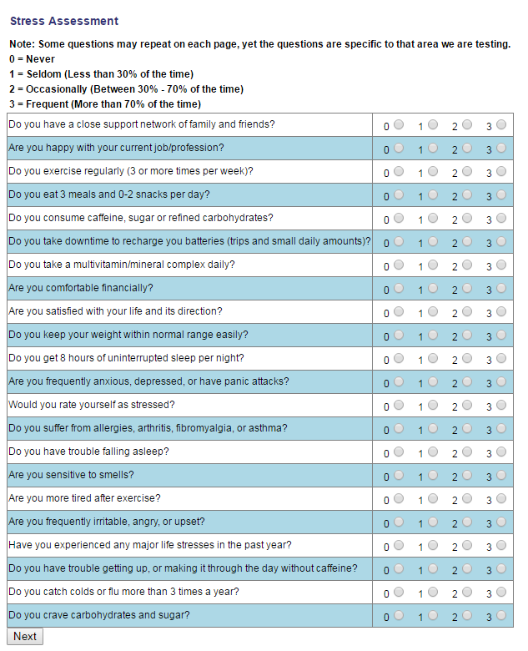

Slide 7
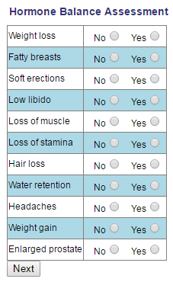
Male Assessment

Slide 8
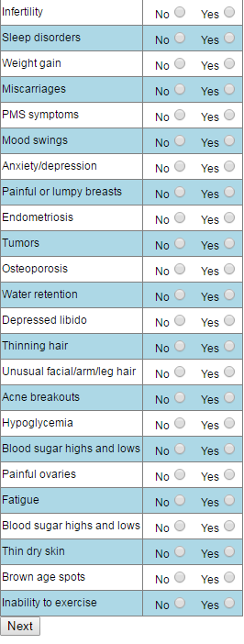
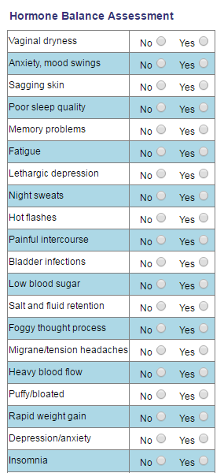
Female
Assessment

Slide 9
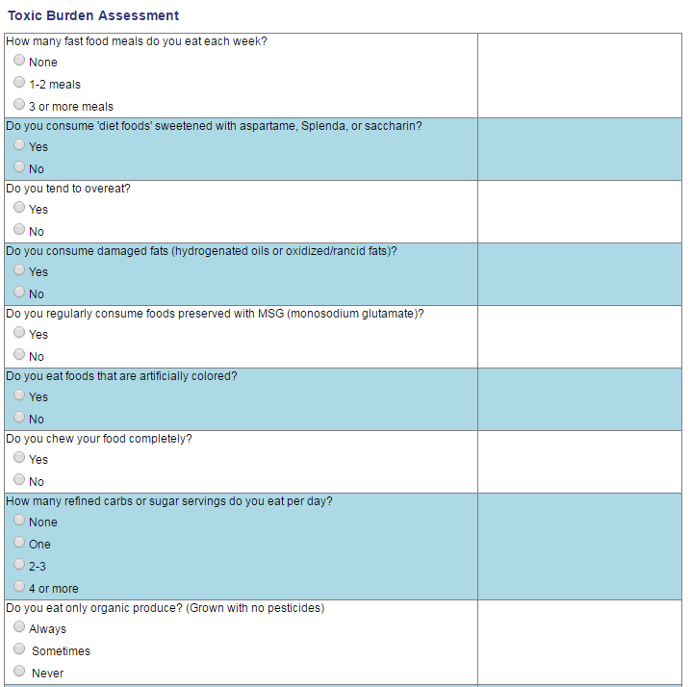

Slide 10
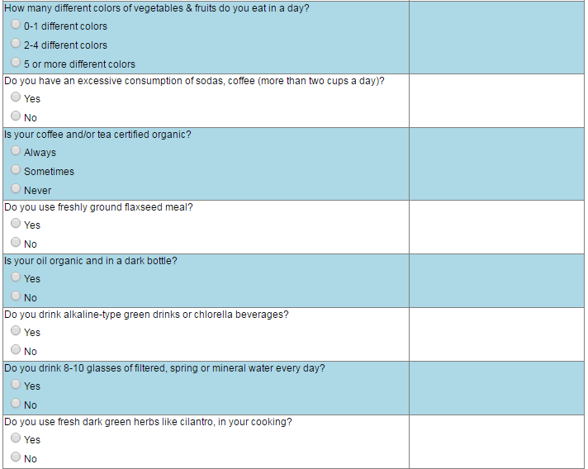

Slide 11
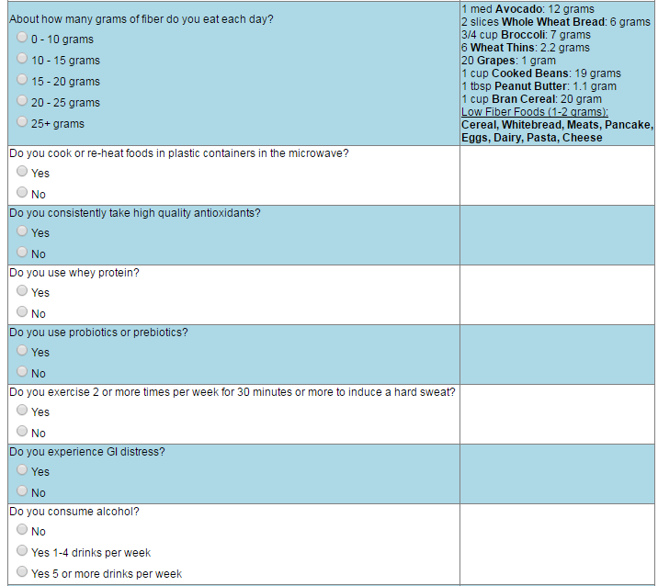

Slide 12
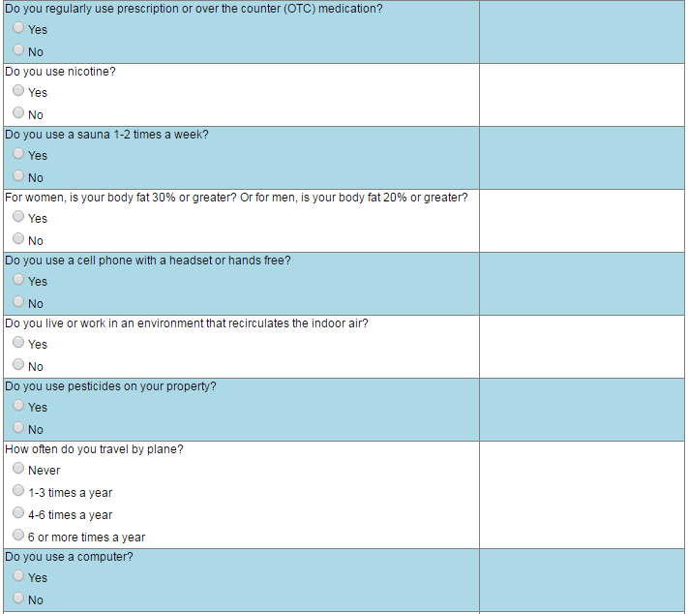

Slide 13
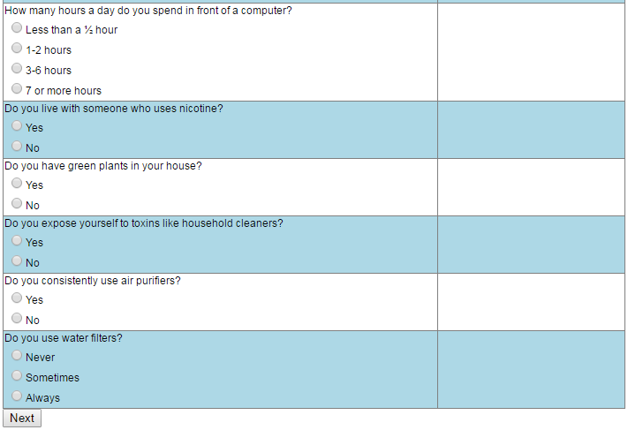

Slide 14
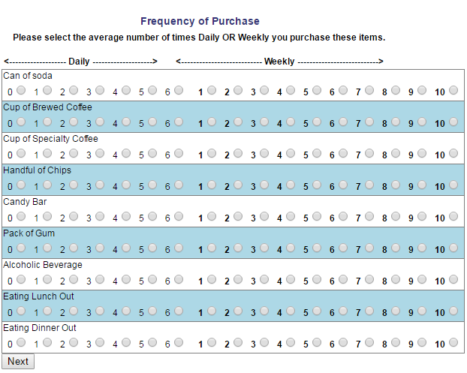
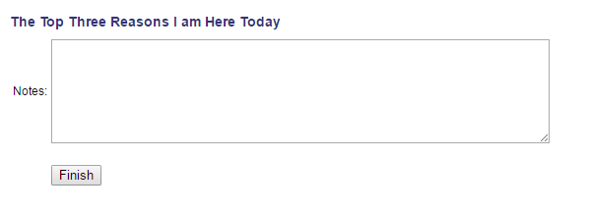

Slide 15
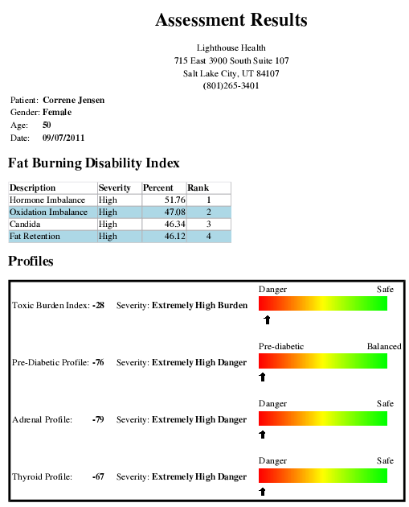
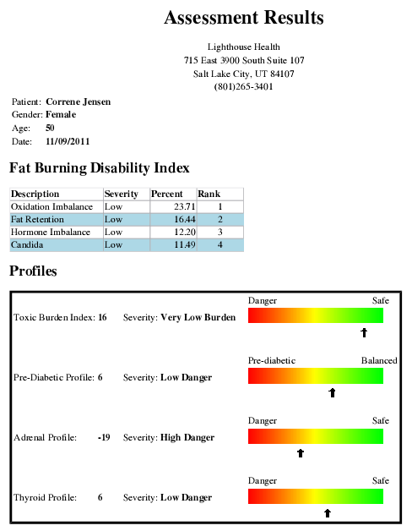

Slide 16
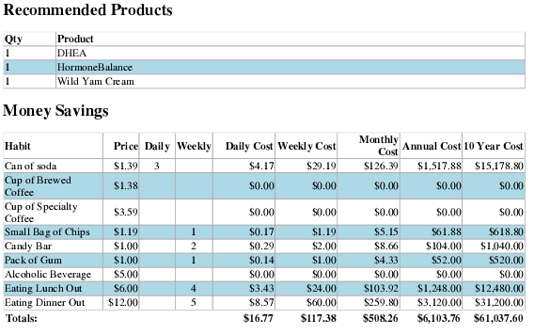
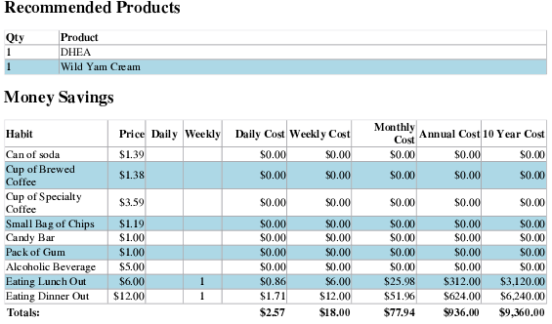

Slide 17
Resolving Questions from Patients about the Assessment
“I am not pre diabetic”
“I don’t spend that much money”
“How is this assessment accurate”

Slide 18
Any Additional Questions?
Call or text me at 801-903-7141

