Slide 1
Overview of the 5 and 12 Week Candida Programs
With Linda Lever

Slide 2
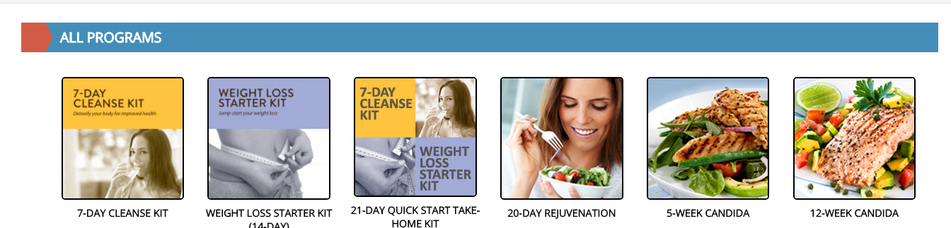
Everything you need for the Candida programs are found on Club Reduce.
PROGRAMS > ALL > 5 OR 12 WEEK CANDIDA

Slide 3




Candida Manual Covers

Slide 4
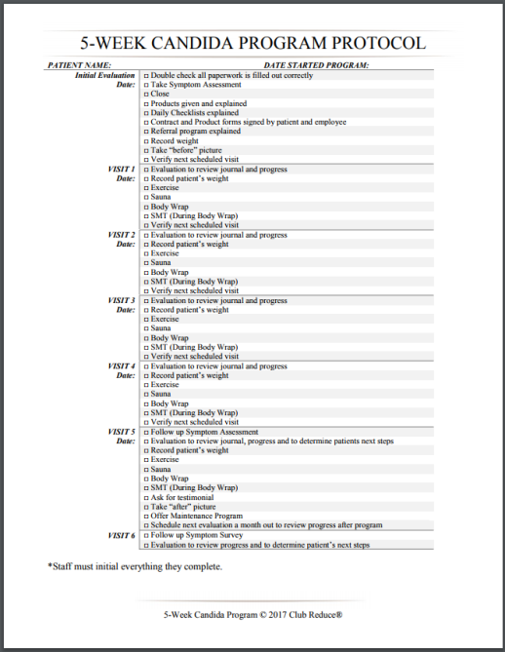
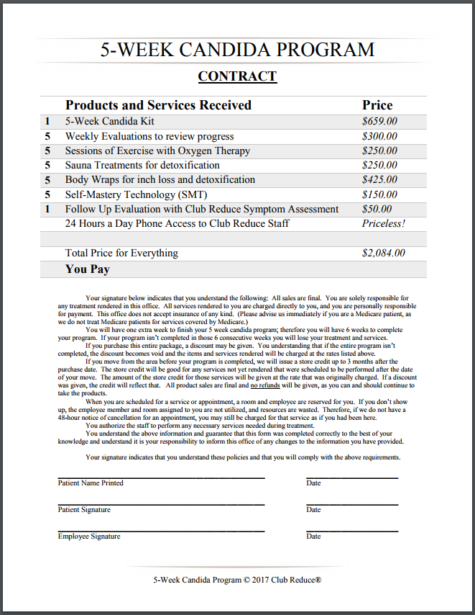
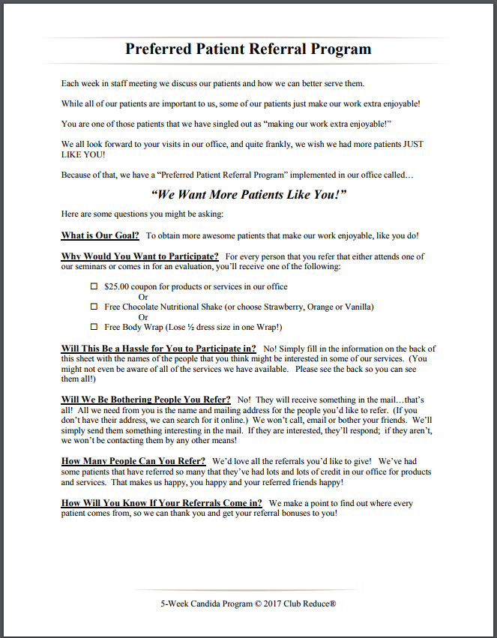
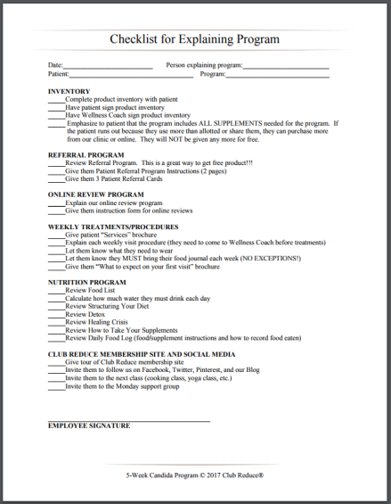
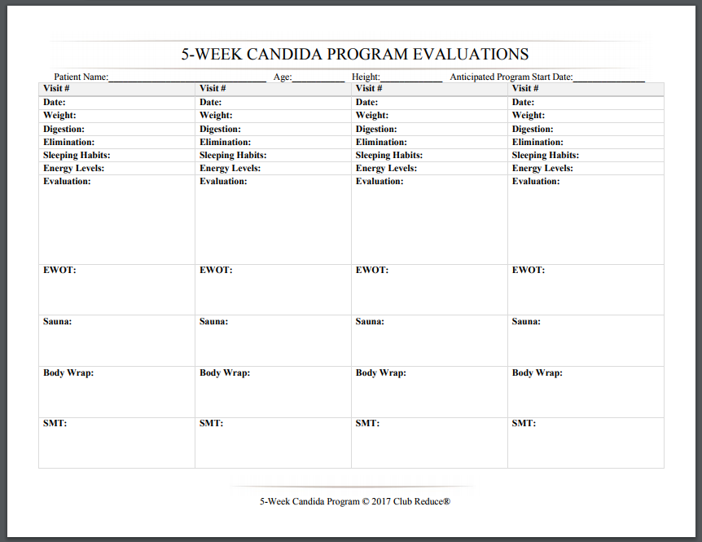
Candida Protocol Sheets

Slide 5
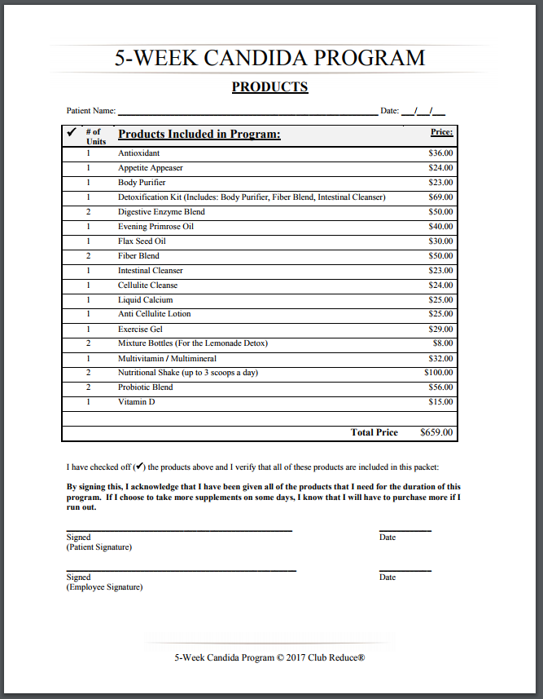
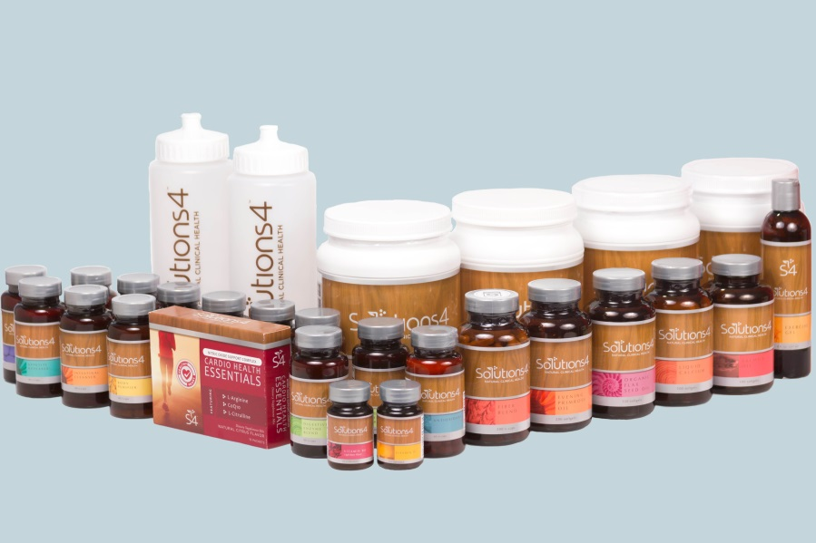
Candida Product List

Slide 6
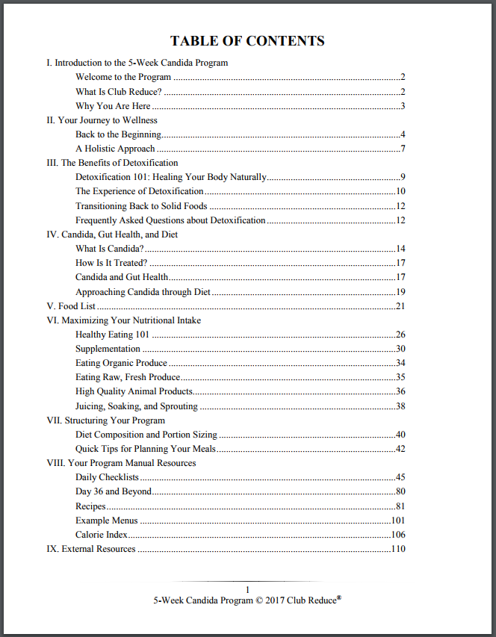
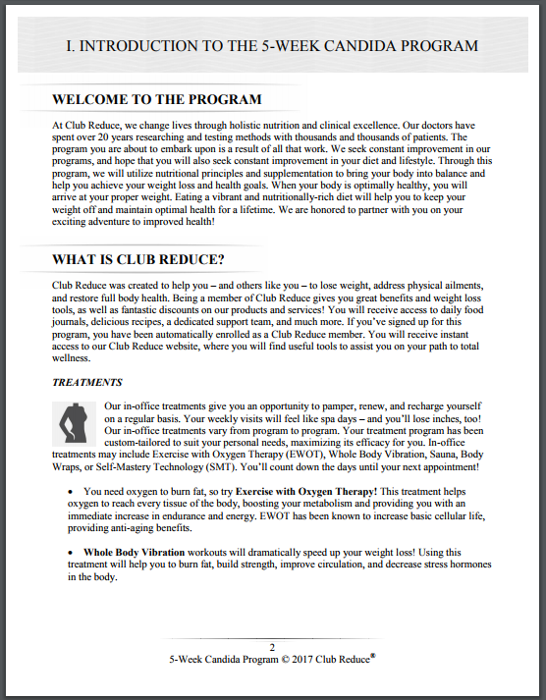
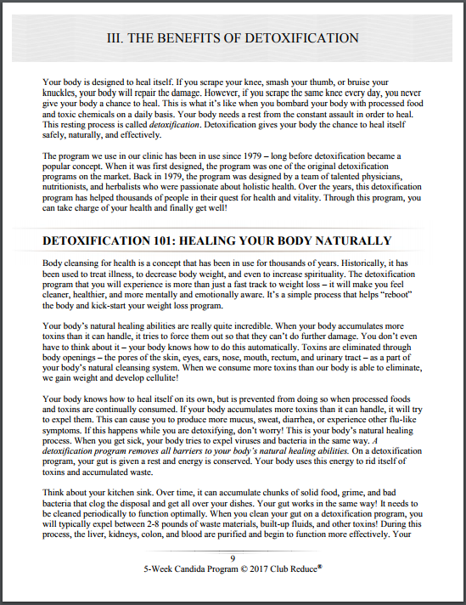
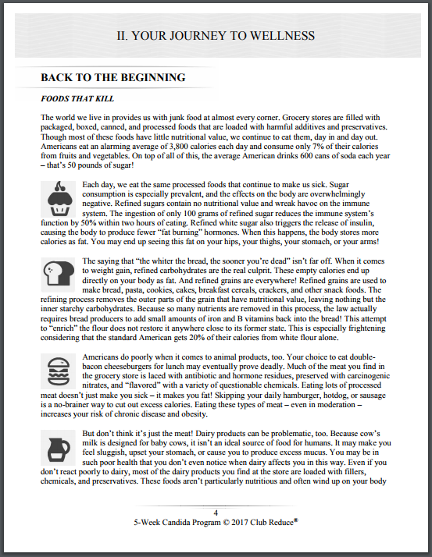
Candida Program Manual
You can print out the Program Manuals to give to the patients OR your patient can go to the Patient Club Reduce Member Site and enter their information there.

Slide 7

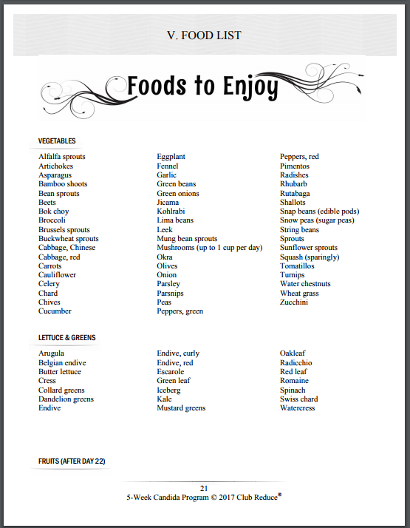
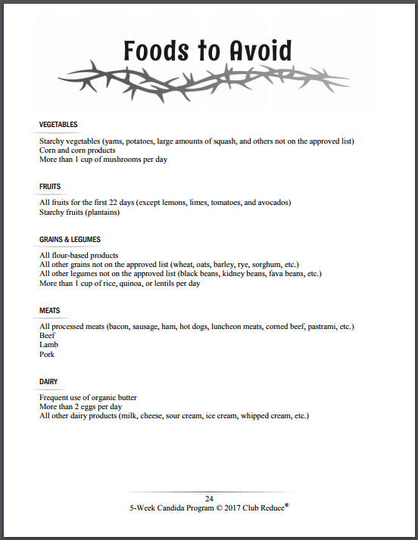
Candida Food List

Slide 8
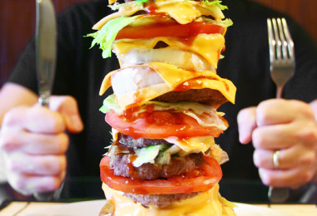


Teaching Patient Lifestyle Habits
Overeating
Stress
Inactivity
Sleeplessness

Slide 9
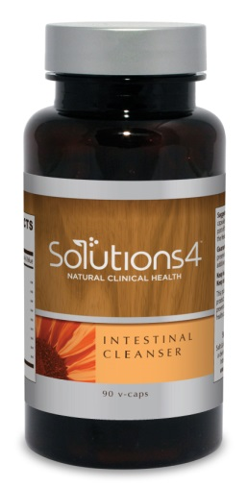

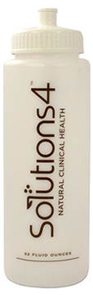

The Detox
Supplements included…
Body Purifier
Intestinal Cleanser
Fiber Blend
Benefits..
Purify Liver
Kidney
Colon
Blood

Slide 10
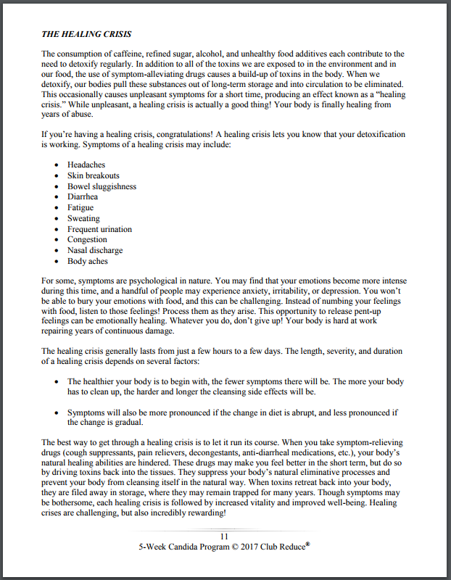
Healing Crisis – Page 11

Slide 11
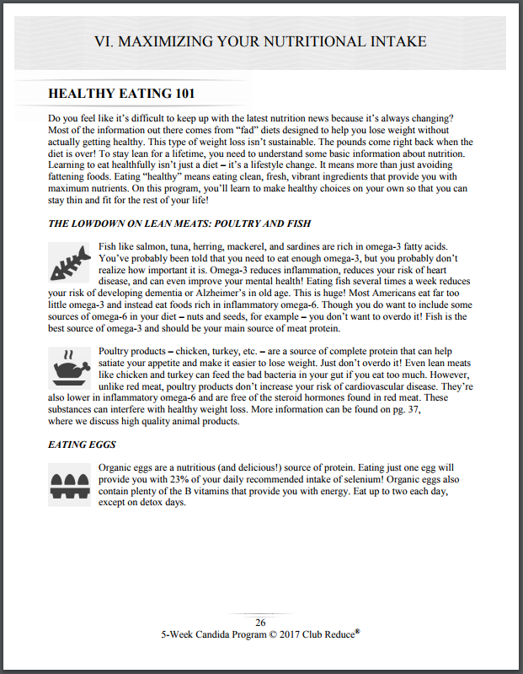




Healthy Eating – Page 26-30

Slide 12


Solutions4 Supplements
Taking the supplements and pills

Slide 13
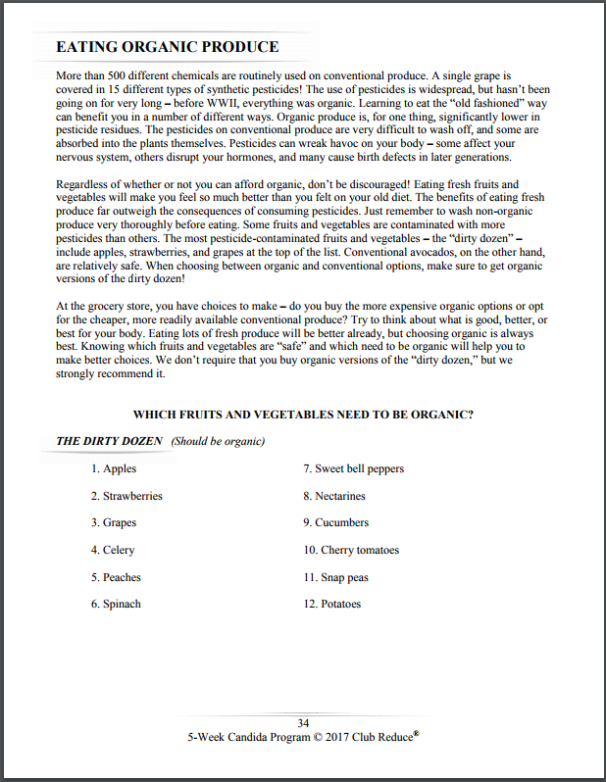
Dirty Dozen – Clean 15 – Food Graph

Slide 14


Meal Planning
Grocery Shopping Strategies
Water – ½ body weight in ounces

Slide 15
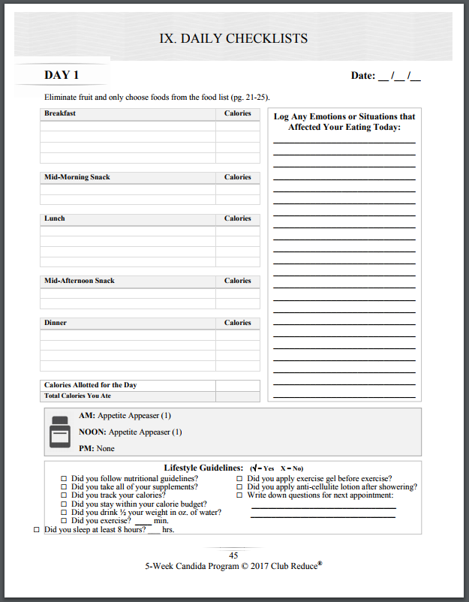
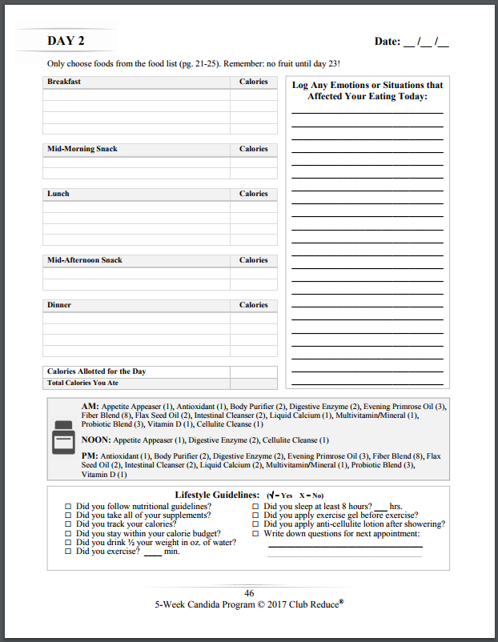
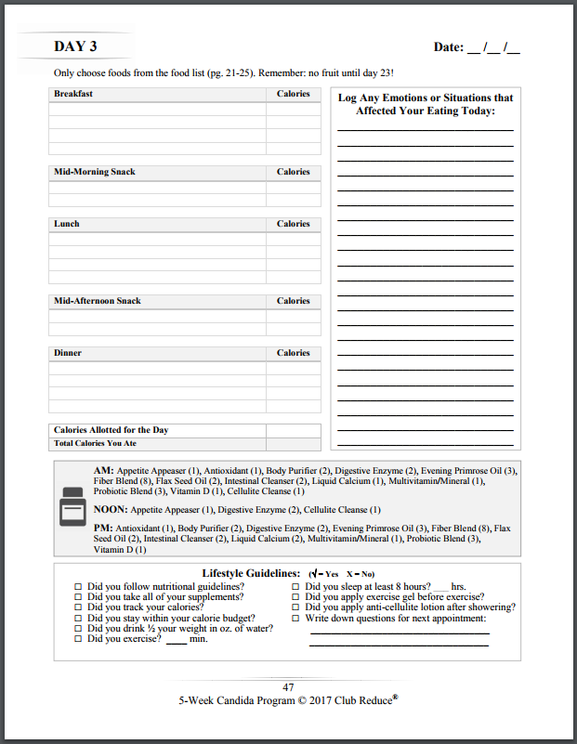
Daily Journal

Slide 16
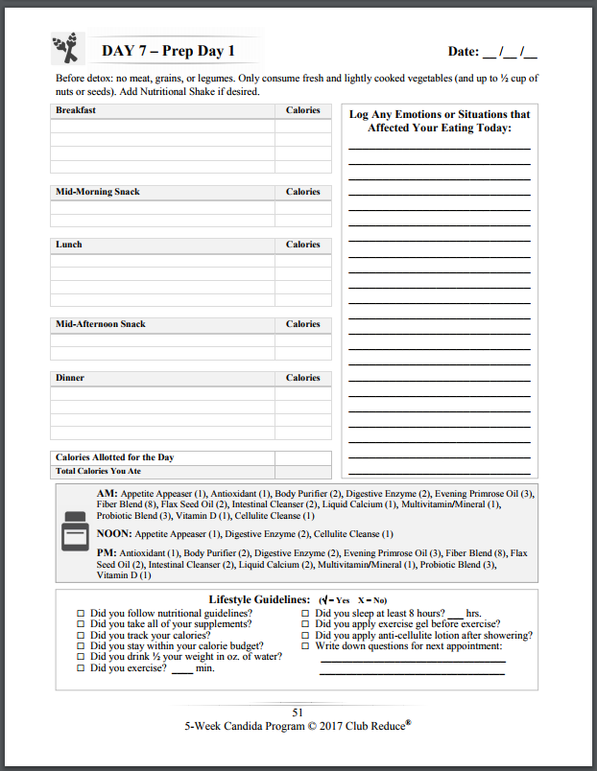

Prep Days – Detox Days

Slide 17
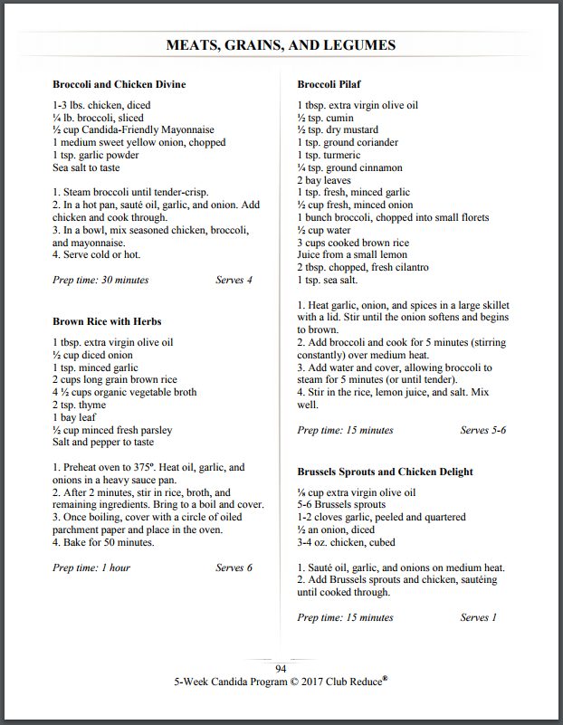


Recipes

Slide 18
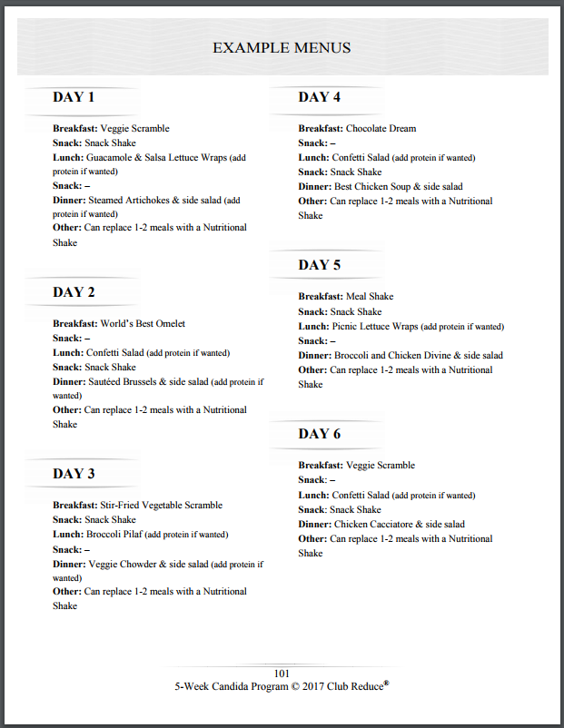
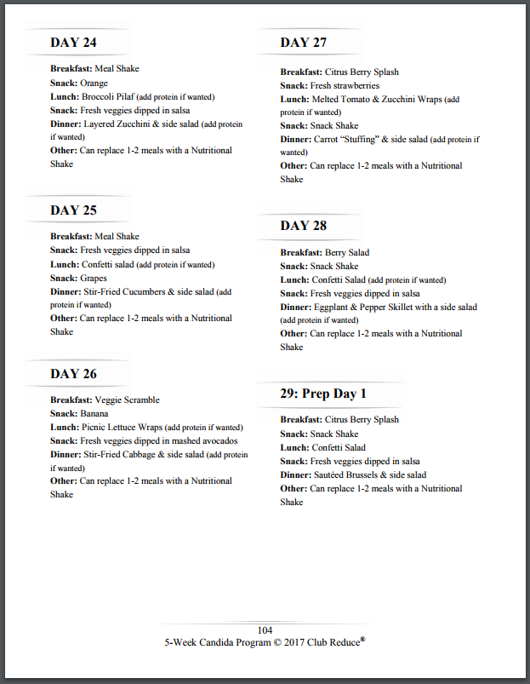
Menus

Slide 19
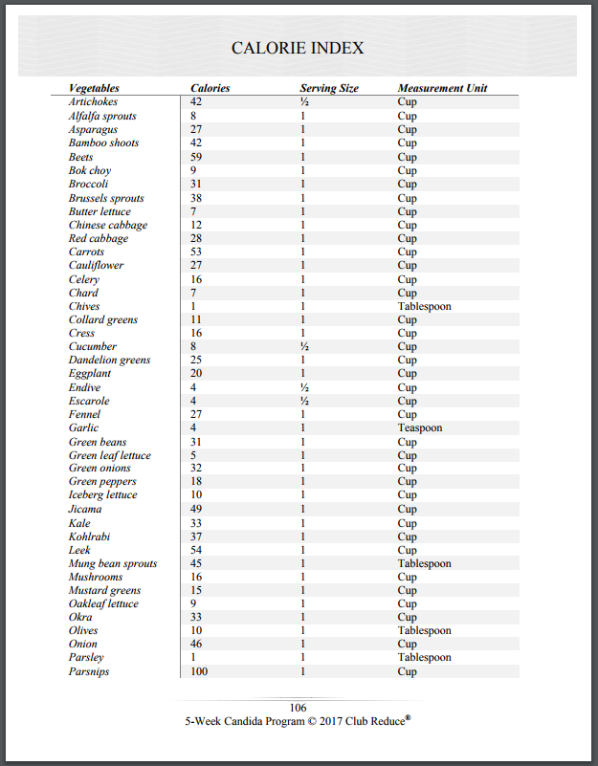
Calorie Index

Slide 20

Watch Dr. Singleton’s webinar on
‘CANDIDA 101 with Dr. Singleton’
to understand more of what Candida is!
Found under Programs > All > 5 Week Candida or 12 Week Candida

Slide 21
Thank you!
Please call me with any questions – 801-590-0881

