Slide 1
Facebook Advertising Options
Dayo Adiatu of LeadGen180

Slide 2
Here’s What You’ll Learn
Why You Should Use Facebook Ads
What You Need To Get Results From Your Ads
Which Advertising Options Should You Use

Slide 3
Why Facebook Ads
Targeting
Perfect For Any Budget
Reach New Potential Patients
Showcase Results

Slide 4
What You Need To Get Results From Facebook Ads

Slide 5
Getting Results From Your Ads
The Right Goal
Targeting
Image
Copy
Landing Page
Follow-Up

Slide 6
Facebook Goals
More Website Visitors
Collect Emails
Increase FB Page Likes
Increase Event Attendees
Increase Opt-Ins
Follow-Up
Notes:
Important B/C Facebook shows the ad to people who are most likely to do these things

Slide 7
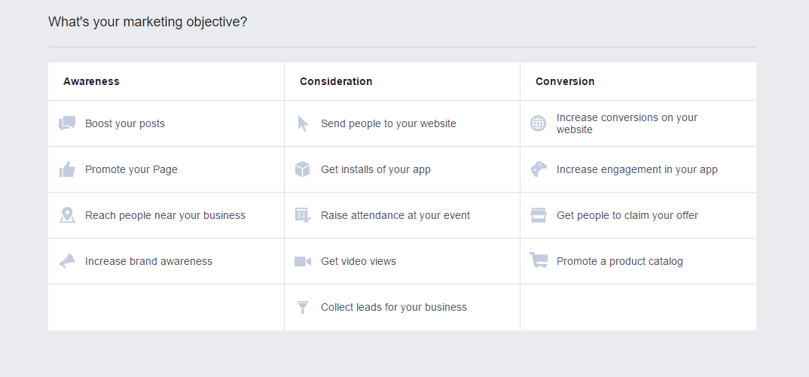

Slide 8
Boosting Your Post
Perfect For Small Budgets
Done From Your Clinic Page
Landing Page is Optional
Showcase Testimonials, Offers, Blog Post, or Clinic Website

Slide 9
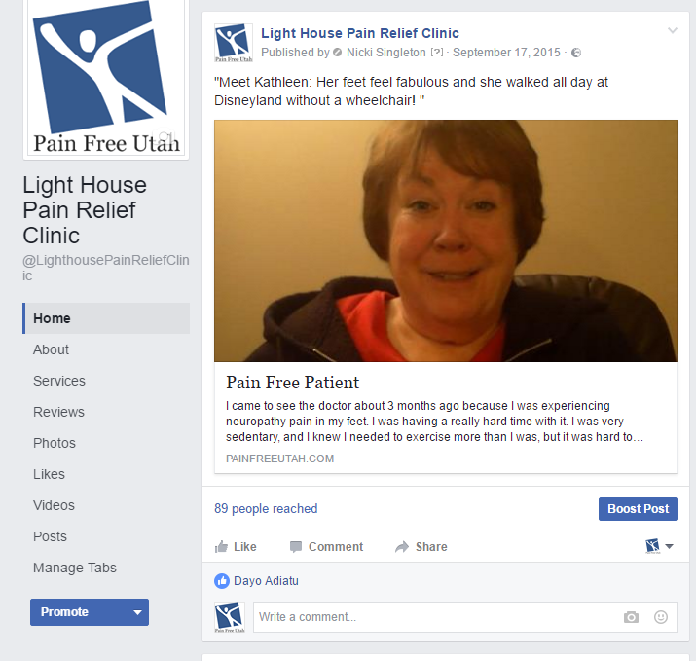

Slide 10
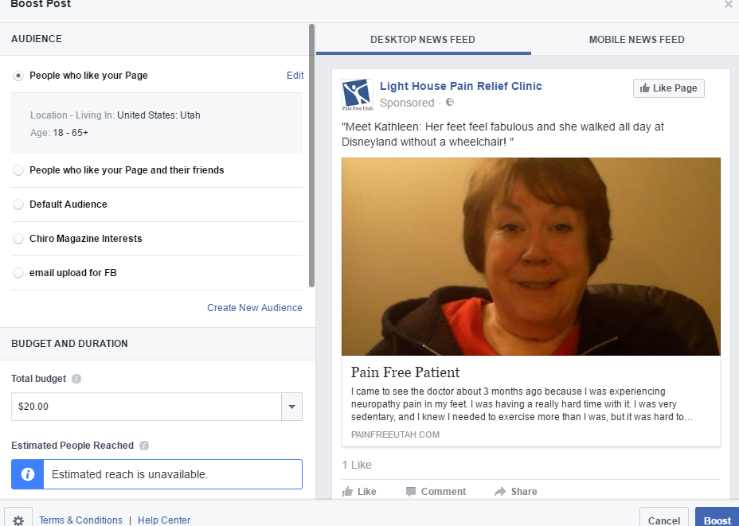
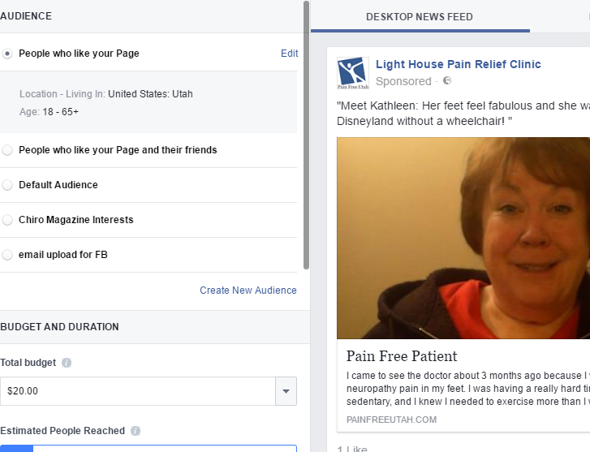

Slide 11
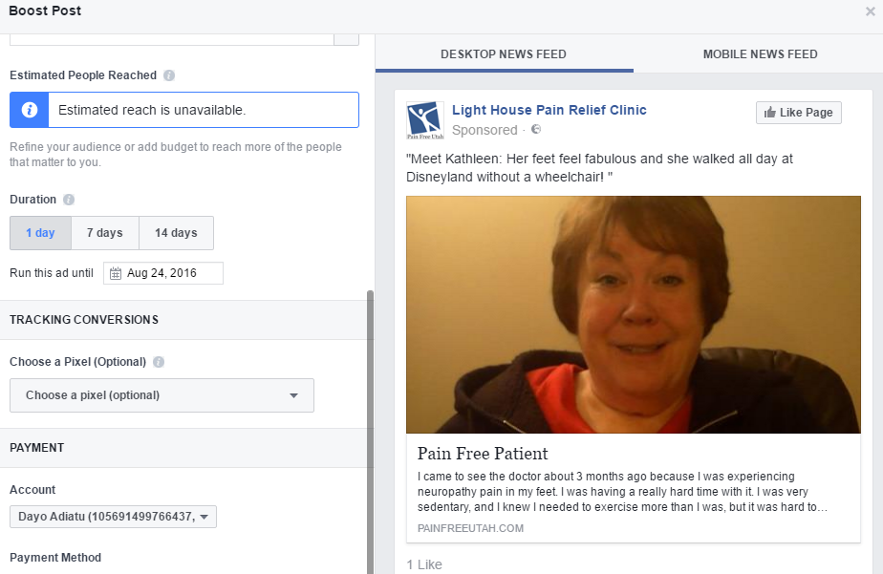

Slide 12
Send People To Your Site
Traditional Facebook Ad Creation
Perfect For A New Audience
Send To A Page With A Lot of Content ie Blog, Sales Page
Need A Landing Page

Slide 13
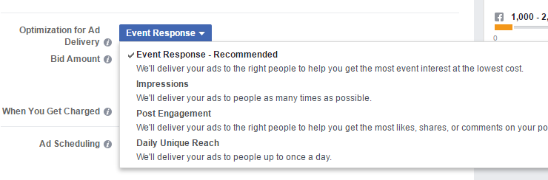
Raise Attendance For An Event
Great For Local Seminars
Need To Create A Facebook Event
No Landing Page Needed
Notes:
Can also just boost post

Slide 14
Collect Leads
No Landing Page Needed - Can Collect Leads Within The Platform
Perfect for Testimonials or Thoroughly Explains Posts

Slide 15
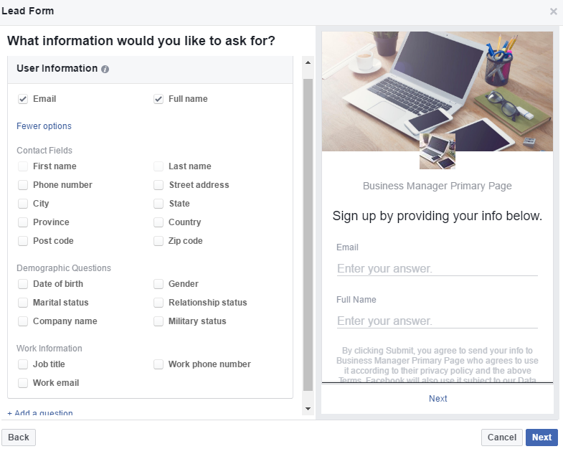

Slide 16
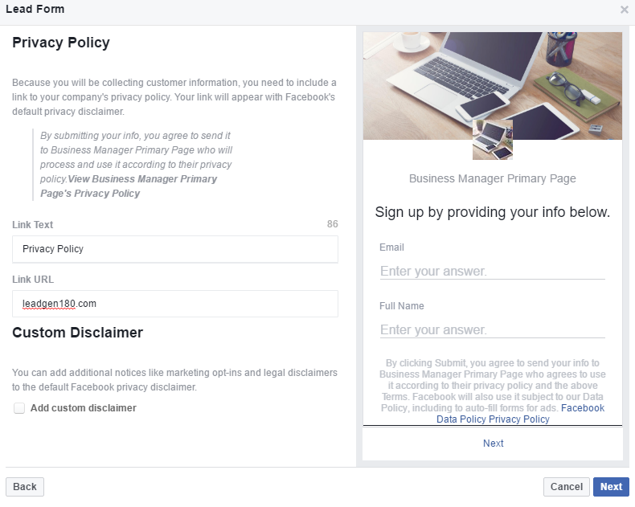

Slide 17
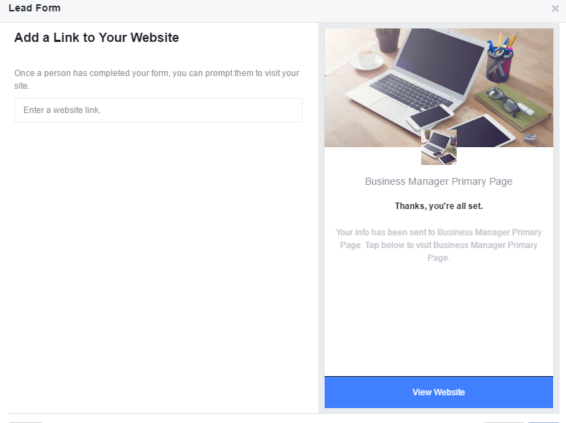

Slide 18
Increase Website Conversion
Need Landing Page
Perfect For Leads That Are Warm
Need Facebook Pixel
Conversion is Defined By You

Slide 19
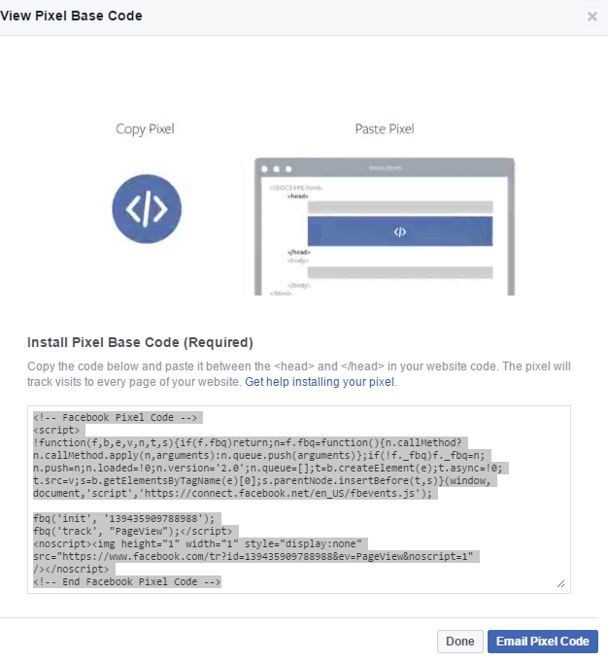
Facebook Pixel
Invisible Piece of Code Installed On Your Website
Provides Analytics For Your Facebook Campaigns

Slide 20
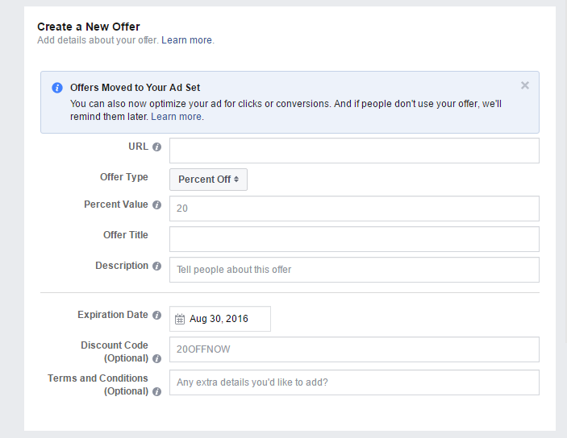
Claim Offer
Experience is Similar to Groupon
Facebook Provides The Email Reminders
Can Create An Offer On Your Page For Free

Slide 21
Tips For Better Results
Test
Pick A Good Offer
Budget Wisely
Review
Update Facebook Page

Slide 22
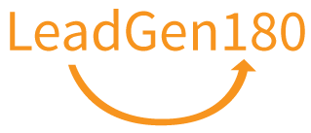
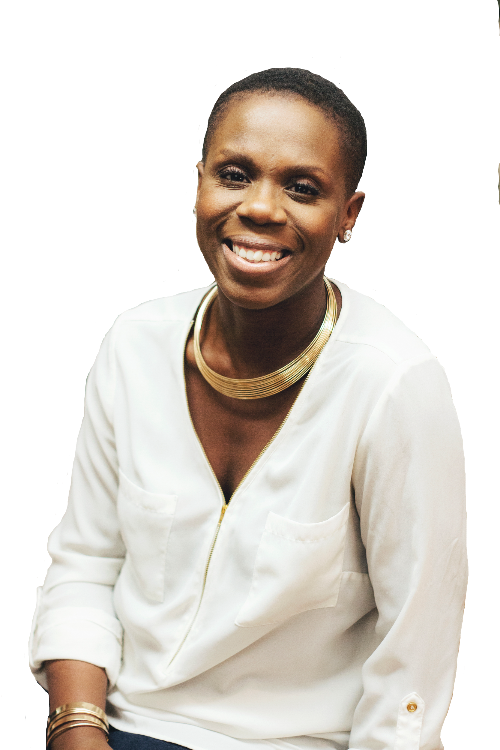
Thank You!
Dayo Adiatu - LeadGen180
dayo@leadgen180.com
Schedule A Time To Chat:
https://calendly.com/leadgen180

