Slide 1
Before we start…
Take a moment to open a webpage and sign into Club Reduce.
Go to Training > Annual Weight Loss Summit > November 14 & 15, 2014
Download the “New Patient Intake Form – Weight Loss” and print it out.
I’ll wait…

Slide 2
Training on the New Patient
Intake Form!
With Dr. Todd Singleton

Slide 3

Why this form?

Slide 4
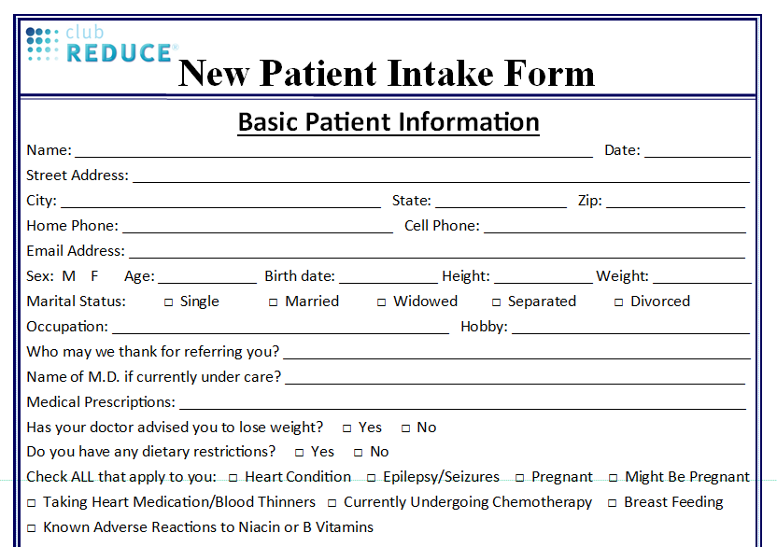
NEW Patient Intake Form!

Slide 5
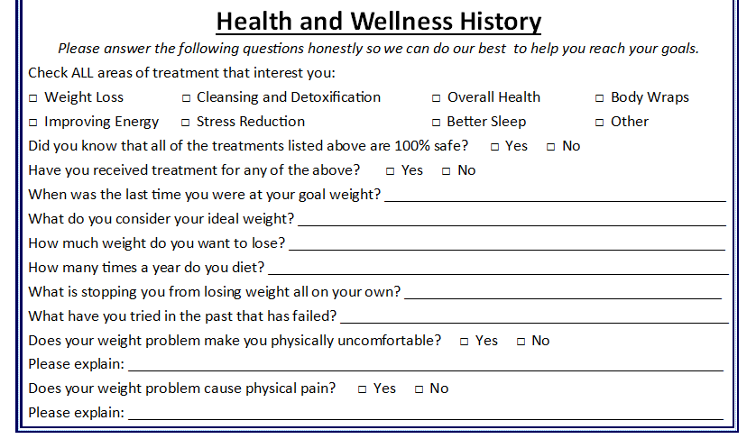
NEW Patient Intake Form!

Slide 6
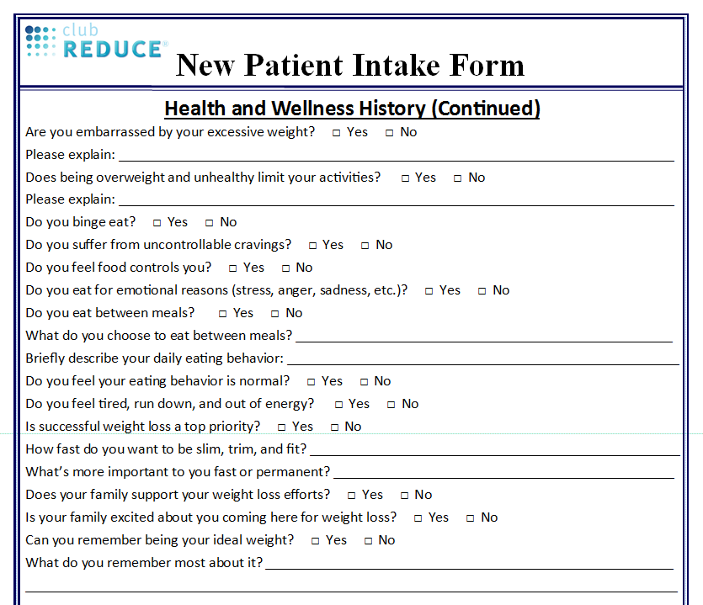
NEW Patient Intake Form!

Slide 7
NEW Patient Intake Form!

Slide 8
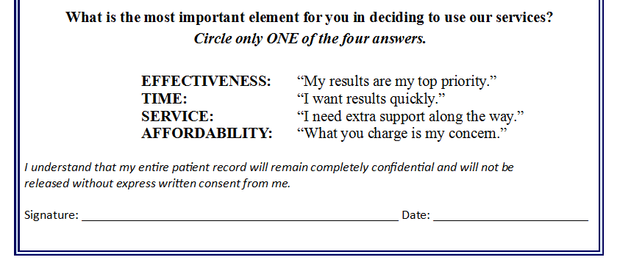
NEW Patient Intake Form!

Slide 9
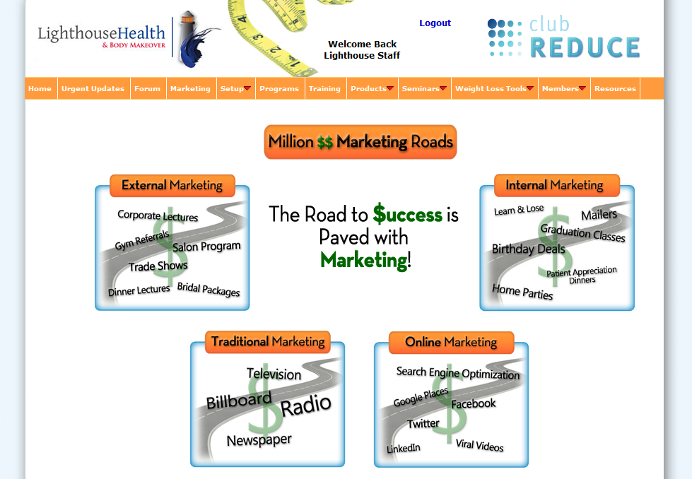
Make Use of Your Club Reduce Resources!

Slide 10

Additional Tips for Success

Slide 11
Thanks for Joining Us!

