Slide 1
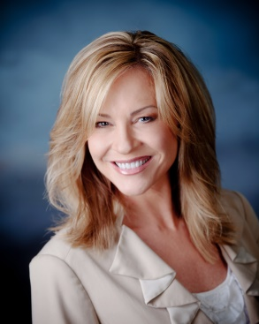
PRACTICE WHAT YOU PREACH!
Shar Lewis
Club Reduce Consultant
Vice President of Business Development

Slide 2
Help your Patients and Sell more Programs
Practicing what you preach is crucial in your health and weight loss business.
In this webinar we will go over the importance of you and your staff doing one of our Club Reduce programs. Relating with your patients is key in helping your patients get to their goal and sell more programs. If you can understand how they are feeling during their programs, they will be more successful. It is influential for you and your staff to believe in what you are selling to your patients. That is why taking the Solutions4 supplements and doing a Club Reduce program will help you sell programs to more patients if you personally have seen benefits from eating healthy and taking the supplements.

Slide 3
Would you listen to you?
INTEGRITY!
If you believe it they will believe it too!
TRUST!
If you do it they will do it too!
LEAD BY EXAMPLE!

Slide 4


Have Fun and Practice What You Preach!

Slide 5

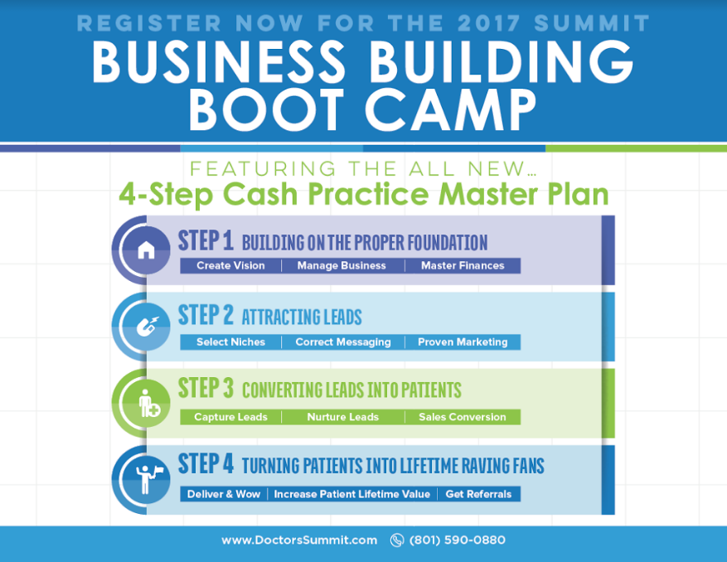
ANNUAL DOCTORS SUMMIT &
1-DAY CONDENSED TRAINING FOR NEWBIES
Thursday, November 9th – 1-Day/Friday & Saturday, November 10-11 – Summit
DoctorsSummit.Com to register - $100 off Early Bird Special

Slide 6

Do you Need Help Growing Your
Club Reduce Business
to Increase your CASH Income and Help your Patients HEAL?
www.ClubReduceConsulting.com
801.917.0900

Slide 7

Thank You!

