Slide 1

Tips and Tricks for Using our Scripts
With Nanette Pututau
Club Reduce Support

Slide 2
Having the Right Script
On Club Reduce 4.0 we have 32 scripts for you to use!
Here are just a few of the many scripts we have…
  Basic Scripts for New Leads
  Basic Script for Holidays
  Basic Telemarketing Script
  Script for Calling Past Patients
  Script for Scheduling Potential Neuropathy Patients
  Script for Radio Ad
  Script for Current Chiro Patients
  Scheduling Script (Weight Loss Seminar)
  AND SO MUCH MORE!!!!
  We have done all the work for you! You just have to decide what you want to focus on when calling. Do you want to call weight loss leads? Neuropathy leads? We have it all!

Slide 3

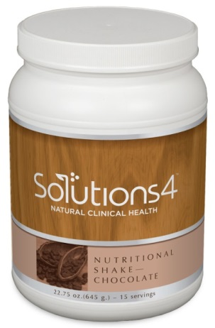
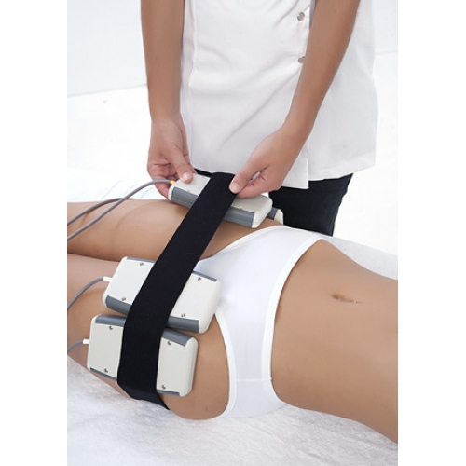
Be Educated and Have Your Own Story
Before you put any staff on the phone they need to know what your clinic is about. Any staff that is making outbound calls or incoming calls should always know
  The treatments and programs you offer
  The benefits of your treatments and programs
  Solutions 4 products
  Success stories from patients
  Personal story from using products, programs or the treatments
This will help the staff or telemarketer to feel much more confident in their calls and the patient on the other line will trust them more and be more willing to come to your office.
This doesn’t mean they have to know everything! They just have to be educated enough on the services and products you offer so that they will be able to answer any objective that may come when talking on the phone to a potential patient.

Slide 4

Basic Strategic Scripting for All Club Reduce Scripts
Always use key words
Ask key questions
Rephrasing
Create a sense of urgency
Giving enough information, but not over informing
Ask for what you want

Slide 5

Key Words
Using their name
  Always repeat their name multiple times. People have an endorphin release when they hear their own name. FACT* Endorphins trigger a positive feeling in the body, similar to that of morphine.
  Create familiarity.
Buzzwords – Want to use these words with a potential lead (What you do in your clinic)
  Natural
  Holistic
  Weight Loss
  Whole Food Supplementation
  Detoxification
Timing
  Want to find out enough information about your lead to make seminar or services appealing to them.
  Find out what their purpose is for calling and how we can help them
Be Assumptive
  Assume that they will come to a seminar or come in for an evaluation
  “Our next seminar is next Tuesday night at 7:00 pm. Can I schedule you for that seminar?”

Slide 6

Asking the Right Questions
Always address their “pain”
  They want to loose weight
  Get off medication
  Get rid of cellulite
  Get out of back pain
  Get rid of their neuropathy
  Sleep at night
  Find out what their “pain” is first and address it throughout the entire call!
Be upfront – Sometimes you might ask them uncomfortable questions like “How much weight do you want to loose?” or “How long have you been using a cane for your neuropathy?”. By asking these questions it gives you the information you need to know to help that potential patient and give them the information they need to know.
Always make the call about THEM. It is never about you, unless you are sharing your personal story or experience of the programs or treatments you offer that have changed your life! That is very important and needed.
Re-address their “pain” throughout the call.

Slide 7

Rephrasing
You always want to state the patients problem in their words. It creates a sense of urgency and it lets the potential patient know that you have been listening. It also creates compasion.
  If the patients main concern is “I want to get healthy so I can feel better, play with my kids and sleep at night”.
  When you are on the phone with them bring this up… “You know I know you said you want to get healthier so you can play with your kids and actually get the deserved sleep you need. We want to help you and we can!”.
Address their specific concerns
  Detox
  Muffin Top
  Get rid of Cellulite
  Be out of pain
  “Well we do have many tools and services that will help with __________”
Again by using their words you are creating a sense of compassion and understanding.

Slide 8

Creating Urgency
Why should they act now?
  “Our weight loss seminars book fast”
  “Our doctor is booked out for appointments for a few weeks”
  “We are only allowing the first 20 callers to schedule for a free neuropathy evaluation”
  “This month only we are doing 20% off our programs and treatments”
Helping them understand that their pain/problem is not going to go away unless THEY make it go away.
As Dr. Singleton says “What you’re doing isn’t working”. Remind them of that and let them know until they make a change to come in, their “pain” will remain the same.

Slide 9

Limit Information Given
Don’t ever drowned the potential patient in information.
You also don’t ever want to sell them on what you offer and what you do in your office.
You want to “sell” them on coming to the class or coming in for a free pain/neuropathy evaluation, and then it’s the sells person’s job to actually sell them on a program.
Don’t over talk to your lead. You do want to give them enough information so they know what they should expect and receive but you don’t want to distract them from the purpose of the call.

Slide 10

Ask For What You Want
Be up front about what you are wanting them to do and asking for
  “Well to help you with your weight problems we have our Weight Loss Seminars on ______ day and ______ day. Which one can I sign you up for”. Or “Since you are in a lot of back pain and our free consultations are limited we could get you in this Friday. Would _______ time or ______ time work best for you”.
Always remember the call is about the patient and their needs but its also about getting them to do what you want them to do in your clinic.

Slide 11

Overcoming Objections
“How much is this going to cost me?”
“Why do I need to come to a class or seminar?”
“Well I am going to wait until I come back from my vacation”
“I don’t have the time to come in”
“I live too far away”

Slide 12
I Am Going to Wait Until…
Always ask “WHY?”
  Well if you don’t mind me asking why? I know that you want to lose 40 lbs. and sleep better at night and it sounds like you have been struggling with losing it for awhile. Isn’t that correct?
  How serious would you say about losing weight? On a scale of 1-10 how badly do you want to lose that weight? Or get healthy? Or get rid of your neuropathy? Or get rid of your back pain?

Slide 13

Time and Travel
You might have patients say that they “Don’t have time” to come in for the seminar or a free neuropathy evaluation.
  Offer something else to increase the value of the class – same day evaluation – body wrap
  Offer different times and different days for the seminars
  Offer a free treatment when they come in for a neuropathy or pain evaluation – or product
Patients might also say “I live too far away”.
  Tell them about the take home kits (7-Day or Weight Loss Quick Start Kit)
  Options to come in monthly instead of weekly
  Tell neuropathy patients about take home neuropathy machine
  Tell pain patients about take home kit (Pain Kit)

Slide 14


Money
Never, ever, EVER give an estimate of the cost over the phone.
  Neuropathy Patient: “Well how much is this going to cost me if I come in?”
  Staff: “Well that is the great part about coming in is that the first visit you come in is FREE. Once you come in and meet with our doctor he will determine if we can help you. At that time he will decide on the best treatment plan for you that will benefit you the most. As I am not a doctor I can not tell you and diagnose you over the phone as to how much the treatment would be. Just like if you were to break your arm and call up the doctor or hospital and ask how much would it cost, they would need to evaluate you and determine how bad the damage is”
  Weight Loss Patient: “I am not sure about coming in because I don’t know if I can afford it”
  Staff: “I understand but let me tell you we work with everyone and their individual budget. We have worked really hard to make our services affordable for our patients. Again the class you will be coming to is absolutely free so you have nothing to loose!”

Slide 15

We’ve Got the Scripts!
Not matter what issues or situation you may have when calling potential patients and leads we have all the scripts you need!
INTRODUCING NEW SCRIPTS!!!

Slide 16

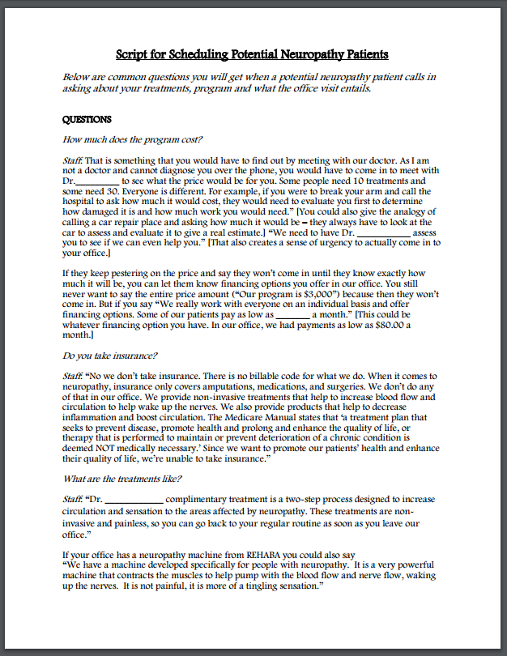
  Script for Scheduling Potential Neuropathy or Pain Patients (Incoming Calls)

Slide 17
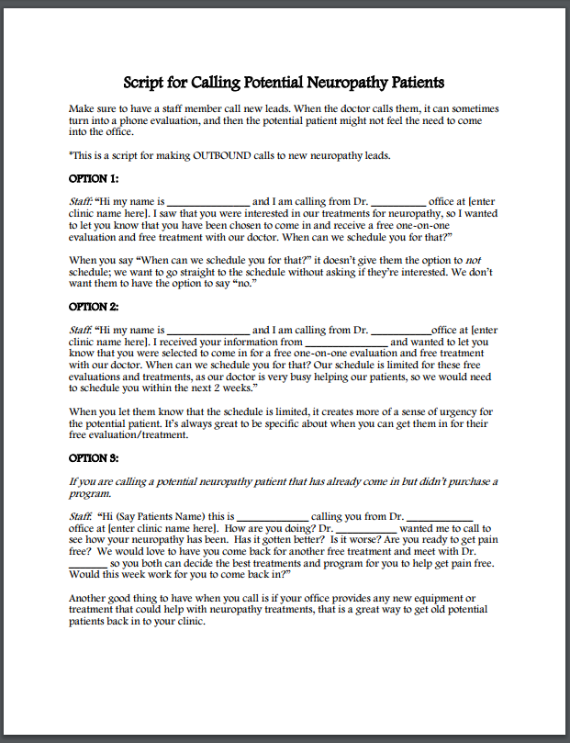
Script for Calling Potential Neuropathy or Pain Patients (Outbound Calls)

Slide 18
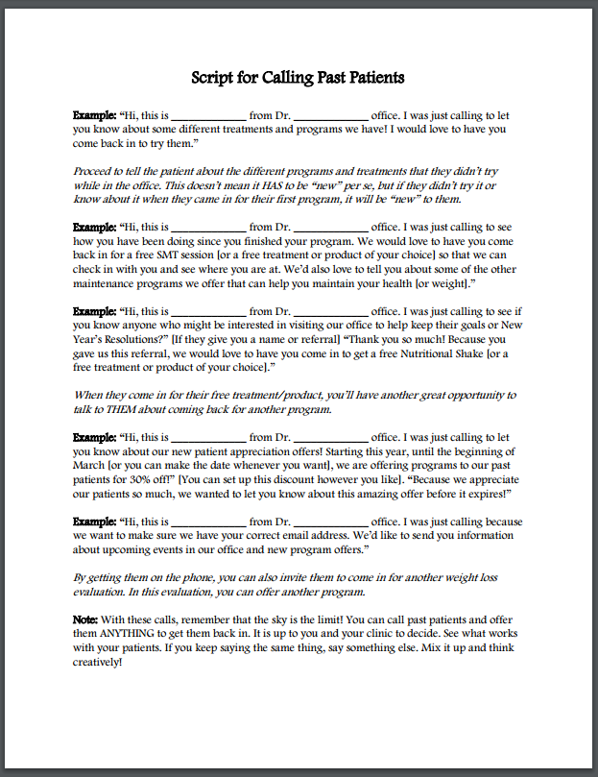
Script for Calling Past Weight Loss Patients (Outbound calls)

Slide 19

Remember…
When using these new scripts make sure it is an employee calling and not the doctor!
You don’t want the doctor making outbound or incoming calls to new potential patients because it could turn into a phone evaluation.

Slide 20

You Have the Scripts
You have 32 done for you scripts available to you right now.
Each office is different, so go through and see which ones applies to your office.
You have 3 NEW weight loss and pain/neuropathy scripts to use.
You have been given some new strategies on using scripts to call leads now start calling!
Log into your Club Reduce 4.0 under Marketing > All > Scripts to find the scripts you need!

Slide 21
Any Questions?
Email: support@clubreduce.com
Support: 801-590-0880 or 801-590-0881
Shar – Marketing Director: 801-917-0900

