Slide 1

Product Spotlight
The Quick Start Kits
Shar Lewis
Club Reduce Consultant
Vice President of Business Development

Slide 2
Help your patients heal with the use of S4 products and increase your income with additional product sales!

Slide 3

Take Home Kits for Every Need
Quick weight loss results and total body health support for everybody, every lifestyle, and every budget.
Rids body of toxins and increases fat burning hormones
Suppresses appetite and increases metabolism naturally
Improves lean muscle and helps eliminate belly fat
Simple, easy, convenient to use

Slide 4

The Perfect Downsell…
Take-Home Weight Loss Program
These kits are perfect for those who do not purchase your full weight loss programs with services such as the 20-Day Rejuvenation, 5-Week Candida and 12-Week Candida weight loss programs.
They are great, easy-to-sell, take-home kits that get incredible results and are affordable for any budget.

Slide 5

What We Provide each Month
Each month we will feature a Product Spotlight for you to feature in your clinic. It will include:
Product Education and Sales webinar
Point of Purchase (POP) Display
Take-a-Way for you to give to your patients
Postcard to mail to patients
Product featured in the Monthly Newsletter (full size and postcard)
Email text for you to send to patients

Slide 6
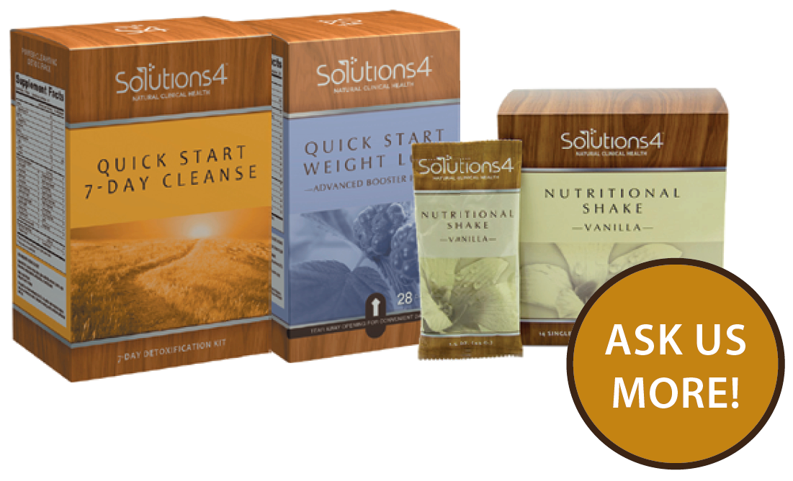
This Month’s Product Spotlight is:
The Quick Start Kits
7-Day Quick Start Cleanse Kit
14-Day Quick Start Weight Loss Kit
21-Day Ultimate Weight Loss Kit (7 & 14 Day Kits Combined with box of Single Serving Nutritional Shake)

Slide 7
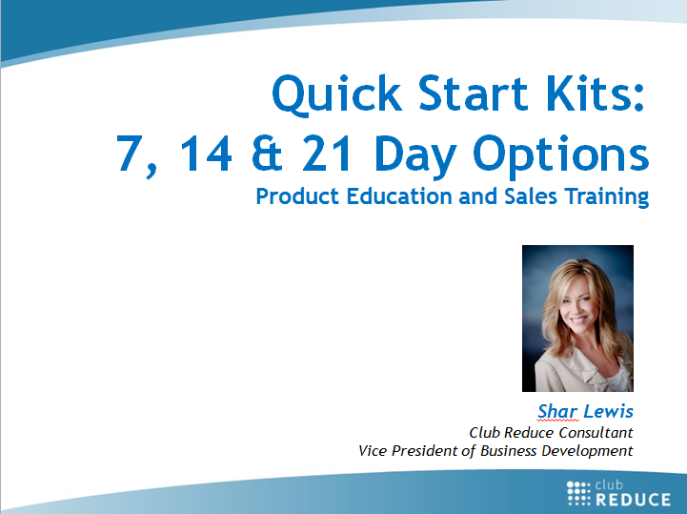
Product Education & Sales
Watch my webinar titled, “Quick Start Kits: 7, 14 & 21 Day Options” This webinar includes:
Product education
How to use it to get better results with your patients
How to increase your CASH income with these kits

Slide 8
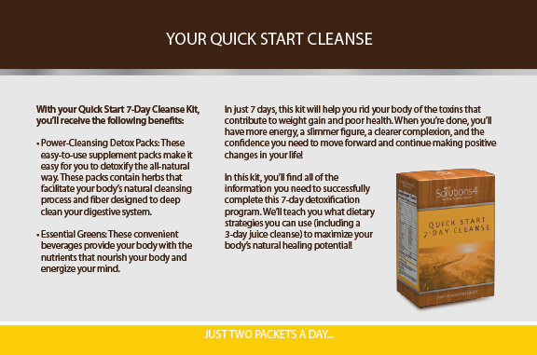
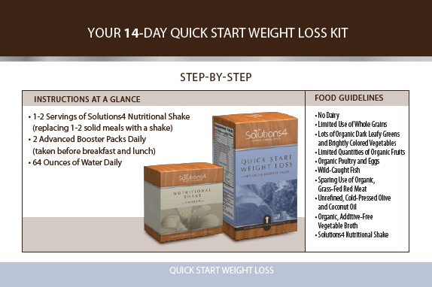
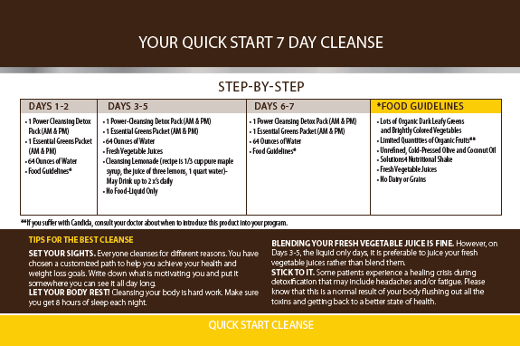
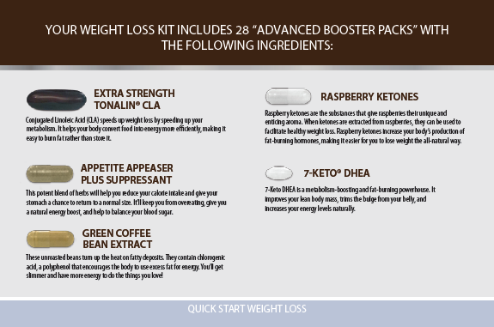
Each Kit Comes with Fantastic Educational Materials for your Patient including Dietary Guidelines and Supplement Education to achieve the best results.

Slide 9

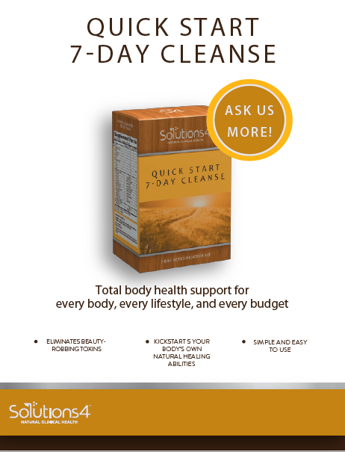
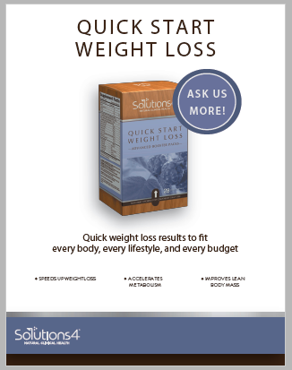
Product POP Displays
Place in acrylic sign holder at your front desk with empty product boxes.

Slide 10
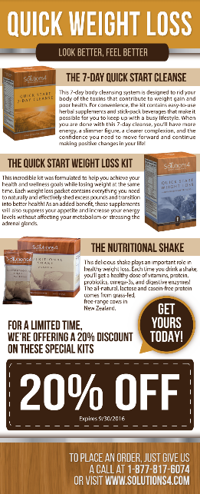
Product Take-a-Way Cards
Place in acrylic brochure holder by the POP and Product Box at front desk.

Slide 11

Product Postcard
Mail this postcard to your patients.

Slide 12

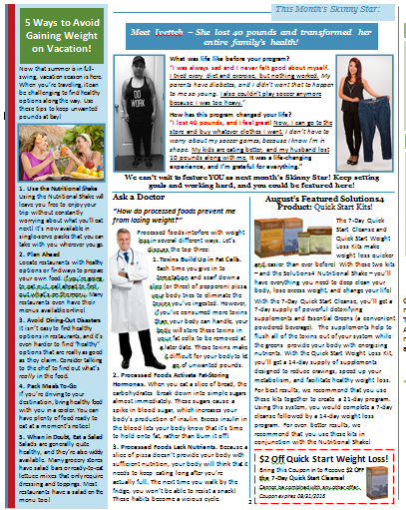
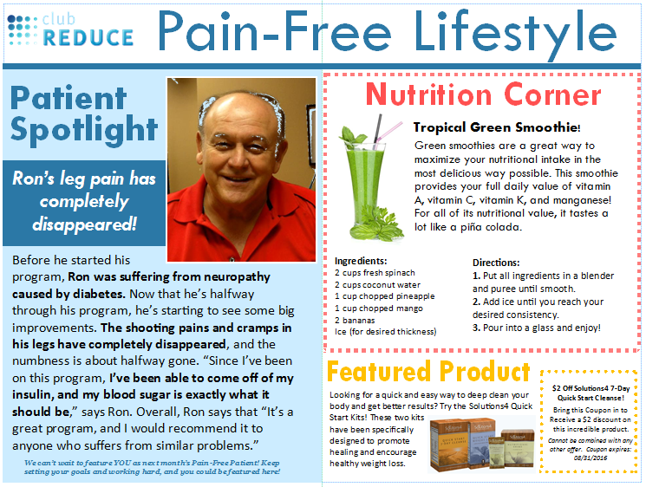
Newsletter Product Feature
Mail the full size newsletter or newsletter postcard to your patients.

Slide 13
Dear Patient,
Have you tried the NEW Solutions4 7,14 or 21-Day QUICK START KITs to detoxify your body and lose weight?
These kits are great for you, your family, and friends, for quick weight loss results with total body health support for every body, every lifestyle and every budget.
- Rids body of toxins and increases fat burning hormones
- Suppresses appetite and increased metabolism naturally
- Improves lean muscle and helps eliminate belly fat
- Simple, convenient and easy to use
Call Dr. Jones TODAY at (801) 123-4567 to see if this kit is right for you!
Yours in Health,
Product Email Blurb
Email your patients about the product of the month.

Slide 14

And…It’s So Cost Effective it Practically Sells Itself!
Cost of 7-Day Quick Start Cleanse
  $35.00 for doctor/ $70 for patient
  Includes: 7 Power Cleansing Detox Supplement Packets & 7 stick packs of Essential Greens
Cost of 14-Day Quick Start Weight Loss
  $29.00 for doctor/ $58 for patient
  Includes: 14 Advanced Weight Loss Booster Packs
Cost of Single Serving Nutritional Shake Box
  $25.00 for doctor/ $50.00 for patient
  Includes: 14 single serving shake packets

Slide 15

Here’s How Much Money you Can Make
Complete 21-Day Take-Home Kit costs the doctor $89.00 and is sold to the patient for $178.00.
You make $89.00 profit off each 21 Day Take-Home Kit!
If you sell just 1 per day or 5 per week that is an additional $445 profit to you each week or $1780 per month.
Sell 5 per day or 25 per week and that is an additional $8900 per month.
This has been a lifesaver for several of our struggling doctors!

Slide 16
You can easily make $500 to $10,000 every month just by selling these kits!

Slide 17
It just doesn’t get any easier than that!

Slide 18

The S4 Quick Start Kits are Good for your PATIENTS and Good for YOU!

Slide 19

Call Solutions4 Today to Place your Order for the Quick Start 7-Day Cleanse, 14-Day Quick Start Weight Loss, and Single Serving Nutritional Shake Box to create the perfect 21-Day Take-Home Weight Loss Kit for your patients.
Get your PRODUCT OF THE MONTH marketing materials on
Club Reduce 4.0.
S4 (877) 817-6074
CR (801) 590-0880

Slide 20

Thank You!

