Slide 1

The NEW
Telemarketing Dashboard
In Club Reduce 4.0
Your Online Marketing Tickler System

Slide 2
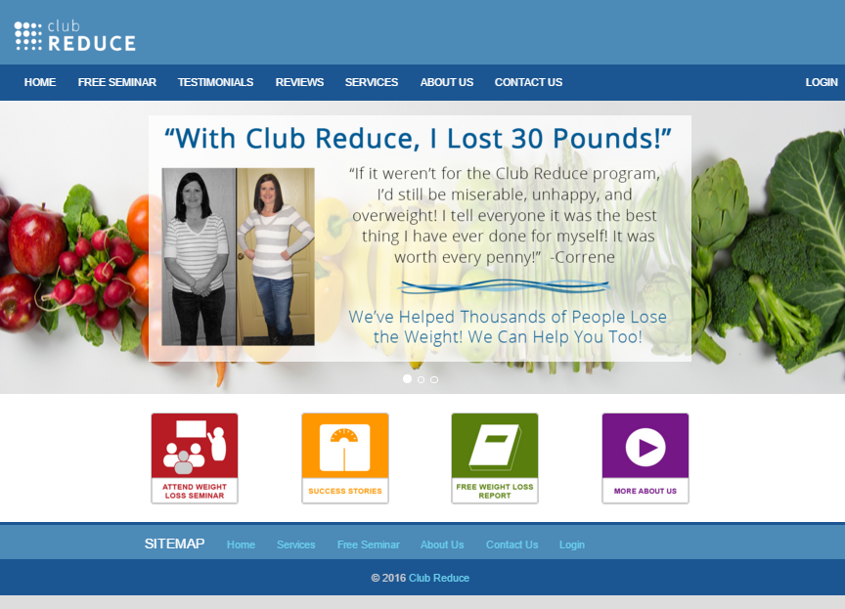
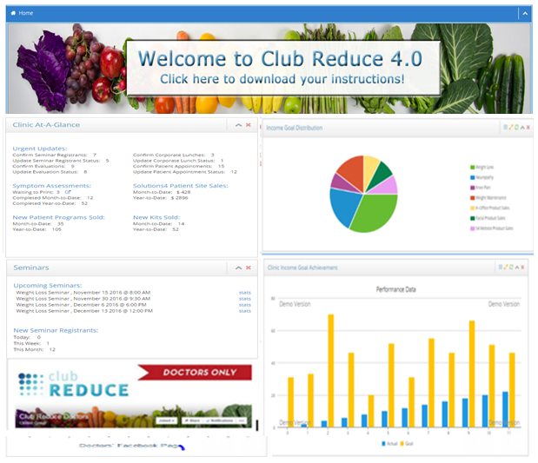
Club Reduce 4.0!
Everything you Need to Succeed!

Slide 3

Dashboards
There are SEVEN DASHBOARDS in Club Reduce 4.0 that will make your clinic run like a lean, mean, well-oiled, money-making machine!
Each dashboard is an electronic implementation of the Tickler Systems and Checklist and Metric forms for each position or ‘roles and responsibilities’ assigned to your staff. They include:
Owner/Office Manager
Telemarketing
Seminar Assistant
Front Desk
Closer/Sales
Accountability Coach
Corporate Lunch

Slide 4

Why Dashboards?
The idea on all dashboards is that each staff member will manage their records (leads & patients) by taking specific actions and entering pertinent notes.
Once you click 'Save,' the record will either remain on your dashboard or disappear, depending on the action taken.
The record WILL disappear from the dashboard when 'Save' is clicked and an ‘Action Date’ has been set, such as a callback date, a seminar date, or an evaluation date, etc. The record will then re-appear on the appropriate date and time and the right dashboard, according to the ‘Result’ selected for that record.
The record WILL NOT disappear when using ‘Log Notes,’ where you can choose a predetermined note such as ‘called - no answer,’ ‘left a message,’ or simply write comments in the ‘Notes’ section. In this instance, when you click ‘Save,’ the note or comment will be saved, but the record will remain on your dashboard until you choose an actionable ‘Result.’

Slide 5
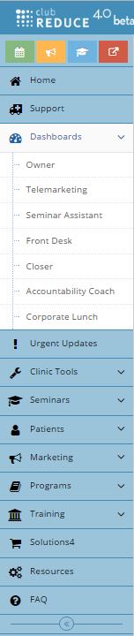
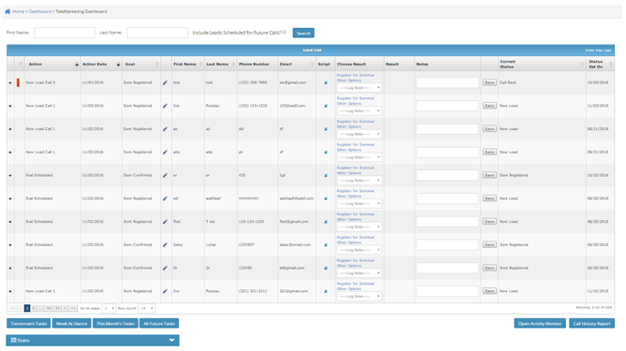

Telemarketing Dashboard
Lead Management from First Point of Contact through Register for Seminar

Slide 6
The Search Bar
On the top of the Telemarketing Dashboard is a SEARCH bar. You may search by ‘First Name’ or ‘Last Name.’
To search for records that do not reside on today's dashboard or ‘Lead List’ check the box titled ‘Include Leads Scheduled for Future Calls,’ then click ‘Search.’ The lead will appear at the top of your dashboard.

Slide 7
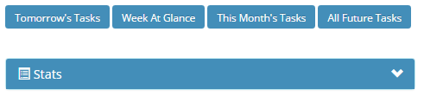

Blue Function Buttons
On the bottom of the Telemarketing Dashboard are BLUE FUNCTION BUTTONS.
The title of each button indicates what function it performs and is self-explanatory. Titles included on the Telemarketing Dashboard; are Tomorrow’s Tasks, Week at Glance, This Month’s Tasks, All Future Tasks, Open Activity Monitor, Call History Report, and Stats.
The Open Activity Monitor allows each staff member to see the status of patients who are scheduled for appointments that day. As the Front Desk updates the status all staff can see that information. This is tied to the Scheduler in Club Reduce. There is a workaround if you are not using our scheduler that can be found in the instruction manual.

Slide 8

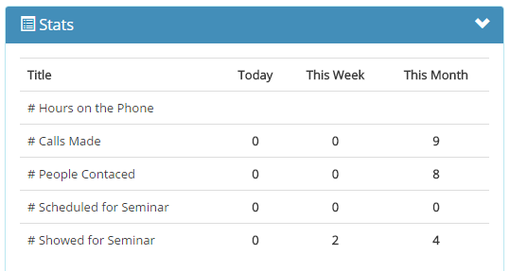
The Stats Button
The ‘Stats’ button at the bottom of the page calculates your stats for the day. Just click on the ‘Stat’ button to see how you performed.

Slide 9
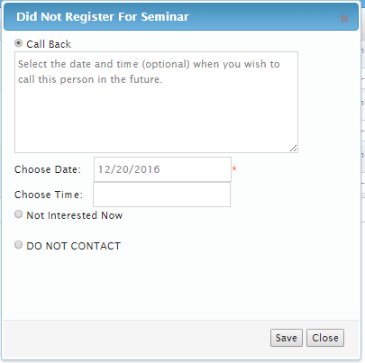
The Save Button
You must click SAVE in the Pop-Up box when you have completed your action to SAVE and log the action you just took.
You must click SAVE on the row of the record when you have completed your actions with each lead to SAVE and log the actions you took.

Slide 10

The Telemarketing Dashboard
The Telemarketing Dashboard is the electronic implementation
of your hardbound Marketing Tickler book.
Every time a lead is obtained from any source, they will be entered into your Telemarketing Dashboard so the appropriate action can be taken to achieve your desired goal.
The Telemarketing Dashboard will handle all the details of maintaining contact with every lead until they have successfully attended a seminar.
Just like the hardbound Marketing Tickler book only it is all online and much easier.

Slide 11

No More Leaky Bucket!
By using the Telemarketing Dashboard correctly, you can rest assured that no lead will ever fall through the cracks.
Whether you succeed in registering them for a seminar immediately, or continue contacting them for several months before registering them, the Telemarketing Dashboard will make sure you call them at the appropriate intervals and always have details about their situation at your fingertips.

Slide 12

Your Telemarketer
The Telemarketing Dashboard is designed for the staff member who is taking incoming calls from your “Marketing Activities,” as well as making outgoing calls to leads who have expressed interest in your programs, with the goal of scheduling them for your seminar.

Slide 13
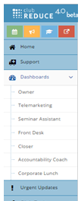

Where is the Telemarketing Dashboard?
Directions:
Choose ‘Dashboard’ from the blue menu bar on the left side of the screen, then click on ‘Telemarketing Dashboard.’

Slide 14
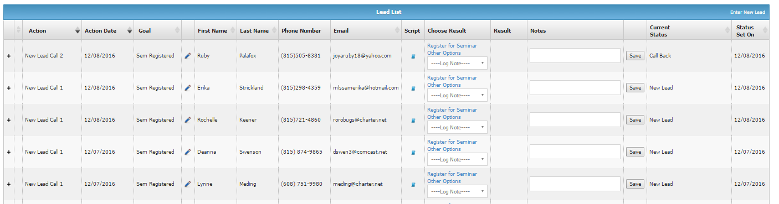
What You Will See
If this is your first time here, you will see a table with a blue header titled 'Lead List' containing no records.
Otherwise, the Telemarketing Dashboard will appear containing a table with all the marketing leads you have entered to date that are scheduled for a call.

Slide 15

Enter New Lead
To add a ‘New Lead’ to the dashboard, start by clicking 'Enter New Lead' on the far right of the blue header.

Slide 16
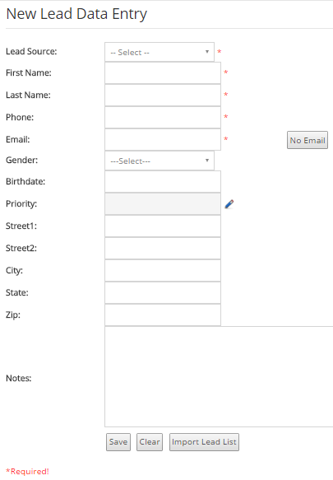
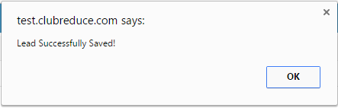

Enter New Lead Data
Enter lead data in the ‘Required’ fields marked with the red *asterisk; this includes Lead Source, First Name, Last Name, Phone, and Email.
‘Lead Source’ is an important field for you to choose correctly so you can track your leads back to the ‘Source’ or ‘Marketing Activity’ that they came from. ‘Lead Source’ will tie to your ‘Clinic Income Goals’ which will be automatically calculated so you can easily see your ROI and Cost per Lead for each of your ‘Marketing Activities.’
Click ‘Save,’ then you will see a pop-up message saying 'Lead Successfully Saved!'
The ‘New Lead Data Entry’ form will disappear, and you will be taken back to your ‘Lead List.’
If you do not have an email type in the word NONE or click on the ‘No Email’ button.
To learn how to add a Marketing Activity so it appears as an option under ‘Lead Source’ review pages 49-51 in the Instruction Manual.

Slide 17
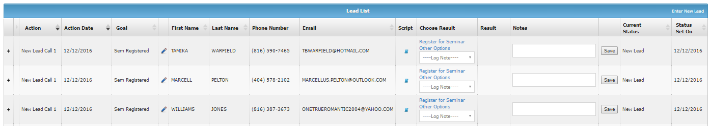
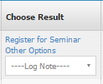
Managing Your Lead
When you are ready to work your lead, use the ‘Choose Result’ column from the ‘Lead List’ table on your Telemarketing Dashboard.

Slide 18
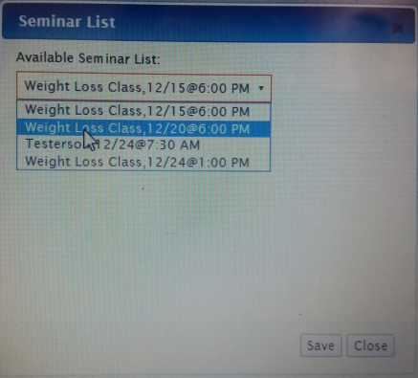
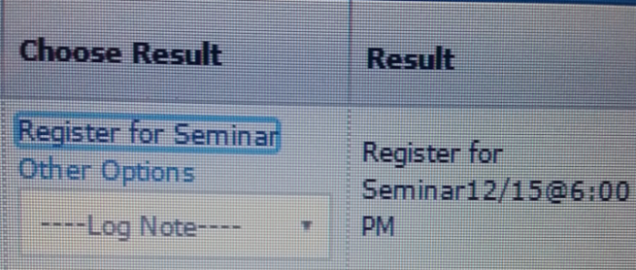

Register for Seminar
Click 'Register for Seminar’ from the ‘Choose Result’ column. You will see a pop-up box containing a drop-down list with the available seminars you have put in the system.
Choose a seminar from the drop down list and click 'Save' inside the pop-up box.
The ‘Result’ column is now populated with 'Registered for Seminar.’
Click 'Save' on the row containing the lead you just registered for seminar
This lead and the record will disappear. This lead will reappear on your Telemarketing Dashboard the day before the seminar for you to make your ‘Seminar Confirmation Call.’
To verify your lead appears in the ‘Registered for Seminar List,’ Choose Seminars > Attendees from the blue menu bar on the left. Click the ‘+’ icon next to the seminar you chose when registering the lead. You will see their name listed there.

Slide 19
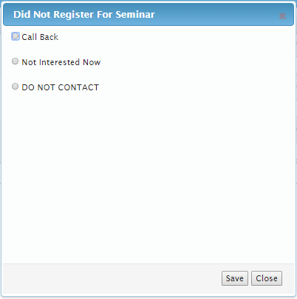
Other Options
Schedule Call Back, Not Interested Now, Do Not Contact
To choose a result other than ‘Register for Seminar’ that HAS a follow-up action, click on ‘Other Options’ from the ‘Choose Result’ column.

Slide 20
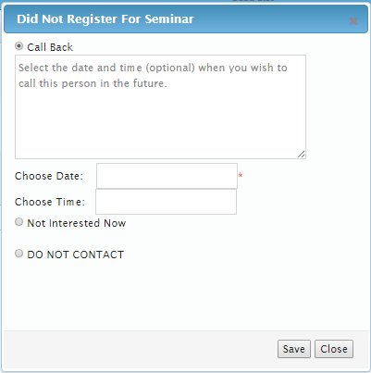



Other Options
Scheduled Call Back, Not Interested Now, Do Not Contact
Click on ‘Call Back’ and enter the Date you want to call this lead back, then click ‘Save’ inside the pop-up box.
Click on ‘Not Interested Now’ and enter the Date (and Time if desired) you want to call this lead back, then click ‘Save’ inside the pop-up box.
Click on ‘DO NOT CONTACT’ if the lead specifically tells you never to call them again or put them on your DO NOT CALL list, then click ‘Save’ inside the pop-up box.
Click 'Save' on the row containing the lead you just chose ‘Other Options’ on. This lead and the record will disappear. This lead will reappear on your dashboard the day before the seminar for you to make your ‘Seminar Confirmation Call.’

Slide 21
Log a Note
Log Note, Dialed-No Answer, Called Left Message
When choosing a result that has NO follow-up action, the activity will remain on that day’s dashboard for you to take further action later.

Slide 22
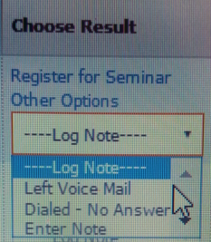



Log a Note
Log Note, Dialed-No Answer, Called Left Message
Click on ‘Called Left Message’ and leave any comments in the ‘Notes’ section, then click ‘Save’ in that row.
Click on ‘Dialed - No Answer’ and add any comments in the ‘Notes’ section, then click ‘Save’ in that row.
Click on ‘Enter Note’ and write your comments in the ‘Notes’ section, then click ‘Save’ in that row.
Your notes are saved to that lead entry. To view the notes click on the ‘+’ in front of the lead record. You will see that note recorded along with all other notes and activities associated with that record along with a time stamp.

Slide 23

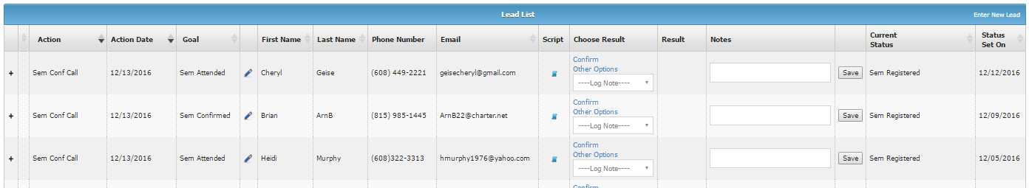
Seminar Confirmation Calls
Confirm Seminar, Other Options, Log Notes
Seminar Confirmation Calls will automatically appear on your telemarketing dashboard the day BEFORE the seminar.
Be sure to check the ‘Action’ column for ‘Seminar Confirmation Call’ or the ‘Goal’ column for ‘Confirm Seminar’ to identify those leads on your dashboard and make those calls.
Seminar Confirmation calls work much like the ‘Lead’ calls we just described with the following ‘Result’ options; ‘Confirm Seminar,’ ‘Other Options,’ and Log Notes.’

Slide 24
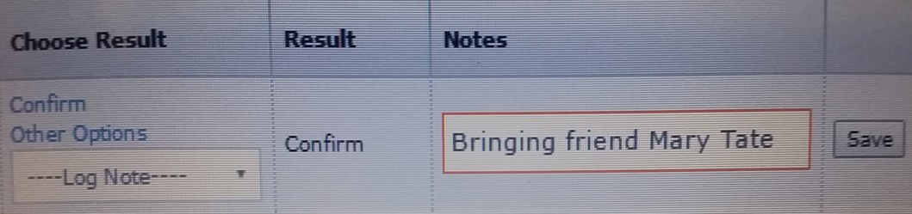
Confirm Seminar
Click on ‘Confirm’ from the ‘Results’ column. You will see the word ‘Confirm’ populate that column. Add your comments to the ‘Notes’ section, then click ‘Save’ in that row.
The notes section is a good place to note if that lead will be bringing a friend and put their name there. If the friend attends the seminar, you can add them at the event. Once you click ‘Save,’ the record will disappear from your dashboard and will appear on the ‘Seminar Assistant’ dashboard to be updated after the seminar.

Slide 25
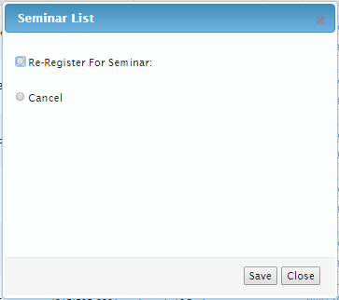
Other Options
Re-Register for Seminar, Cancel Seminar
To choose a result other than ‘Confirm Seminar’ that HAS a follow-up action, click on ‘Other Options’ from the ‘Choose Result’ column. You will see a pop-up box where you can select additional options.

Slide 26
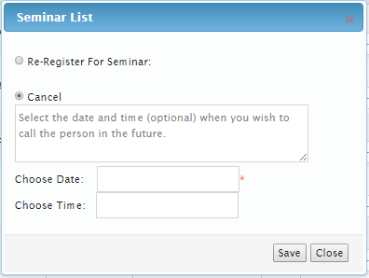
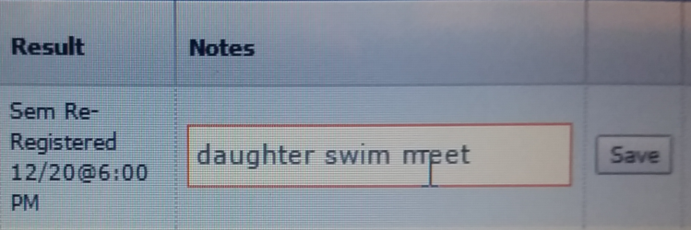
Other Options
Re-Register for Seminar, Cancel Seminar
Click on ‘Re-Registered for Seminar,’ choose the seminar they wish to attend, click ‘Save’ in the pop up box.
Click on ‘Cancel,’ choose a date to call this lead back to reschedule for the seminar, then click ‘Save’ in the pop up box.
Add notes in the ‘Notes’ section, then click 'Save' on the row containing the lead you just chose ‘Other Options’ on. This lead and the record will disappear and reappear on the call back date you selected.

Slide 27
Log a Note
Log Note, Dialed-No Answer, Called Left Message
When choosing a result that has NO follow-up action, the activity will remain on that day’s dashboard for you to take further action later.

Slide 28
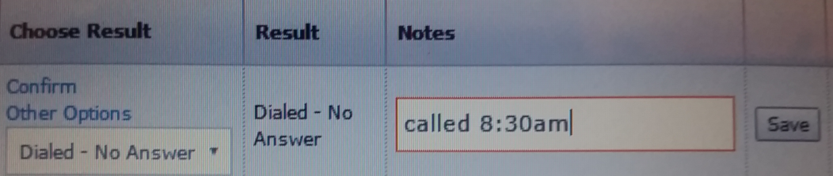
Log a Note
Log Note, Dialed-No Answer, Called Left Message
Click on ‘Enter Note’ and write your comments in the ‘Notes’ section, then click ‘Save’ in that row.
Click on ‘Dialed - No Answer’ and add any comments in the ‘Notes’ section, then click ‘Save’ in that row.
Click on ‘Called Left Message’ and leave any comments in the ‘Notes’ section, then click ‘Save’ in that row.
Your notes are saved to that lead entry. To view the notes click on the ‘+’ in front of the lead record. You will see that noted recorded along with all other notes and activities associated with that record along with a time stamp.

Slide 29

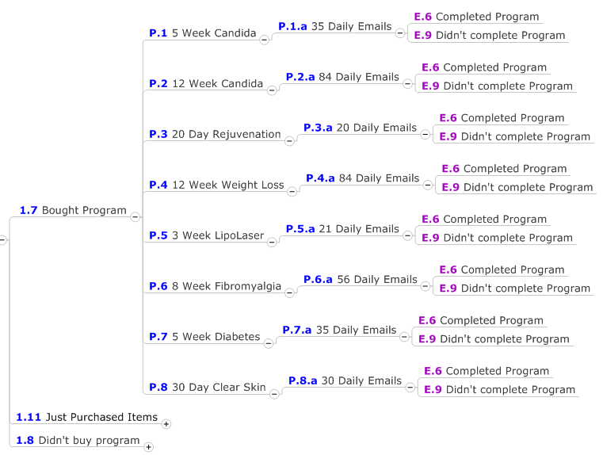
NEW Automatically Generated Emails
And NEW Reminder Text
There is a new series of automatically generated emails that go out for NEW LEADS. The final reminder email goes out the night before and a reminder TEXT goes out 2 hours before the scheduled seminar.

Slide 30

What Does This Mean for You?
Our TELEMARKETING DASHBOARD and MARKETING MANAGEMENT SOFTWARE will make you money!
No more lost leads
No more wasting money
Know your cost per lead
Know your return on investment
Make smart marketing decisions based on stats
Seeing how easy it is to reach your goals when you have a plan

Slide 31
There is nothing comparable to
Club Reduce 4.0 on the market today!

Slide 32

With Club Reduce 4.0
You will Help More People Heal

Slide 33

With Club Reduce 4.0
Your Clinic will
Run Like a Well-Oiled Machine

Slide 34

With Club Reduce 4.0
You will
Turn Your Passion Into Profit

Slide 35
Club Reduce 4.0
Is Everything You’ve Been
Waiting for and More!
Call us TODAY at
(801) 590-0880

