Slide 1
Start the New Year with Weight Loss Promotions
With Dr. Todd Singleton

Slide 2

New Beginnings
When January 1st hits, everyone is ready to create their New Year Resolutions List.
  Lose Weight
  Get Healthy
  Get Fit
  Exercise
  Save Money
Make sure YOU are the clinic that everyone turns to at the beginning of the year!

Slide 3
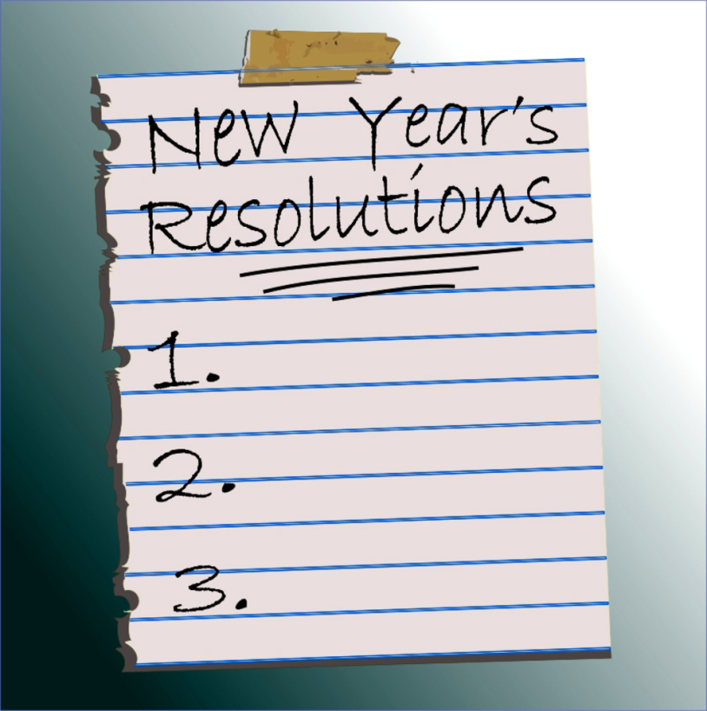

Resolutions
A recent article shows that ‘Losing Weight is the #1 New Years Resolution’. That is HUGE!
Take advantage of this time of year to get old and new patients to come into your office so you can help them the right way at the beginning of the year!
I will be giving you 8 different options to help with most people’s #1 goal for the new year!

Slide 4

Option 1
Calling Potential Patients
Get a list of potential weight loss patients from this last year you met with in your office that didn’t purchase a program.
You should have them all in your tickler book or wherever you keep track of them.
Start calling today to let to schedule them to come in for the following.
  Free Body Wrap
  Free Evaluation with Doctor or Coach
  Free Sauna Session
  Free Detox Kit
  Free Weight Loss Seminar
We have created a new script for calling for the new year that you can use, but as always you can modify it however is best for your office!

Slide 5

Option 2
Emailing or Mailing Potential Patients
If you have potential patients emails you could email them with our new email template we have provided for you on 4.0.
Just like calling it is great to reach out, let them know they can start a new year fresh at your clinic and again offer them a free service or product of any kind.
You can also mail out a postcard for seminars you will offer in January.
This is such an easy way to get to the mass of your potential patients!

Slide 6

Option 3
Schedule Cooperate Luncheons
Have someone in your office start calling businesses right away for the New Year!
You can have your marketer, front desk or any employee call to schedule these luncheons.
This is a great way to reach a lot of new potential patients at the beginning of the year.
For cooperate luncheons during the new year you want to change your seminar to focuss on starting new and fresh for the year! – NEW YEAR, NEW YOU!

Slide 7

Option 4
Wanted or Bandit Signs
Find a location near your office where there is a lot of traffic.
Place BANDIT and WANTED signs around to let people know what you offer
  FREE WEIGHT LOSS EVAUATION
  NEW YEAR, NEW YOU, NEW BODY!
  GET A FREE TANITA SCANNING
  START THE NEW YEAR RIGHT…
  COME IN FOR FREE WEIGHT LOSS SEMINAR!

Slide 8

Option 5
Marketing on the Radio
Find local radio stations with DJ’s that need to lose weight or want to get healthy.
Have them come into your office for a free program if they are willing.
Once the radio DJ has successfully done your program, have them advertise your NEW YEAR, NEW YOU campaign to get new people to come in to start their new years resolutions!
A google study showed that 65.2 million people in the US ages 18-34 listen to the radio each week! That’s roughly half of all people in that age group!
It doesn’t matter where you live, people still listen to the radio!

Slide 9
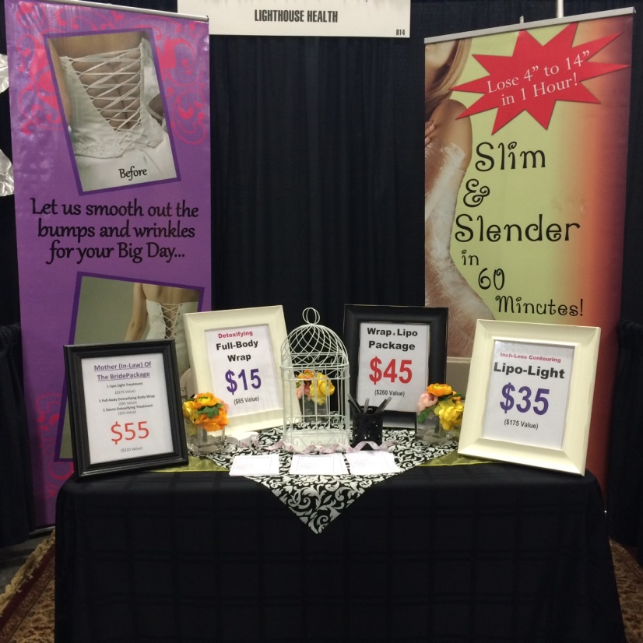
Option 6
Tradeshows
Find upcoming seminars at the beginning of the year to market to those people who have weight loss as their #1 New Years Resolution.
Even if you do a Tradeshow later in January or even February, you will still get a lot of people who probably haven’t found the best way to lose their weight and keep it off.
You can advertise for…
  Weight Loss
  Free Seminar
  Free Evaluation
  Free Detoxification Kit
  Or discount your services like Body Wraps

Slide 10

Option 7
Reactivate Inactive Patients
Have your coach or Doctor call your inactive patients to get them to come back in for the New Year to get them on a Maintenance Program.
A lot of people fall off track during the Holidays so it is a great time to call them to remind your patients you can help them lose their weight they gained over the Holidays.
You already have a good relationship with past patients, so take advantage of calling them to sell them on a Maintenance Program.
Some good ideas to get them back in might be to discount or give coupons programs, products, services or take-home kits.

Slide 11

Option 8
New Years Resolutions Seminars
In the month of January schedule a Seminar every week to help your patients hit their goals!
It’s a great way to let your past and current patients know you can help them with their New Years Resolution Goals!
Make sure to tell your patients to bring in their friends and family to help each other.

Slide 12



NEW FLYERS
For 2017

Slide 13

Thank you!
Have a HAPPY NEW YEAR!
Lets make 2017 the best year yet!!!
Cell: 801-903-7141

