Slide 1
Top 5 Marketing Strategies
With Linda Lever

Slide 2

What are the Top 5 Marketing Strategies?

Slide 3

Banners
Market to Current Chiro Patients
Luncheons
Trade Shows
Patient Referrals

Slide 4




Banners Marketing > All > Banners

Slide 5

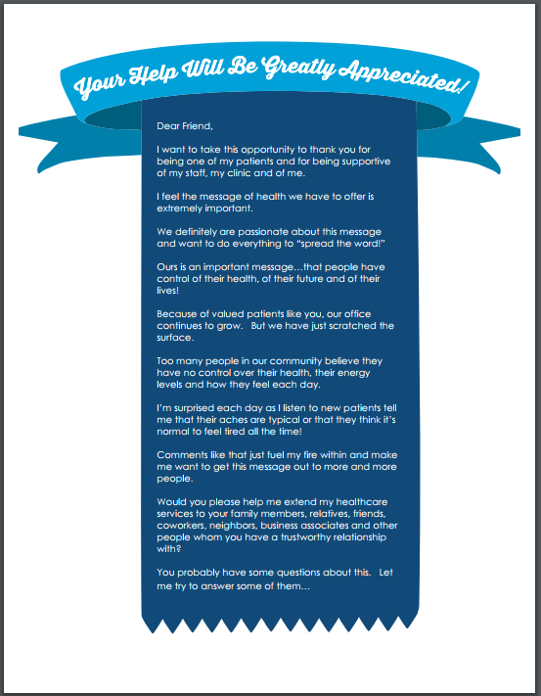
Market to Current Chiro Patients Marketing > All > Market to Current Chiro Patients

Slide 6



Luncheon Marketing > All > Corporate Lunches

Slide 7

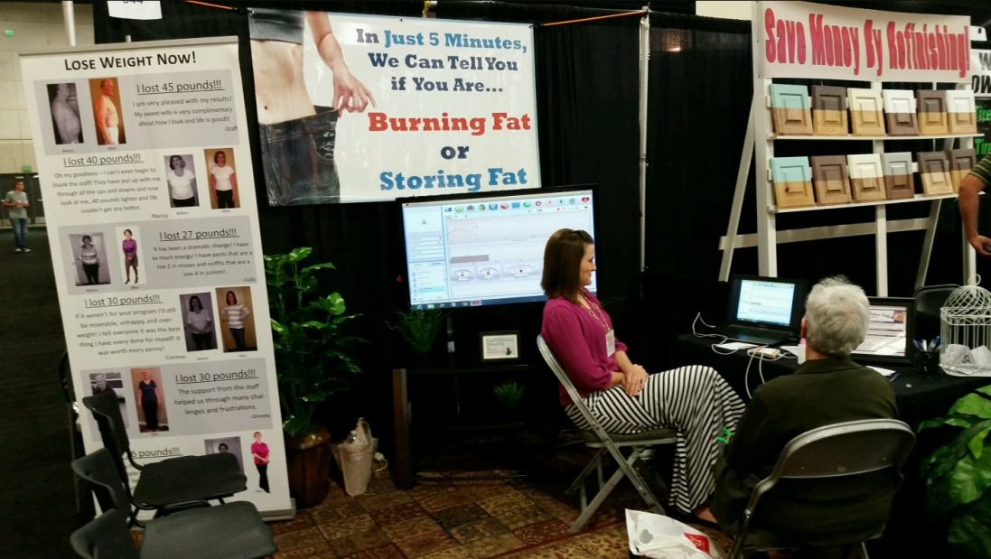
Trade Shows Marketing > All > Tradeshows

Slide 8


Patient Referral Marketing > All > Patient Referral Program

Slide 9
Thank You!
Call with any questions at 801-590-0881
Or email at linda@singletonsystems.com

