Slide 1
Introducing the Solutions4 Take-Home Kits
With Trish Salisbury

Slide 2

The Wait Is Over!
We are so excited to introduce our 16 NEW Take-Home Kits from Solutions4!
We are going to go through each amazing kit so you know what you can start implementing in your clinic right away!

Slide 3

What’s Available for Each Kit
Each of the 16 Kits have the following Documents available to your clinic.
Point of Purchase Displays
Kit Instructional Brochure
Pullcard for Point of Purchase Displays
(All Available on the NEW Club Reduce 4.0 site.)

Slide 4


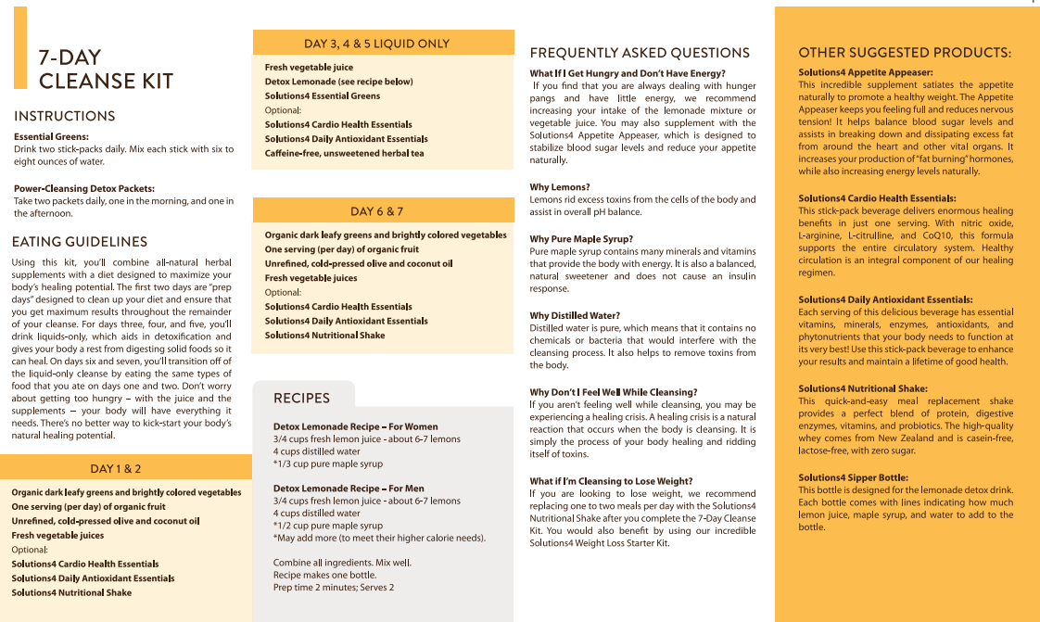
7-Day Cleanse Kit

Slide 5
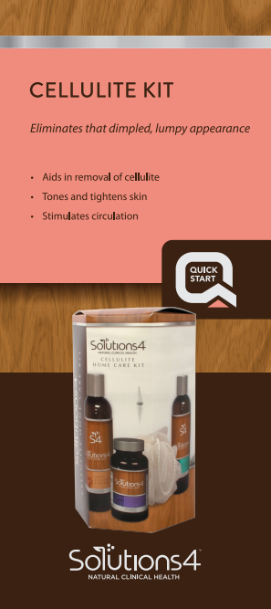
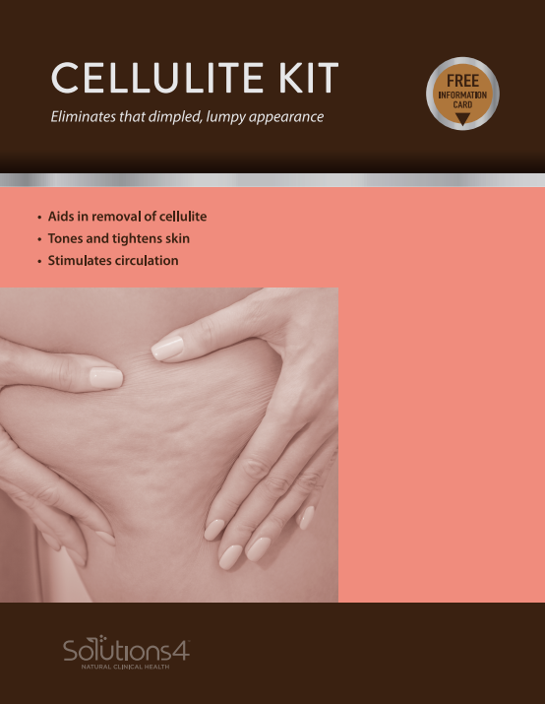
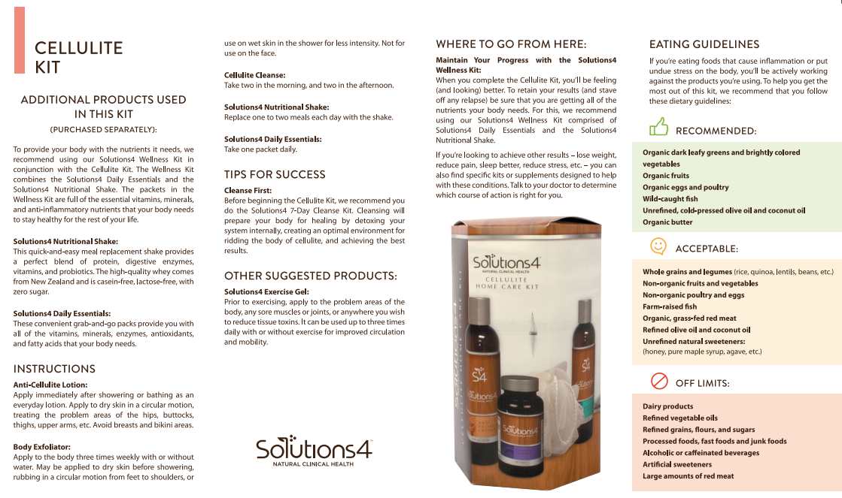
Cellulite Kit

Slide 6
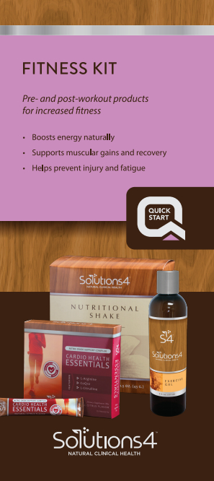

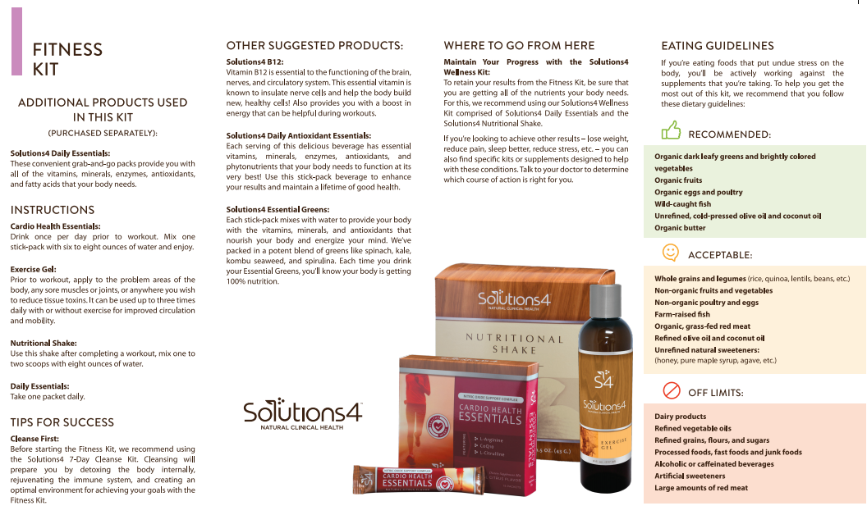
Fitness Kit

Slide 7


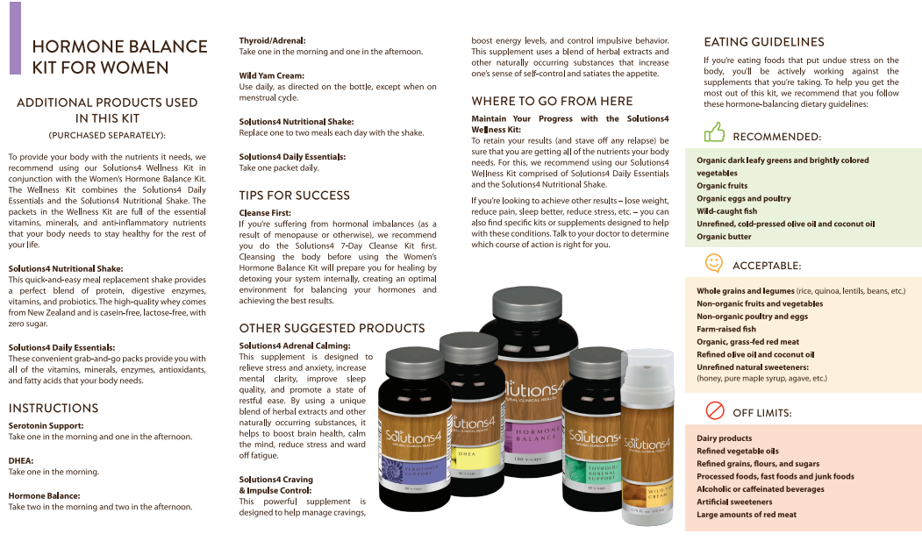
Hormone Balance Kit For Woman

Slide 8


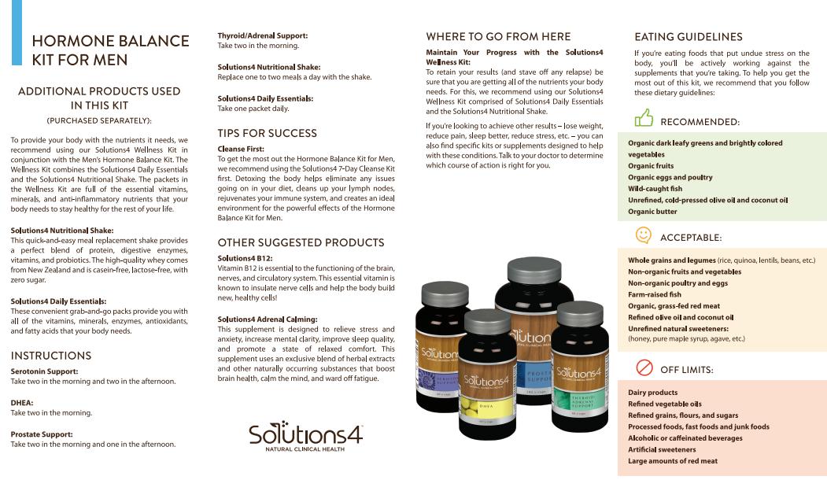
Hormone Balance Kit For Men

Slide 9


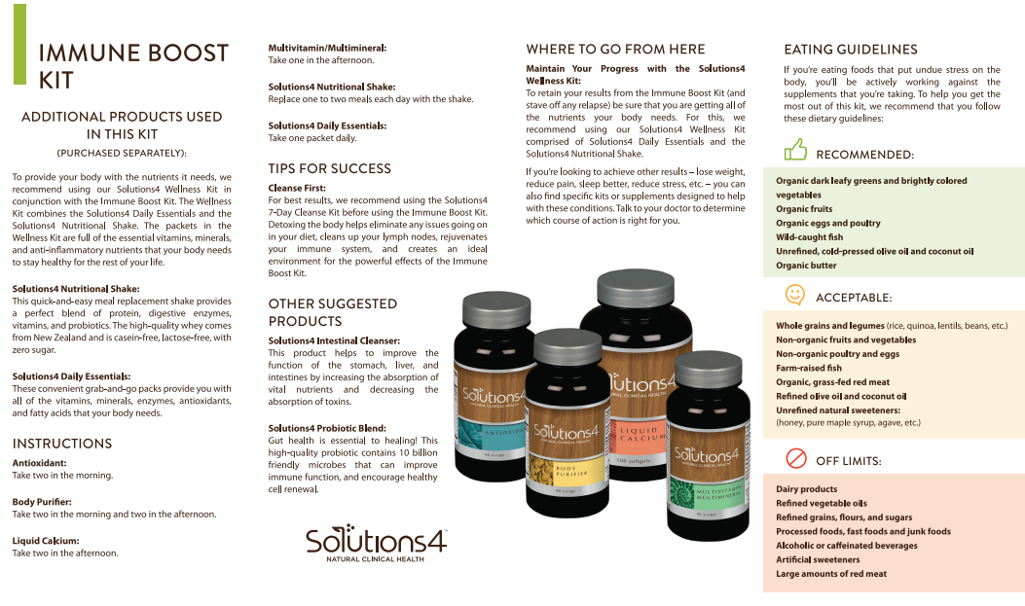
Immune Boost Kit

Slide 10
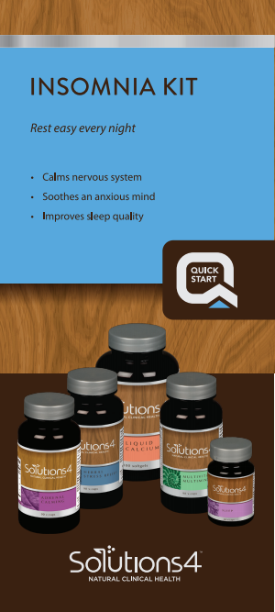
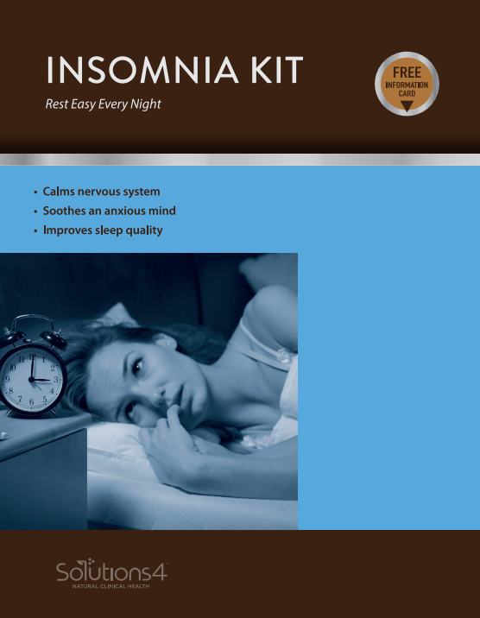
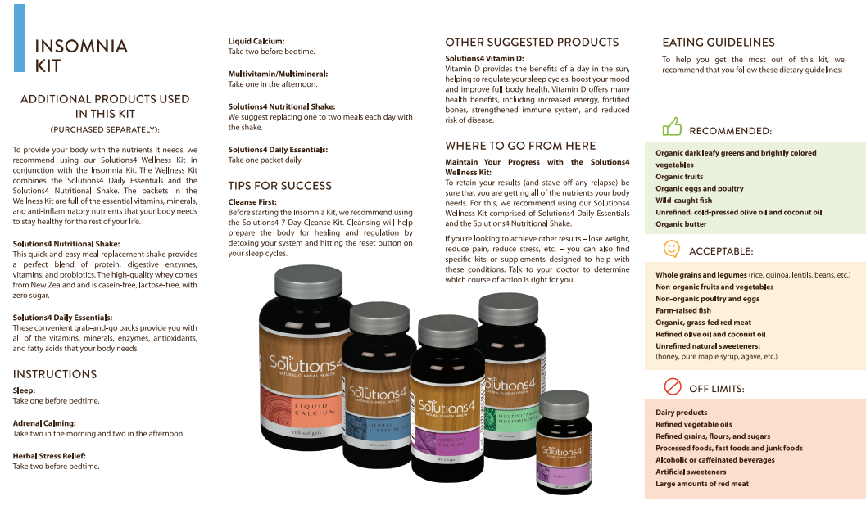
Insomnia Kit

Slide 11


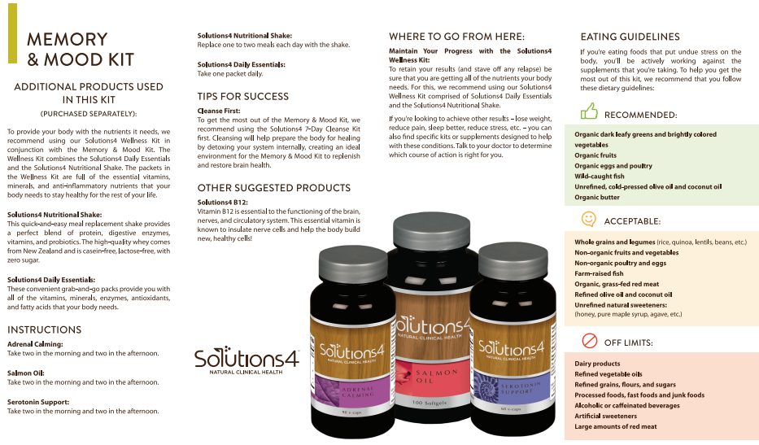
Memory & Mood Kit

Slide 12

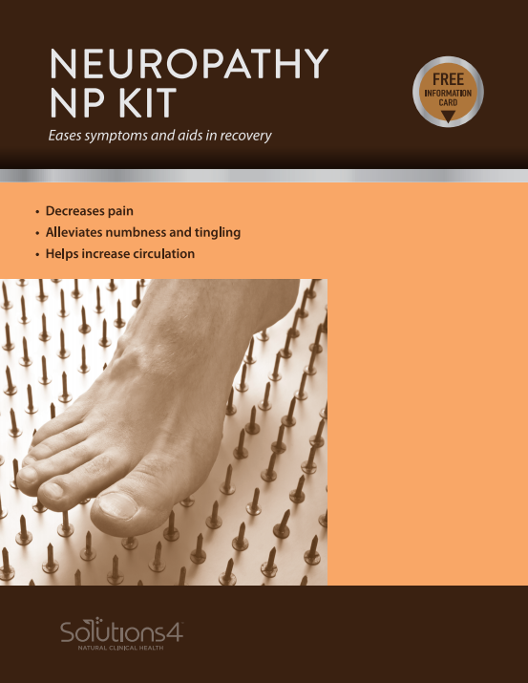
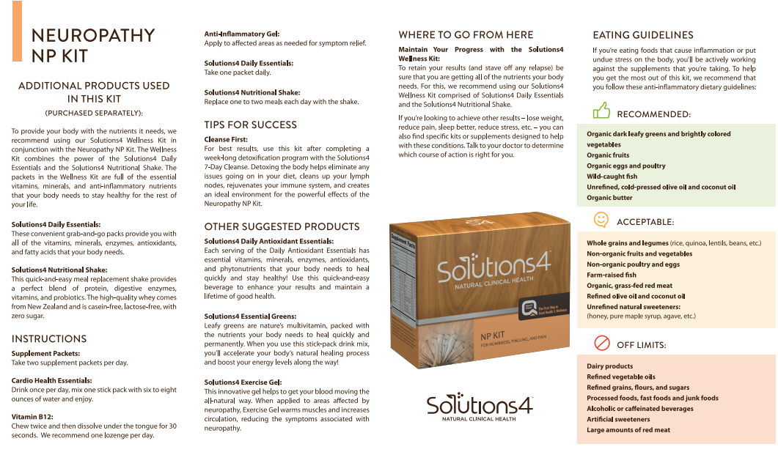
Neuropathy NP Kit

Slide 13



Pain Relief Kit

Slide 14


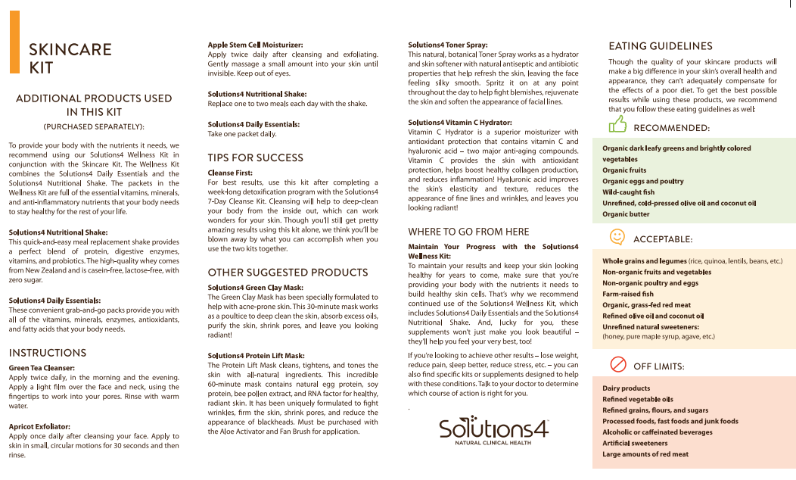
Skincare Kit

Slide 15
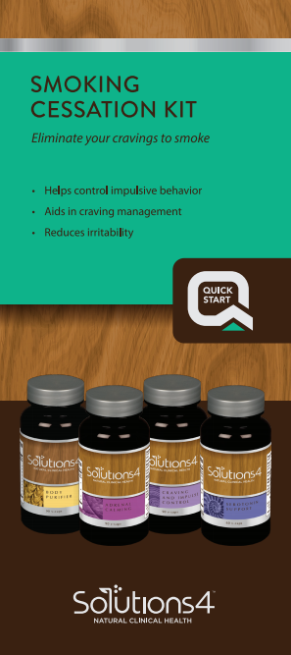
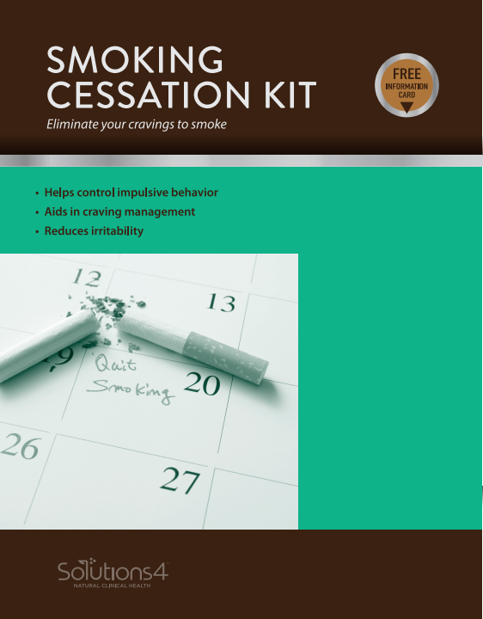
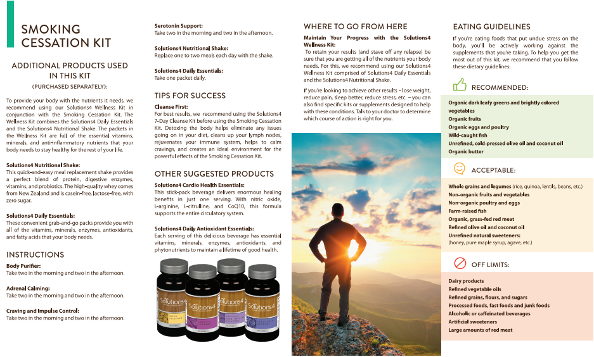
Smoking & Cessation Kit

Slide 16


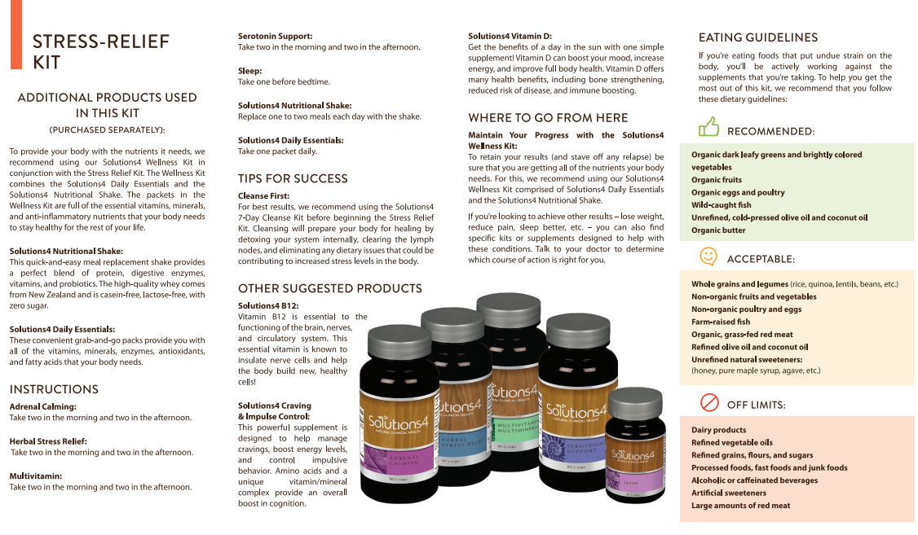
Stress Relief Kit

Slide 17


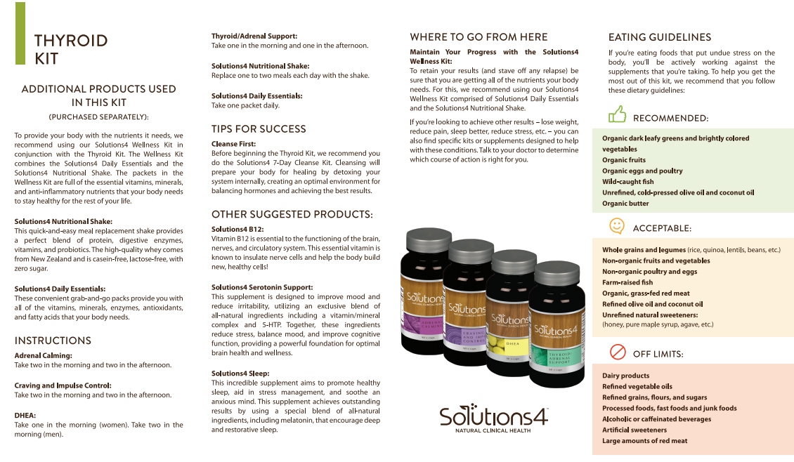
Thyroid Kit

Slide 18


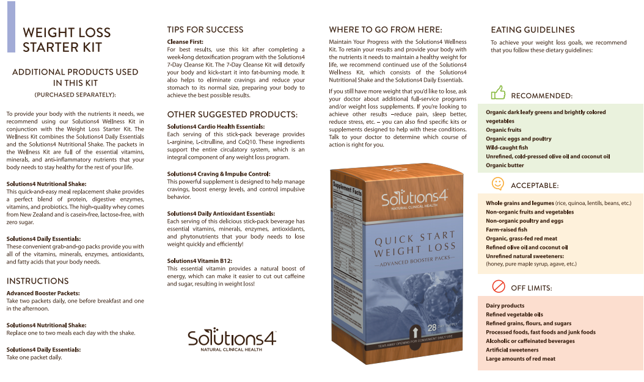
Weight Loss Starter Kit 14 Day

Slide 19


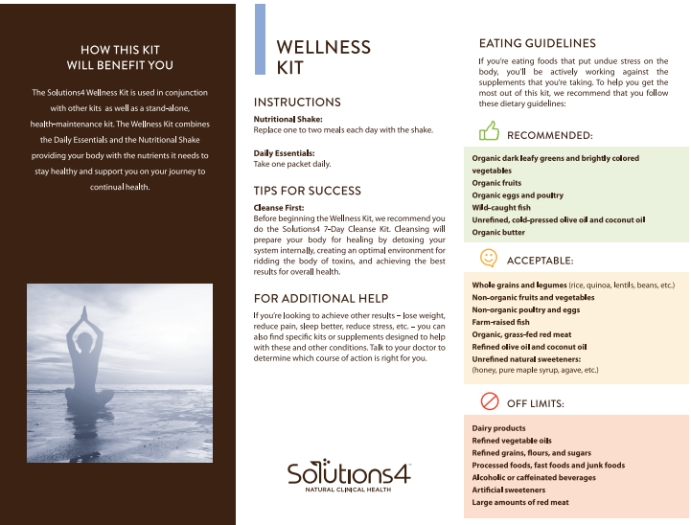
Wellness Kit

Slide 20
Thank you!
Questions?
Solutions4 - #877-817-6074
Club Reduce Support - #801-590-0880

