Slide 1

Marketing Planning For The New Year
Attract New Clients In 2016
By: Dayo Adiatu
www.LeadGen180.com

Slide 2
Marketing Channels
Online Marketing
Patient Referral
Search Engine Marketing
Social Media Marketing
Offline Ads (Newspaper, Billboards, etc)
Email Marketing
Content Marketing/Newsletters
SEO
Blogs
Tradeshows
TV
Radio
Mailers
Speaking Engagements
Community Events
Salon Program
Notes:
All of these work

Slide 3
It’s Not Working
Notes:
Many of you have tried some or all of this and have concluded that it’s not working at quit.

Slide 4
Where Do You Begin?
Notes:
Many of these are on Club Reduce, but many of you have not tried or mastered these.

Slide 5
Bullseye Method
Brainstorm
Rank
Prioritize
Test
Focus

Slide 6
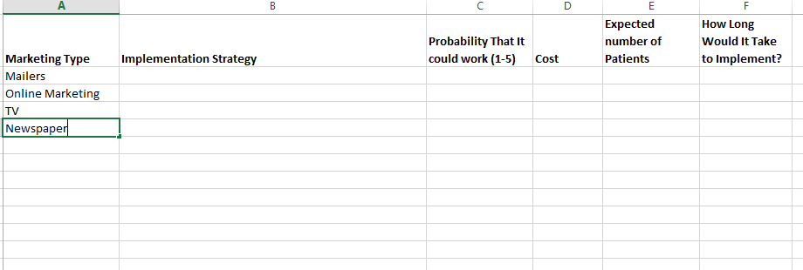
Brainstorm
Notes:
Organize Your Brainstorm with a spreadsheet.
Don’t be afraid to make guesses

Slide 7
Rank
Column A (Inner Circle): which marketing method seems most promising right now?
Column B (Potential): which marketing method could possibly work?
Column C (Long-shot): which marketing method seems like a stretch for your office?
Notes:
Organize Your Brainstorm with a spreadsheet.
Don’t be afraid to make guesses

Slide 8
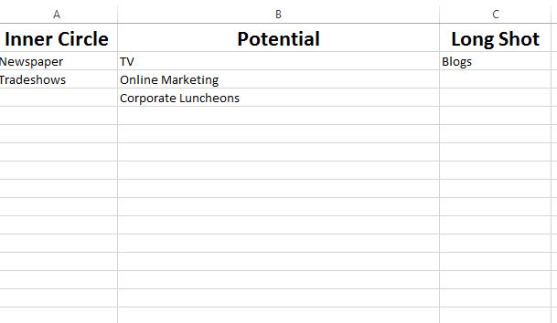

Slide 9
Prioritize
Choose A Top 3 from your Inner Circle and Potential Columns
It’s important that you choose only 3
Notes:
Organize Your Brainstorm with a spreadsheet.
Don’t be afraid to make guesses

Slide 10
Test
Tests can happen simultaneously
Tests should be short and pre-defined
Test should answer:
  How much does it cost to get a new patient?
  How many patients can I get?
  Are these the kind of patients I want?

Slide 11
What Are Your Stats?
Number of leads
Cost per lead
Cost per conversion

Slide 12
Focusing
Which of your 3 tests has done the best?
How can you direct funds towards this marketing method to increase results?
REPEAT! – If none of your top 3 are promising then repeat the process
Notes:
Organize Your Brainstorm with a spreadsheet.
Don’t be afraid to make guesses

Slide 13
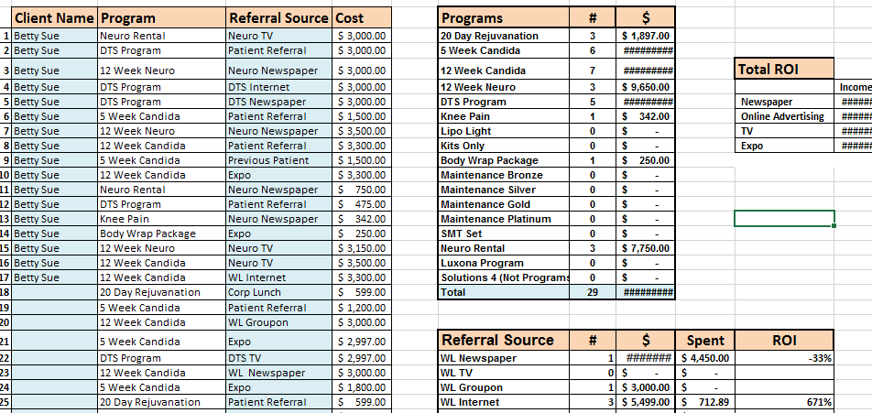
Keeping Track of It All
Notes:
Organize Your Brainstorm with a spreadsheet.
Don’t be afraid to make guesses

Slide 14
Numbers Are King
Online Marketing
Expos
Patient Referrals
Notes:
Organize Your Brainstorm with a spreadsheet.
Don’t be afraid to make guesses

Slide 15
Online Marketing
Great Ad
Page That Collects Leads
Email Follow Up
Phone Call Follow Up

Slide 16
Resources: Summit
FB, Twitter, Pinterest
Google Adwords & Instagram
Scripting

Slide 17
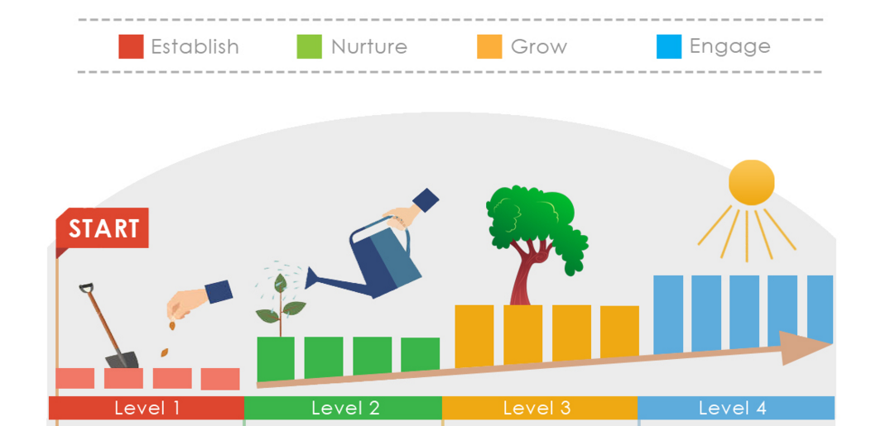

Slide 18
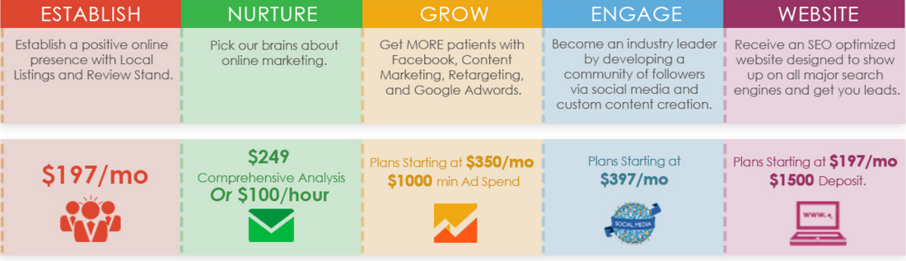

Slide 23
www.LeadGen180.com
dayo@leadgen180.com
adam@leadgen180.com
Schedule a time to speak with us!
https://calendly.com/leadgen180/dayo
https://calendly.com/leadgen180/adam

