Slide 1
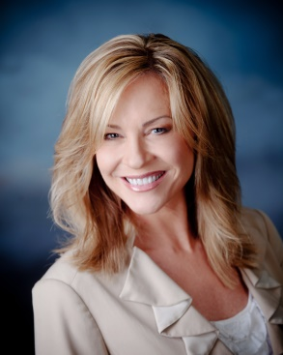
How to Price Your Club Reduce Programs
Shar Lewis
Club Reduce Consultant
Vice President of Business Development

Slide 2

Presentation Takeaways
Basic Program Breakdown
Foods to Avoid/Foods to Enjoy
Services to Offer
How to Price a Program
What Makes Us Different

Slide 3
What Programs Will You Offer?

Slide 4
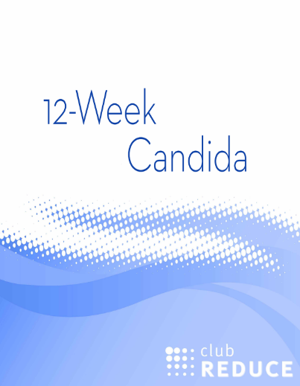
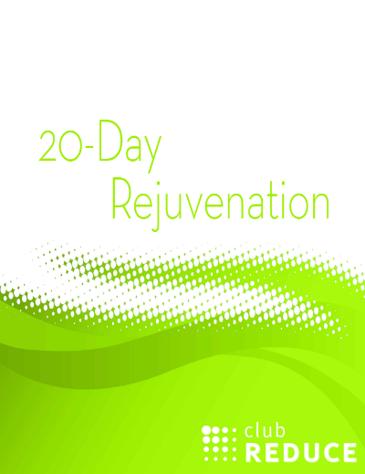

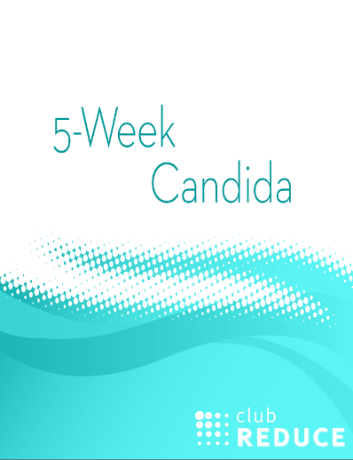

Club Reduce Programs
Typically Sold

Slide 5
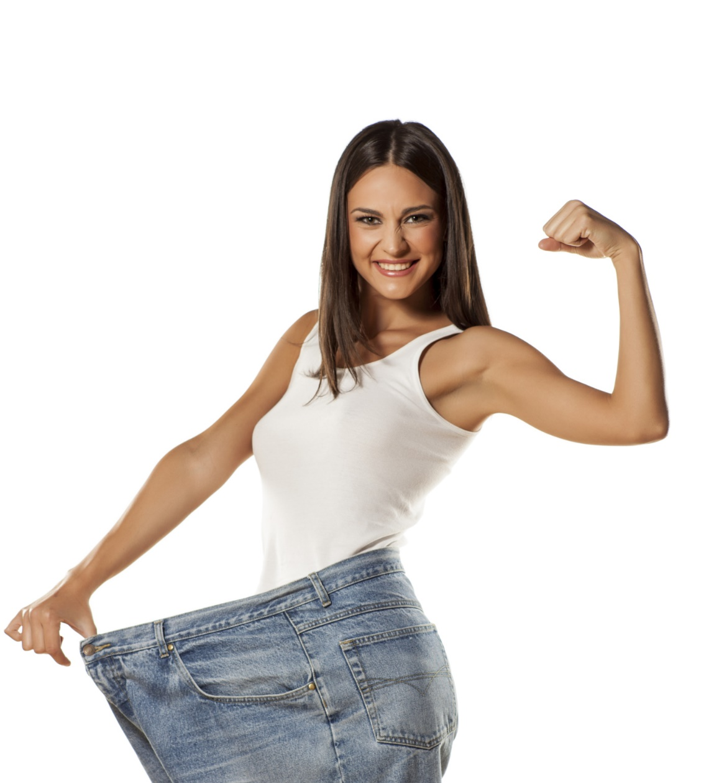
Other Weight Loss Programs
3-Week LipoLaser Program
3-Week LipoLight Program
12-Week Ultimate Weight Loss Program

Slide 6

Additional Condition-Specific Programs
5-Week Diabetes
8-Week Fibromyalgia
5-Week Gluten-Free
Hormone Balancing
Insomnia Solutions
Quit for Life (Quit Smoking)
Stress-Free Lifestyle
30-Day Clear Skin

Slide 7
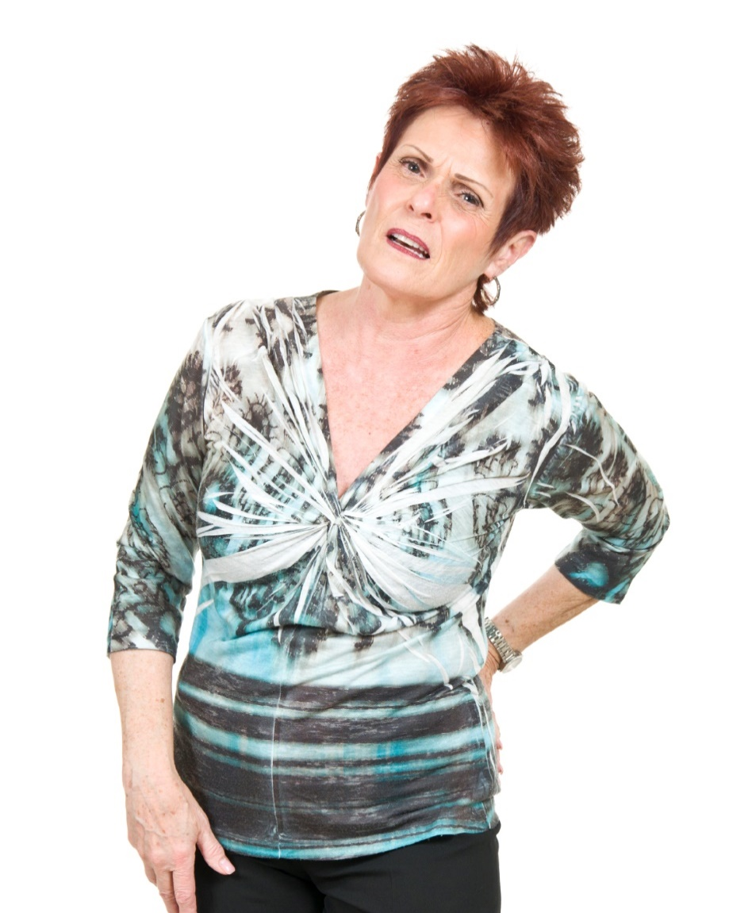
Pain/Neuropathy Programs
Neuropathy Breakthrough Program
Pain-Free Now
Knee Pain
8-Week Fibromyalgia

Slide 8

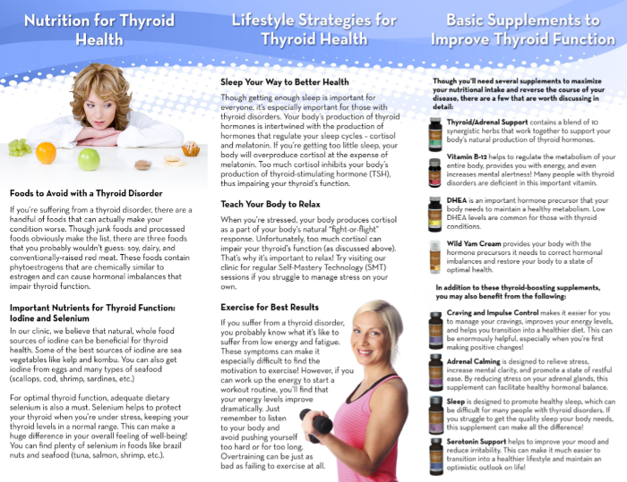
Program Enhancement Brochures
Acne
Anti-Aging
Clear Skin (General)
Diabetes
Fibromyalgia
Hormone Balancing
Insomnia
Quit for Life
Thyroid

Slide 9
Basic Program Breakdown
20-Day Rejuvenation | 5-Week Candida | 12-Week Candida
Fruit & vegetables throughout | No fruit for first 23 days Vegetables throughout | “ “
No meat | Lean meat (organic, grass-fed) and eggs | “ “
No grains or legumes | Brown rice, lentils, and quinoa | “ “
3-day detox | 5-day detox & 3-day detox | 5-day detox & two 3-day detoxes
Organic butter, olive oil, coconut oil | “ “ | “ “
No dairy (besides organic butter), sugar, processed food, soda, coffee, alcohol, etc. | “ “ | “ “

Slide 10

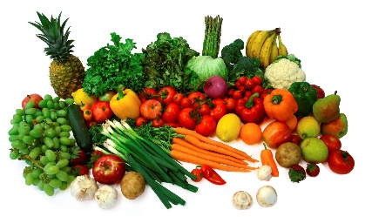
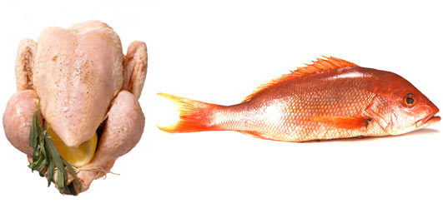
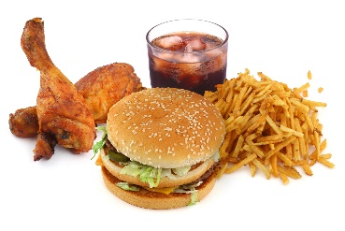
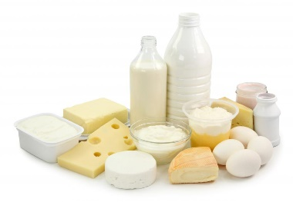
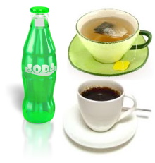

Foods to Avoid/Foods to Enjoy
No DAIRY
No COFFEE, SODA, ALCOHOL or SUGARY DRINKS
Nothing out of a BOX, BAG, CAN or DRIVE THRU
Yes to FRESH FRUITS and VEGGIES (fruit added after day 23 if on candida)
Yes to ORGANIC LEAN MEATS and EGGS
Yes to BROWN RICE, QUINOA and LENTILS

Slide 11

Treatments & Services
Weekly Coaching Visit
Solutions4 Supplements & Food Guidelines
Exercise with Oxygen Therapy
Whole Body Vibration
Infrared Sauna
Detoxifying Body Wrap
Self Mastery Technology – SMT
What else do you have to offer? Use all or none

Slide 12
Weekly Coaching Visit
Studies show that working with a health coach increases compliance and weight loss
Weekly visit and phone/text support – celebrate success and pin point areas for improvement
Track food intake and calories in food journal – aware of eating behaviors & ways to change
Set specific goal and have a reward when achieved

Slide 13
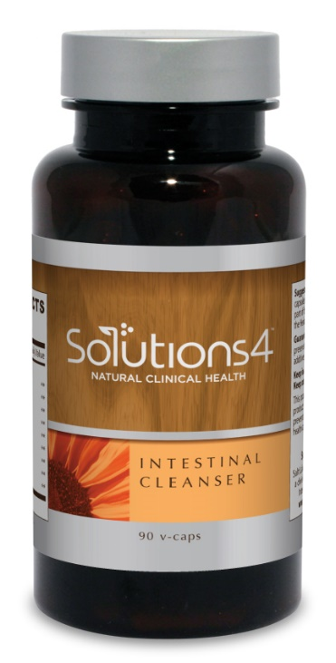
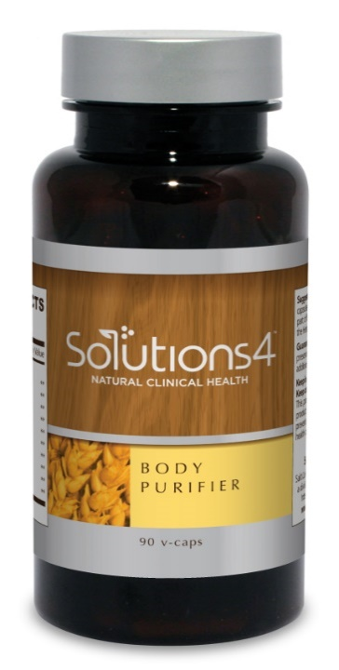
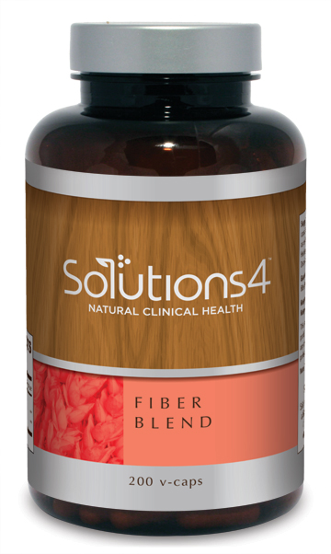
Solutions4 Supplements
Supplements are critical for healing and weight loss.
Solutions4 products are produced to Japanese Standards.
U .S. standards allow up to 50% fillers. Japanese standards allow less than 1% fillers, so all of the S4 products are pure, concentrated and effective.
Quality of the ingredients in the supplements matters.
How the supplements are created matters
Your body’s ability to absorb the supplements matters.
Solutions4 supplements are tested for quality and proven effective.

Slide 14
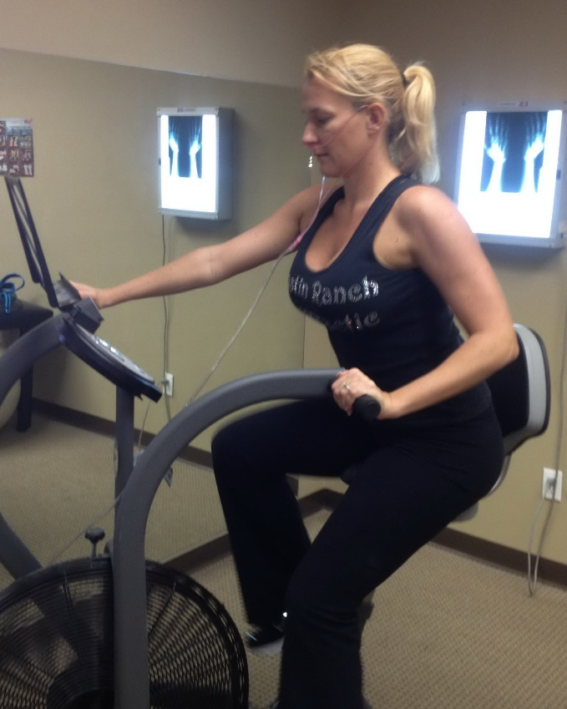
Exercise with Oxygen Therapy (EWOT)
Helps oxygen reach every tissue of the body, boosting the metabolism and providing your patients with an immediate increase in endurance and energy.
Increases basic cellular life providing anti-aging benefits!

Slide 15
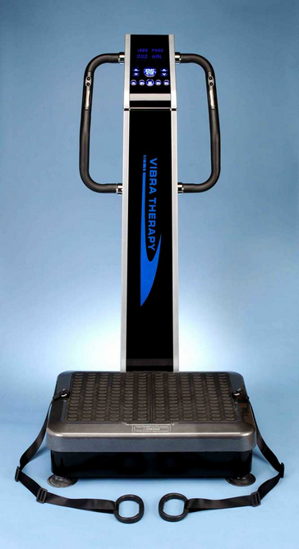
Whole Body Vibration
Used for the astronauts by NASA
Helps patients burn fat, build strength, improve circulation, and decrease stress hormones in the body.
10 minutes on the Whole Body Vibration provides the approximate equivalent of 1 hour of regular exercise!

Slide 16
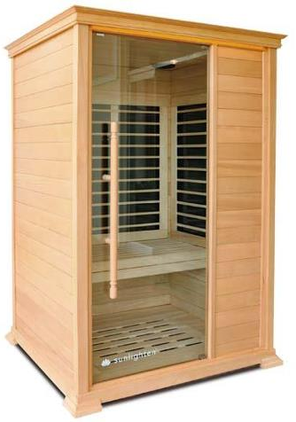
Infrared Sauna
Sweating is one of the body’s natural detoxification systems.
It cleanses the skin, flushes out toxins, and helps the body heal.
The Infrared Sauna can burn up to 600 calories in half an hour.
This is the equivalent of running 10-15 miles!
Your patients will love how relaxing weight loss can be.

Slide 17
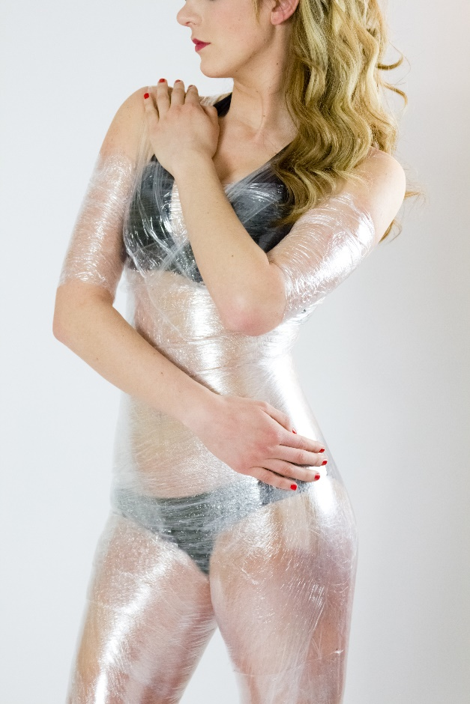
Detoxifying Body Wraps
The cream used in our Body Wraps was formulated by a biochemist from UCLA.
Body Wraps aid in detoxification and promote healthy inch loss.
The wraps remove cellulite by targeting and removing the toxins trapped in your connective tissue.
Patients can expect to lose 4-14 inches in one hour!

Slide 18
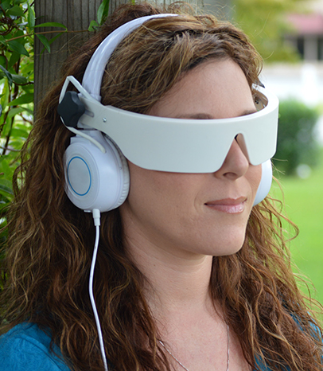
Self-Mastery Technology
Light and sound technology that helps patients deal with the emotional and stressful aspects of weight loss.
SMT sessions help make weight loss permanent.
SMT sessions help patients regain control over their lives and overcome emotional eating.
Each session makes it easier to tune out stress and make healthier choices!
What other weight loss program does that?

Slide 19
Additional Services you May Want to Offer

Slide 20
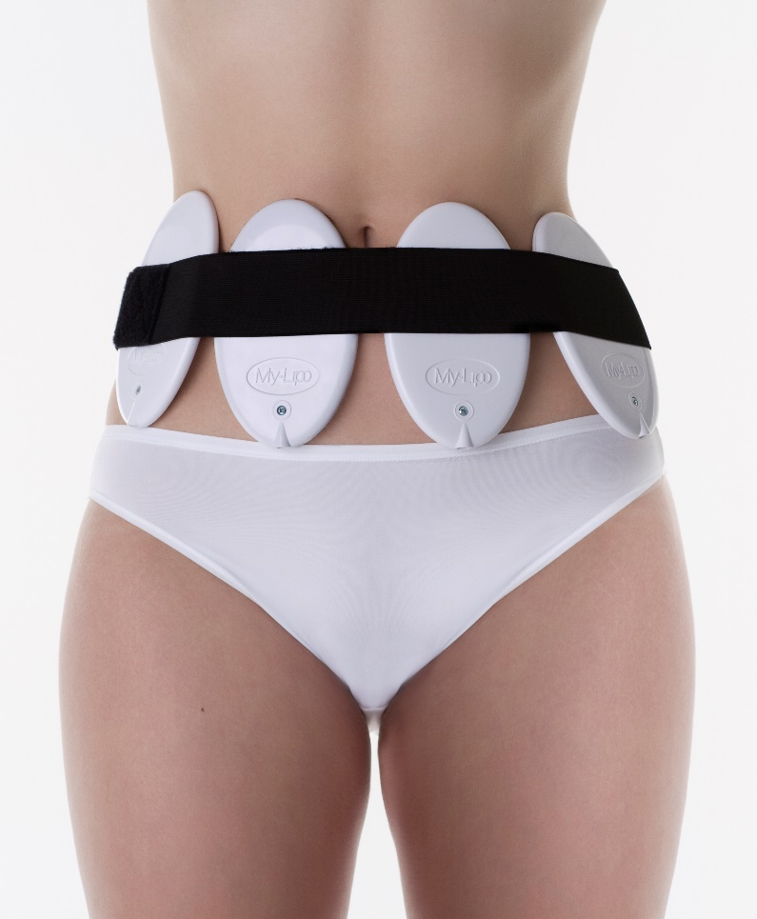
LipoLight/LipoLaser
LipoLight and LipoLaser treatments help patients achieve inch-loss results without turning to expensive and painful surgeries.
Helps to break down and melt fat deposits inside the fat cell – shrinking the size of the fat cells.
You can offer LipoLight/LipoLaser as a stand-alone program or as an upsell to one of our programs!

Slide 21
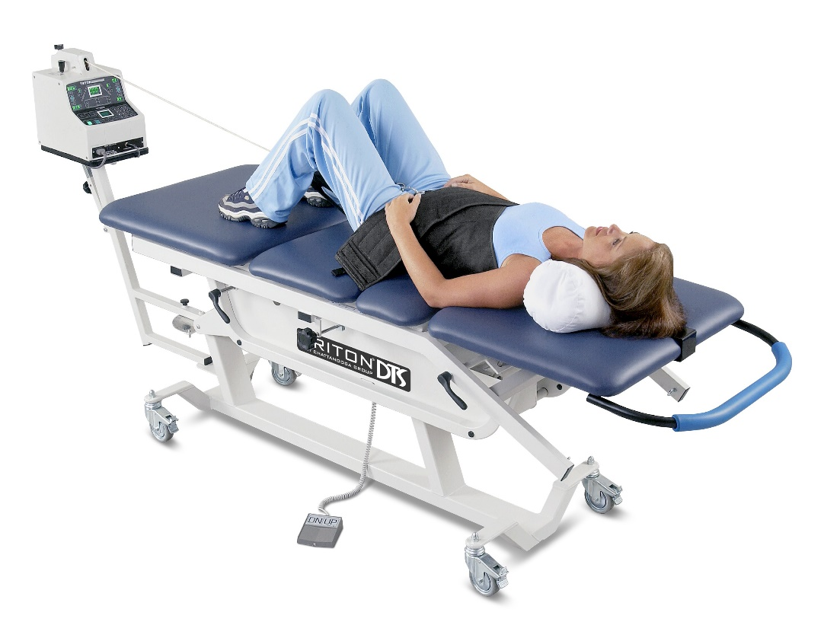
Pain and Neuropathy Treatments
TeslaMax
Leg Wraps
Light Therapy
Spinal Decompression
Cold Laser Therapy
10-Watt Laser Therapy
Active Therapeutic Movement
Kinesio Tape
Vibratory Massage

Slide 22

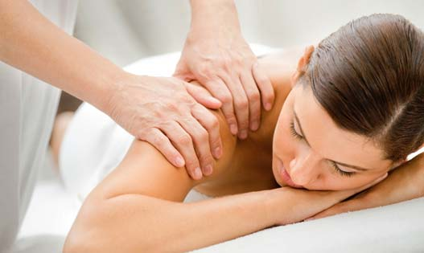
Other Treatments and Services
Gym Membership
Massage Service
Chiropractic Care
Energy Work

Slide 23
Decide What Treatments & Services You Will Offer With Your Programs

Slide 24
Now Let’s Price Your Programs with the Services you Will Offer

Slide 25
Start with the Cost of the Kit
20-Day Rejuvenation
Kit costs $289 (retail)/ $145 (your price)
5-Week Candida
Kit costs $661 (retail)/ $331 (your price)
12-Week Candida
Kit costs $1,014 (retail)/ $507 (your price)
Neuropathy Breakthrough
Kit costs $838 (retail)/ $419 (your price)

Slide 26
Add the Price for Services You’ll Offer
We price our services as follows:
$60 for a Weekly Coaching Visit
$50 for Exercise with Oxygen Therapy
$50 for Whole Body Vibration with Exercise with Oxygen
$50 for an Infrared Sauna session
$125 for a Detoxifying Body Wrap
$50 for a Self-Mastery Technology (SMT) session
$125 for LipoLight or LipoLaser Treatments

Slide 27
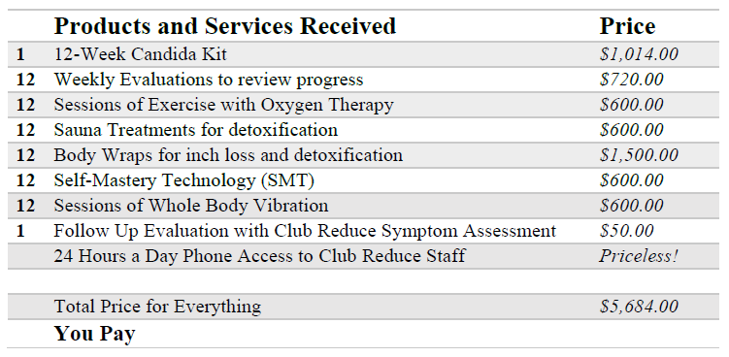
Determine the Frequency for Each Service and Total on
Program Protocol Sheets

Slide 28
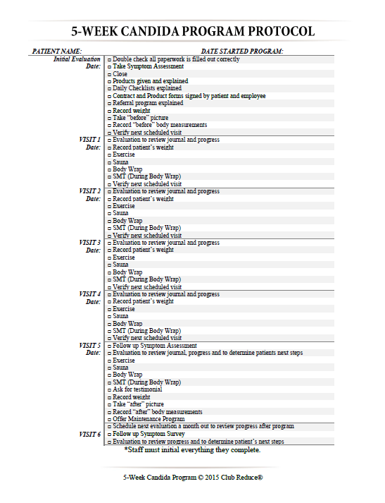
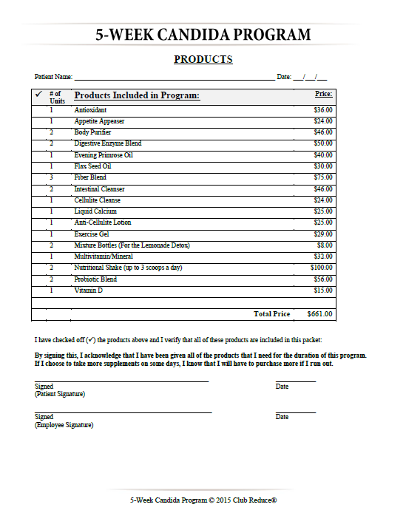
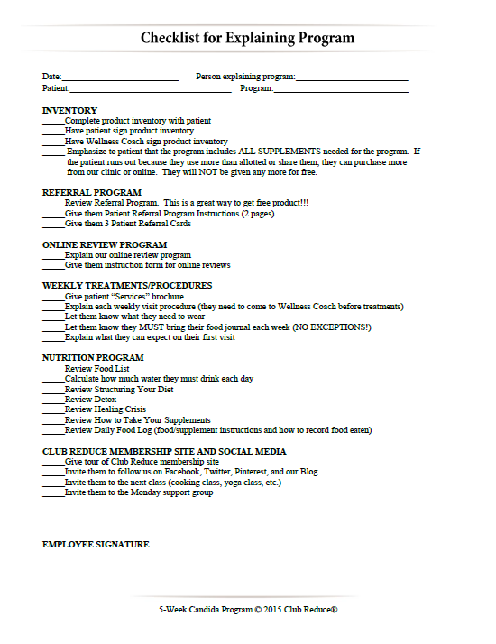
Update All Your
Program Protocol Sheets

Slide 29
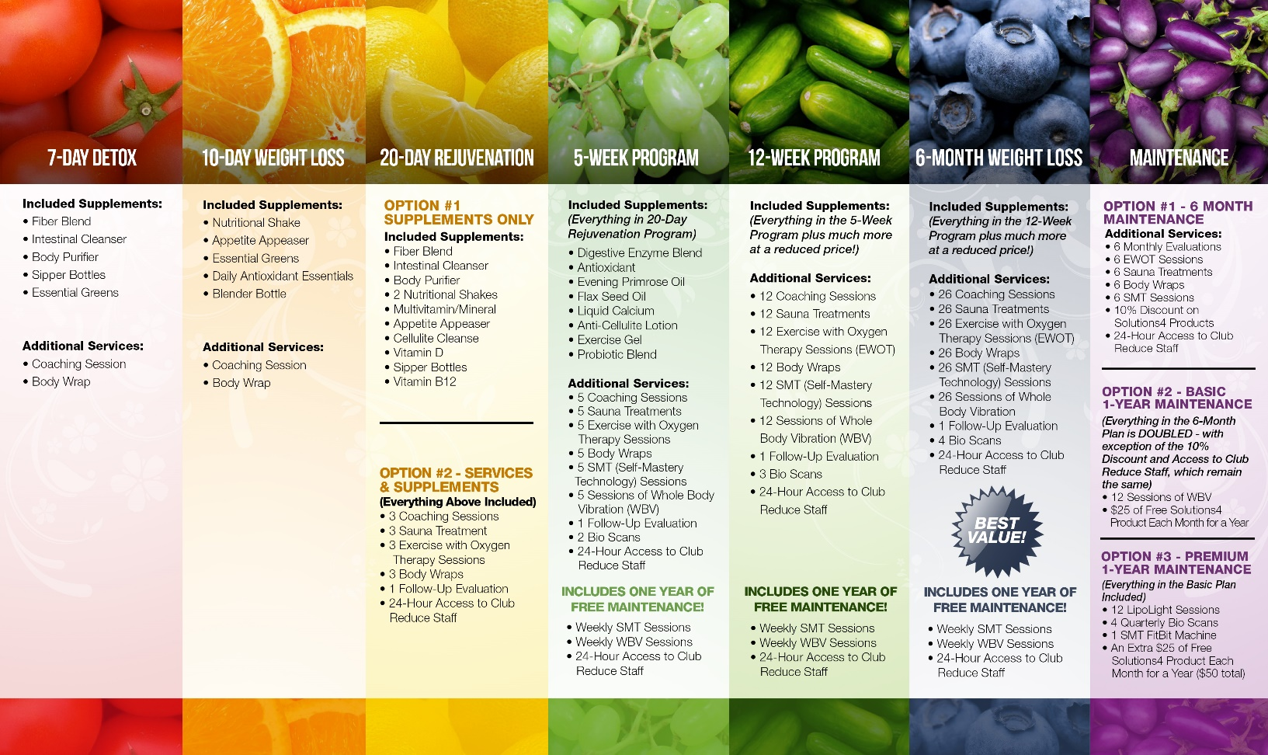
Use the Program Overview Chart to Help You

Slide 30
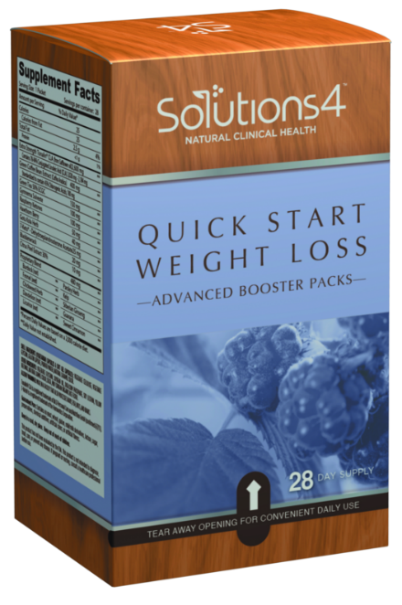
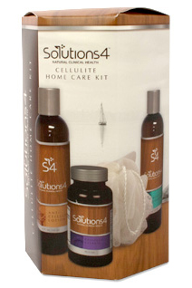
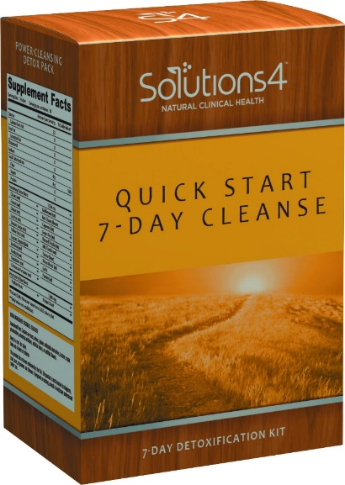
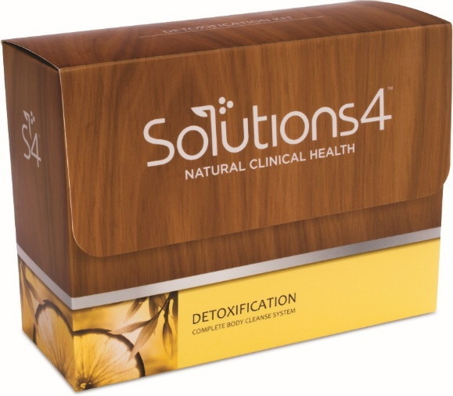
Club Reduce Kits
Downselling Options
Don’t let them walk out the door without purchasing something to get
them on the road to good health!

Slide 31
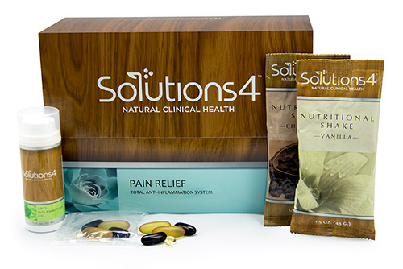
Pain Relief Kit
Has 3 Components: Nutritional Shake, Pain Relief Supplement Pack and Anti-Inflammatory Gel
What they Eat will Affect their Pain
Great Price! $39.50 Wholesale and Shakes alone are Worth $25!

Slide 32
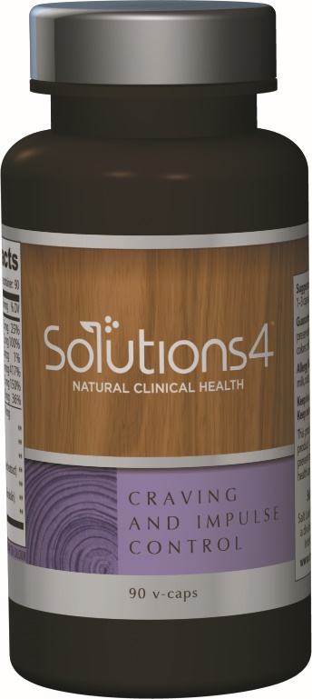
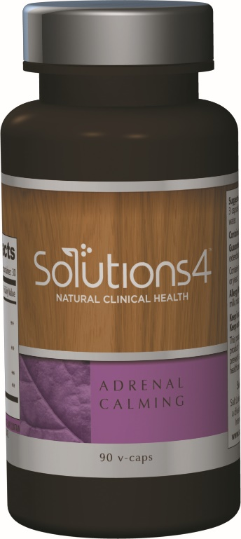
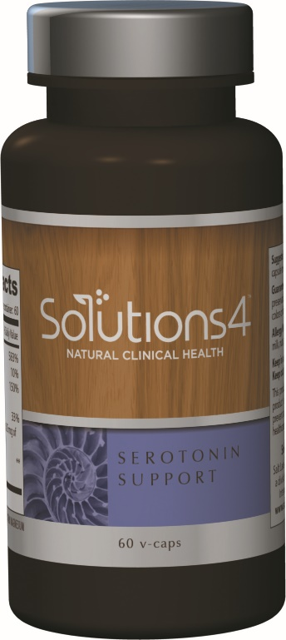
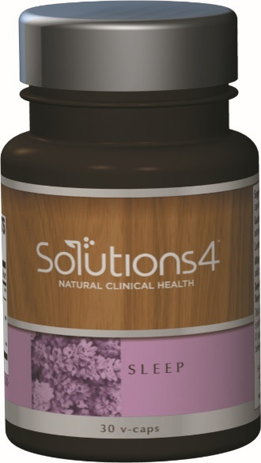
Brain-Based Wellness
Supports Cognition, Memory, Concentration, Mood and Better Sleep

Slide 33
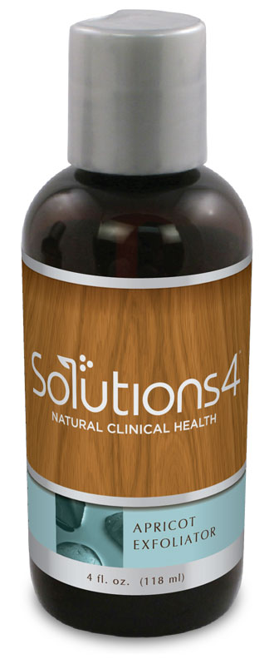
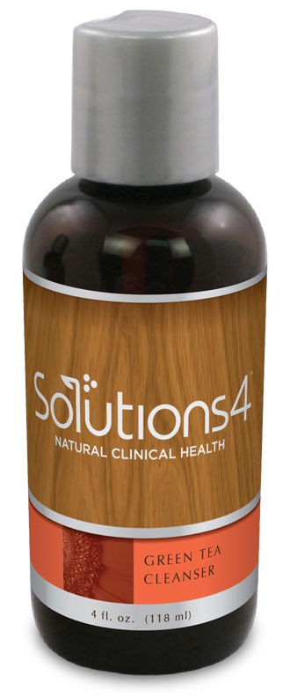
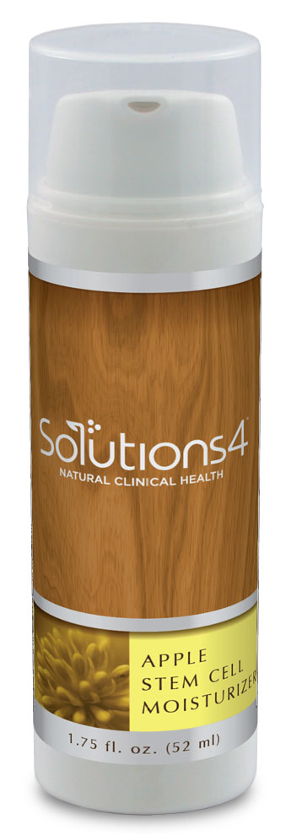
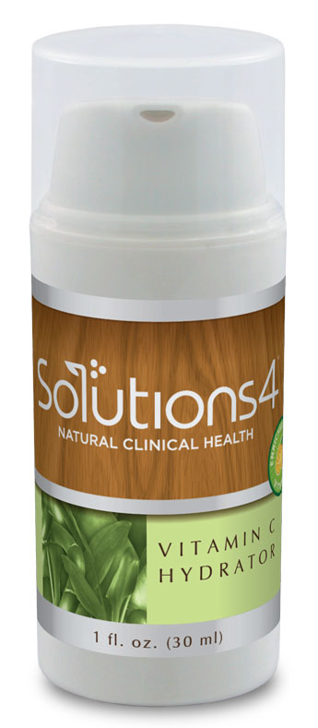
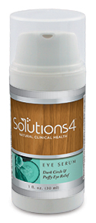
Solutions4 Skincare
Anti-Aging, Organic, No Harsh Chemicals
Cleanses, Hydrates and Feeds the Skin!

Slide 34

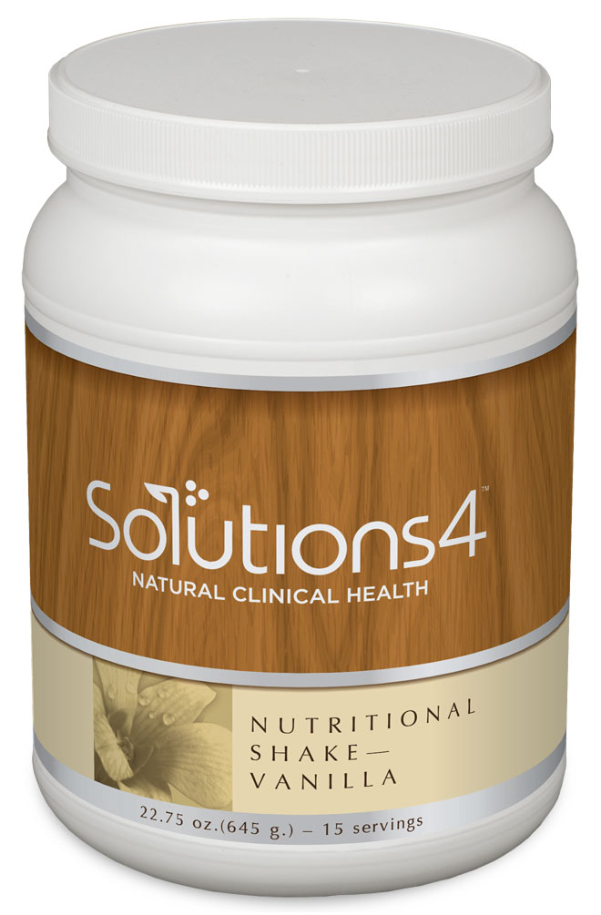

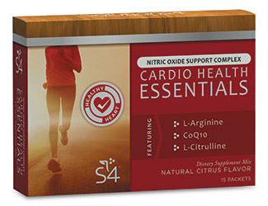
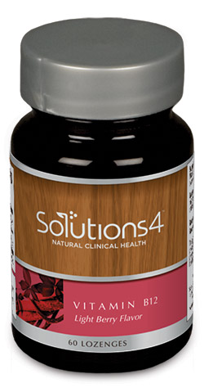
Great Products for Health and Fitness

Slide 35



Children’s Supplements
The right formulations, education, and dosing to provide maximum benefit to young people at the time when a healthy start is most critical!

Slide 36

What Sets Us Apart?
No one else offers comprehensive nutritional programs and holistic, detoxifying services that achieve such outstanding results!
We’re in a league of our own!
We provide you with all of the information you need to get incredible patient results AND build your business at the same time!
It’s a win-win for everyone!

Slide 37

Love your Patients to Health and Make them
Patients for Life!

Slide 38
Success Stories

Slide 39
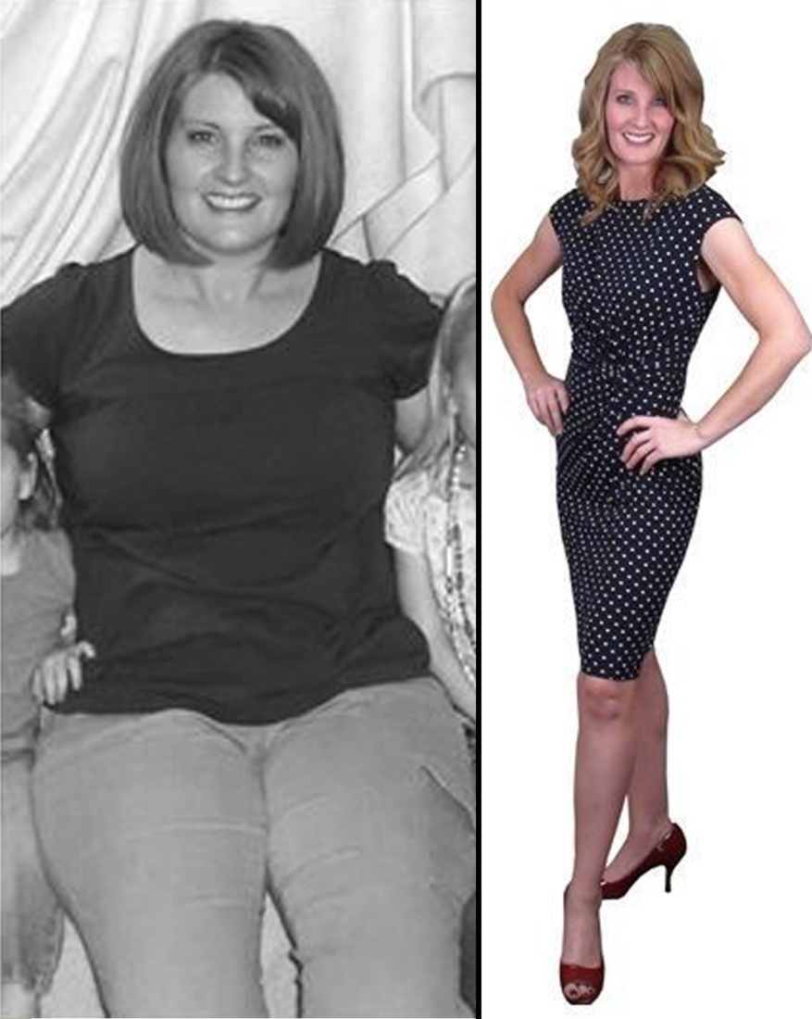
“I lost 60 pounds in 6 months, I’m off my medications, I can play with my kids and I love to shop again!”

Slide 40
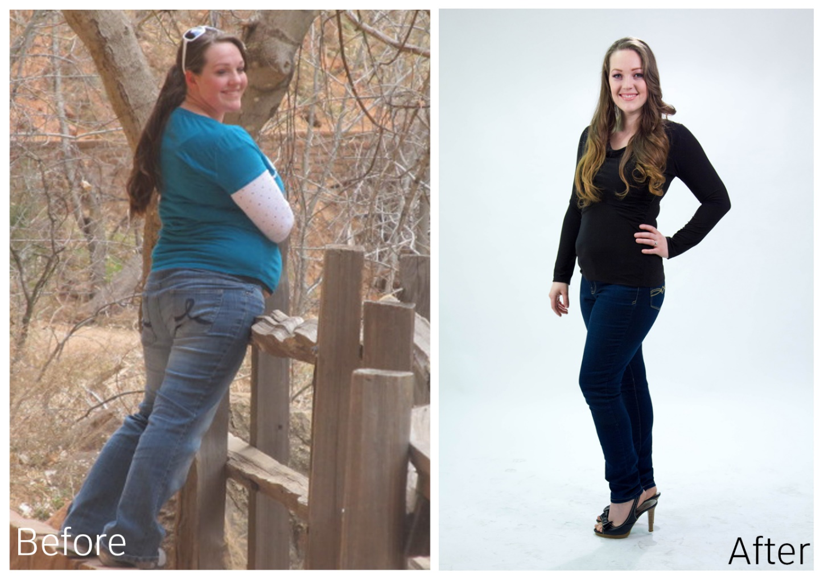
“I lost 34 pounds and 34 inches, and I feel great!”

Slide 41
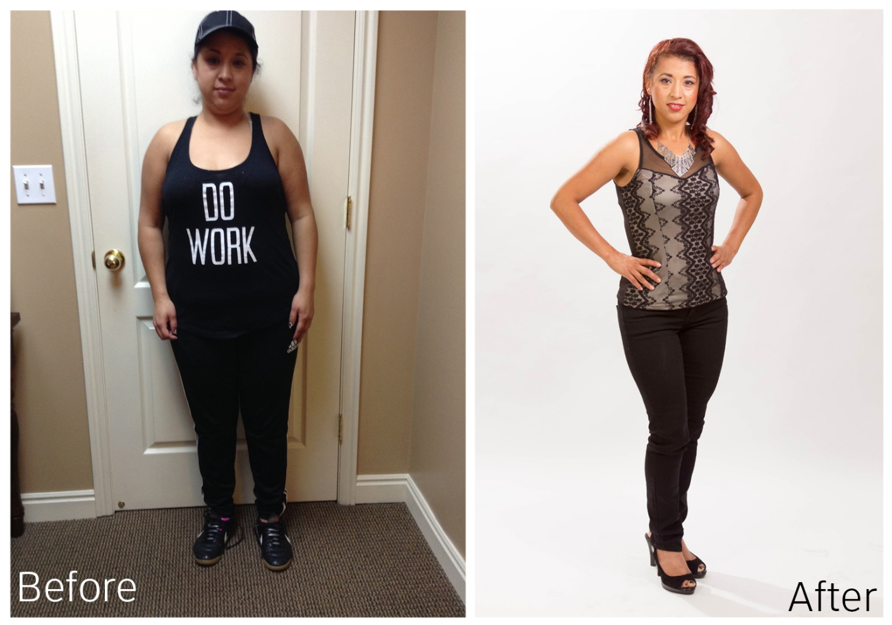
“I lost 53 pounds on the 12-Week Candida Program.
My kids are eating better, and my husband lost 10 pounds along with me.”

Slide 42
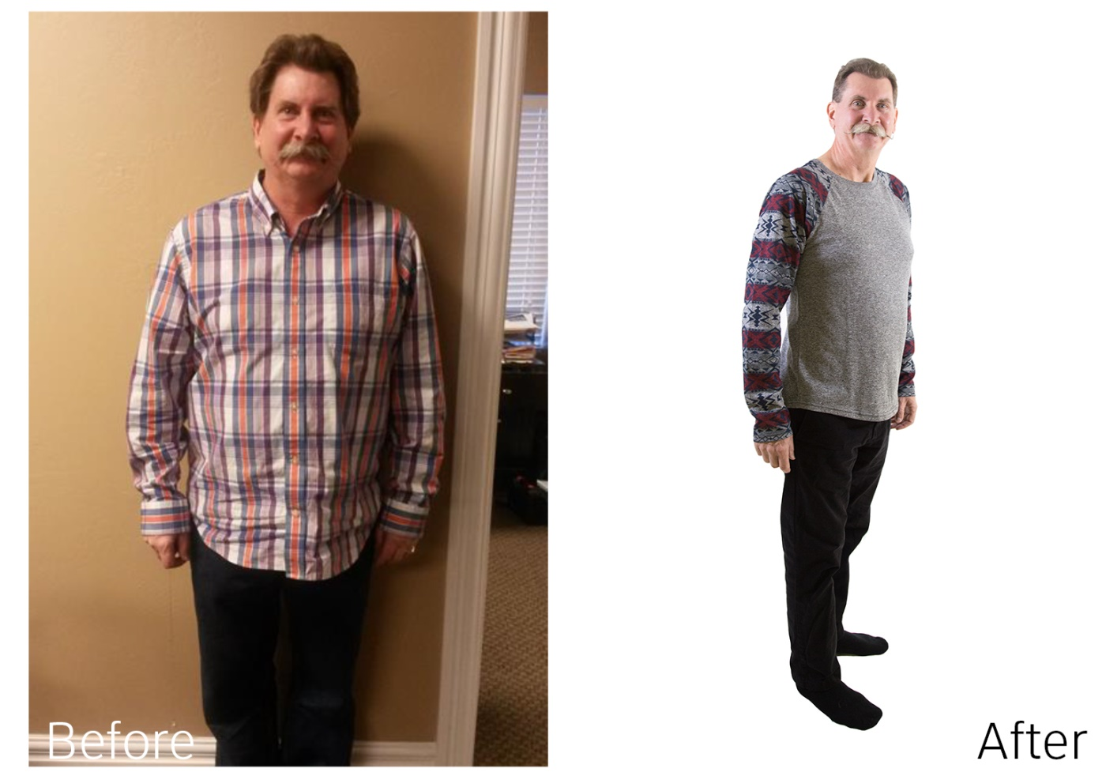
“I lost 58 pounds and have never felt better.”

Slide 43
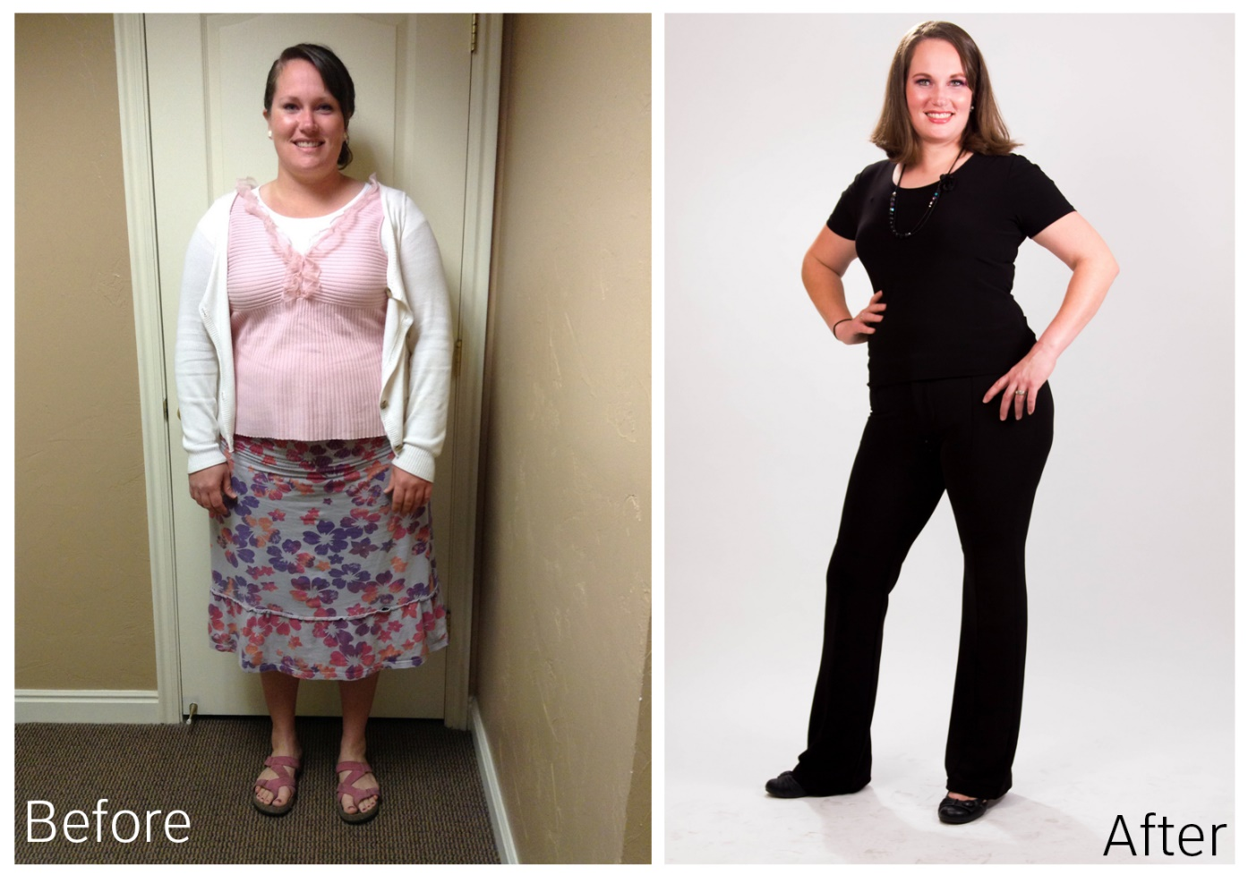
“I feel amazing! I lost 53 pounds on the
12-Week Candida Program, which put me 3 pounds away from my pre-pregnancy weight!”

Slide 44

“I lost 34 pounds and 34 inches.”

Slide 45


Every member of your team MUST do one of your programs!
Remember to…
Practice What You Preach

Slide 46

Do you Need Help Growing Your
Club Reduce Business
to Increase your CASH Income and Help your Patients HEAL?
www.ClubReduceConsulting.com
801.917.0900

Slide 47

Client Testimonials
www.ClubReduceConsulting.com

Slide 48

Thank You!

